Slide 1

IT Job Search
Team LCDC:
Leanna Jewart, Christopher Martin, David Brooks, & Colton Kauffman

Slide 2
Members & Roles
Leanna Jewart – Job Description page & general research
Christopher Martin – Job Forum Development
David Brooks – Accounts Management & GitHub Lead
Colton Kauffman – Search and Search Results

Slide 3
Motivation
Unique solution to a common need
Easily comparable to other similar sites
Combination convenient features

Slide 4
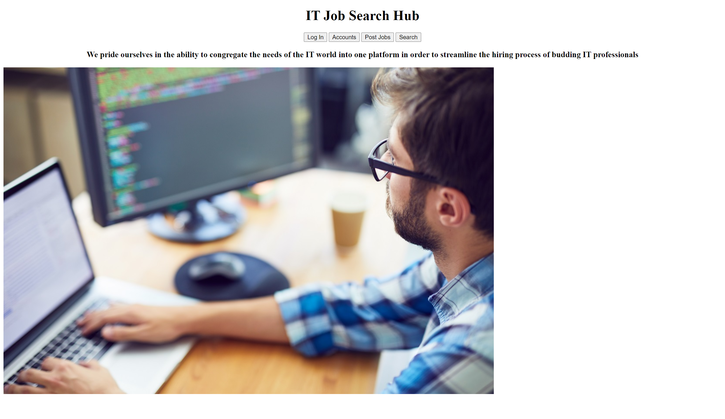
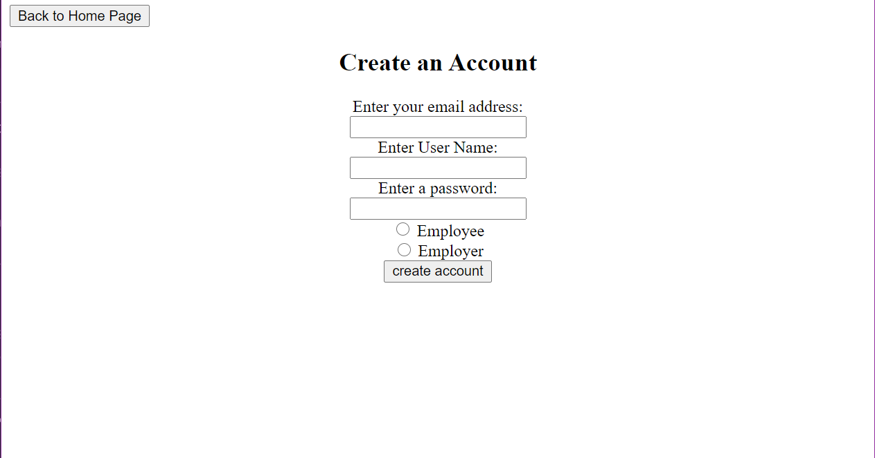
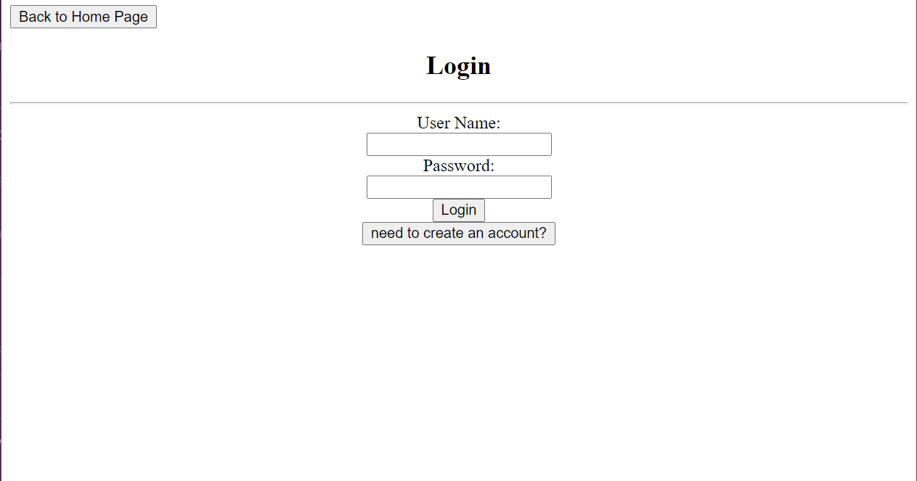
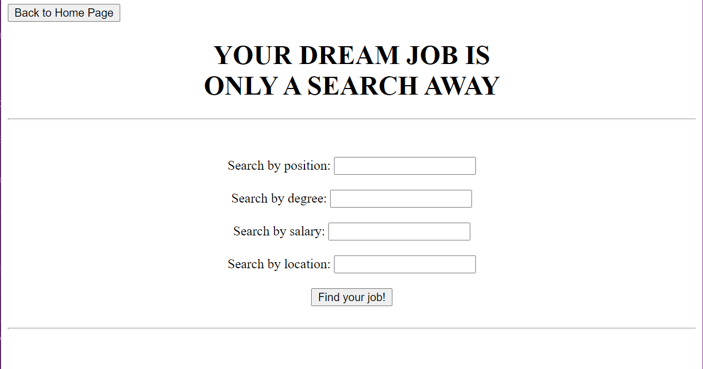
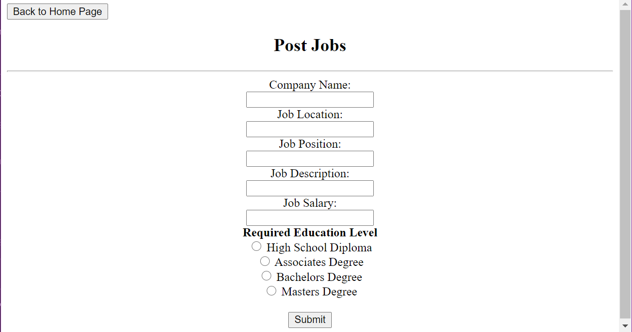
Tentative Design

