Slide 1
Intelligent Flood Prediction — Nigerian Coastal Cities
MSc Artificial Intelligence — Project Pipeline & Results
[Your Name Here]
[Date Here]

Slide 2
The Challenge: Nigerian Coastal Floods
Motivation for Intelligent Early Warning Systems
• Frequent flooding in cities like Lagos and Port Harcourt.
• Impact: Infrastructure damage, economic loss, and risk to life.
• Need: Shift from reactive response to proactive AI-driven alerts.
• Goal: Develop a pipeline for reliable flood risk prediction.

Slide 3
Multi-Source Data Acquisition
Integrating diverse data formats and sources:
• Rainfall: World Bank (1901–2024), CHIRPS, and Kaggle (Lagos).
• Sea Levels: PSMSL Station 162/404 recordings.
• Tide Data: UHSLC Station 233.
• Geospatial: USGS SRTM Digital Elevation Models (DEM).
• Labels: Historical flood events from Dartmouth Flood Observatory & EM-DAT.

Slide 4
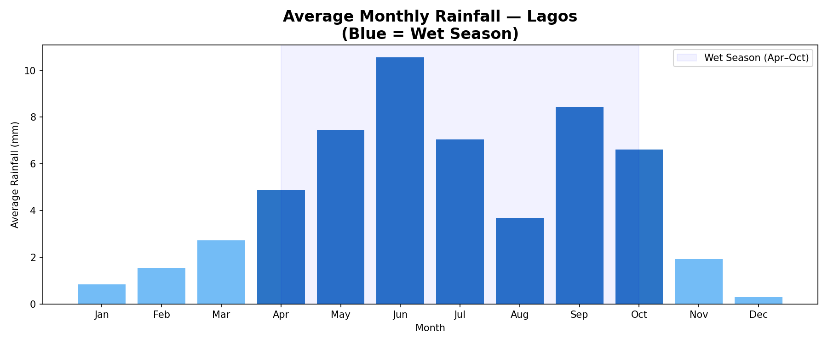
EDA: Rainfall Seasonality & Trends
Key Observations:
• Well-defined wet season (Apr-Oct).
• Annual variability in precipitation.
• Moderate rising trend in mean sea level.

Slide 5
Feature Engineering & Preprocessing
Transforming raw data into predictive features:
• Temporal Accumulation: 3, 7, 14, and 30-day cumulative rainfall lags.
• Tide Statistics: Moving averages and max tide levels over 7-day windows.
• Flags: Wet season indicator and heavy rain intensity thresholds.
• Handling Imbalance: Temporal splitting & Positional Weights.

Slide 6
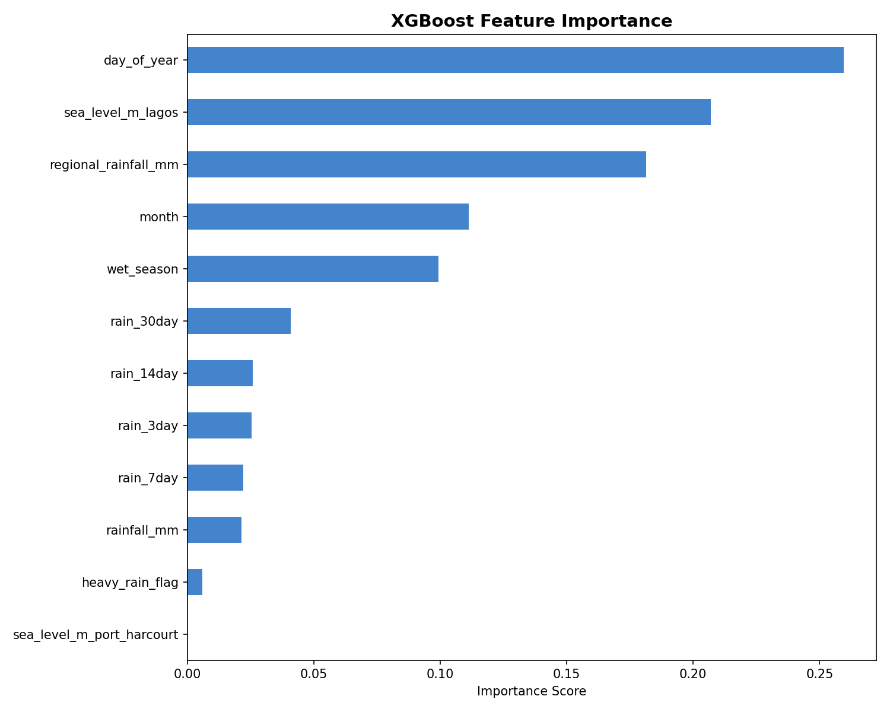
Model A: XGBoost (Gradient Boosting)
Baseline Classifier:
• Fast, robust to outliers.
• Handles class imbalance via scale_pos_weight.
• Highly interpretable outputs.

Slide 7
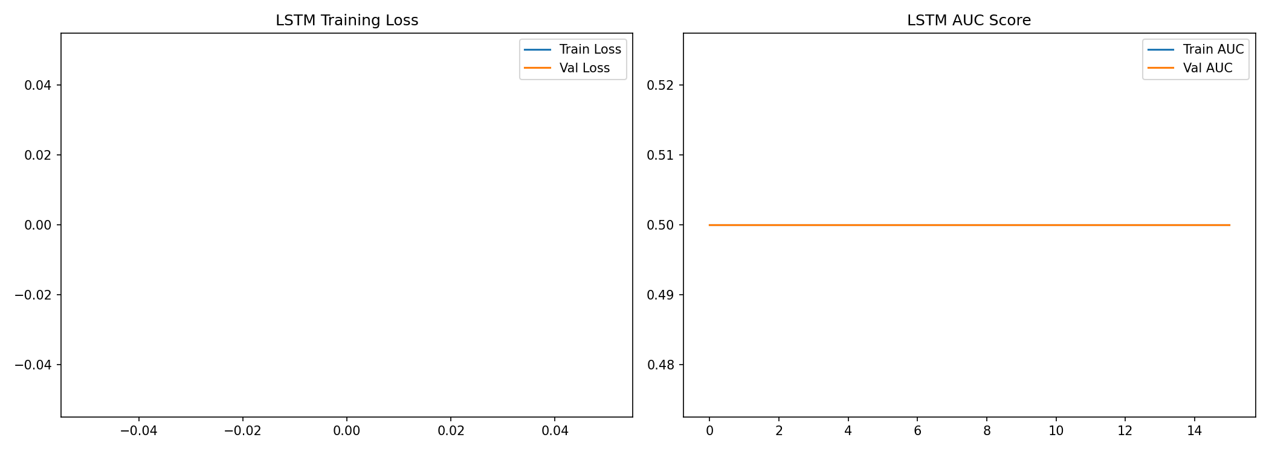
Model B: LSTM (Deep Learning)
Capturing Temporal Dependencies:
• Architecture: Sequential LSTM with Dropout & BatchNorm.
• Input Window: 14-day sliding lookback sequence.
• Purpose: Learn the 'build-up' phase leading to flood incidents.

Slide 8
The Early Warning System (EWS)
Standard Operating Procedures (SOP):
🟢 GREEN (<35%): Normal monitoring.
🟡 AMBER (35-65%): Heightened alert, drainage preparation.
🔴 RED (>65%): Evacuation & Emergency response activation.

Slide 9
Scenario Testing: Model Robustness
Validating model response across risk levels:
🔴 HIGH RISK (July Scenario):
- Monthly total rain 500mm, Daily rain 190mm, High Sea Level (7.25m).
- Result: Significant Flood Probability (>80%), Red Alert Triggered.
🟢 LOW RISK (Baseline Scenario):
- Daily rain 10mm, Monthly total rain 40mm.
- Result: Low Probability (~15%), Green Alert Status.

Slide 10
FastAPI Backend & Dashboard
Operationalizing the Research:
• REST API: High-performance endpoint for real-time risk scoring.
• Smart Defaults: Automatically fills sea level and seasonality metadata.
• Integration: Connected to a modern Next.js dashboard.

Slide 11
Conclusion & Future Directions
Summary of Work:
• Successfully built an end-to-end Nigerian coastal flood pipeline.
• Combined traditional ML with sequence-based Deep Learning.
Future Work:
• Incorporation of Sentinel-1/2 satellite imagery.
• Expansion to Abuja/Kano and riverine flooding (Benue/Niger).

