Slide 1
Prediction of rented bikes per day – Linear Regression vs Random Forest
Learning Portfolio 2
by David Cloos

Slide 2
Data.head()
weathersit: A categorical variable indicating the weather situation (1: clear, 2: mist/cloudy, 3: light rain/snow, 4: heavy rain/snow)
temp: The temperature in Celsius --> Normalized temperature in Celsius. The values are derived via (t-t_min)/(t_max-t_min), t_min=-8, t_max=+39 (only in hourly scale)

Slide 3
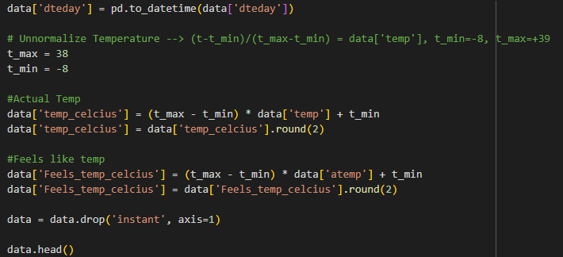
Get clearer understanding of the normalized temperature

Slide 4
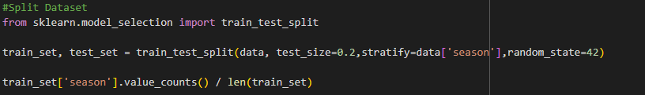
Split data – using stratified splitting

Slide 5
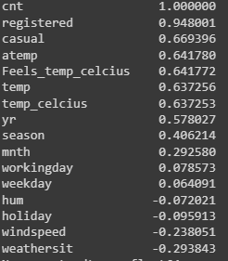
Correlation

Slide 6
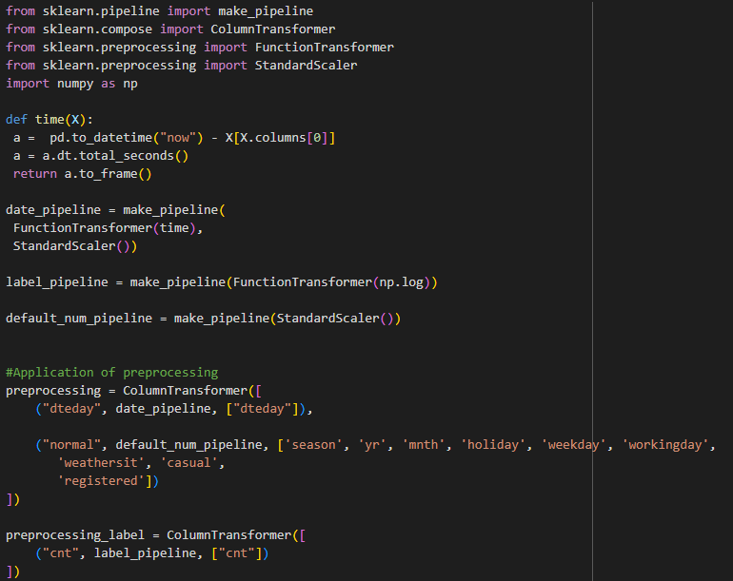
Data Transformation

Slide 7


Results
Linear Regression Random Forest

