Slide 1

BERT & GPT
Homework – SE Digital Organization
by David Cloos

Slide 2
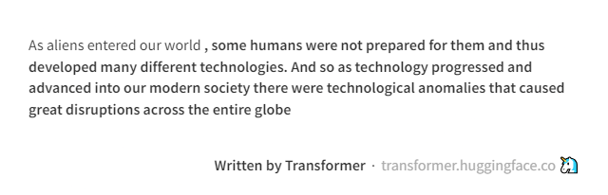
GPT2 - Transformer
¹https://transformer.huggingface.co/doc/gpt2-large
Digital Organization| SE| Cloos

Slide 3
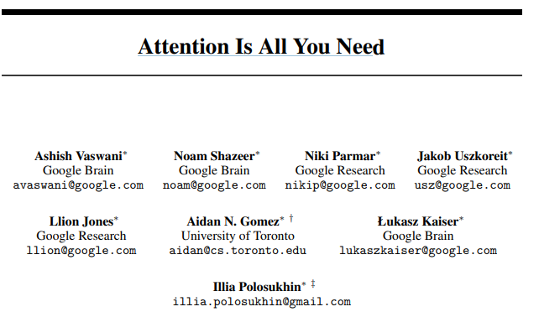
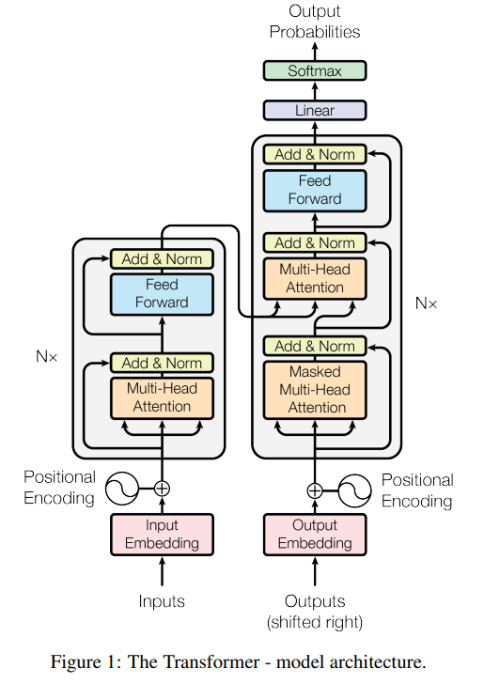
Model architecture – “The Transformer”
„Attention is all you need“
Infinite reference window → references from (almost) unlimited amount of sequences before
Identify all relevant information within a sequence → Attention
Encoder
N=6 identical layers → repeated 6 times
Contains two sublayers
multi head self attention mechanism
Feed forward network
Surrounded by residual connection and followed by layer normalization
Decoder
N=6 identical layers
Contains a third sublayer
Multi head attention on the input of the Encoder (cross attention)
¹Vaswani et al., (2017)
Notes:
Why was this paper so revolutionary
No recurrent methods such as recurrent neural networks (RNNs) and long short-term memory (LSTM) are needed anymore
The Transformer relies on self-attention mechanisms to capture dependencies between tokens, making it more parallelizable and efficient for training on GPUs.
Attention scores could be computed independently for each token → parallelism instead of sequentially processing each input token
Infinite reference window
Focus on relevant information within a sequence

Slide 4
Encoder
Input Embedding:
Sequence of tokens (words, sentences), represented as a vector (embedding) of dimension 512 for each token
Embeddings do not account for position of which tokens might appear within a sequence
Positional Encoding
Encode relative position of given token in a sequence (using sine and cosine functions)
Multi-Self-Attention
Compute attention scores for each tokens in the sequence → Attention scores used to compute weighted sums of the embedding
E.g., “I love cats” → “Cats” in combination with “love” in a sequence might get higher weights
Result:
Score Matrix: measure of importance of the tokens within a sequence
¹Vaswani et al., (2017)
Notes:
Encoder Main purpose:
“see the entire input sequence at once & decide which tokens are important corresponding to other tokens in the sequence”
Input: One hot encoded representation of the input sequence
Input Embeddings: related words will have approximately similar embeddings & vice versa → e.g. “Children” and “Child”
Embeddings without Positional encoding:
He has a black Ferrari. He also has a white cat. AND He has a black & white Ferrari → black and white would have similar embeddings, however relate to totally different tokens → therefore we need positional encoding

Slide 5
Encoder
4. Residual connection (training part)
Auto regressive approach → take inputs from multi head attention vector and add it to the original input
Purpose is to effectively propagate information through deep neural networks and enable “backpropagation”
4.1 Feed Forward Network
Non-linear activation function between fully connected layers (ReLu) → capture more complex relationships
E.g.: learns that “love cats” corresponds to a positive sentiment
4.2 Layer normalization (handles varying length of sequences)
All input values in all neurons in the same layer are normalized (same mean and variance)
¹Vaswani et al., (2017)
Notes:
auto-regressive = consuming the previously generated symbols as additional input when generating the next

Slide 6
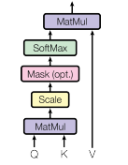
Attention
Attention:
Input:
An attention function is a mathematical operation that takes a question (query) and a collection of related information (key-value pairs) as inputs → represented as vectors
Output
taking a weighted sum of the information vectors (values), where each weight is determined by how well the question vector (query) matches the corresponding information vector (key)
Short Example
Query:
Query on YouTube
Key-value pairs:
Keys: Video title, Description etc. will be mapped against the query
Value: Suggested videos from the database
¹Vaswani et al., (2017)
Notes:
Attention function compares query vector with each key vector to determine the compabitility. Then a similarity score is calculated on query and key (e.g. using the cosine similarity). Based on that similarity score, the attention function assigns weights on the values vector

Slide 7

Attention
Example
Word Vectors(Embeddings + positional encoding):
"The": [0.2, 0.5, 0.3]
"cat": [0.7, 0.1, 0.4]
"sat": [0.6, 0.9, 0.2]
"on": [0.3, 0.4, 0.7]
"the": [0.1, 0.8, 0.5]
"mat": [0.9, 0.3, 0.6]
Now, let's say we want to compute the attention for the word "cat" (the query) in the sentence.
Query (Q): [0.7, 0.1, 0.4]
Keys (K): [[0.2, 0.5, 0.3], [0.7, 0.1, 0.4], [0.6, 0.9, 0.2], [0.3, 0.4, 0.7], [0.1, 0.8, 0.5], [0.9, 0.3, 0.6]]
Values (V): [[0.2, 0.5, 0.3], [0.7, 0.1, 0.4], [0.6, 0.9, 0.2], [0.3, 0.4, 0.7], [0.1, 0.8, 0.5], [0.9, 0.3, 0.6]]
Now, we compute the attention scores between the query and each key. This is done by taking the dot product between the query and each key vector:
Attention scores: [0.14, 1.0, 0.43, 0.59, 0.39, 0.64]
Next, we scale the attention scores by dividing them by the square root of the dimensionality of the key vectors. Assuming the dimensionality is 3:
Scaled attention scores: [0.14 / sqrt(3), 1.0 / sqrt(3), 0.43 / sqrt(3), 0.59 / sqrt(3), 0.39 / sqrt(3), 0.64 / sqrt(3)]
We then apply a softmax function to obtain the attention weights:
Attention weights: [0.08, 0.21, 0.11, 0.15, 0.10, 0.16]
Finally, we compute the weighted sum by multiplying each attention weight by its corresponding value vector:
Weighted sum: [0.08 * [0.2, 0.5, 0.3] + 0.21 * [0.7, 0.1, 0.4] + 0.11 * [0.6, 0.9, 0.2] + 0.15 * [0.3, 0.4, 0.7] + 0.10 * [0.1, 0.8, 0.5] + 0.16 * [0.9, 0.3, 0.6]]
The resulting weighted sum represents the attended information or context associated with the word "cat" in the sentence.
Attention:
Input:
An attention function is a mathematical operation that takes a question (query) and a collection of related information (key-value pairs) as inputs → represented as vectors
Output
taking a weighted sum of the information vectors (values), where each weight is determined by how well the question vector (query) matches the corresponding information vector (key)
¹Vaswani et al., (2017) | ²ChatGPT
Notes:
Attention function compares query vector with each key vector to determine the compabitility. Then a similarity score is calculated on query and key (e.g. using the cosine similarity). Based on that similarity score, the attention function assigns weights on the values vector

Slide 8
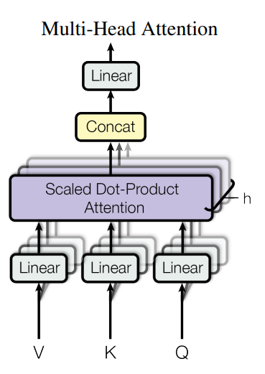

Multi head self attention
Stack of parallel Attention layers
Helps us to understand different aspects of a sentence
Receive generalized & different perspectives of a sequence
Output of all heads is concetenated back into the dimension of n x 512
Example: He sat on the chair & it broke’. Here, one of the attention heads may associate ‘it’ with chair & other may associate it with ‘he’.
Advantage over traditional recurrent or convolutional NN’s:
Wider range of dependencies and relationships from the input can be captured
Attends different information with different representations simultaneously
Parallel computation across multiple heads or attention layers

Slide 9
Decoder
Similar to encoder, but purpose is to generates text sequences
Includes one more layer that takes the output from the encoder (cross attention) and performs multi head self attention on input Queries
But keys and values are coming from the encoder
E.g.: Translation German-English
Because of cross attention the decoder gets the representation of attention information by the encoder and can focus to express the semantic and contextual information of the german sentence into english
Softmax makes sure to predict the probability for next best fitting word
¹Vaswani et al., (2017)
Notes:
Cross attention:
The decoder can take into account the semantic and contextual information of the English sentence to generate the appropriate French translation

Slide 10
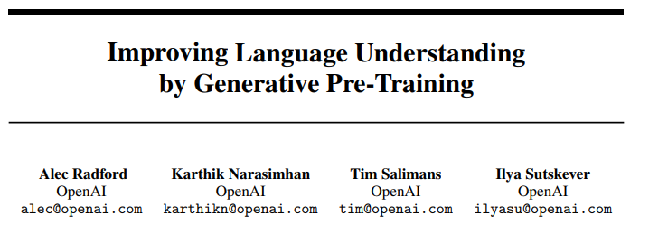
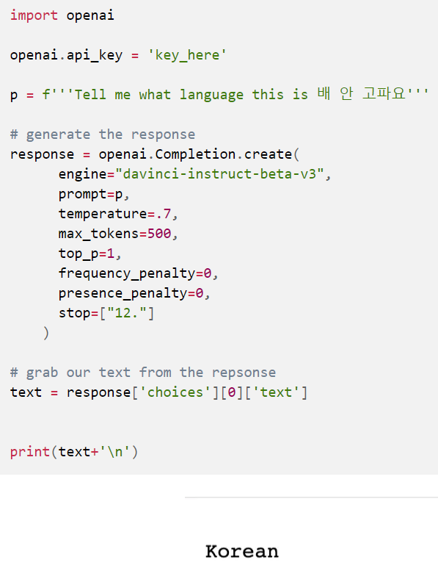
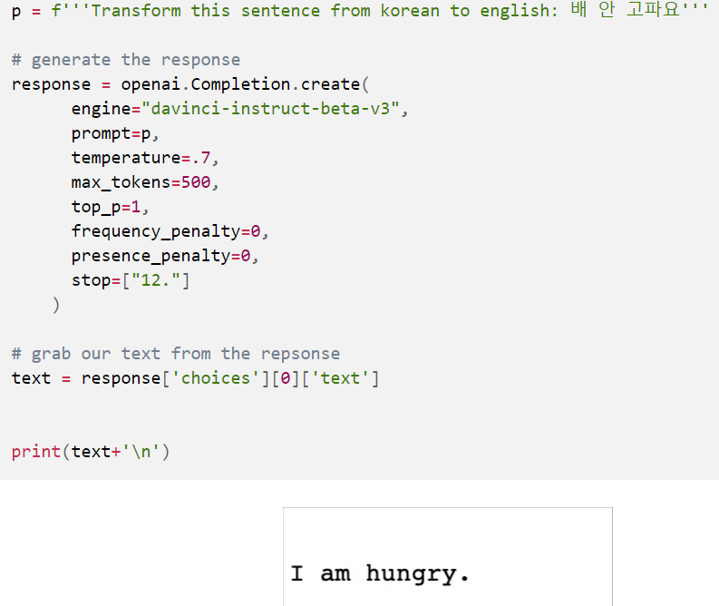
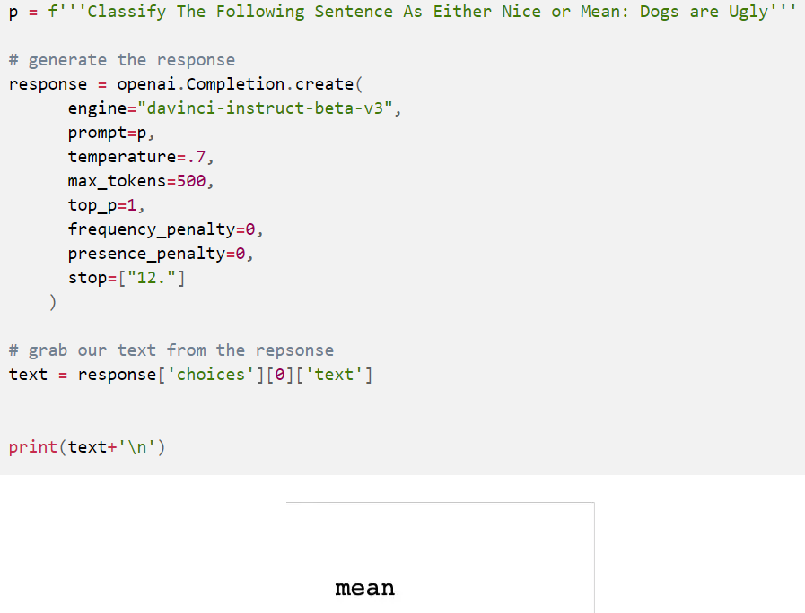
Generative Pre-Training (GPT)
“For our model architecture, we use the Transformer presented by Vaswani et al., (2017)” [..] “This model choice provides us with a more structured memory for handling long-term dependencies [..] compared to alternatives like recurrent networks”
Language detection
Translation
Classification
¹Radford et al., (2018)
Notes:
- GPT uses unsupervised pretraining, where the model is trained on unlabeled text data
Uses transformer which enables capturing long range dependencies
GPT however is a decoder-only transformer

Slide 11
Architecture implemented in Code
https://www.youtube.com/watch?v=kCc8FmEb1nY&t=1333s

Slide 12
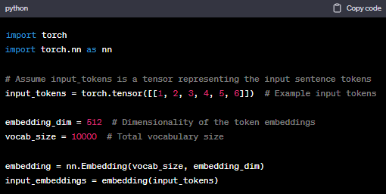
Input Embedding - Code according to ChatGPT

Slide 13
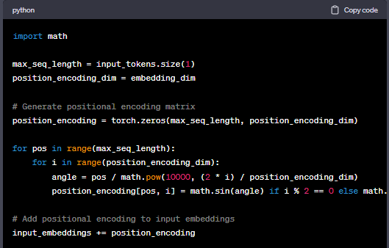
Positional Encoding

Slide 14
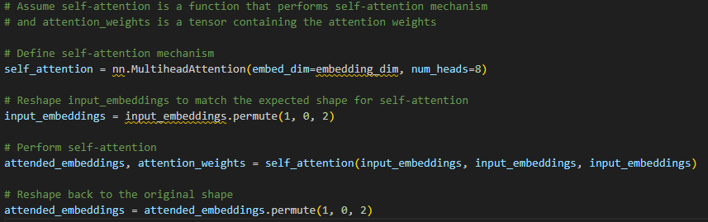
Self attention

Slide 15
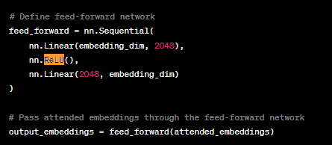
Feed forward network

Slide 16
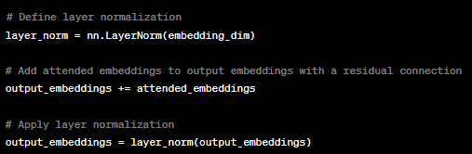
Residual connection and Layer normalization

Slide 17

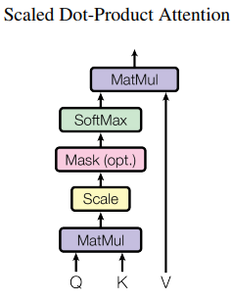
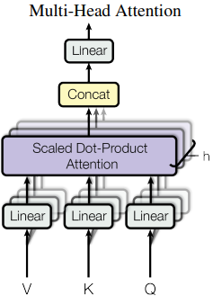

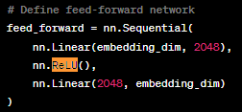

Main mathematical functions¹
Positional encoding using sine and cosine functions
Keep same dimensions as the embeddings so they can be added up
Scaled Dot-Product Attention
Computes the attention scores between the vectors of Query, Key and Value
Taking the dot product of the query with all keys, divide each by the dimension of queries and keys and apply softmax to obtain the weights on the values
$\sqrt{dk}$ → square root of dimension of keys
Feed Forward Network
¹Vaswani et al., (2017)
Notes:
Math behind: Scaled dot product Suppose we have the following vectors:
Query vector Q = [0.5, 0.2, -0.3] (dimensionality dᵠ = 3)
Key vectors K = [[0.8, -0.1, 0.4], [0.2, 0.7, -0.5]] (dimensionality dᵠ = 2)
Value vectors V = [[1.0, 2.0], [0.5, -1.0]] (dimensionality dᵛ = 2)
Dot product calculation:
Compute the dot product between the query vector and each key vector: Dot product 1 = Q · K[1] = 0.50.8 + 0.2(-0.1) + (-0.3)0.4 = 0.37 Dot product 2 = Q · K[2] = 0.50.2 + 0.20.7 + (-0.3)(-0.5) = 0.17
Scaling:
Scale the dot products by dividing them by the square root of the dimensionality of the key vectors: Scaled score 1 = Dot product 1 / √2 = 0.37 / √2 ≈ 0.262 Scaled score 2 = Dot product 2 / √2 = 0.17 / √2 ≈ 0.120
Attention weights:
Apply the softmax function to the scaled scores: Attention weight 1 ≈ softmax([0.262, 0.120]) ≈ [0.687, 0.313] Attention weight 2 ≈ softmax([0.120, 0.262]) ≈ [0.313, 0.687]
Weighted sum of values:
Multiply each value vector by its corresponding attention weight and sum them up: Weighted sum = Attention weight 1 * V[1] + Attention weight 2 * V[2] ≈ [0.6871.0 + 0.3130.5, 0.6872.0 + 0.313(-1.0)] ≈ [0.844, 1.344]
So, in this example, the Scaled Dot-Product Attention mechanism calculates attention weights based on the dot products between the query and key vectors, scales them, and applies softmax to obtain the weights. The weighted sum of the value vectors using these attention weights gives us the final output of the attention mechanism.

