Slide 1
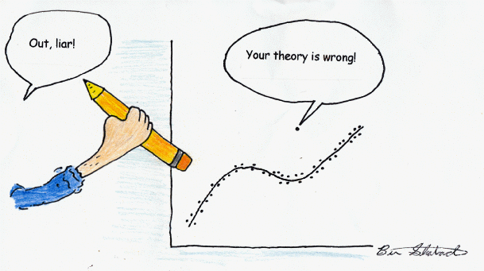
Biology 4605 / 7220
Model Based Statistics in Biology

Slide 2
Biology 4605 / 7220
Model Based Statistics in Biology
Topics:
Lies, Damn Lies, and Statistics
Statistics are Balderdash - Get rid of them!
Statistics are like taxes - inevitable
Hypothesis testing is statistical flotsam
Model Based Statistics
Discarding more flotsam
Learning model-based statistics

Slide 3
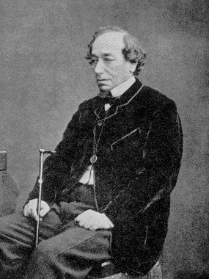
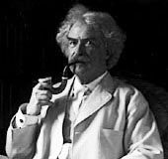
There are three kinds of lies; lies, damned lies and statistics.
5100 hits with Google in Sept 2002.
Who said it ?

Slide 4
There are three kinds of lies; lies, damned lies and statistics.
5100 hits with Google in Sept 2002.
Who said it ?
In his Autobiography (1924 vol 1 p 246) Mark Twain attributed the quote to Benjamin Disraeli
Did Disraeli say it ?

Slide 5
There are three kinds of lies; lies, damned lies and statistics.
Did Disraeli say it ?
No

Slide 6
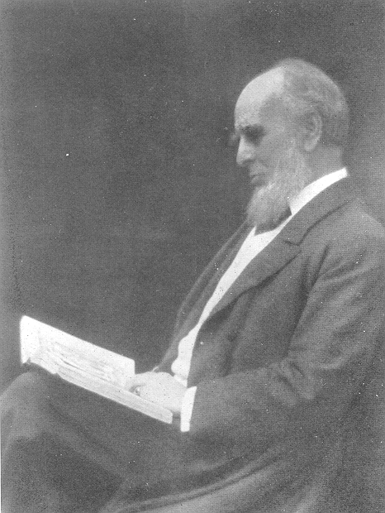
There are three kinds of lies; lies, damned lies and statistics.
If Disraeli didn’t say it
then who did?
Leonard Henry Courtney
British economist and politician (1832-1918)

Slide 7
There are three kinds of lies; lies, damned lies and statistics.
The quote can be found in a statistics journal !!!!
Journal of the Royal Statistical Society, No. 59 (1896)
Leonard Henry Courtney
British economist and politician (1832-1918)

Slide 8

There are three kinds of lies; lies, damned lies and statistics.
If you think lawyers lie, try statistics.
Numbers are to paint what statisticians are to artists.
Paint is to art as numbers are to statisticians.
Numbers are to statisticians what paint is to artists.
Notes:
Print out quotes in 16 point, to be read aloud, not silently.

Slide 9
There are three kinds of lies; lies, damned lies and statistics.
.
When in doubt , use statistics.
Statistics are numbers looking for an argument.
When all else fails, use statistical reasoning.
If you want to really lie use statistics.
Notes:
Print out quotes in 16 point, to be read aloud, not silently.

Slide 10
Like other occult techniques of divination, the statistical method has a private jargon deliberately contrived to obscure its methods from non-practitioners.
--G. O. Ashley.
Confusing students is its only function.
It frustrates and mystifies, in conjunction.
Man without statistics is like a fish without a bicycle.
Notes:
On statistical terminology
by Cory Lation
Whoever invented statistical terms
Had a head that was stuffed with worms.
All these new words are so much junk,
And if I don't learn them, I'm really sunk.
Why's the bell-shaped curve called normal?
Is it normal to be so formal?
There's nothing mean about the mean.
Its just average, as is clearly seen.
And what's so standard about that deviation?
Its a really malicious creation.
Confusing students is its only function.
It frustrates and mystifies, in conjunction.
"Histogram" throws me, at least bit.
I remember the first time I heard of it.
I wanted an antihistogram to get rid of it.
But then I studied it, and after some beers,
I learned its a bar chart--there went my fears.
Just a bar chart--like Norm's tab at Cheers.

Slide 11
Like other occult techniques of divination, the statistical method has a private jargon deliberately contrived to obscure its methods from non-practitioners.
--G. O. Ashley.
.
A statistician is a mathematician broken down by age and sex
The only thing we have to fear is Statistics.
Smoking is a leading cause of statistics.
ScitsitatS spelt backward is STATISTICS.
Notes:
Print out quotes in 16 point, to be read aloud.

Slide 12
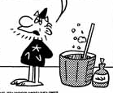
Like other occult techniques of divination, the statistical method has a private jargon deliberately contrived to obscure its methods from non-practitioners.
--G. O. Ashley.
I’m going to abolish statistics from my kingdom.
You can’t do that.
Notes:
On statistical terminology
by Cory Lation
Whoever invented statistical terms
Had a head that was stuffed with worms.
All these new words are so much junk,
And if I don't learn them, I'm really sunk.
Why's the bell-shaped curve called normal?
Is it normal to be so formal?
There's nothing mean about the mean.
Its just average, as is clearly seen.
And what's so standard about that deviation?
Its a really malicious creation.
Confusing students is its only function.
It frustrates and mystifies, in conjunction.
"Histogram" throws me, at least bit.
I remember the first time I heard of it.
I wanted an antihistogram to get rid of it.
But then I studied it, and after some beers,
I learned its a bar chart--there went my fears.
Just a bar chart--like Norm's tab at Cheers.

Slide 13
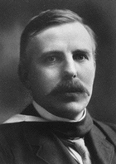
If your experiment needs statistics, you ought to have done a better experiment.
--Ernest Rutherford (1871-1937)
Of course I can.
Lord Rutherford says so.
That’s an unsourced quote.
Notes:
On statistical terminology
by Cory Lation
Whoever invented statistical terms
Had a head that was stuffed with worms.
All these new words are so much junk,
And if I don't learn them, I'm really sunk.
Why's the bell-shaped curve called normal?
Is it normal to be so formal?
There's nothing mean about the mean.
Its just average, as is clearly seen.
And what's so standard about that deviation?
Its a really malicious creation.
Confusing students is its only function.
It frustrates and mystifies, in conjunction.
"Histogram" throws me, at least bit.
I remember the first time I heard of it.
I wanted an antihistogram to get rid of it.
But then I studied it, and after some beers,
I learned its a bar chart--there went my fears.
Just a bar chart--like Norm's tab at Cheers.

Slide 14
“If your experiment needs statistics, you ought to have done a better experiment.” Attributed to Rutherford by N.T.J. Bailey.
A latin square design uses statistics (two blocking factors in an ANOVA).
Now according to that quote, if you use a latin square design, you should have done a better experiment.
Once wrong doesn’t mean always wrong.

Slide 15
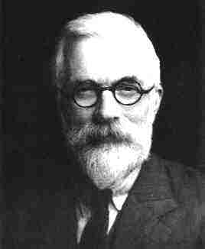
I say again.
Statistics are balderdash.
Get rid of them.
Rutherford did experiments.
Here’s a quote.

Slide 16
“If your experiment needs statistics, you ought to have done a better experiment.” Attributed to Rutherford by N.T.J. Bailey.
Every experiment may be said to exist only in order to give the facts a chance of disproving the null hypothesis
--R.A. Fisher 1935

Slide 17
Google hits in July 2018
3689 hits on
“If you need statistics”
4110 hits on Fisher quote
Fisher won the argument.
5 million hits on “null hypothesis”
That doesn’t prove Fisher was right.
I have it on good authority he was wrong.

Slide 18

Every experiment may be said to exist only in order to give the facts a chance of disproving the null hypothesis
--R.A. Fisher 1935
It is "extraordinarily difficult to find a statistician who argues explicitly in favor of the retention of significance tests...."
--Oakes 1986

Slide 19
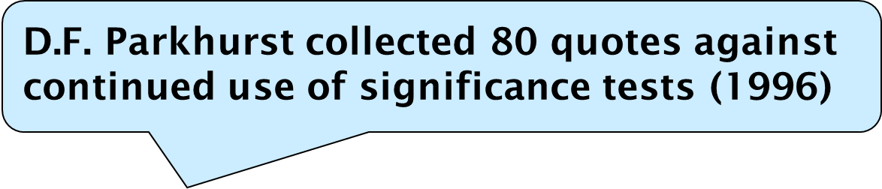
Every experiment may be said to exist only in order to give the facts a chance of disproving the null hypothesis
--R.A. Fisher 1935
M.R. Nester (1996) collected over 125 quotes against use of hypothesis tests.

Slide 20
Every experiment may be said to exist only in order to give the facts a chance of disproving the null hypothesis
--R.A. Fisher 1935
Everyone will have his own pet assortment of flotsam; mine include most of the theory of significance testing, including multiple comparison tests, and non parametric statistics.
John Nelder, 1971. Fisher's successor as Director of the Statistics Department at the Rothamsted Station.

Slide 21
Hypothesis testing is malarky
Get rid of it.
OK, Ok. Let’s not get carried away.
Let’s get another opinion.

Slide 22
You are always better off thinking about why a model could generate your data and then testing that model.
--L. Wilkinson et al. 1992
What’s all this stuff about models?
I’m glad you asked.

Slide 23
Learn to write the model instead of memorizing tests.
What test do I use?
Problem solving
Identify a test by name.
Check its assumptions.
Use automated routines provided in a package.
Sort through the output for a p-value.
Report whether p was less than 5%.
What is the response variable?
What are the explanatory variables?
Write the model.
Check the residuals. Model appropriate? Error structure correct?
Take corrective action.
Report the model, parameter values, and standard errors.

Slide 24
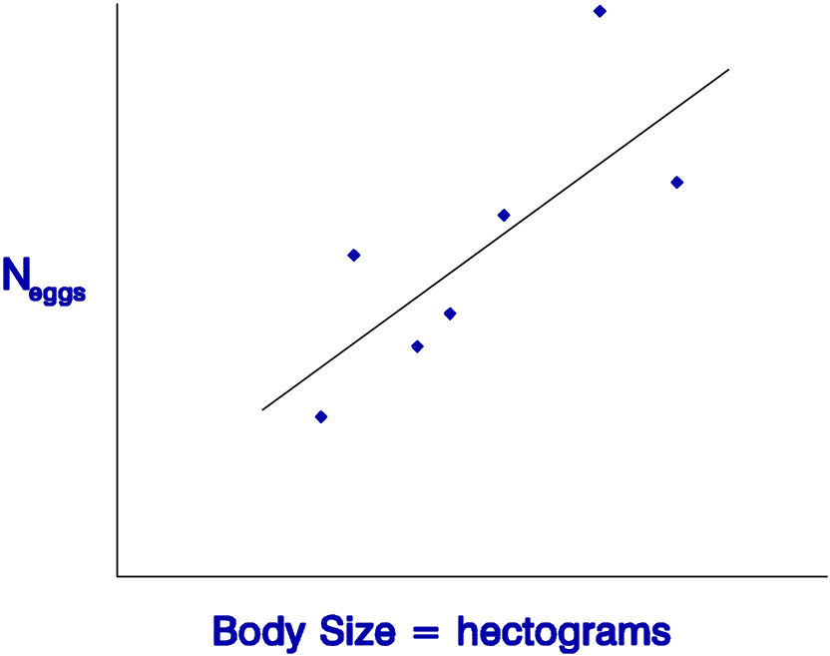
No Problem. Can you write the equation for a straight line?
What? Me write a model?
Data = Model + Residual
Y = mX + b + Residual
Regression
See. No Problem

Slide 25
It’s easy.
Write the model.
Discard the search for tests.
The General Linear Model.
Data = Model + Normal Residual
Data = [Two means] + Normal residual
t-test
Data = [Several means] + Normal residual
Oneway Anova
Data = [Two factors] + Normal residual
Twoway Anova
Data = [Line] + Normal residual
Regression
Data = [Line + factors} + Normal residual
AnCova

Slide 26
While we are at it, let’s discard some flotsam.
Statistical tests of assumptions
Checking assumptions before analysis.
3. Non-parametric (rank based) tests.
4. A posteriori tests.

Slide 27
Discarding the Flotsam
Statistical tests of assumptions are like going out in a rowboat to see if it is too windy to set sail in the Queen Mary.
--Roger Green
Statistical tests have little capacity to detect problems when it matters (n small).
Statistical tests detect small violations when even large violations do not matter (n large).
Statistical tests of assumptions reliably lead to the wrong conclusion.

Slide 28
Discarding the Flotsam
Checking statistical assumptions before analysis is like taking rabies shots before before being bitten. --D. Schneider
The assumptions for computing a p-value from F, t, or X² distributions:
Residuals sum to zero
Residuals are homogeneous
Residuals are independent
Residuals are normally distributed

Slide 29
Discarding the Flotsam
Non-parametric test: An assumption-free procedure for investigating a hypothesis of no practical interest.
--S.J. Penn
As biologists, we are more interested in the magnitude of the difference between groups, than we are in the ranking of the groups.
Data = Model + Any Residual
Dept. of Biology
Dept. of Statistics

Slide 30
Discarding the Flotsam
A posteriori tests.
-turns lying over to the computer.
-almost always less effective than planned comparisons.
A priori (planned) tests.
-an important mode of biological reasoning.
-almost always more effective than a posteriori comparisons.

Slide 31
Learning
Model-based Statistics
Elementary statistics courses for biologists tend to lead to the use of a stereotyped set of tests:
1 without critical attention to the underlying model involved;
2 without due regard to the precise distribution of sampling errors;
3 with little concern for the scale of measurement;
4 careless of dimensional homogeneity;
5 without considering the ideal transformation;
6 without any attempt at model simplification;
7 with too much emphasis on hypothesis testing and too little emphasis on parameter estimation.
--M.J. Crawley 1993

Slide 32
Gary Ramseyer’s 1997 Advice on Teaching Statistics
1. Utilize group activities
2. Use open-book examinations!
3. Use power not timed examinations. …another great anxiety-reducing tool.
4. I firmly believe that a comprehensive basic course that covers the waterfront of statistical techniques is WORTHLESS.
5. Emphasize the handful of reoccurring themes in basic statistics, such as variability or dispersion of the data.
6. Give graded assignments on a weekly basis consisting of one or two problems.
7. And . . .

Slide 33
Gary Ramseyer’s 1997 Advice on Teaching Statistics
7. Show students how statistical methodology can have relevance in their lives. Above everything else, maintain a sense of humor and don't take yourself so seriously.

Slide 34
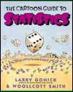
Gary Ramseyer’s Gallery of Statistical Humor
# 28 Did you hear about the statistician who went out on a limb to obtain a nested design?
#45 One day there was a fire in a wastebasket in the Dean's office and in rushed a physicist, a chemist, and a statistician . . .
Notes:
One day there was a fire in a wastebasket in the Dean's office and in rushed a physicist, a chemist, and a statistician. The physicist immediately starts to work on how much energy would have to be removed from the fire to stop the combustion. The chemist works on which reagent would have to be added to the fire to prevent oxidation. While they are doing this, the statistician is setting fires to all the other wastebaskets in the office.
"What are you doing?" they demanded. "Well to solve the problem, obviously you need a large sample size" the statistician replies.

Slide 35
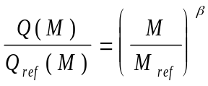


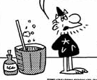
Model based Statistics in Biology
That’s all very nice, but . . .
I don’t have time and it’s Greek to me . . .

Slide 36
Models in Biology. And the good news is . . .
Spreadsheet Statistical packages
Excel MTab SAS SPSS Splus Systat
Spreadsheet visible   No   
Pull down menus   No   
Basic statistical functions      
Return a column of data No    ? ?
in random order.
General Linear Model ??      
Residual analysis       
Logistic regression No     
Generalized Linear Model No No     

Slide 37
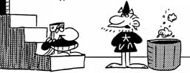
Model Based Statistics in Biology
They are easy in one of these packages.
They can be taught at the 2nd year level in University.
It’s better practice than looking up some test.
It’s quicker than looking up some test.
Then I decree that all must take this course . . .

Slide 38
Model Based Statistics in Biology
Then I decree that all must take this course . . .
Let’s not get carried away….

Slide 39
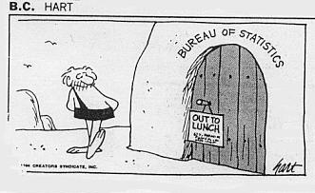
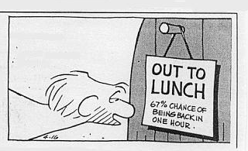
Statistical Models in Biology

