Slide 1
BIOL 4605/7220
CH 9.3 Regression
GPT Lectures
Cailin Xu
October 12, 2011

Slide 2
General Linear Model (GLM)
Last week (Dr. Schneider)
- Introduction to the General Linear Model (GLM)
- Generic recipe for GLM
- 2 examples of Regression, a special case of GLM
Ch 9.1 Explanatory Variable Fixed by Experiment
(experimentally fixed levels of phosphorus)
Ch 9.2 Explanatory Variable Fixed into Classes
(avg. height of fathers from families)

Slide 3
General Linear Model (GLM)
Today – Another example of GLM regression
Ch 9.3 Explanatory Variable Measured with Error
(fish size)
Observational study
E.g., per female fish ~ fish body size M
(observational study; fish size measured with error)
Based on knowledge, larger fish have more eggs (egg size varies little within species; larger fish- more energy)
Notes:
3

Slide 4
General Linear Model (GLM) --- Regression
Special case of GLM: REGRESSION
Explanatory Variable Measured with Error
Research question:
- NOT: whether there is a relation
- BUT: what the relation is? 1:1?, 2:1?, or ?
Parameters Estimates & CL & Interpret pars
(rather than hypothesis testing)

Slide 5
General Linear Model (GLM) --- Regression
Go through GLM recipe with an example
Explanatory Variable Measured with Error
How egg # ( ) ~ female body size (M)?
Ref: Sokal and Rohlf 1995 - Box 14.12

Slide 6
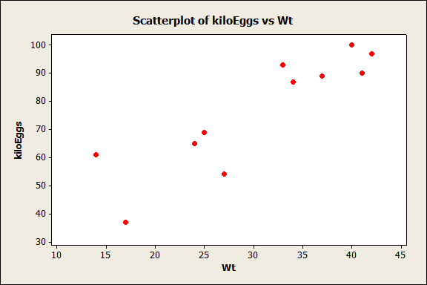
KiloEggs | Wt
61 | 14
37 | 17
65 | 24
69 | 25
54 | 27
93 | 33
87 | 34
89 | 37
100 | 40
90 | 41
97 | 42
Notes:
6

Slide 7
General Linear Model (GLM) --- Generic Recipe
Construct model
Execute model
Evaluate model
State population; is sample representative?
Hypothesis testing?
Yes
State pair
ANOVA
No
Recompute p-value?
Report & Interpr.of parameters
Declare decision:

Slide 8
General Linear Model (GLM) --- Generic Recipe
Construct model
Verbal model
How does egg number depend on body mass M ?
Graphical model
Symbol Units Dimensions Scale
Dependent: kiloeggs # ratio
Explanatory: hectograms M ratio

Slide 9
General Linear Model (GLM) --- Generic Recipe
Construct model
Verbal model
How does egg number depend on body mass M ?
Graphical model
Formal model (dependent vs. explanatory variables)
For population:
For sample:
DIMENSION for

Slide 10
General Linear Model (GLM) --- Generic Recipe
Construct model
Execute model
Place data in an appropriate format
Minitab: type in data OR copy & paste from Excel
R: two columns of data in Excel; save as .CSV (comma
delimited)
dat <- read.table(file.choose(), header = TRUE, sep = “,”)

Slide 11
General Linear Model (GLM) --- Generic Recipe
Construct model
Execute model
Place data in an appropriate format
Execute analysis in a statistical pkg: Minitab, R
Minitab:
MTB> regress ‘Neggs’ 1 ‘Mass’;
SUBC> fits c3;
SUBC> resi c4.

Slide 12
General Linear Model (GLM) --- Generic Recipe
Construct model
Execute model
Place data in an appropriate format
Execute analysis in a statistical pkg: Minitab, R
Minitab:
R: mdl <- lm(Neggs ~ Mass, data = dat)
summary(mdl)
mdl$res
mdl$fitted

Slide 13
General Linear Model (GLM) --- Generic Recipe
Construct model
Execute model
Place data in an appropriate format
Execute analysis in a statistical pkg: Minitab, R
Output: par estimates, fitted values, residuals

Slide 14
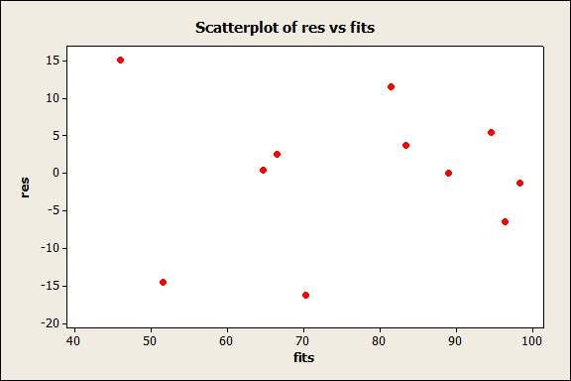
General Linear Model (GLM) --- Generic Recipe
Construct model
Straight line assumption
-- res vs. fitted plot (Ch 9.3, pg 5: Fig)
-- No arches & no bowls
-- Linear vs. non-linear
(√)
Execute model
Evaluate model
(Residuals)

Slide 15
General Linear Model (GLM) --- Generic Recipe
Construct model
Straight line assumption
Homogeneous residuals?
-- res vs. fitted plot (Ch 9.3, pg 5: Fig)
-- Acceptable (~ uniform) band; no cone
(√)
Execute model
(√)
Evaluate model
(Residuals)

Slide 16
General Linear Model (GLM) --- Generic Recipe
Construct model
Straight line assumption
Homogeneous residuals?
If n (=11 < 30) small, assumptions met?
(√)
Execute model
(√)
Evaluate model
(Residuals)

Slide 17
General Linear Model (GLM) --- Generic Recipe
Construct model
Straight line assumption
Homogeneous residuals?
If n small, assumptions met?
1) residuals homogeneous?
2) sum(residuals) = 0? (least squares)
(√)
Execute model
(√)
Evaluate model
(√)
(√)
(Residuals)

Slide 18
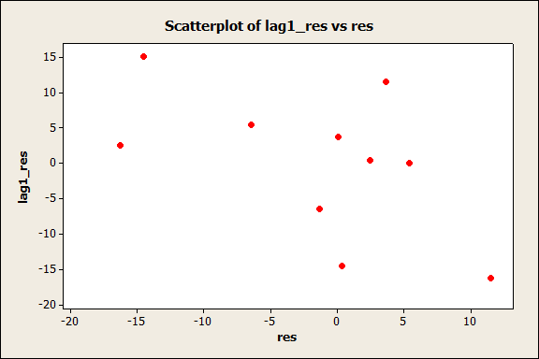
General Linear Model (GLM) --- Generic Recipe
Construct model
Straight line assumption
Homogeneous residuals?
If n small, assumptions met?
1) residuals homogeneous?
2) sum(residuals) = 0? (least squares)
3) residuals independent?
(Pg 6-Fig; res vs. neighbours plot; no trends up or down)
(√)
Execute model
(√)
Evaluate model
(√)
(√)
(√)
(Residuals)

Slide 19
General Linear Model (GLM) --- Generic Recipe
Construct model
Straight line assumption
Homogeneous residuals?
If n small, assumptions met?
1) residuals homogeneous?
2) sum(residuals) = 0? (least squares)
3) residuals independent?
4) residuals normal?
- Histogram (symmetrically distributed around zero?)
(Pg 6: low panel graph) (NO)
- Residuals vs. normal scores plot (straight line?)
(Pg 7: graph) (NO)
(√)
Execute model
(√)
Evaluate model
(√)
(√)
(√)
(Residuals)
(×)

Slide 20
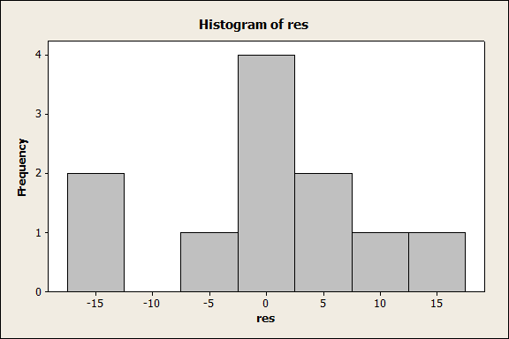
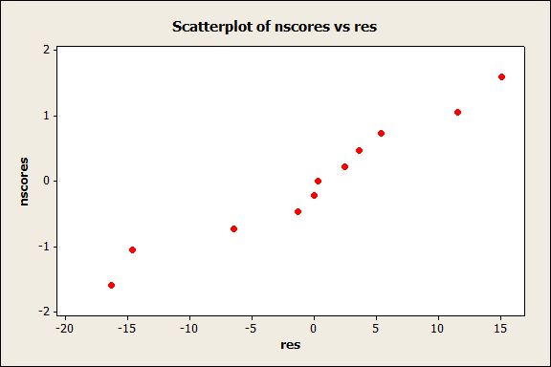
General Linear Model (GLM) --- Generic Recipe
Construct model
Straight line assumption
Homogeneous residuals?
If n small, assumptions met?
4) residuals normal? NO
(√)
Execute model
(√)
Evaluate model
(Residuals)
Notes:
20

Slide 21
General Linear Model (GLM) --- Generic Recipe
Construct model
Execute model
Evaluate model
State population; is sample representative?
All measurements that could have been made by the same experimental protocol
1). Randomly sampled
2). Same environmental conditions
3). Within the size range?

Slide 22
General Linear Model (GLM) --- Generic Recipe
Construct model
Execute model
Evaluate model
State population; is sample representative?
Hypothesis testing?
Research question:
- NOT: whether there is a relation
- BUT: what the relation is? 1:1? 2:1? or ?
Parameters & confidence limit

Slide 23
General Linear Model (GLM) --- Generic Recipe
Construct model
Execute model
Evaluate model
State population; is sample representative?
Hypothesis testing?
No
Parameters & confidence limit
Deviation from normal was small
Homogeneous residuals –
CI via randomization ~those from t-distribution

Slide 24
General Linear Model (GLM) --- Generic Recipe
Parameters & confidence limit
Probability statement (tolerance of Type I error @ 5%)
Variance of
Confidence limit (do NOT forget UNITS)

Slide 25
General Linear Model (GLM) --- Generic Recipe
Parameters & confidence limit
Interpretation of confidence limit
Confidence limit [1.12, 2.62] has 95 percent of chance to cover the true slope
Biological meaning
1). Strictly positive: larger fish, more eggs
2). CI beyond 1: > 1:1 ratio

Slide 26
General Linear Model (GLM) --- Generic Recipe
Parameters & confidence limit
Consideration of downward bias
(due to measurement error in explanatory variable)
0 < k < 1; the closer k to 1, the smaller the bias

Slide 27
General Linear Model (GLM) --- Generic Recipe
Parameters & confidence limit
Consideration of downward bias
(due to measurement error in explanatory variable)
0 < k < 1; the closer k to 1, the smaller the bias
For the current example:
k > 92.25/93.25 = 0.989 (very close to 1; bias is small)

Slide 28
General Linear Model (GLM) --- Generic Recipe
Parameters & confidence limit
Report conclusions about parameters
1). Egg # increases with body size (Large fish produce more eggs than small fish)
2). With a ratio of > 1 : 1
-- 95% confidence interval for the slope estimate is 1.12-2.62
kiloeggs/hectogram, which excludes 1:1 relation

Slide 29
General Linear Model (GLM)
Today – Another example of GLM regression
Ch 9.3 Explanatory Variable Measured with Error
(fish size)
Ch 9.4 Exponential Regression
(fish size)
Notes:
29

Slide 30
Regression--- Application to exponential functions
Exponential rates common in biology
1). Exponential population growth:
r – the intrinsic rate of population increase
2). Exponential growth of body mass:
k – exponential growth rate

Slide 31
Regression--- Application to exponential functions
Same recipe as in (GLM) regression analysis
Only thing extra: linearize the exponential model
Exponential model:
Linearized model:
Response variable - , ratio of final to initial on a log-scale
Explanatory variable - t, time in days from initial to recapture

Slide 32
Regression--- Application to exponential functions
Formal model
For population:
For sample:

