Slide 1
BIOL 4605/7220
Ch 13.3 Paired t-test
GPT Lectures
Cailin Xu
October 26, 2011

Slide 2
Overview of GLM
Regression
Simple regression
Multiple regression
ANOVA
Two categories (t-test)
Multiple categories
- Fixed (e.g., treatment, age)
- Random (e.g., subjects, litters)
One-Way ANOVA
GLM
2 fixed factors
1 fixed & 1 random
Two-Way ANOVA
(e.g., Paired t-test)
Multi-Way ANOVA
ANCOVA

Slide 3
GLM: Paired t-test
Two factors (2 explanatory variables on a nominal scale)
One fixed (2 categories)
The other random (many categories)
+
Random factor
Remove var. among units → sensitive test
Fixed factor

Slide 4
GLM: Paired t-test
An Example:
Effects of two drugs (A & B) on 10 patients
Fixed factor: drugs (2 categories: A & B)
Random factor: patients (10)
Remove individual variation (more sensitive test)

Slide 5
GLM: Paired t-test
Data:
Hours of extra sleep (reported as averages) with two
Drugs (A & B), each administered to 10 subjects
Response variable: T = hours of extra sleep
Explanatory variables: drug & subject
Fixed
Nominal scale (A & B)
Random
Nominal scale (0, 1, 2, . . . , 9)

Slide 6
General Linear Model (GLM) --- Generic Recipe
Construct model
Execute model
Evaluate model
State population; is sample representative?
Hypothesis testing?
Yes
State pair
ANOVA
No
Recompute p-value?
Report & Interpr.of parameters
Declare decision:

Slide 7
General Linear Model (GLM) --- Generic Recipe
Construct model
Verbal model
Hours of extra sleep (T) depends on drug ( )
Graphical model (Lecture notes Ch13.3, Pg 2)
Formal model (dependent vs. explanatory variables)
GLM form:
Exp. Design Notation:
Fixed
Random
Interactive

Slide 8
General Linear Model (GLM) --- Generic Recipe
Construct model
Formal model
GLM form:
- Appears little/no
Limited data
Assume no
Fixed
Random
Interactive effect
GLM form:
Fixed
Random
Break

Slide 9
General Linear Model (GLM) --- Generic Recipe
Construct model
Execute model
Place data in an appropriate format
Execute analysis in a statistical pkg: Minitab, R
Minitab:
MTB> GLM ‘T’ = ‘XD’ ‘XS’;
SUBC> fits c4;
SUBC> resi c5.
~~~~~~~~~~~~~~~~~~~~~~~~~~~~~~~~~~~~~~~~~~~~~~~~~~~~~~~~
ANOVA table, fitted values, residuals |
(more commands to obtain parameter estimates)

Slide 10
General Linear Model (GLM) --- Generic Recipe
Construct model
Execute model
Place data in an appropriate format
Execute analysis in a statistical pkg: Minitab, R
Minitab:
MTB> means ‘T’
MTB> ANOVA ‘T’ = ‘XD’ ‘XS’;
SUBC> means ‘XD’ ‘XS’.

Slide 11
Output from Minitab
XD | N | Means |  | Drug effect (fixed)
-1 | 10 | 0.75 |  | -0.79
1 | 10 | 2.33 |  | 0.79
XS | N | Means |  | Subject effect (random)
0 | 2 | 1.3 |  | -0.24
1 | 2 | -0.4 |  | -1.94
2 | 2 | 0.45 |  | -1.09
3 | 2 | -0.55 |  | -2.09
4 | 2 | -0.1 |  | -1.64
5 | 2 | 3.9 |  | 2.36
6 | 2 | 4.6 |  | 3.06
7 | 2 | 1.2 |  | -0.34
8 | 2 | 2.3 |  | 0.76
9 | 2 | 2.7 |  | 1.16
Means minus grand mean = parameter estimates for subjects

Slide 12
General Linear Model (GLM) --- Generic Recipe
Construct model
Execute model
Place data in an appropriate format
Execute analysis in a statistical pkg: Minitab, R
Minitab:
R:
library(lme4)
model <- lmer(T ~ XD + (1|XS), data = dat)
fixef(model)
fitted(model)
residuals(model)

Slide 13
General Linear Model (GLM) --- Generic Recipe
Construct model
Straight line assumption
-- No line fitted, so skip
Execute model
Evaluate model
(Residuals)

Slide 14
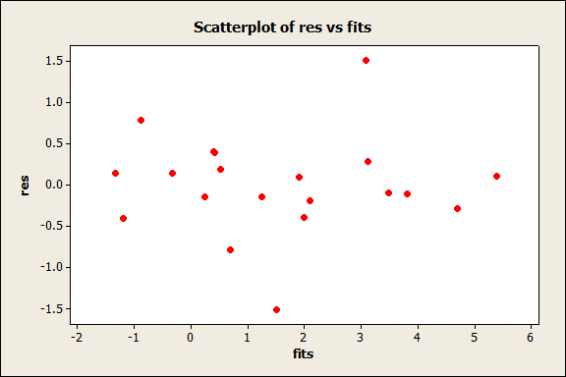
General Linear Model (GLM) --- Generic Recipe
Construct model
Straight line assumption
Homogeneous residuals?
-- res vs. fitted plot (Ch 13.3, pg 4: Fig.1)
-- Acceptable (~ uniform) band; no cone
(skip)
Execute model
(√)
Evaluate model
(Residuals)

Slide 15
General Linear Model (GLM) --- Generic Recipe
Construct model
Straight line assumption
Homogeneous residuals?
If n small, assumptions met?
(skip)
Execute model
(√)
Evaluate model
(Residuals)

Slide 16
General Linear Model (GLM) --- Generic Recipe
Construct model
Straight line assumption
Homogeneous residuals?
If n (=20 < 30) small, assumptions met?
1) residuals homogeneous?
2) sum(residuals) = 0? (yes, least squares)
(skip)
Execute model
(√)
Evaluate model
(√)
(√)
(Residuals)

Slide 17
General Linear Model (GLM) --- Generic Recipe
Construct model
Straight line assumption
Homogeneous residuals?
If n (=20 < 30) small, assumptions met?
1) residuals homogeneous?
2) sum(residuals) = 0? (least squares)
3) residuals independent?
(Pg 4-Fig.2; pattern of neg. correlation, because every value within A, a value of opposite sign within B)
(Pg 4-Fig.3; res vs. neighbours plot; no trends up or down within each drug)
(skip)
Execute model
(√)
Evaluate model
(√)
(√)
(√)
(Residuals)

Slide 18
General Linear Model (GLM) --- Generic Recipe
Construct model
Straight line assumption
Homogeneous residuals?
If n small, assumptions met?
1) residuals homogeneous?
2) sum(residuals) = 0? (least squares)
3) residuals independent?
4) residuals normal?
- Residuals vs. normal scores plot (straight line?)
(Pg 4-Fig. 4) (YES, deviation small)
(skip)
Execute model
(√)
Evaluate model
(√)
(√)
(√)
(Residuals)
(√)

Slide 19
General Linear Model (GLM) --- Generic Recipe
Construct model
Execute model
Evaluate model
State population; is sample representative?
All measurements of hours of extra sleep, given the mode of collection
1). Same two drugs
2). Subjects randomly sampled with similar characteristics as in the sample

Slide 20
General Linear Model (GLM) --- Generic Recipe
Construct model
Execute model
Evaluate model
State population; is sample representative?
Hypothesis testing?
Research question:
Do drugs differ in effect, controlling for individual variation in response to the drugs?
Hypothesis testing is appropriate

Slide 21
General Linear Model (GLM) --- Generic Recipe
Construct model
Execute model
Evaluate model
State population; is sample representative?
Hypothesis testing?
Yes
State pair
Hypothesis for the drug term: (not interested in whether subjects differ)

Slide 22
General Linear Model (GLM) --- Generic Recipe
Construct model
Execute model
Evaluate model
State population; is sample representative?
Hypothesis testing?
Yes
State pair
Hypothesis for the drug term: (not interested in whether subjects differ)
Test statistic: F-ratio
Distribution of test statistic: F-distribution
Tolerance of Type I error: 5% (conventional level)

Slide 23
General Linear Model (GLM) --- Generic Recipe
Construct model
Execute model
Evaluate model
State population; is sample representative?
Hypothesis testing?
Yes
State pair
ANOVA

Slide 24
General Linear Model (GLM) --- Generic Recipe
ANOVA
Calculate & partition df according to model
df : (20-1) = ? + ? + ?
= (2-1) + (10-1) + (19-1-9)
= 1 + 9 + 9

Slide 25
General Linear Model (GLM) --- Generic Recipe
ANOVA
Calculate & partition df according to model
df : 19 = 1 + 9 + 9
ANOVA Table
Source | df | SS | MS | F | p
Drug | 1 | 12.48 | 12.48 | 16.5
Subject | 9 | 58.08 | 6.45
Res | 9 | 6.81 | 0.756
Total | 19 | 77.37

Slide 26
General Linear Model (GLM) --- Generic Recipe
ANOVA
Calculate & partition df according to model
df : 19 = 1 + 9 + 9
ANOVA Table
Source | df | SS | MS | F | p
Drug | 1 | 12.48 | 12.48 | 16.5
Subject | 9 | 58.08 | 6.45
Res | 9 | 6.81 | 0.756
Total | 19 | 77.37

Slide 27
General Linear Model (GLM) --- Generic Recipe
ANOVA
Calculate & partition df according to model
df : 19 = 1 + 9 + 9
ANOVA Table
Source | df | SS | MS | F | p
Drug | 1 | 12.48 | 12.48 | 16.5
Subject | 9 | 58.08 | 6.45
Res | 9 | 6.81 | 0.756
Total | 19 | 77.37
Notes:
27

Slide 28
General Linear Model (GLM) --- Generic Recipe
ANOVA
Calculate & partition df according to model
df : 19 = 1 + 9 + 9
ANOVA Table
Source | df | SS | MS | F | p
Drug | 1 | 12.48 | 12.48 | 16.5
Subject | 9 | 58.08 | 6.45
Res | 9 | 6.81 | 0.756
Total | 19 | 77.37
Notes:
28

Slide 29
General Linear Model (GLM) --- Generic Recipe
ANOVA
Calculate & partition df according to model
df : 19 = 1 + 9 + 9
ANOVA Table
Source | df | SS | MS | F | p
Drug | 1 | 12.48 | 12.48 | 16.5
Subject | 9 | 58.08 | 6.45
Res | 9 | 6.81 | 0.756
Total | 19 | 77.37

Slide 30
General Linear Model (GLM) --- Generic Recipe
ANOVA
Calculate & partition df according to model
df : 19 = 1 + 9 + 9
ANOVA Table
Source | df | SS | MS | F | p
Drug | 1 | 12.48 | 12.48 | 16.5
Subject | 9 | 58.08 | 6.45
Res | 9 | 6.81 | 0.756
Total | 19 | 77.37

Slide 31
General Linear Model (GLM) --- Generic Recipe
ANOVA
Calculate & partition df according to model
MTB > cdf 16.5;
SUBC> F 1 9.
R:
x P( X <= x ) 1-pf(16.5,1,9)
16.5 0.997167
df : 19 = 1 + 9 + 9
ANOVA Table
Source | df | SS | MS | F | p
Drug | 1 | 12.48 | 12.48 | 16.5 | 0.0028
Subject | 9 | 58.08 | 6.45
Res | 9 | 6.81 | 0.756
Total | 19 | 77.37

Slide 32
General Linear Model (GLM) --- Generic Recipe
Construct model
Execute model
Evaluate model
State population; is sample representative?
Hypothesis testing?
Yes
State pair
ANOVA
Deviation from normal small
p-value far from 5%
No need to recompute
Recompute p-value?

Slide 33
General Linear Model (GLM) --- Generic Recipe
Construct model
Execute model
Evaluate model
State population; is sample representative?
Hypothesis testing?
Yes
State pair
ANOVA
Recompute p-value?
Declare decision:

Slide 34
General Linear Model (GLM) --- Generic Recipe
Construct model
Execute model
Evaluate model
State population; is sample representative?
Hypothesis testing?
Yes
State pair
ANOVA
No
Recompute p-value?
Report & Interpret parameters
Declare decision:

Slide 35
General Linear Model (GLM) --- Generic Recipe
Report parameters & confidence limits
Subject: random factor, means of no interest
Drug effects ( )
S.E. Lower limit Upper limit
0.5657 -0.53 hours 2.03 hours
0.6332 0.90 hours 3.76 hours
C.L. overlap, because subject variation is not controlled statistically

Slide 36
Paired t-test --- Alternative way
Calculate the difference within each random category
t-statistic
Current example
S.E. L U
0.389 0.70 hours 2.46 hours
Strictly positive, significant difference between the drugs

Slide 37
Data (hours of extra sleep)
Subject | Drug A | Drug B
1 | 0.7 | 1.9
2 | -1.6 | 0.8
3 | -0.2 | 1.1
4 | -1.2 | 0.1
5 | -0.1 | -0.1
6 | 3.4 | 4.4
7 | 3.7 | 5.5
8 | 0.8 | 1.6
9 | 0 | 4.6
10 | 2 | 3.4

Slide 38
Graphical model

Slide 39
Data format in Minitab & R
T | XD | XS
0.7 | -1 | 0
-1.6 | -1 | 1
-0.2 | -1 | 2
-1.2 | -1 | 3
-0.1 | -1 | 4
3.4 | -1 | 5
3.7 | -1 | 6
0.8 | -1 | 7
0 | -1 | 8
2 | -1 | 9
1.9 | 1 | 0
0.8 | 1 | 1
1.1 | 1 | 2
0.1 | 1 | 3
-0.1 | 1 | 4
4.4 | 1 | 5
5.5 | 1 | 6
1.6 | 1 | 7
4.6 | 1 | 8
3.4 | 1 | 9

Slide 40
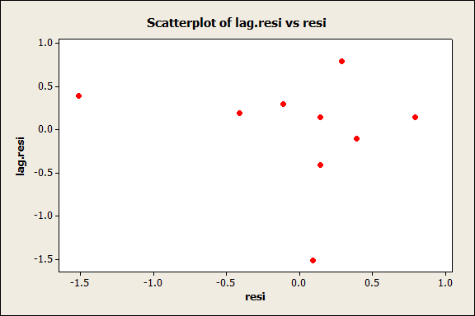

Slide 41
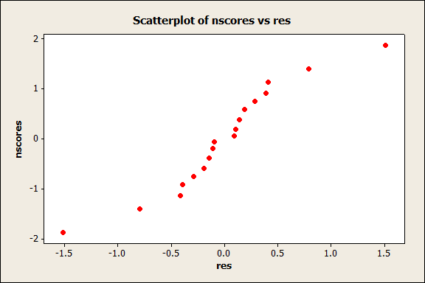

Slide 42
Data (hours of extra sleep)
Subject | Drug A | Drug B | Diff | Fits | Res
1 | 0.7 | 1.9 | 1.2 | 1.58 | -0.38
2 | -1.6 | 0.8 | 2.4 | 1.58 | 0.82
3 | -0.2 | 1.1 | 1.3 | 1.58 | -0.28
4 | -1.2 | 0.1 | 1.3 | 1.58 | -0.28
5 | -0.1 | -0.1 | 0.0 | 1.58 | -1.58
6 | 3.4 | 4.4 | 1.0 | 1.58 | -0.58
7 | 3.7 | 5.5 | 1.8 | 1.58 | 0.22
8 | 0.8 | 1.6 | 0.8 | 1.58 | -0.78
9 | 0 | 4.6 | 4.6 | 1.58 | 3.02
10 | 2 | 3.4 | 1.4 | 1.58 | -0.18

