Slide 1
BIOL 4605/7220
CH 20.1 Correlation
GPT Lectures
Cailin Xu
November 9, 2011
Notes:
1

Slide 2
GLM: correlation
Regression
ANOVA
Only one dependent variable
GLM
ANCOVA
Multivariate analysis
Multiple dependent variables
(Correlation)

Slide 3
Correlation
Two variables associated with each other?
No casual ordering (i.e., NEITHER is a function of the other)
Total length of aphid stem mothers
Mean thorax length of their parthenogenetic offspring
Data from Box 15.4 Sokal and Rohlf 2012

Slide 4
Correlation

Slide 5
Correlation

Slide 6
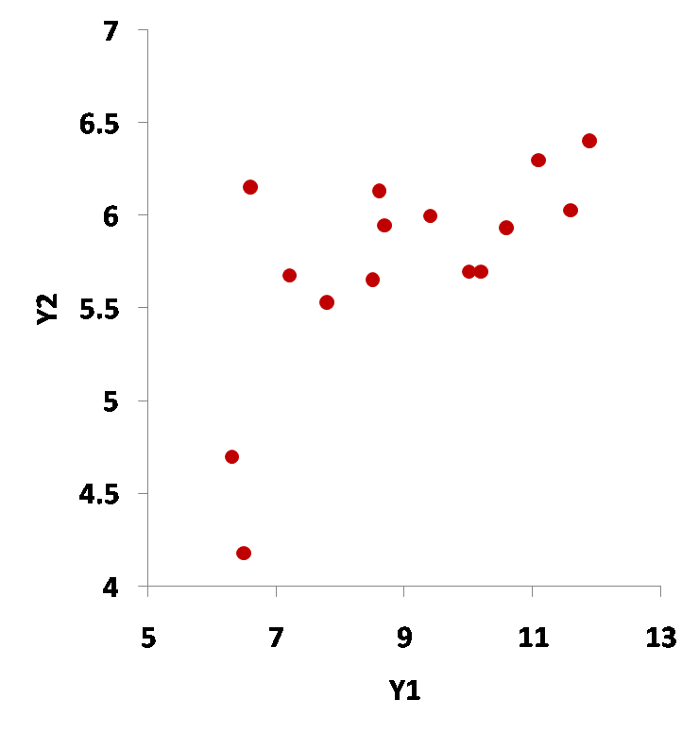
Correlation
Rotate

Slide 7
Regression vs. Correlation
Regression
Does Y depend on X?
(describe func. relationship/predict)
Usually, X is manipulated & Y
is a random variable
Casual ordering Y=f(X)
Correlation
Are Y1 and Y2 related?
Both Y1 & Y2 are random
variables
No casual ordering

Slide 8
Correlation: parametric vs. non-parametric
Parametric measures: Pearson’s correlation
Nonparametric measures: Spearman’s Rho, Kendall’s Tau
Type of data | Measures of correlation
Measurements (from Normal/Gaussian Population) | Parametric: Pearson’s correlation
Ranks, Scores, or Data that do not meet assumptions for sampling distribution (t, F, χ²) | Nonparametric: Spearman’s Rho, Kendall’s Tau

Slide 9
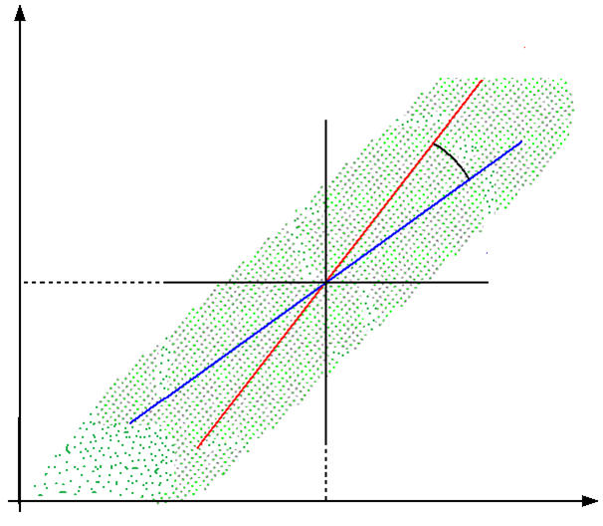
Pearson’s Correlation Coefficient (ρ)
- Strength of relation between two variables
- Geometric interpretation
Perfect positive association:
ϴ =0° ρ=1
No association:
ϴ =90° ρ=0
Perfect negative association:
ϴ =180° ρ=-1
-1 ≤ ρ ≤ 1, true relation

Slide 10
Pearson’s Correlation Coefficient (ρ)
- Strength of relation between two variables
- Geometric interpretation
- Definition
Covariance of the two variables divided by the product of their standard deviations

Slide 11
Pearson’s Correlation Coefficient (ρ)
- Strength of relation between two variables
- Geometric interpretation
- Definition
- Estimate from a sample
Parameter |  | Estimate
Name | Symbol

Slide 12
Pearson’s Correlation Coefficient (ρ)
- Strength of relation between two variables
- Geometric interpretation
- Definition
- Estimate from a sample
Parameter | Estimate

Slide 13
Pearson’s Correlation: Significance Test
Determine whether a sample correlation coefficient
could have come from a population with a parametric correlation coefficient of ZERO
Determine whether a sample correlation coefficient
could have come from a population with a parametric correlation coefficient of CERTAIN VALUE ≠ 0
Generic recipe for Hypothesis Testing

Slide 14
Hypothesis Testing --- Generic Recipe
State population
State model/measure of pattern (statistic)
State null hypothesis
State alternative hypothesis
State tolerance for Type I error
State frequency distribution
Calculate statistic
Report statistic with decision
Calculate p-value
Declare decision

Slide 15
Hypothesis Testing --- Generic Recipe
State population
All measurements on total length of aphid stem mothers & mean thorax length of their parthenogenetic offspring made by the same experimental protocol
1). Randomly sampled
2). Same environmental conditions

Slide 16
Hypothesis Testing --- Generic Recipe
State population
State model/measure of pattern (statistic)
Correlation of the two variables, ρ
In the case
In the case
z: Normal/tends to normal rapidly as n increases for ρ ≠ 0
t-statistic: N(0, 1) or t (df = ∞)

Slide 17
Hypothesis Testing --- Generic Recipe
State population
State model/measure of pattern (statistic)
Correlation of the two variables, ρ
In the case

Slide 18
Hypothesis Testing --- Generic Recipe
State population
State model/measure of pattern (statistic)
State null hypothesis

Slide 19
Hypothesis Testing --- Generic Recipe
State population
State model/measure of pattern (statistic)
State null hypothesis
State alternative hypothesis

Slide 20
Hypothesis Testing --- Generic Recipe
State population
State model/measure of pattern (statistic)
State null hypothesis
State alternative hypothesis
State tolerance for Type I error

Slide 21
Hypothesis Testing --- Generic Recipe
State population
State model/measure of pattern (statistic)
State null hypothesis
State alternative hypothesis
State tolerance for Type I error
State frequency distribution
t-distribution

Slide 22
Hypothesis Testing --- Generic Recipe
State population
State model/measure of pattern (statistic)
State null hypothesis
State alternative hypothesis
State tolerance for Type I error
State frequency distribution
Calculate statistic
t-statistic
correlation coefficient estimate, r = 0.65
t = (0.65 – 0)/0.21076 = 3.084

Slide 23
Hypothesis Testing --- Generic Recipe
State population
State model/measure of pattern (statistic)
State null hypothesis
State alternative hypothesis
State tolerance for Type I error
State frequency distribution
Calculate statistic
t = 3.084, df = 13
p = 0.0044 (one-tail) & 0.0088 (two-tail)
Calculate p-value

Slide 24
Hypothesis Testing --- Generic Recipe
State population
State model/measure of pattern (statistic)
State null hypothesis
State alternative hypothesis
State tolerance for Type I error
State frequency distribution
Calculate statistic
p = 0.0088 < α = 0.05
reject
Calculate p-value
Declare decision

Slide 25
Hypothesis Testing --- Generic Recipe
State population
State model/measure of pattern (statistic)
State null hypothesis
State alternative hypothesis
r = 0.65, n = 15, p = 0.0088
Total length & offspring
thorax length are related
State tolerance for Type I error
State frequency distribution
Calculate statistic
Report statistic with decision
Calculate p-value
Declare decision

Slide 26
Pearson’s Correlation – Assumptions
Assumptions
Normal & independent errors
Homogeneous around straight line
What if assumptions for Pearson test not met?
Here are the observations relative to the correlation line (comp 1)
Not homogeneous, due to outliers (observations 8 & 9)
Notes:
26

Slide 27
Pearson’s Correlation – Randomization test
Significance test with no distributional assumptions
Hold one variable, permute the other one many times
A new r from each new permutation
Construct empirical frequency distribution
Compare the empirical distribution with the observed r

Slide 28
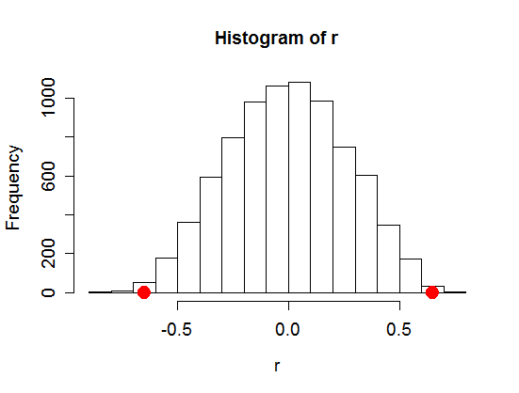
Pearson’s Correlation – Randomization test
8000 times
p1 = p(r > 0.65) = 0.001875
p2 = p (r < -0.65) = 0.003875
p = p1 + p2 = 0.00575 < α = 0.05
Reject Null
Consistent with testing result
from theoretical t-distribution,
for this data
-0.65
0.65

Slide 29
Pearson’s Correlation coefficient – Confidence Limit
95% confidence limit (tolerance of Type I error @ 5%)
t-distribution (df = n – 2) (NO)
a). H0: ρ = 0 was rejected
b). Distribution of r is negatively skewed
c). Fisher’s transformation

Slide 30
Pearson’s Correlation coefficient – Confidence Limit
C. I. for η:
critical value from N(0, 1) at p = 1-α/2
C. I. for ρ:
For our example:
95 percent confidence interval:

Slide 31
Nonparametric: Spearman’s Rho
Measure of monotone association used when the distribution
of the data make Pearson's correlation coefficient undesirable
or misleading
Spearman’s correlation coefficient (Rho) is defined as the Pearson’s
correlation coefficient between the ranked variables
Randomization test for significance (option)

Slide 32
Nonparametric: Kendall’s Tau
Concordant pairs
(if the ranks for both elements agree)
Discordant pairs
(if the ranks for both elements disagree)
Neither concordant or discordant

Slide 33
Nonparametric: Kendall’s Tau
Kendall’s Tau =
(no ties)
(in the case of ties)
Gamma coefficient or Goodman correlation coefficient
Properties:
The denominator is the total number of pairs, -1 ≤ tau ≤ 1
tau = 1, for perfect ranking agreement
tau = -1, for perfect ranking disagreement
tau ≈ 0, if two variables are independent
For large samples, the sampling distribution of tau is approximately normal

Slide 34
Nonparametric
For more information on nonparametric test of correlation
e.g., significance test, etc.
References:
Conover, W.J. (1999) “Practical nonparametric statistics”, 3rd ed. Wiley & Sons
Kendall, M. (1948) “Rank Correlation Methods”, Charles Griffin & Company Limited
Caruso, J. C. & N. Cliff. (1997) "Empirical Size, Coverage, and Power of
Confidence Intervals for Spearman's Rho", Ed. and Psy. Meas., 57 pp. 637–654
Corder, G.W. & D.I. Foreman. (2009) "Nonparametric Statistics for Non-
Statisticians: A Step-by-Step Approach", Wiley

Slide 35
Data Total length of aphid stem mothers (Y1)
Vs.
Mean thorax length of their parthenogenetic offspring (Y2)
#
1 | 8.7 | 5.95
2 | 8.5 | 5.65
3 | 9.4 | 6.00
4 | 10.0 | 5.70
5 | 6.3 | 4.70
6 | 7.8 | 5.53
7 | 11.9 | 6.40
8 | 6.5 | 4.18
9 | 6.6 | 6.15
10 | 10.6 | 5.93
11 | 10.2 | 5.70
12 | 7.2 | 5.68
13 | 8.6 | 6.13
14 | 11.1 | 6.30
15 | 11.6 | 6.03

Slide 36
Total length of mothers Vs. Mean thorax length of offspring
RAW
RANK
#
1 | 8.7 | 5.95 | 8 | 9
2 | 8.5 | 5.65 | 6 | 4
3 | 9.4 | 6.00 | 9 | 10
4 | 10.0 | 5.70 | 10 | 6.5
5 | 6.3 | 4.70 | 1 | 2
6 | 7.8 | 5.53 | 5 | 3
7 | 11.9 | 6.40 | 15 | 15
8 | 6.5 | 4.18 | 2 | 1
9 | 6.6 | 6.15 | 3 | 13
10 | 10.6 | 5.93 | 12 | 8
11 | 10.2 | 5.70 | 11 | 6.5
12 | 7.2 | 5.68 | 4 | 5
13 | 8.6 | 6.13 | 7 | 12
14 | 11.1 | 6.30 | 13 | 14
15 | 11.6 | 6.03 | 14 | 11

Slide 37
Group
Activity

Slide 38
Activity Instructions
Question: REGRESSION or CORRELATION?
Justification guideline:
X
y
Regression:
Y1
Y2
Correlation:
X1, . . . Xn unknown

Slide 39
Activity Instructions
Form small groups or 2-3 people.
Each group is assigned a number
Group members work together on each example for 5
minutes, come up with an answer & your justifications
A number will be randomly generated from the group #’s
The corresponding group will have to present their answer
& justifications
Go for the next example . . .

Slide 40
Activity Instructions
There is NO RIGHT/WRONG ANSWER (for these examples),
as long as your justifications are LOGICAL

Slide 41
Example 1
Height and ratings of physical attractiveness vary across individuals. Would you analyze this as regression or correlation?
Subject | Height | Phy
1 | 69 | 7
2 | 61 | 8
3 | 68 | 6
4 | 66 | 5
5 | 66 | 8
. | .. | .
48 | 71 | 10

Slide 42
Example 2
Airborne particles such as dust and smoke are an important part of air pollution. Measurements of airborne particles made every six days in the center of a small city and at a rural location 10 miles southwest of the city
(Moore & McCabe, 1999. Introduction to the Practice of Statistics).
Would you analyze this relation as regression or correlation?

Slide 43
Example 3
A study conducted in the Egyptian village of Kalama examined the relation between birth weights of 40 infants and family monthly income
(El-Kholy et al. 1986, Journal of the Egyptian Public Health Association, 61: 349).
Would you analyze this relation as regression or correlation?

