Slide 1
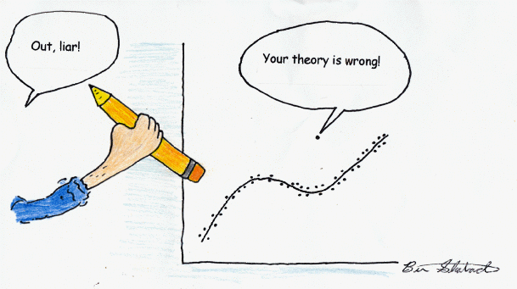
Biology 4605 / 7220
The Role of Statistics in Science

Slide 2
Biology 4605 / 7220
The Role of Statistics in Science
Topics:
“Lies, Damn Lies, and Statistics”
Statistics are balderdash - Get rid of them!
Statistics are like taxes - inevitable
Hypothesis testing is statistical flotsam
Model based analysis and inference
Discarding more flotsam
Learning model-based statistics

Slide 3
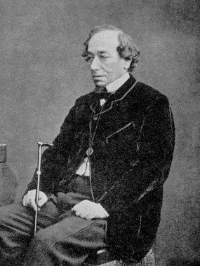
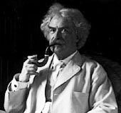
There are three kinds of lies;
Lies, Damned lies and Statistics.
5100 hits with Google in Sept 2002.
Who said it ?

Slide 4
There are three kinds of lies;
Lies, Damned lies and Statistics.
5100 hits with Google in Sept 2002.
Who said it ?
In his Autobiography (1924 vol 1 p 246) Mark Twain attributed the quote to Benjamin Disraeli
Did Disraeli say it ?

Slide 5
There are three kinds of lies;
Lies, Damned lies and Statistics.
Did Disraeli say it ?
No

Slide 6
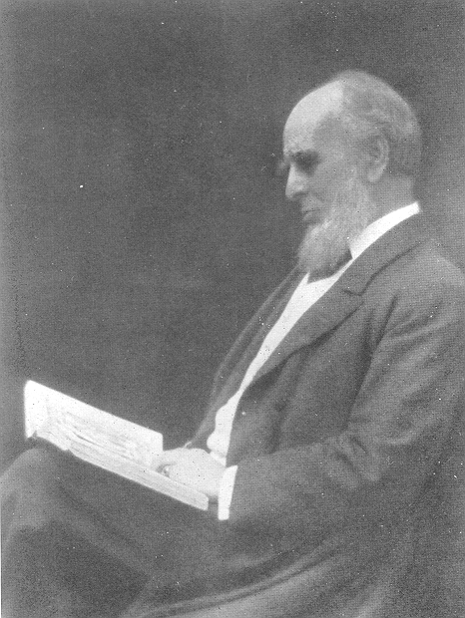
There are three kinds of lies;
Lies, Damned lies and Statistics.
If Disraeli didn’t say it
then who did?
Leonard Henry Courtney
British economist and politician (1832-1918)

Slide 7
There are three kinds of lies;
Lies, Damned lies and Statistics.
The quote can be found in a statistics journal !!!!
Journal of the Royal Statistical Society, No. 59 (1896)
Leonard Henry Courtney
British economist and politician (1832-1918)

Slide 8

There are three kinds of lies;
Lies, Damned lies and Statistics.
If you think lawyers lie, try statistics.
Numbers are to paint what statisticians are to artists.
Paint is to art as numbers are to statisticians.
Numbers are to statisticians what paint is to artists.
Notes:
Print out quotes in 16 point, to be read aloud, not silently.

Slide 9
There are three kinds of lies;
Lies, Damned lies and Statistics.
.
When in doubt , use statistics.
Statistics are numbers looking for an argument.
When all else fails, use statistics.
If you want to really lie use statistics.
Notes:
Print out quotes in 16 point, to be read aloud, not silently.

Slide 10
Like other occult techniques of divination, the statistical method has a private jargon deliberately contrived to obscure its methods from non-practitioners.
--G. O. Ashley.
Confusing students is its only function.
It frustrates and mystifies, in conjunction.
Man without statistics is like a fish without a bicycle.
Notes:
On statistical terminology
by Cory Lation
Whoever invented statistical terms
Had a head that was stuffed with worms.
All these new words are so much junk,
And if I don't learn them, I'm really sunk.
Why's the bell-shaped curve called normal?
Is it normal to be so formal?
There's nothing mean about the mean.
Its just average, as is clearly seen.
And what's so standard about that deviation?
Its a really malicious creation.
Confusing students is its only function.
It frustrates and mystifies, in conjunction.
"Histogram" throws me, at least bit.
I remember the first time I heard of it.
I wanted an antihistogram to get rid of it.
But then I studied it, and after some beers,
I learned its a bar chart--there went my fears.
Just a bar chart--like Norm's tab at Cheers.

Slide 11
Like other occult techniques of divination, the statistical method has a private jargon deliberately contrived to obscure its methods from non-practitioners.
--G. O. Ashley.
A statistician is a mathematician broken down by age and sex
The only thing we have to fear is Statistics.
Smoking is a leading cause of statistics.
ScitsitatS spelt backward is STATISTICS.
Notes:
Print out quotes in 16 point, to be read aloud.

Slide 12
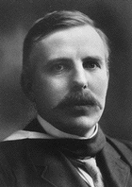
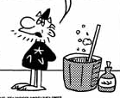
If your experiment needs statistics, you ought to have done a better experiment.
--Ernest Rutherford (1871-1937)
I’m going to abolish statistics from my kingdom.
Lord Rutherford says we don’t need them.
That’s an unsourced quote.
Notes:
On statistical terminology
by Cory Lation
Whoever invented statistical terms
Had a head that was stuffed with worms.
All these new words are so much junk,
And if I don't learn them, I'm really sunk.
Why's the bell-shaped curve called normal?
Is it normal to be so formal?
There's nothing mean about the mean.
Its just average, as is clearly seen.
And what's so standard about that deviation?
Its a really malicious creation.
Confusing students is its only function.
It frustrates and mystifies, in conjunction.
"Histogram" throws me, at least bit.
I remember the first time I heard of it.
I wanted an antihistogram to get rid of it.
But then I studied it, and after some beers,
I learned its a bar chart--there went my fears.
Just a bar chart--like Norm's tab at Cheers.

Slide 13
“If your experiment needs statistics, you ought to have done a better experiment.” Attributed to Rutherford by N.T.J. Bailey.
A latin square design uses statistics (two blocking factors in an ANOVA).
Now according to that quote, if you use a latin square design, you should have done a better experiment.
Once wrong doesn’t mean always wrong.

Slide 14
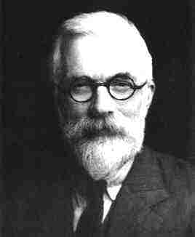
Rutherford never used statistics to analyze his experiments.
So why should we?
Get rid of them!
R.A. Fisher invented experimental design. Here’s what he had to say about experiments.

Slide 15
“If your experiment needs statistics, you ought to have done a better experiment.” Attributed to Rutherford by N.T.J. Bailey.
Every experiment may be said to exist only in order to give the facts a chance of disproving the null hypothesis
--R.A. Fisher 1935

Slide 16
Google hits in July 2018
3689 hits on
“If you need statistics you should have… ”
4110 hits on Fisher quote
Fisher won the argument.
5 million hits on “null hypothesis”
That doesn’t prove Fisher was right.
I have it on good authority he was wrong.

Slide 17

Every experiment may be said to exist only in order to give the facts a chance of disproving the null hypothesis
--R.A. Fisher 1935
It is "extraordinarily difficult to find a statistician who argues explicitly in favor of the retention of significance tests...."
--Oakes 1986

Slide 18
Every experiment may be said to exist only in order to give the facts a chance of disproving the null hypothesis
--R.A. Fisher 1935
M.R. Nester (1996) collected over 125 quotes against the use of hypothesis tests
D.F. Parkhurst (1996) collected 80 quotes against continued use of significance tests.

Slide 19
Every experiment may be said to exist only in order to give the facts a chance of disproving the null hypothesis
--R.A. Fisher 1935
Everyone will have his own pet assortment of flotsam; mine include most of the theory of significance testing, including multiple comparison tests, and non-parametric statistics.
John Nelder, 1971. Fisher's successor as Director of the Statistics Department at the Rothamsted Station.

Slide 20
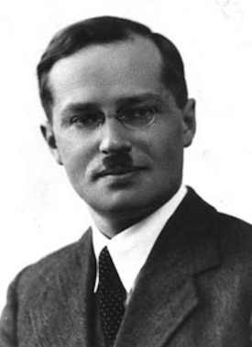
Hypothesis testing is malarky
Get rid of it.
Fisher didn’t invent hypothesis testing against a fixed error rate. Jerzy Neyman invented it.

Slide 21

“A whole series of erroneous tests of significance have ensured that many young men now entering employment in research…have been partly incapacitated by crooked reasoning” R.A. Fisher 1960
Fisher didn’t think much of Neyman’s theory of hypothesis testing.

Slide 22
“The [Neyman-Pearson] hypothesis test approach offered scientists a Faustian bargain -- a seemingly automatic way to limit the number of mistaken conclusions in the long run, but only by abandoning the ability to measure evidence [a la Fisher] and assess truth from a single experiment.” N. Goodman, 1999
Goodman called it the p-value fallacy.

Slide 23
It’s all malarky
Get rid of it.
How about more thinking and less hypothesis testing?

Slide 24
You are always better off thinking about why a model could generate your data and then testing that model.
--L. Wilkinson et al. 1992
What to you say to that?
Thinking instead of ritual hypothesis testing?

Slide 25
Problem solving instead of memorization.
What test do I use?
Problem solving
Identify a test by name.
Check its assumptions.
Use automated routines provided in a package.
Sort through the output for a p-value.
Report whether p was less than 5%.
What is the response variable?
What are the explanatory variables?
Write the model.
Model checking. Model appropriate? Error structure correct?
Take corrective action.
Report the model, parameter values, and standard errors.

Slide 26
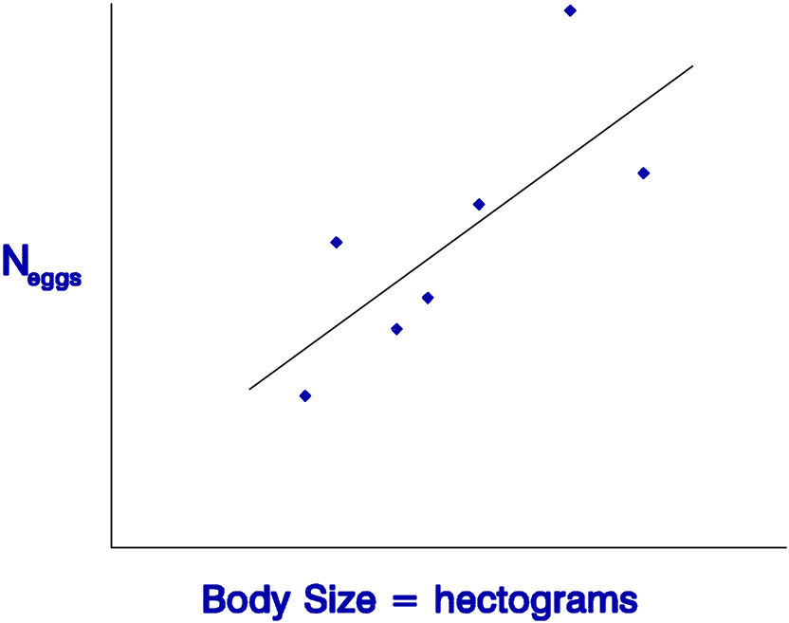
What? Me write a model?
No Problem
Data = Model + Residual
Y = mX + b + Residual
Regression
See. No Problem

Slide 27
Thinking instead of memorization.
Write the model.
Discard the search for tests.
The General Linear Model.
Data = Model + Normal Residual
Data = [Two means] + Normal residual
t-test
Data = [Several means] + Normal residual
Oneway Anova
Data = [Two factors] + Normal residual
Twoway Anova
Data = [Line] + Normal residual
Regression
Data = [Line + factors} + Normal residual
AnCova

Slide 28
While we are at it, let’s discard some more flotsam.
Statistical tests of assumptions
Checking assumptions before analysis.
3. Non-parametric (rank based) tests.
4. A posteriori tests.

Slide 29
Discarding the Flotsam
“Statistical tests of assumptions are like going out in a rowboat to see if it is too windy to set sail in the Queen Mary.”
--Roger Green
Statistical tests have little capacity to detect problems when it matters (n small).
Statistical tests detect small violations when even large violations do not matter (n large).
Statistical tests of assumptions reliably lead to the wrong conclusion.

Slide 30
Discarding the Flotsam
Checking statistical assumptions before analysis is like taking rabies shots before before being bitten. --D. Schneider
The assumptions for computing a p-value from F, t, or X² distributions:
Residuals sum to zero
Residuals are homogeneous
Residuals are independent
Residuals are normally distributed

Slide 31
Discarding the Flotsam
“Non-parametric test: An assumption-free procedure for investigating a hypothesis of no practical interest.”
--S.J. Penn
As biologists, we are more interested in the magnitude of the difference between groups, than we are in the ranking of the groups.
Data = Model + Any Residual
Dept. of Biology
Dept. of Statistics

Slide 32
Discarding the Flotsam
A posteriori tests.
-turns “lying” over to the computer.
-almost always less effective than planned comparisons.
A priori (planned) tests.
-an important mode of reasoning in science.
-almost always more effective than a posteriori comparisons.

Slide 33
Learning Model-based Statistics
Elementary statistics courses for biologists tend to lead to the use of a stereotyped set of tests:
1 without critical attention to the underlying model involved;
2 without due regard to the precise distribution of sampling errors;
3 with little concern for the scale of measurement;
4 careless of dimensional homogeneity;
5 without considering the ideal transformation;
6 without any attempt at model simplification;
7 with too much emphasis on hypothesis testing and too little emphasis on parameter estimation.
--M.J. Crawley 1993

Slide 34
Gary Ramseyer’s 1997 Advice on Teaching Statistics
1. Utilize group activities
2. Use open-book examinations!
3. Use power not timed examinations. …another great anxiety-reducing tool.
4. I firmly believe that a comprehensive basic course that covers the waterfront of statistical techniques is WORTHLESS.
5. Emphasize the handful of reoccurring themes in basic statistics, such as variability or dispersion of the data.
6. Give graded assignments on a weekly basis consisting of one or two problems.
7. And . . .

Slide 35
Gary Ramseyer’s 1997 Advice on Teaching Statistics
7. Show students how statistical methodology can have relevance in their lives. Above everything else, maintain a sense of humor and don't take yourself so seriously.

Slide 36
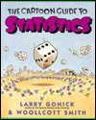
Gary Ramseyer’s Gallery of Statistical Humor
# 28 Did you hear about the statistician who went out on a limb to obtain a nested design?
#45 One day there was a fire in a wastebasket in the Dean's office and in rushed a physicist, a chemist, and a statistician . . .
Notes:
One day there was a fire in a wastebasket in the Dean's office and in rushed a physicist, a chemist, and a statistician. The physicist immediately starts to work on how much energy would have to be removed from the fire to stop the combustion. The chemist works on which reagent would have to be added to the fire to prevent oxidation. While they are doing this, the statistician is setting fires to all the other wastebaskets in the office.
"What are you doing?" they demanded. "Well to solve the problem, obviously you need a large sample size" the statistician replies.

Slide 37
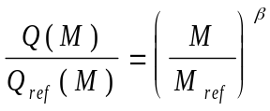


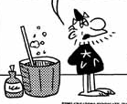
Model based Statistics in Science
That’s all very nice, but . . .
I don’t have time and it’s Greek to me . . .

Slide 38
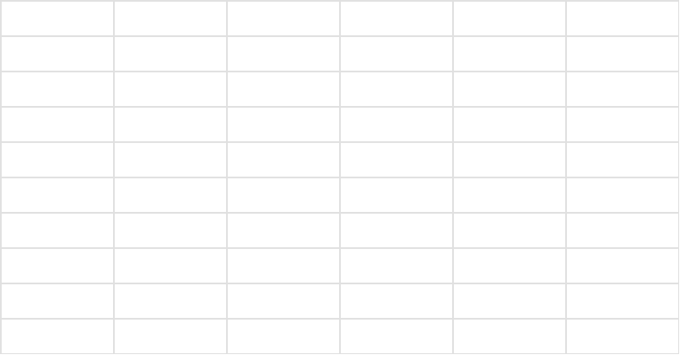
Statistical Science. And the good news is . . .
 | Excel | Mtab | SAS | SPSS | Systat | Splus | Rstudio
Spreadsheet visible | ✓ | ✓ | No | ✓ | ✓ | ✓ | No
Pull down menus | ✓ | ✓ | No | ✓ | ✓ | ✓ | No
Basic stat functions | ✓ | ✓ | ✓ | ✓ | ✓ | ✓ | ✓
Data in random order | No | ✓ | ✓ | ✓ | ? | ? | ✓
General Linear Model | ?? | ✓ | ✓ | ✓ | ✓ | ✓ | ✓
Residual display | No | ✓ | ✓ | ✓ | ✓ | ✓ | ✓
Logistic regression | ? | ✓ | ✓ | ✓ | ✓ | ✓ | ✓
Generalized Linear Model | No | No | ✓ | ✓ | ✓ | ✓ | ✓

Slide 39
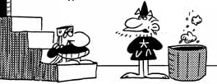
Statistical Science
They are easy in one of these packages.
They can be taught at the 2nd year level in University.
It’s better than looking up some test.
It’s quicker than looking up some test.
Then I decree that all must take this course !

Slide 40
Statistical Science
Then I decree that all must take this course !
Let’s not get carried away….

Slide 41
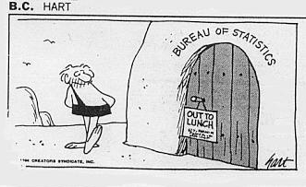
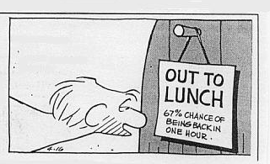
Statistical Science

