Slide 1

Implementing E2R Guidelines on Images Using Multimodal Deep Learning
David Cano Rosillo
Ontology Engineering Group
Universidad Politécnica de Madrid, Spain
Dr. Mª del Carmen Suárez de Figueroa Baonza
david.cano.rosillo@alumnos.upm.es
31 March 2023
H-1003
Notes:
Cambiar la licencia por la que aplique.

Slide 2


A pair of words from my CV
David Cano Rosillo
Third Grade Student on Computer Engineering at Universidad Politécnica de Madrid (UPM)
Ongoing Collaboration grant at OEG under Dr. Mª del Carmen Suárez de Figueroa Baonza (UPM)
This work is under the investigation line
Applying Artificial Intelligence (AI) techniques to achieve Cognitive Accessibility

Slide 3
Table of Contents
Context on E2R methodology
E2R image guidelines implemented on this work
Multimodal Embeddings
BLIP2
Image Captioning
Calculating Explicitness
Image Classification
Web and API implementation
Future research and criticism

Slide 4

Introduction: The Easy-to-Read Methodology
The Easy-to-Read Methodology (IFLA, 2010) is the result of a social need
The Easy-to-Read Methodology has the general goal of ending the discrimination of people with intellectual disabilities
The Easy-to-Read Methodology helps to guarantee the exercise of rights included in the UN Convention on the Rights of Persons with Disabilities
This convention emphasizes that the access to information in Plain or Easy-to-Read Language is a matter of democracy and inclusion
4

Slide 5
State of the Art: Easy-To-Read Methodology
The main goal of having materials that are easy-to-read is to present clear and easily understood contents
The Easy-To-Read methodology aims to have understandable content and accessible information for people with learning difficulties
Persons with a disability
They have a permanent need for easy-to-read products
Readers with limited language or reading proficiency
They may find this kind of material useful, for a period of time
5

Slide 6
State of the Art: Easy-To-Read Methodology
The E2R Methodology provides guidelines, requirements, and recommendations for different aspects of a document
Writing of texts
Supporting images
Design
Layout of documents
Final editing format
6

Slide 7

E2R image guidelines implemented on this work
”Title images”
“Images should refer text explicitly and with a clear link“
”Avoid diagrams, statistical graphs and technical tables.”
Automating / detecting them would help create more E2R documents.
Oscar García Muñoz. Lectura fácil: Métodos de redacción y evaluación. (2012)

Slide 8
Proposed solutions
1. Title images
→ Generate Descriptions Automatically
2. Images should refer text explicitly and with a clear link
→ Explicitness Threshold
3. Avoid diagrams, statistical graphs and technical tables.
→ Image Classification*
* Detect undesired images for later removal

Slide 9
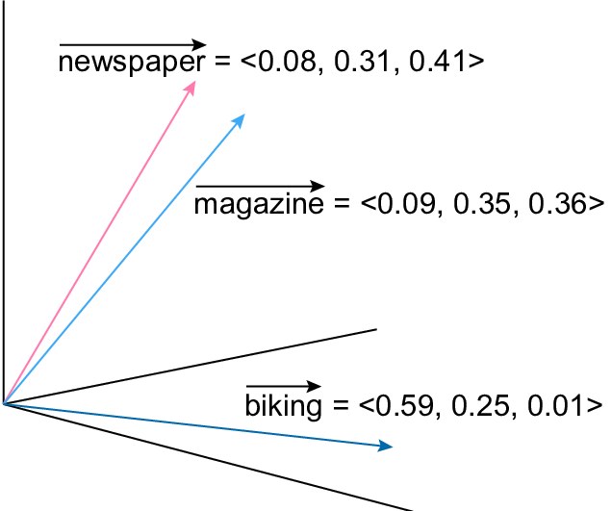
Intro to Embeddings
Learn a function which maps words to n-dimensional vectors.
This function will place semantically close words near in the n-dimensional space.
Embeddings enable models to understand input data in a more meaningful way.

Slide 10
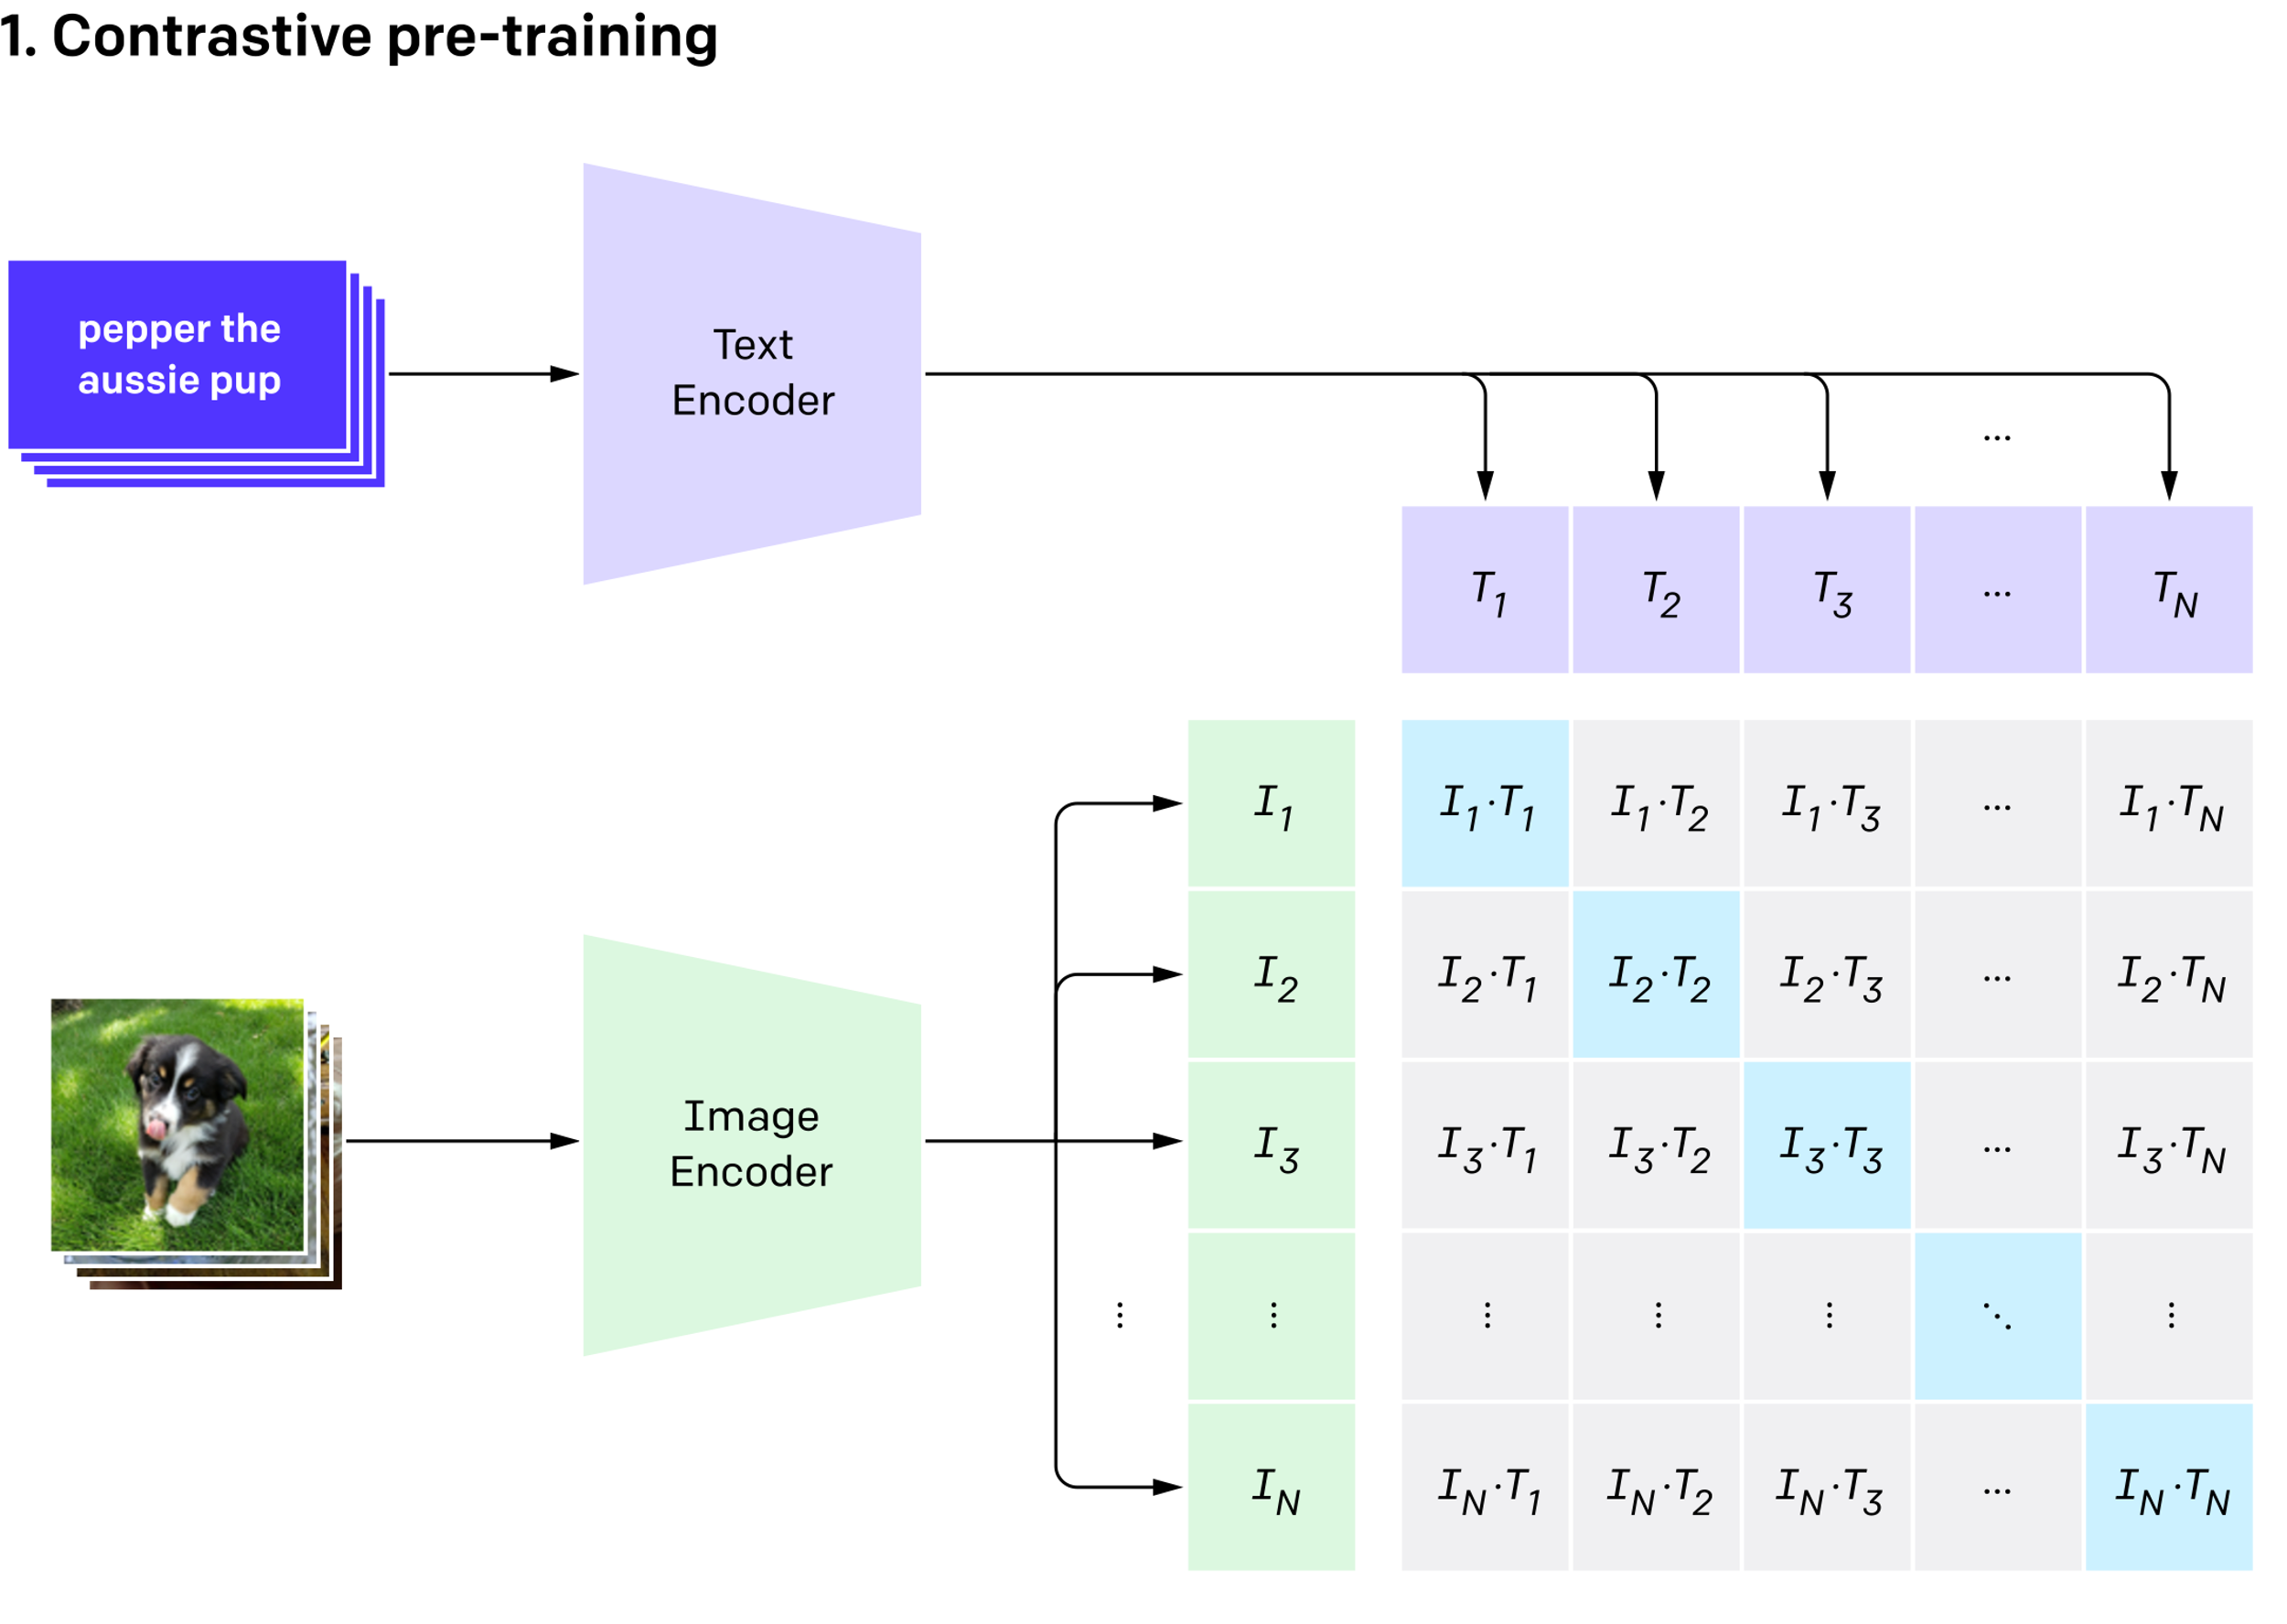
Multimodal Embeddings
CLIP model from OpenAI:
If Image and Text paired
Reduce distance
Else:
Maximize distance
We can use the learned embedding for many tasks:
Generate descriptions
Encoded distance = Semantic Distance

Slide 11
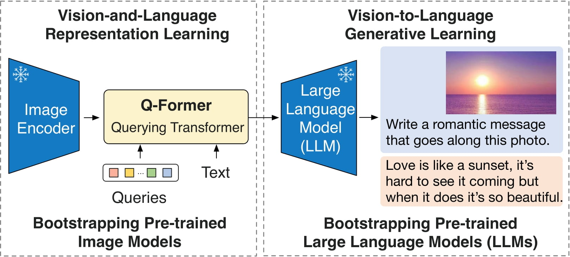
BLIP2 model
Current state of the art
Learns embedding by optimizing for many tasks:
First phase:
1. Max/Min distance
2. Gen. image descriptions
3. Predict if paired
Second phase:
Aid Large Language Model to generate text based on image.

Slide 12
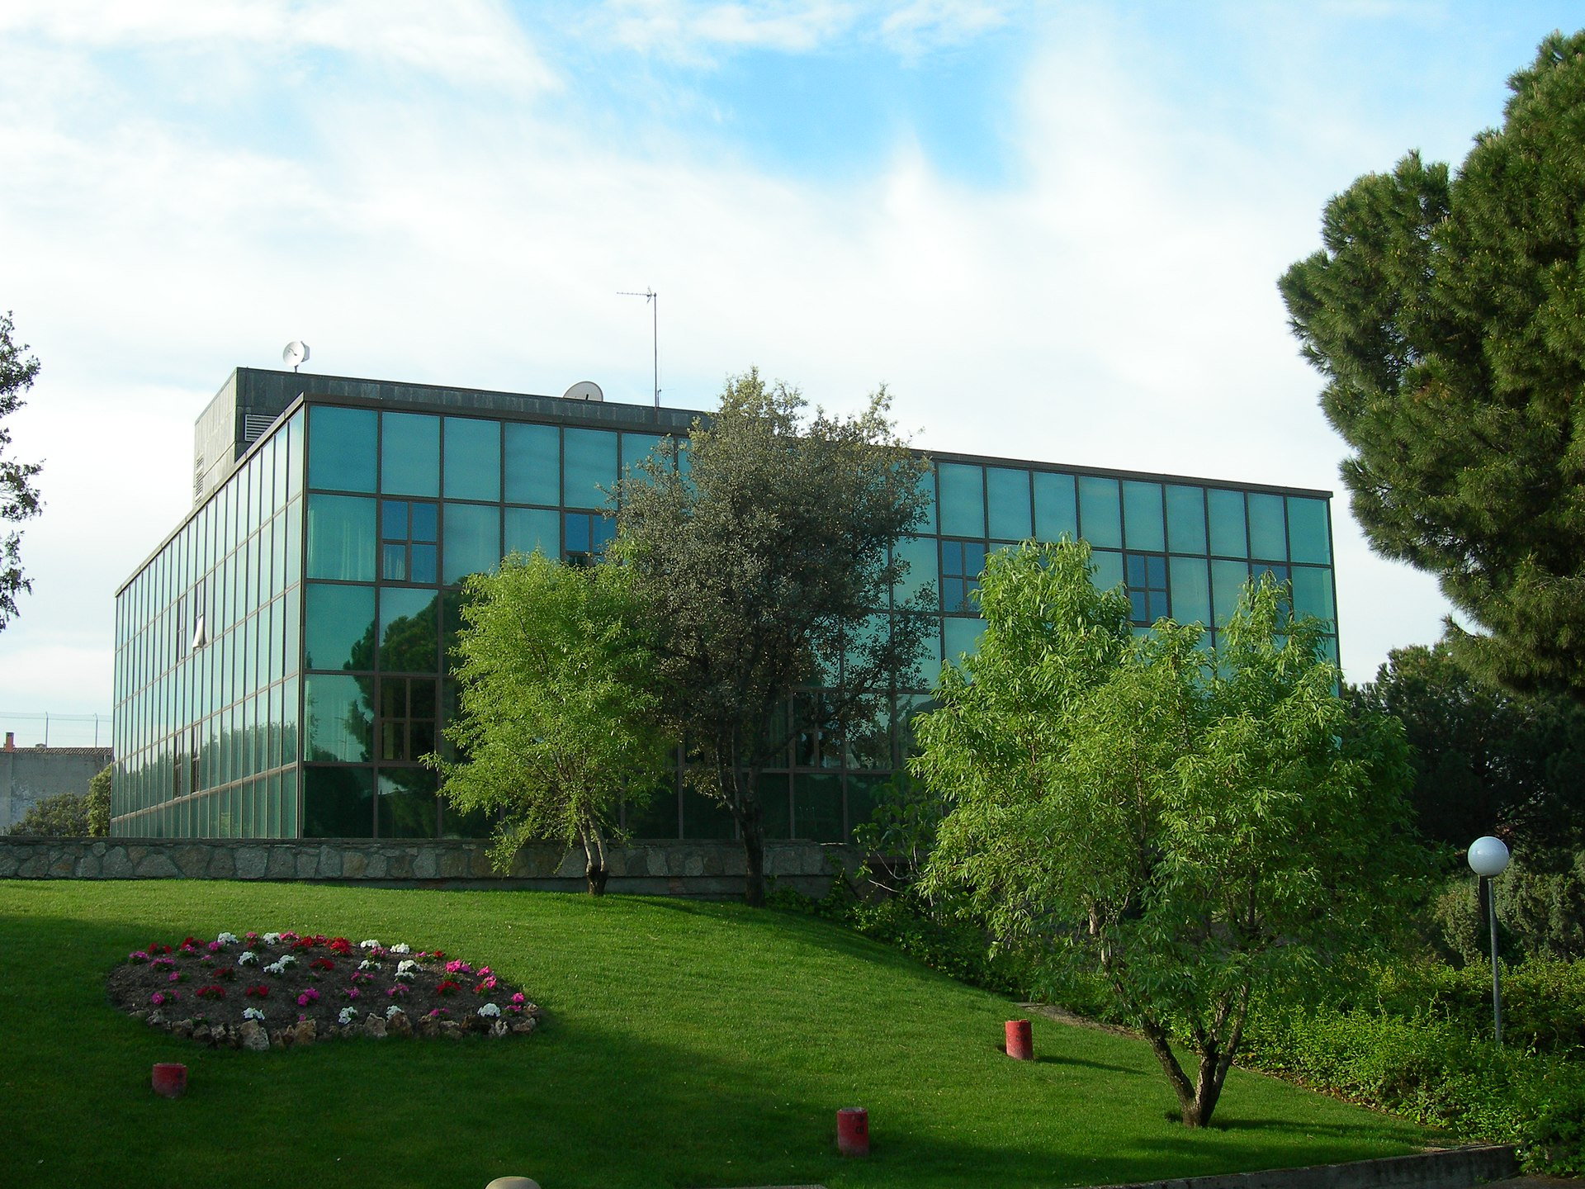
Image captioning
1. Title images
→ Generate Descriptions Automatically
Finetune BLIP2 for image captioning. Given an input image, complete the phrase “a photo of …”
→
” Un gran edificio de cristal sobre un exuberante campo verde”

Slide 13
Calculating Explicitness
2. Images should refer text explicitly and with a clear link
→ Explicitness Threshold
We can frame the problem as:
Find a way to measure ”explicitness” between a text and image.
Calculate a threshold value for “explicit enough”.
On inference:
If image to text ”explicitness” < threshold:
Not following guideline
Else:
Following guideline

Slide 14
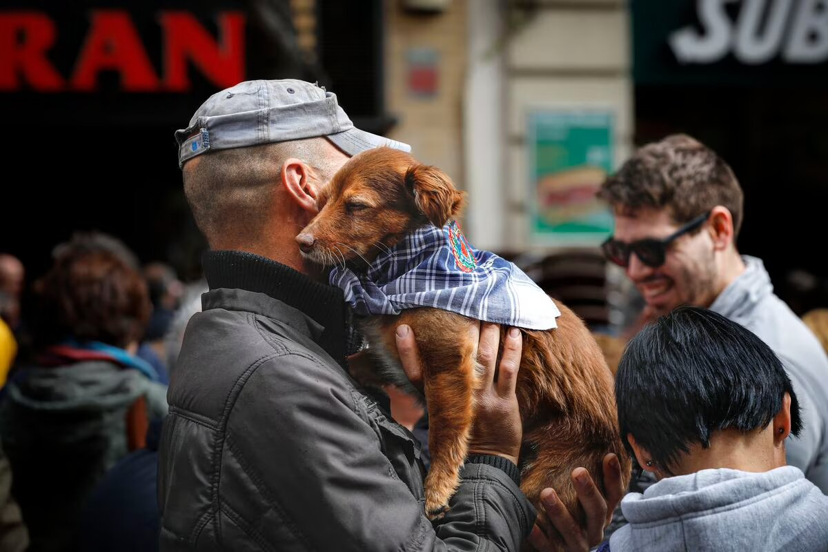
Measuring “explicitness”
Use model that outputs the probability of an image and a caption being paired. This model is BLIP2 based.
Larger texts which reference indirectly are less explicit. When are they explicit enough?
Using 8% as threshold on news dataset classifies unpaired from paired with 87% accuracy.
Caption: Un hombre con un perro pequeño en sus brazos.
→ 90%
News Article: Huck tiene pánico a los petardos. En cuanto oye uno en la calle empieza a temblar, nervioso...
→ 10%

Slide 15
Image Classification
3. Avoid diagrams, statistical graphs and technical tables.
→ Image Classification
Finetune model on Kaggle graph dataset:
Download model with weights pretrained on Imagenet
Replace last layer so it predicts between 8 classes instead of 1000
Train with low learning rate to mitigate ”Catastrophic Forgetting”
Save model with 93% accuracy

Slide 16
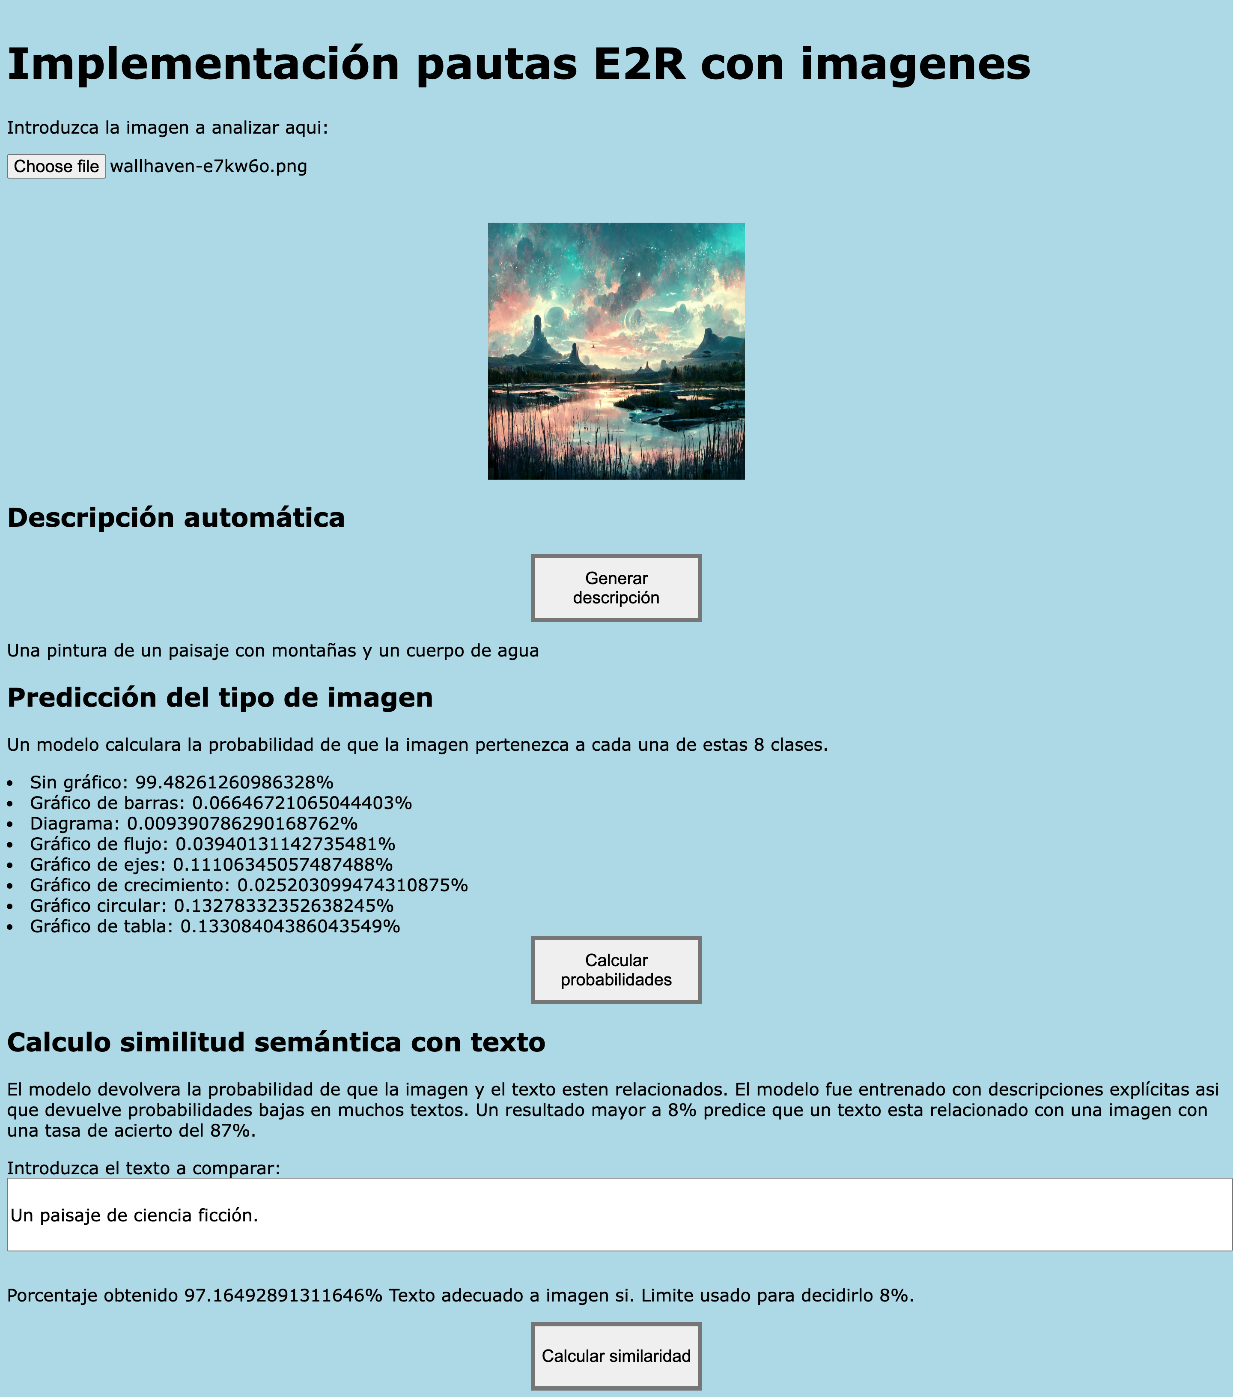
Web and API developed
Usable API and web demo thanks to OEG domain and server.
The following image is a screenshot of the frontend.

Slide 17
Future research and criticism
Generated captions are only based on images. Adding the paired text as input would help generate more relevant descriptions.
From our experiments, the average explicitness between news and images is 8%. Should our E2R texts be more explicit than news?
Multimodal deep learning has gained a lot of attention since GPT4 release. Better models will come along the way.

Slide 18
Implementing E2R Guidelines on Images Using Multimodal Deep Learning
David Cano Rosillo
Ontology Engineering Group
Universidad Politécnica de Madrid, Spain
Dr. Mª del Carmen Suárez de Figueroa Baonza
david.cano.rosillo@alumnos.upm.es
31 March 2023
H-1003
Notes:
Cambiar la licencia por la que aplique.

