Slide 1
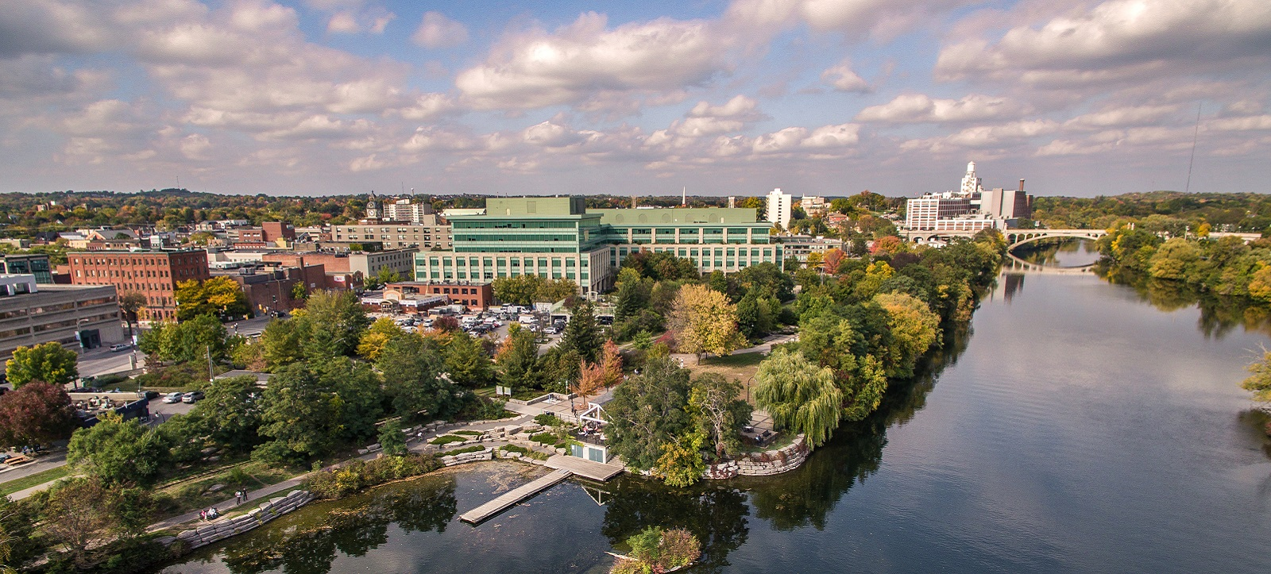
THE ECONOMIC STATE OF PETERBOROUGH
Presented by: Dante Christopher-Alphonso and David Cardenas Ochoa
(Source: Official City of Peterborough Website)

Slide 2

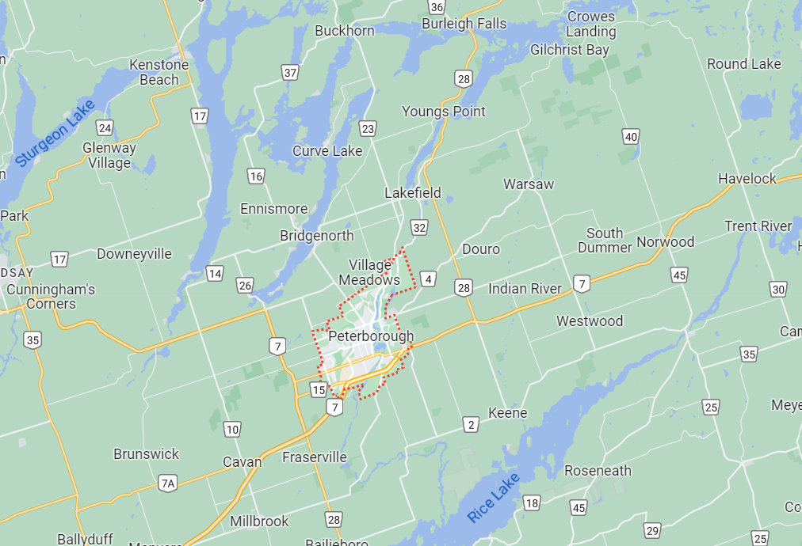
Background – Location and Size
Peterborough is a city located in Southeastern Ontario
Part of the County of Peterborough
It has a population of 83, 651 and a land area 64.76 km² (as of 2021)
Chemong Lake is to the North and Rice Lake is to the South
Otonabee River runs straight through the city
Image captured from Google Maps

Slide 3

Background – Economic focus
-Peterborough's main industrial focus is on Health Care and social assistance, followed by retail trade, and then educational services. (StatsCan 2021).
-Had a GDP of $5,16 million as of 2019.
-Based on overall statistics of the labour force in each industry, Peterborough's primary focus is on the tertiary sector, such as Public Services.

Slide 4
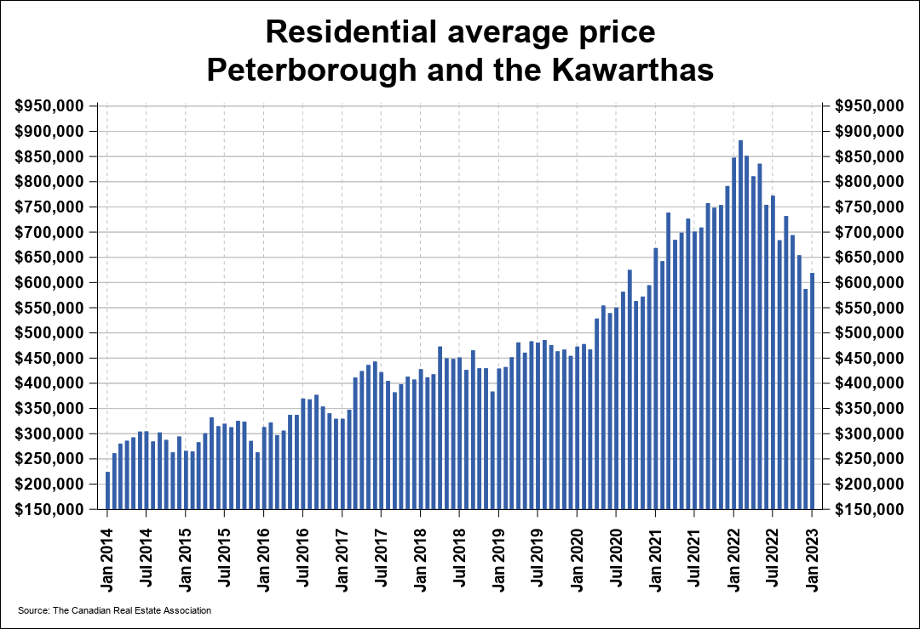
BACKGROUND – HOUSING PRICES
The average price of homes sold in the Peterborough and Kawartha Lakes area was $618,865 as of January 2023.
Highest prices were in January 2022, but it has decreased since then.
The most common dwelling type is single-detached, which makes up over 50% of dwelling types in the Peterborough subdivision (StatsCan 2021).
Source: The Canadian Real Estate Association

Slide 5

BACKGROUND –Largest employers
1) Peterborough Regional Health Centre: 2,410
2) Kawartha Pine Ridge District School Board: 1,500
3) City of Peterborough: 1,343
4) Trent University: 1,163
5) Ministry of Natural Resources: 1,023

Slide 6
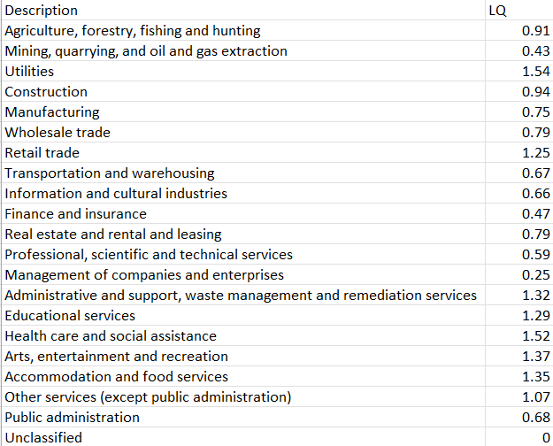
Analysis - Location Quotient
Utilities, Administrative and support, waste management and remediation services, Educational services, Health care and social assistance, Arts, entertainment and recreation, and Accommodation and food services are the industries with the highest concentration.

Slide 7
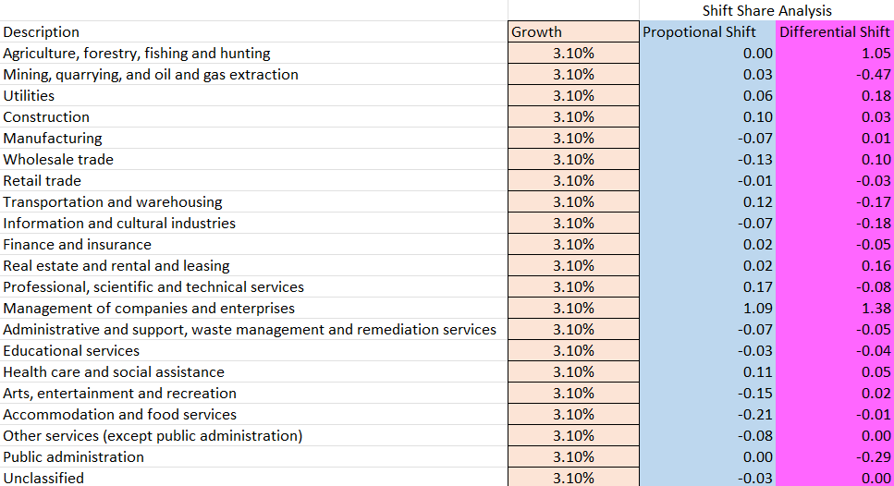
Analysis - Shift-share
Based on the results, Management of companies and enterprises has seen the highest increase in both the proportional shift and differential shift out of all industries in Peterborough.
Transportation and warehousing follow after in terms of growth, with professional, scientific and technical services being third.
Although recently, there has been a massive boost in the Agriculture, forestry, fishing and hunting industry in Peterborough compared to the rest of Ontario.

Slide 8

Analysis – A deeper look
Except for Health care and social assistance, the most concentrated industries in Peterborough (Educational services, Arts, entertainment and recreation) have seen little growth in the last five years compared to the rest of Ontario. Some of the industries, as mentioned above, have seen a decline.
Many of the primary and secondary industries have also shown decline or very little growth in Peterborough.
This Photo by Unknown author is licensed under CC BY-NC.

Slide 9
Analysis – in summary
The strongest industries in Peterborough are the service industries, which would include Educational services, Health care and social assistance, entertainment and recreation, and Accommodation and food services. However, they are declining or have shown little growth locally and provincially. They fall under the "Promising" classification.
Primary industries (Mining, Quarrying, and oil gas extraction) and Secondary industries (Manufacturing, Wholesale Trade, Retail trade) are weak and declining and fall under the bottom-left quadrant in the Cluster Bubble Chart.
The Agriculture, forestry, fishing and hunting and the professional, scientific and technical service industries do not fall under the same trends on the other hand, with the former being shown to be a "Yielding" industry, and the latter being a "Transitional" industry. In other words, they are both average in terms of economic representation but have shown growth at certain levels.

Slide 10
references
“Census Profile, 2021 Census of Population, Profile Table.” Statistics Canada, 1 Feb. 2023, https://www12.statcan.gc.ca/census-recensement/2021/dp-pd/prof/details/page.cfm?Lang=E&SearchText=Peterborough&DGUIDlist=2021A00053515014&GENDERlist=1%2C2%2C3&STATISTIClist=1&HEADERlist=0.
Cleave, Evan "GEO-530 Week 3 Lecture." Toronto Metropolitan University, January 2023.
“Peterborough and the Kawarthas Association of REALTORS® Inc. MLS® Home Sales Surge to Average Levels in January.” Peterborough and the Kawarthas Association of REALTORS® Inc. | CREA Statistics, https://creastats.crea.ca/board/pete.
“Official Plan Update.” City of Peterborough, https://www.peterborough.ca/en/doing-business/official-plan-update.aspx.
Tuffin, Lois. “Who Are the Top Employers in Peterborough in 2018?” MyKawartha.com, 29 Mar. 2018, https://www.mykawartha.com/news-story/8325311-who-are-the-top-employers-in-peterborough-in-2018-/.

