Slide 1
Geospatial Toronto Police Facilities Database
David Cardenas Ochoa

Slide 2
Project Overview
Create a geodatabase to analyze relations of where police stations are located
Answer spatial questions through SQL Server
Create an effective ER Diagram in the process
Create an effective Data Dictionary in the process

Slide 3
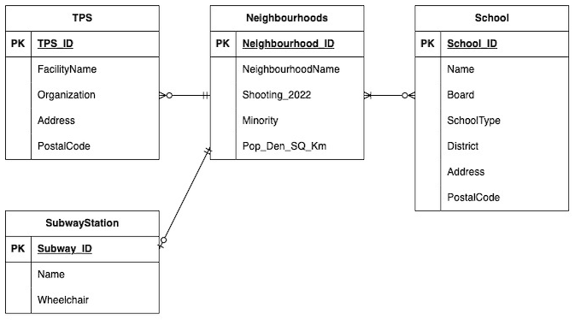
ER Diagram

Slide 4
Data Dictionary
Column Name | Data Type (Length) | Key | Null Status | Default Value | Remark | Description
TPS_ID | Smallint | Primary Key | Not Null | None |  | Unique identifier for each TPS facility
FacilityName | nvarchar(55) | No | Not Null | None |  | The name of the facility
Organization | nvarchar(23) | No | Not Null | None |  | What organization the facility belongs to
Address | nvarchar(25) | No | Not Null | None |  | Address of the TPS facility
PostalCode | nvarchar(7) | No | Not Null | None | Format: A#A #A# | The postal code of the TPS facility
LATITUDE | numeric(23,15) | No | Not Null | None |  | The latitude coordinates of the TPS facility
LONGITUDE | numeric(23,15) | No | Not Null | None |  | The longitude coordinates of the TPS facility
Shape | Geometry | No | Not Null | None |  | Geometry file of the TPS facilities
TPS (TPS_ID, FacilityName, Organization, Address, PostalCode, LATITUDE, LONGITUDE, Shape)
TPS is the location of existing Toronto Police Services facilities

Slide 5
Data Dictionary
Column Name | Data Type (Length) | Key | Null Status | Default Value | Remark | Description
Neighbourhood_ ID | numeric(38,8) | Primary Key | Not Null | None |  | Unique identifier for each neighbourhood
NeighbourhoodsName | nvarchar(80) | No | Not Null | None |  | The name for neighbourhoods
Shooting_2022 | numeric(38,8) | No | Not Null | None |  | Shooting count in a neighbourhood in the year 2022
Minority | numeric(38,8) | No | Not Null | None |  | Minority population per neighbourhood
Pop_Den_SQ_ Km | numeric(38,8) | No | Not Null | None |  | Population density per kilometer square
Shape | geometry | No | Not Null | None |  | Geometry file of the neighbourhoods
NEIGHBOURHOODS (Neighbourhood_ID, NeighbourhoodsName, Shooting_2022, Minority, Pop_Den_SQ_Km, Shape)
Neighbourhoods is a geographic boundary that can be any area within the City of Toronto

Slide 6
Data Dictionary
Column Name | Data Type (Length) | Key | Null Status | Default Value | Remark | Description
School_ID | numeric(18,0) | Primary Key | Not Null | None |  | Unique identifier for each school
Name | nvarchar(80) | No | Not Null | None |  | The name of each school
Board | nvarchar(80) | No | Null | None |  | The district school board the school belongs to
SchoolType | nvarchar(80) | No | Not Null | None |  | The type of school
Address | nvarchar(80) | No | Not Null | None |  | The address of the school
PostalCode | nvarchar(80) | No | Not Null | None | Format: A#A#A# | The postal code of the school
District | nvarchar(80) | No | Not Null | None |  | The inner suburb that the school belongs to
Shape | geometry | No | Not Null | None |  | Geometry file of the school’s location
SCHOOLS (School_ID, Name, Board, SchoolType, Address, PostalCode, District, Shape)
Schools is the location of existing schools in the City of Toronto

Slide 7
Data Dictionary
Column Name | Data Type (Length) | Key | Null Status | Default Value | Remark | Description
Subway_ID | numeric(38,8) | Primary Key | Not Null | None |  | Unique identifier for each subway station
Wheelchair | nvarchar(20) | No | Not Null | None |  | If the subway station is wheelchair accessible
Name | nvarchar(254) | No | Not Null | None |  | Name of the subway station
Shape | geometry | No | Not Null | None |  | Geometry file of the subway station
SUBWAY (Subway_ID, Wheelchair, Name, Shape)
Subway is the location of existing subway stations in the City of Toronto

Slide 8
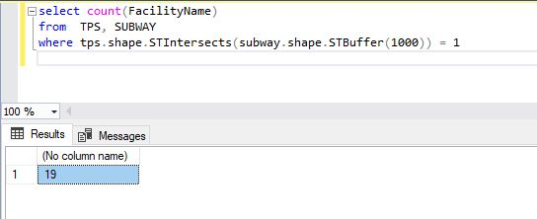
Query 1
How many TPS facilities are within a 1km buffer to a subway station for quick response time?

Slide 9
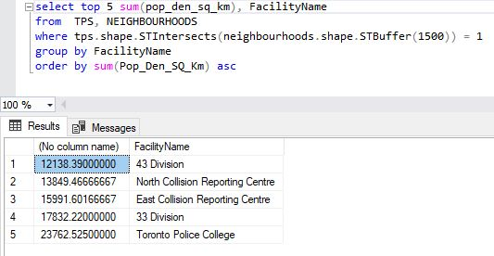
Query 2
Which 5 TPS facilities have the least population density within a 1.5km buffer?

Slide 10
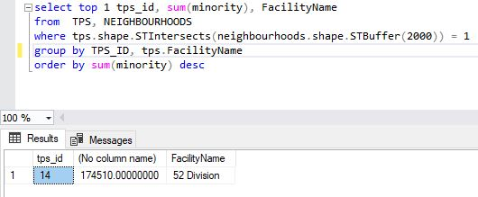
Query 3
Which TPS facility has the highest count of visible minorities within a 2km buffer?

Slide 11
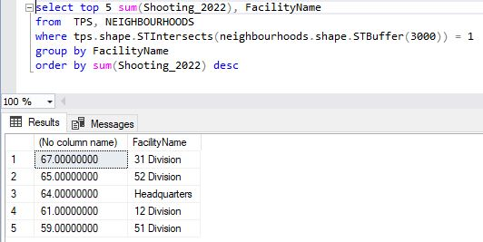
Query 4
What are the top 5 TPS facilities with the highest shooting count in 2022 within a 3km buffer?

Slide 12
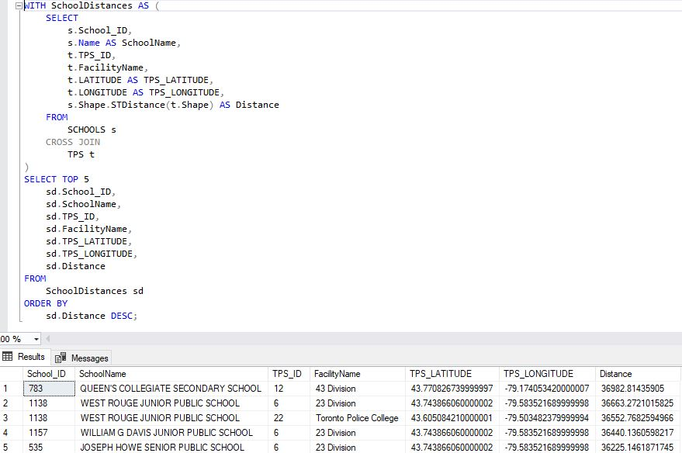
Query 5
Which five schools are the furthest away from a TPS Facility?

