Slide 1
Capstone Final Project
Schools and their environment

Slide 2
Schools and enviroment
Based on a dataset(geojson)of the locations of the schools on my city (Bogotá, Colombia) I decided to cross that information with the foursquare data to know if there are some venues preeminent over others.
Thanks to foursquare we were able to generate a list of venues from the location (coordinates) of the schools
With cluster we can see if there is some relation of the near venues with the school location.
It will be a nice complement crossing the data with the official test of Colombia (Pruebas Saber 11)

Slide 3
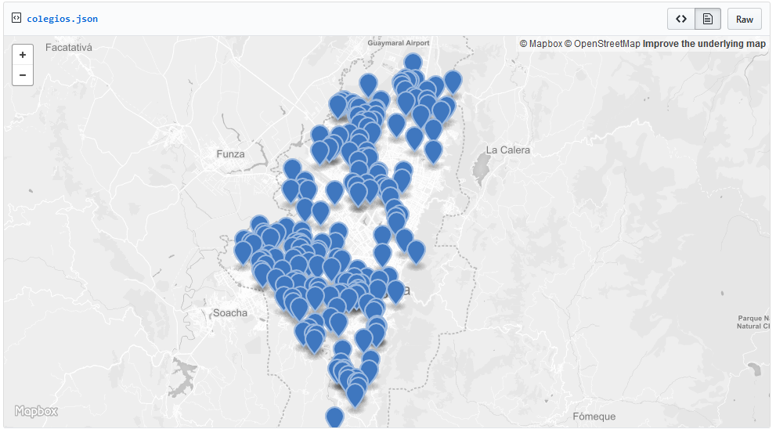
Data

Slide 4
Method
Transpose the GEOJSON to a new pandas data frame
Correlate the coordinates with the information retrieved from foursquare
Visualize the 10 most common venues
Plot in a map
Cluster the schools looking for correlation

Slide 5
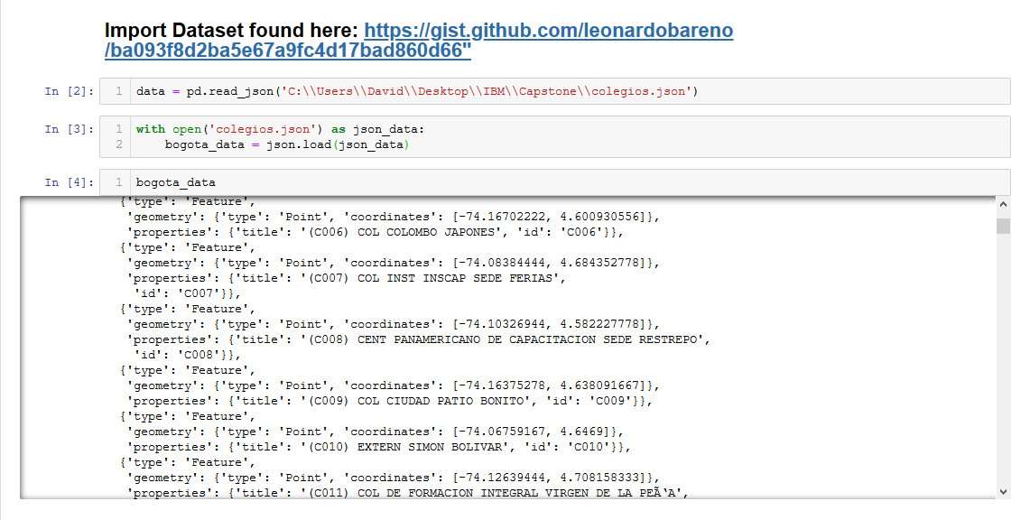

Slide 6
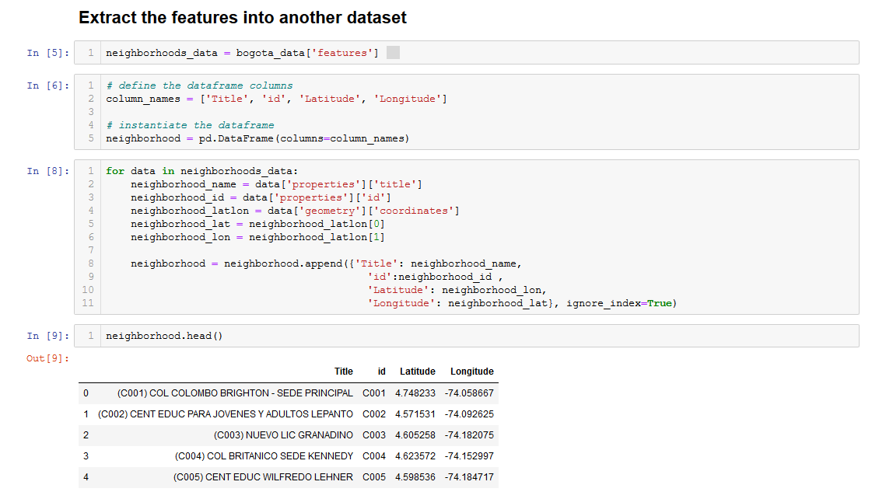

Slide 7
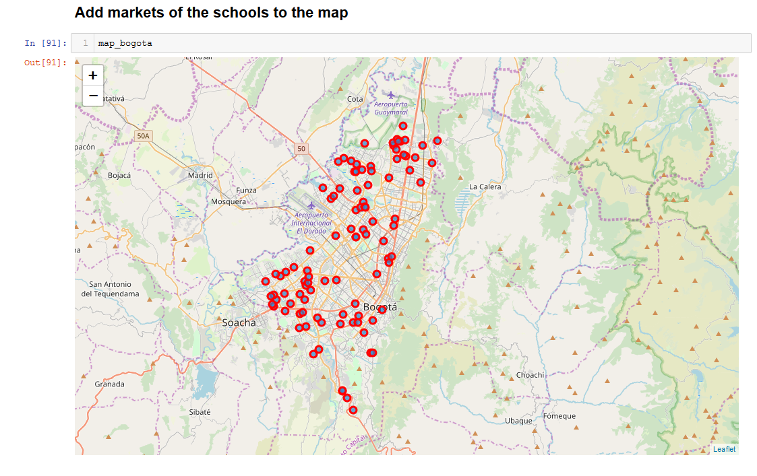

Slide 8
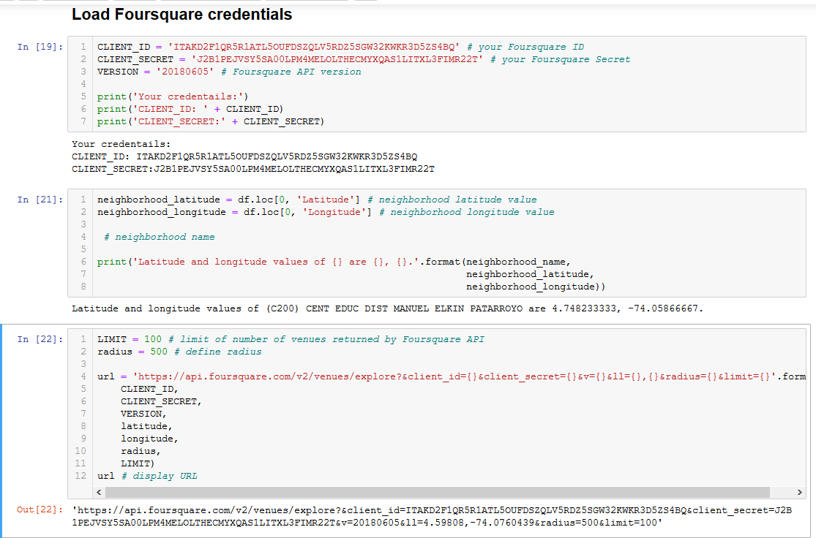
Foursquare Data

Slide 9
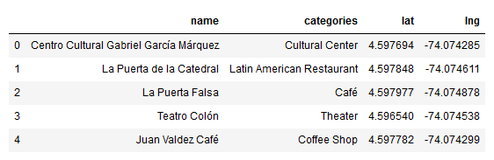
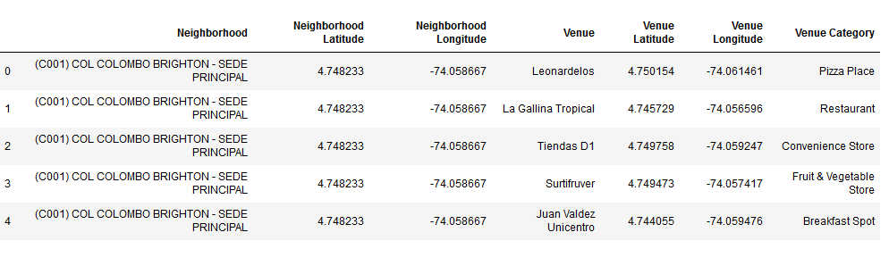
Retrieve results from foursquare

Slide 10
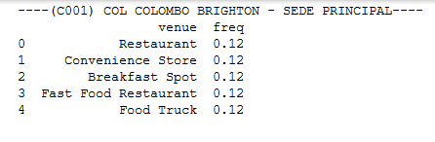
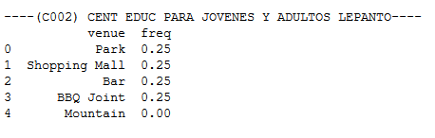
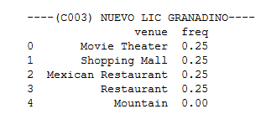
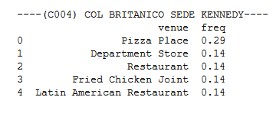
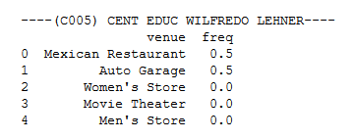
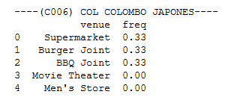
Locate Near Venues and sort

Slide 11
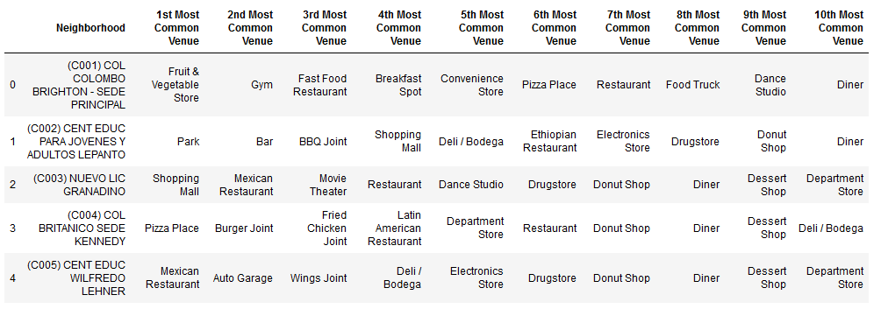

Slide 12
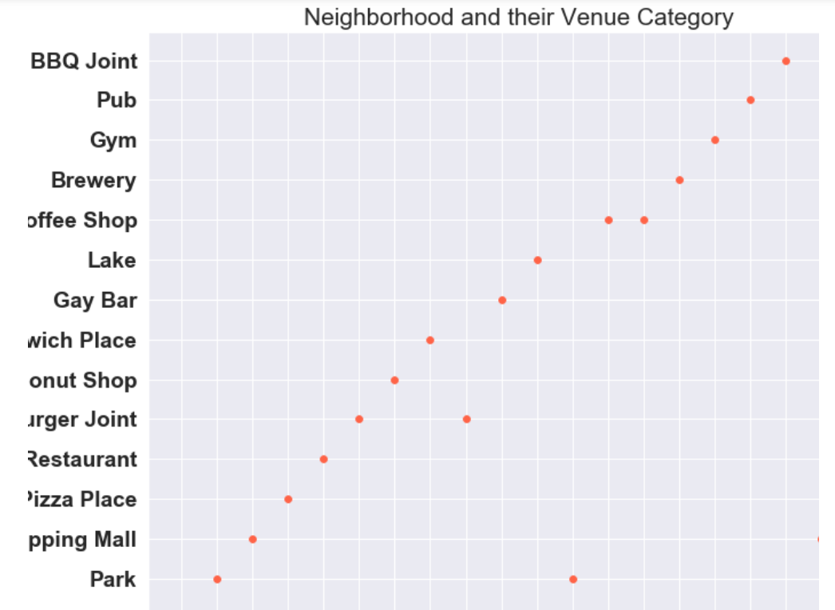
Visualize first 20 Schools

Slide 13
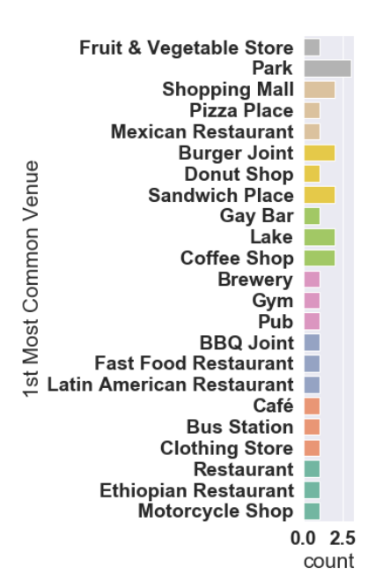
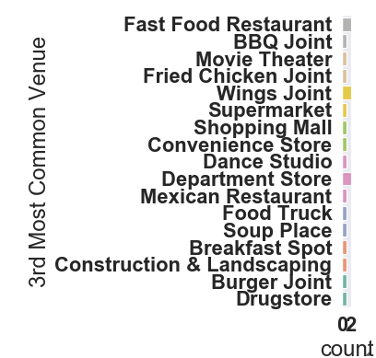
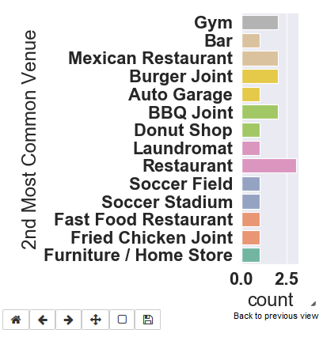

Slide 14
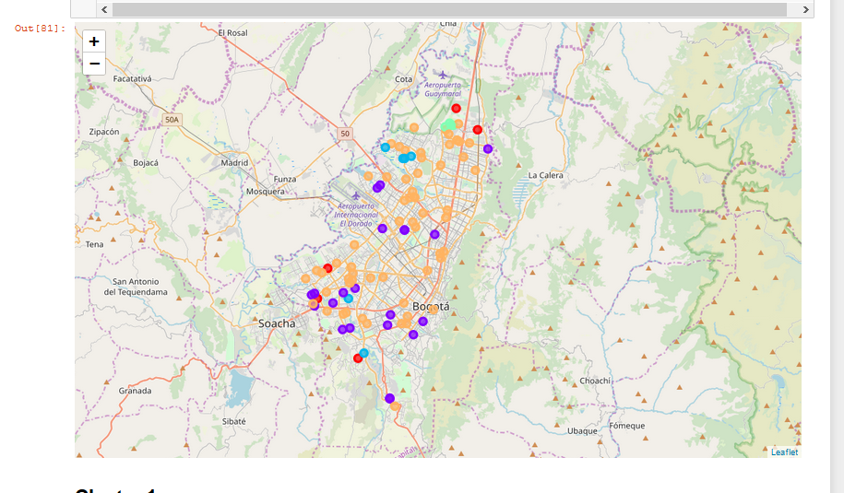
Cluster Organization

Slide 15
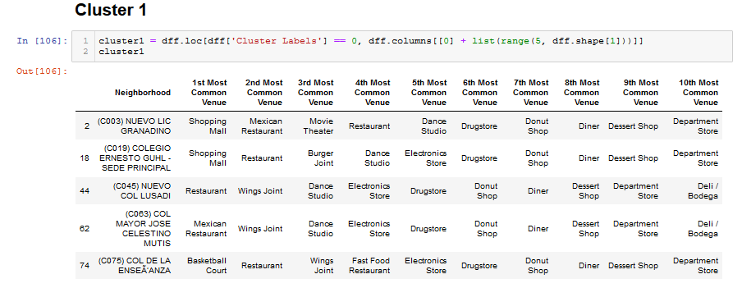
Cluster Distribution

Slide 16
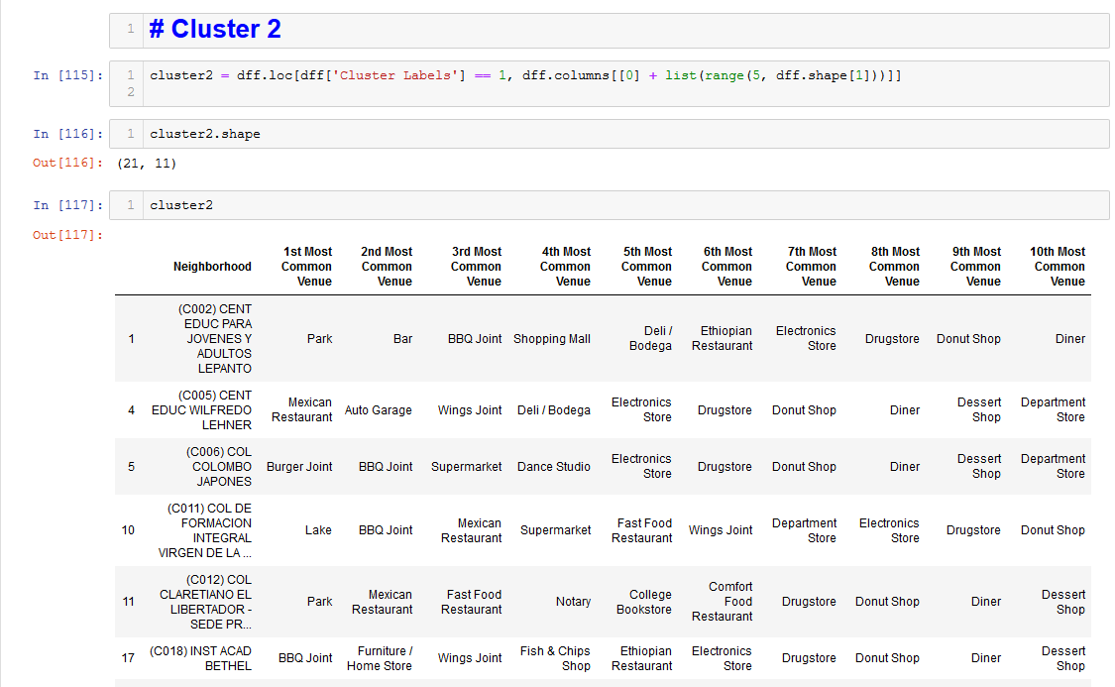

Slide 17
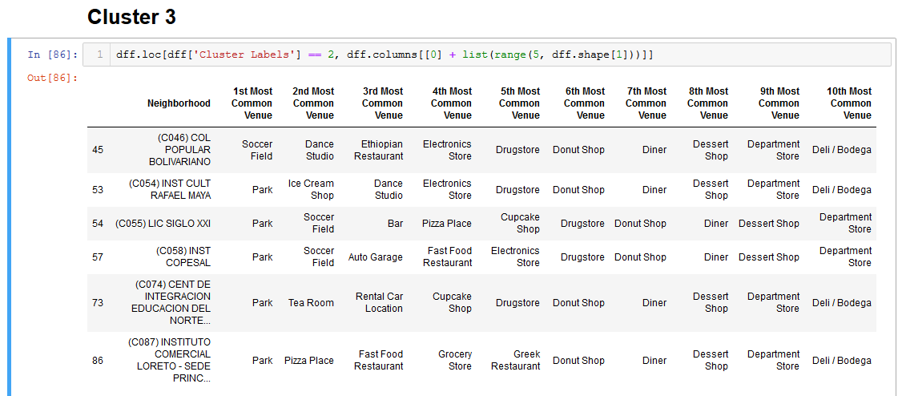

Slide 18
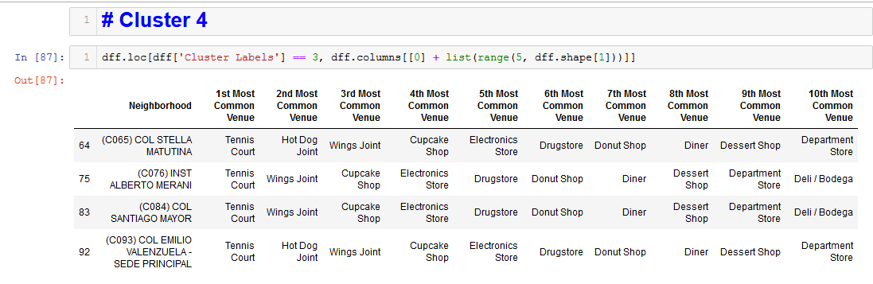

Slide 19
