Slide 1

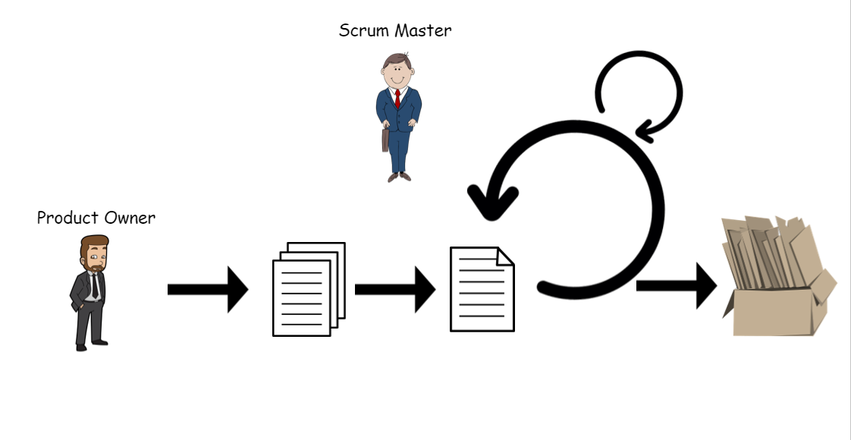






Developers - team
Sprint review
Demonstrating what the team accomplished during the sprint.
Inputs from executives, costumers, users, stakeholders
Stand up review
Scrum master
…. Week Sprint
Product Increment
(Finished Work)
Sprint planing meeting
(Goal, Scope, Selecting stories)
Product owner
product
backlog
(Ranked list of
what is required)
sprint backlog
(Selected stories to complete during the Sprint)
Scrum retrospective
What went well?
What went wrong?
Improvement Areas?

