Slide 1
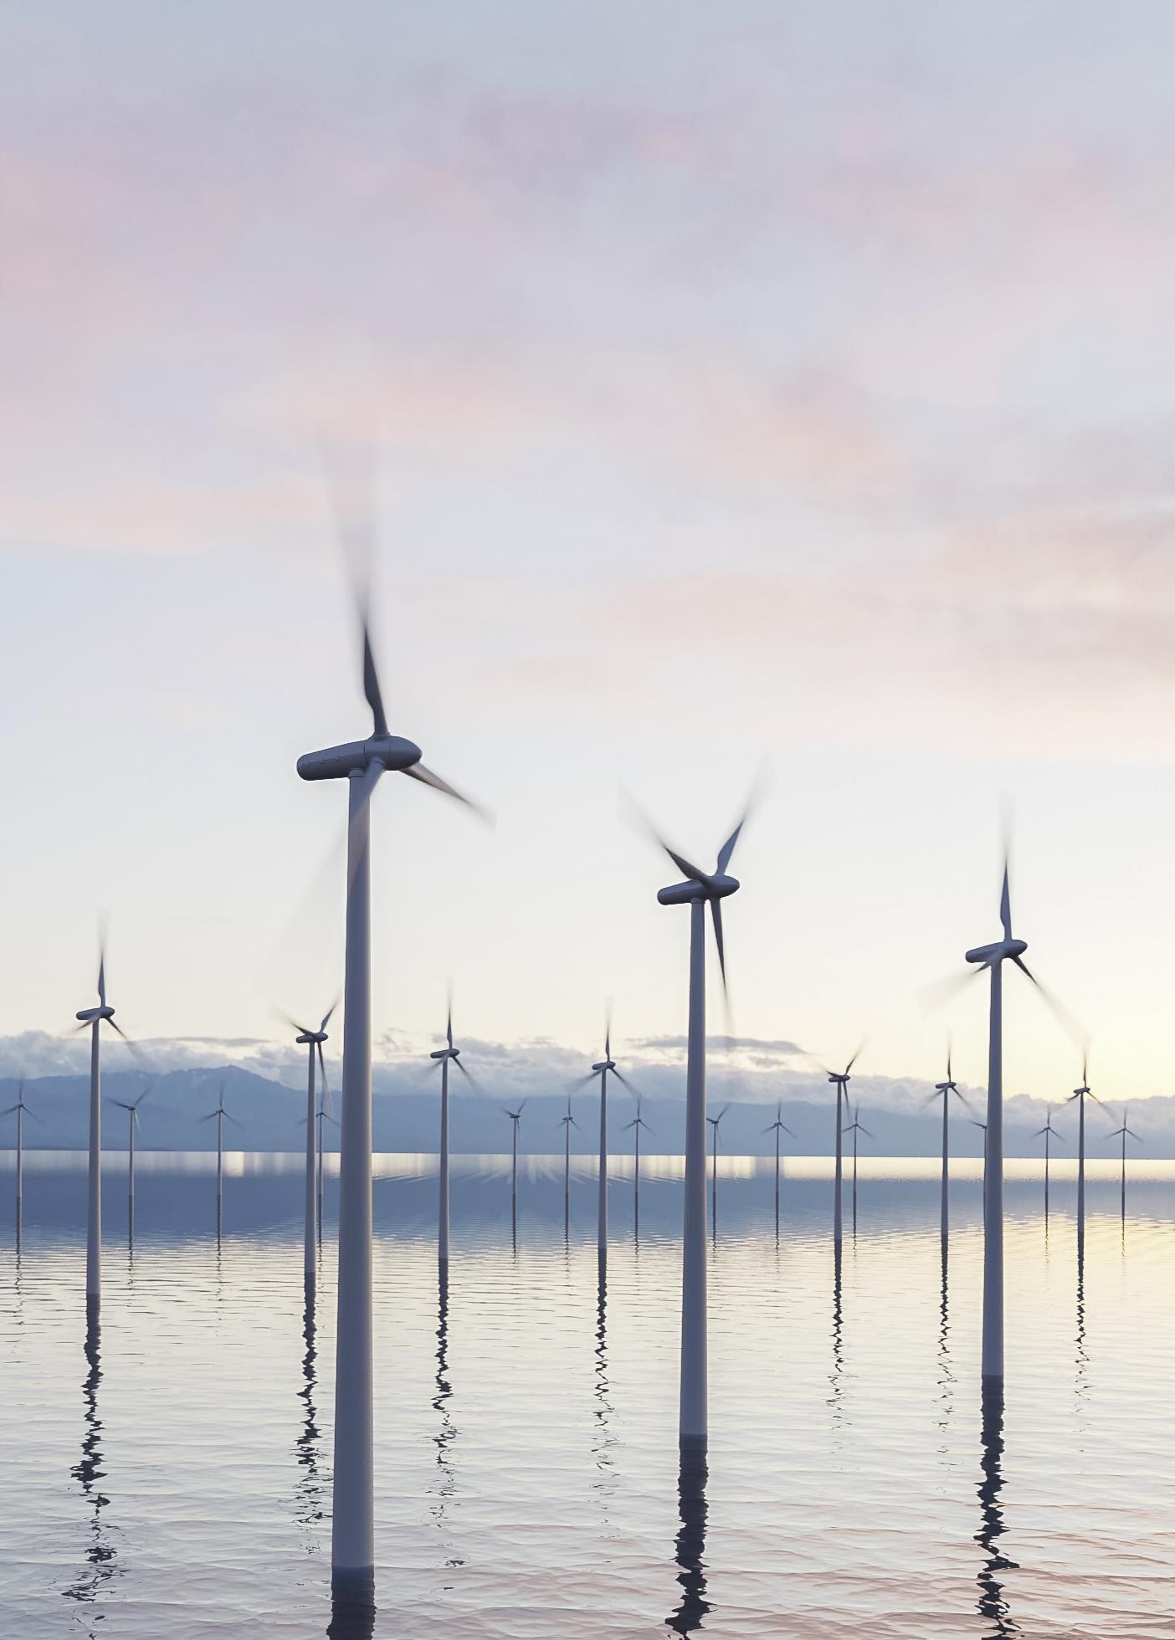
Title slide + image
LiDAR Enhanced Closed-Loop Active Wake Mixing Control
Zekai (David) Chen

Slide 2
Agenda
Create/edit a Hyperlink TO A SLIDE
1
Go to the tab ‘Insert’ and click on the button ‘Shapes’. Choose the shape ‘Rectangle’ and drag the mouse over the slide to create a shape.
Shapes
2
Drag the shape over the menu button and scale the shape as large as the button. Click with the right mouse button on the shape and choose ‘Edit shape’.
Size and position…
Edit shape…
3
Click on the paint bucket icon, click on ‘Shape Fill’ and drag the ‘Transparency’ slider to 100%. Now the shape is completely transparent.
01
02
03
04
05
Background & Introduction
Research Question
System Design
Experiment Validation
Conclusion & Future Work
Transparency
100%
4
Click on the transparent shape and use the shortcut Ctrl + K to add a hyperlink. At the left side of the window, click on ‘Place in this document’ and select the preferred slide in the list. Then click on ‘OK’.
5
Copy the transparent shape and repeat step 4. Do this for all menu buttons.
Want to know more? Go to the tab 'SLIDEBUILDER’ and click on the button ‘Inspiration'
Inspiration

Slide 3
Chapter | dark mode
01
Background & Introduction
Subtitle

Slide 4
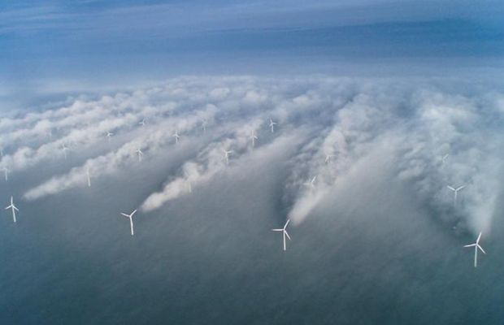
Wake Effect
Near-wake region:
Reduced wind speed
Increased turbulence intensity
Less power production
Increased structural loads
Notes:
The wake result in reduced wind speed and increased turbulence intensity --> power loss and increased structural load

Slide 5
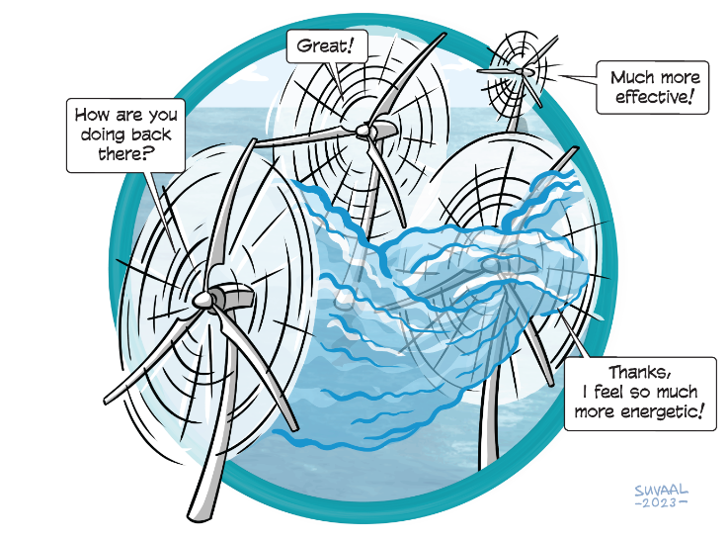
Wind Farm Flow Control
Axial Induction Control
Wake Steering
Wake Mixing

Slide 6
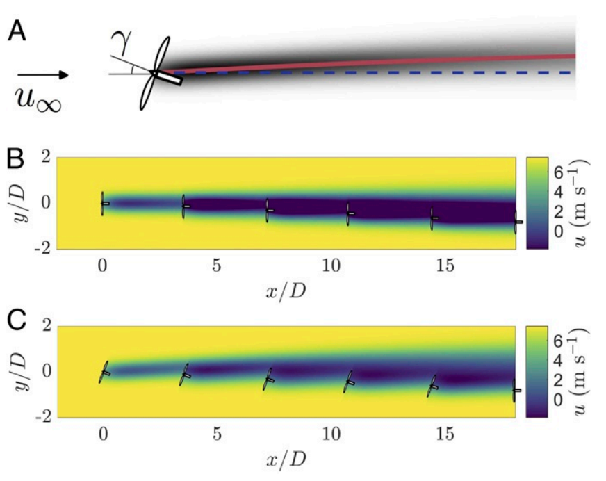
Wake Steering
Howland, Michael F., Sanjiva K. Lele, and John O. Dabiri. "Wind farm power optimization through wake steering." Proceedings of the National Academy of Sciences 116.29 (2019): 14495-14500.

