Slide 1
期末報告
simpledb
A relational database engine built from scratch in C SQL subset · B-Tree indexing · Data persistence
組員: 陳達偉， 孫義廷

Slide 2
Table of contents
Modules
Dependency
Data Structure
Page
Pager
Cursor
B+ Tree
How it works
Demo

Slide 3
Modules
REPL
Read-Eval-Print Loop
Executor
INSERT / SELECT / UPDATE / DELETE
B-Tree
index, search, split / merge
Cursor
B-Tree position pointer
Pager
Memory Page Manager
Row
serialize / deserialize
Catalog
table schema

Slide 4
Dependency
REPL → Executor → B-Tree → Pager → disk

Slide 5
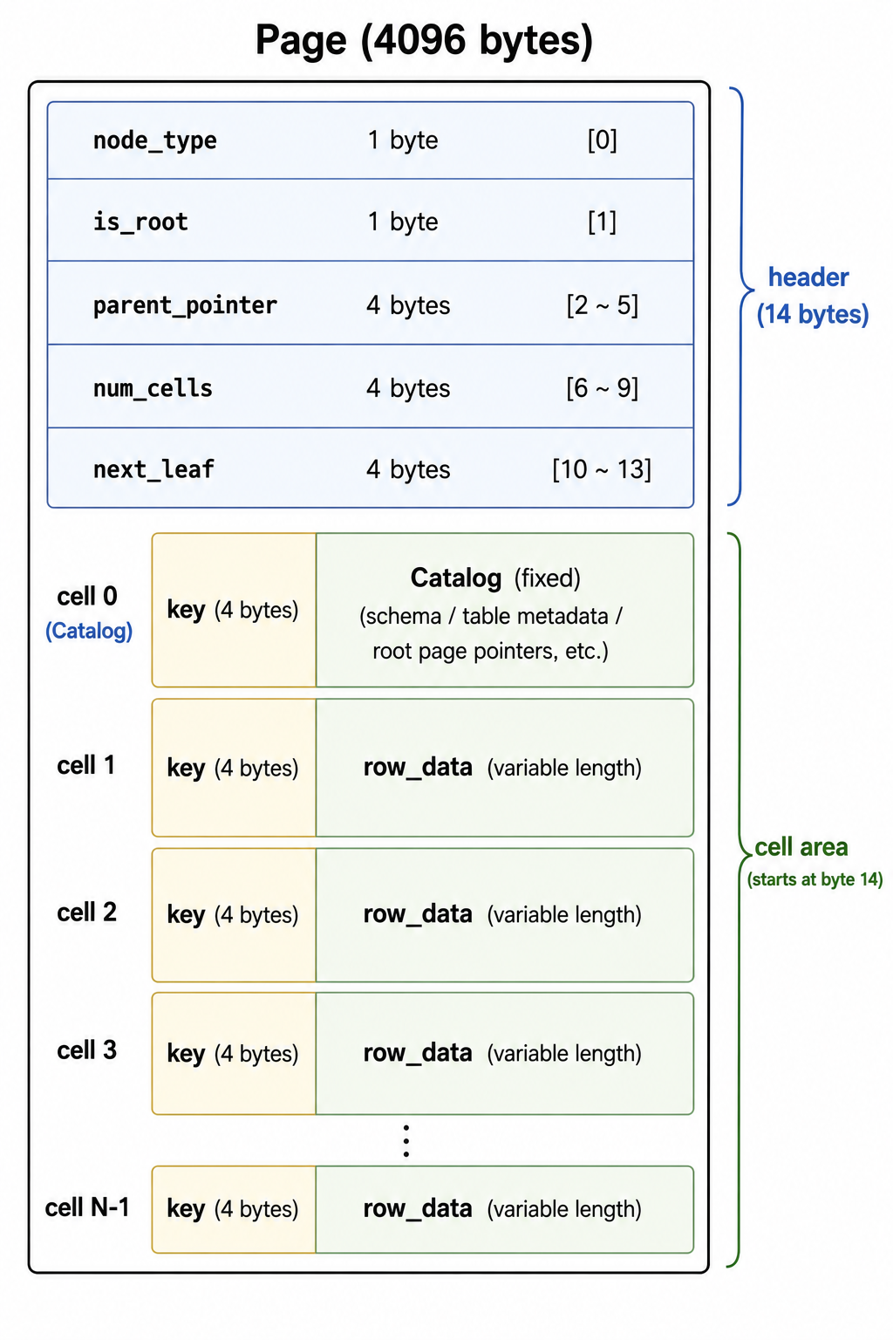
Page
users: id INT(4) + name TEXT(64) + age INT(4) = 72 bytes​ cell_size = key(4) + row(72) = 76 bytes​ max_cells = (4096 - 14) / 76 = 53

Slide 6
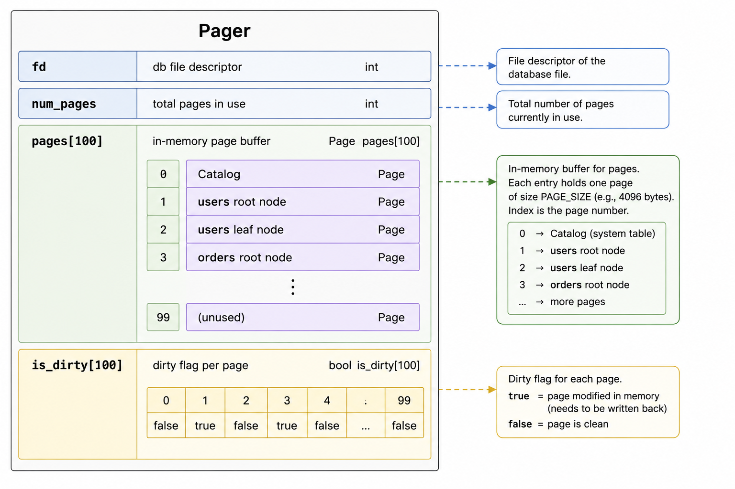
Pager

Slide 7
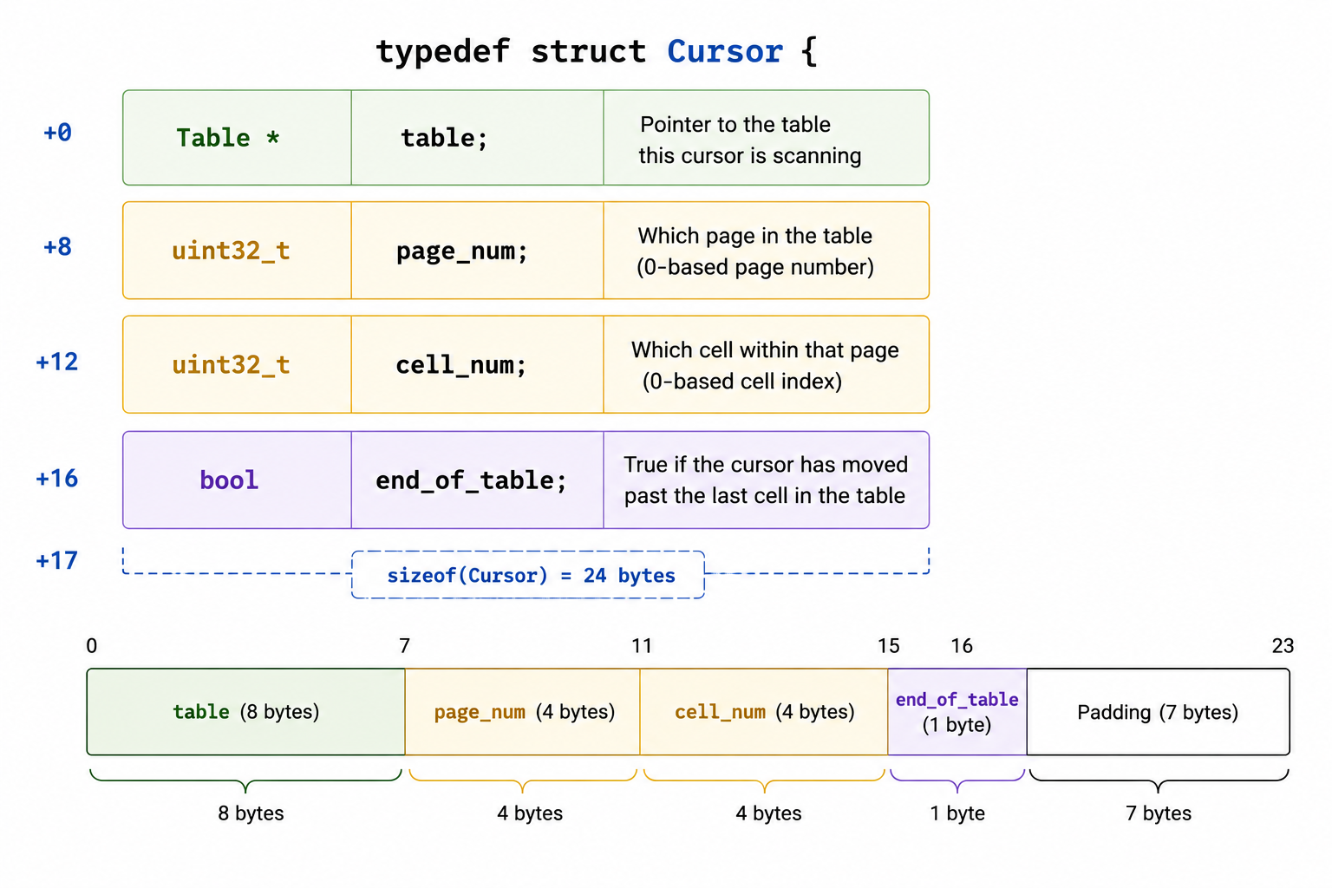
Cursor

Slide 8
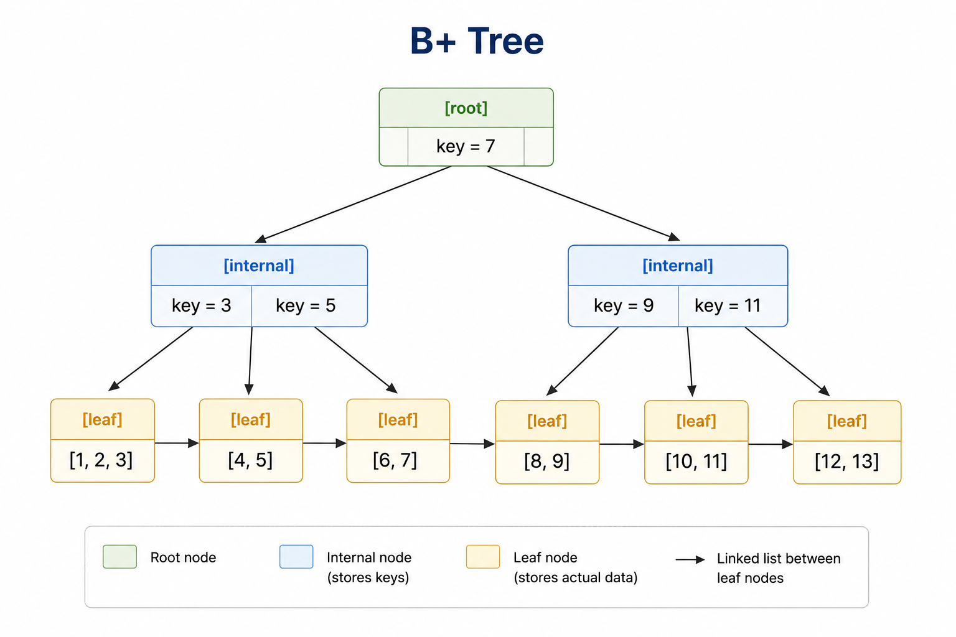
B+ Tree
• internal node — routing key only, decides direction
• leaf node — stores row data, linked list between leaves
• search: O(log n) · full scan: walk leaf linked list

Slide 9
How it works — Insert (1/2)
1. Tokenize input
char *tok = strtok(buf, " \t\r\n"); while (tok && n < MAX_TOKENS) { tokens[n++] = tok; tok = strtok(NULL, " \t\r\n"); }
2. table_open → catalog lookup → malloc Table
Table *table_open(Database *db, const char *name) { const int idx = catalog_find(&db->catalog, name); Table *t = malloc(sizeof(Table)); t->meta = &db->catalog.tables[idx];
}
3. Compute page layout
t->cell_size = LEAF_NODE_KEY_SIZE + t->meta->row_size; t->max_cells = (PAGE_SIZE - LEAF_NODE_HEADER_SIZE) / t->cell_size; t->right_split_count = (t->max_cells + 1) / 2; t->left_split_count = (t->max_cells + 1) - t->right_split_count;

Slide 10
How it works — Insert (2/2)
4. table_find → recursive + binary search → Cursor
// recursive if (get_node_type(child) == NODE_LEAF) return leaf_node_find(table, child_page, key); return internal_node_find(table, child_page, key); // binary search while (lo < hi) { const uint32_t mid = (lo + hi) / 2; const uint32_t k = *leaf_node_key(table, node, mid); if (key < k) hi = mid; else lo = mid + 1; }
5. Shift cells, write at cursor position, update num_cells
for (uint32_t i = num_cells; i > cursor->cell_num; --i) memcpy(leaf_node_cell(table, node, i), leaf_node_cell(table, node, i - 1), cursor->table->cell_size); *leaf_node_num_cells(node) += 1; memcpy(leaf_node_value(table, node, cursor->cell_num), row_data, cursor->table->meta->row_size);
6. Mark dirty, flush on .exit
for (int i = 0; i < MAX_PAGES; ++i) { if (pager->pages[i] && pager->is_dirty[i]) pager_flush(pager, i); }

Slide 11
報告完畢，感謝聆聽！​

