Slide 1
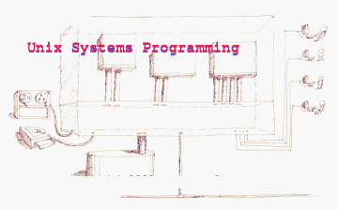

Slide 2
Name of your course
Your Name
Your email or other address

Slide 3
Outline of today's class
Course information
Course content
Introduction to Unix
Examples of topics

Slide 4
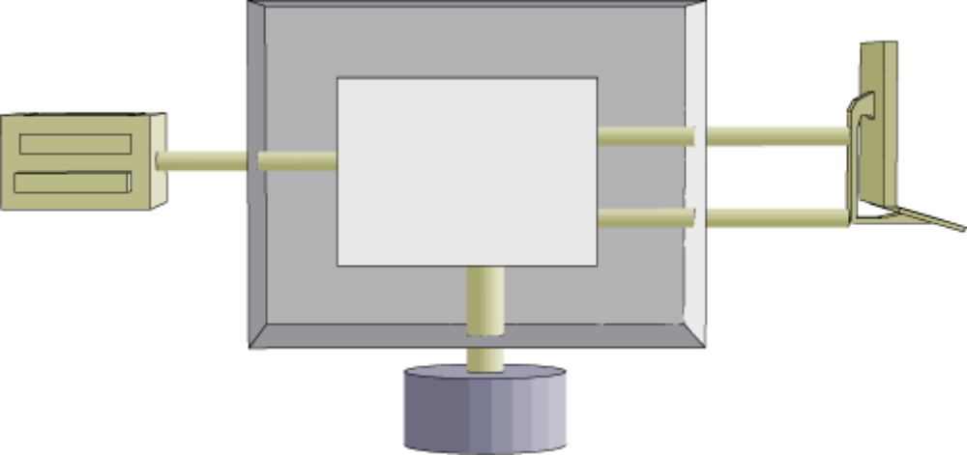
I. What is systems programming?
1. The naive, simple model of programming
computer
display and
keyboard
program
printer
disk

Slide 5
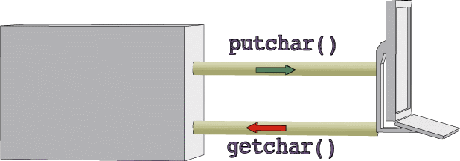
Typical program in this model
main()
{
int c;
while ( ( c=getchar()) != EOF )
putchar(c);
}

Slide 6
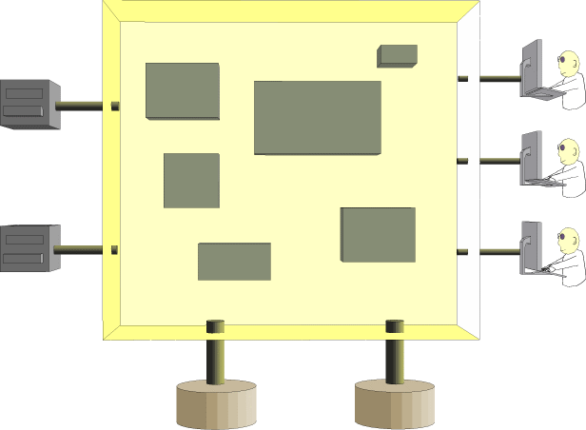
Reality

Slide 7
Reality
Lots of users
Lots of programs
Lots of disk files
Lots of devices
Somehow, these are all connected

Slide 8
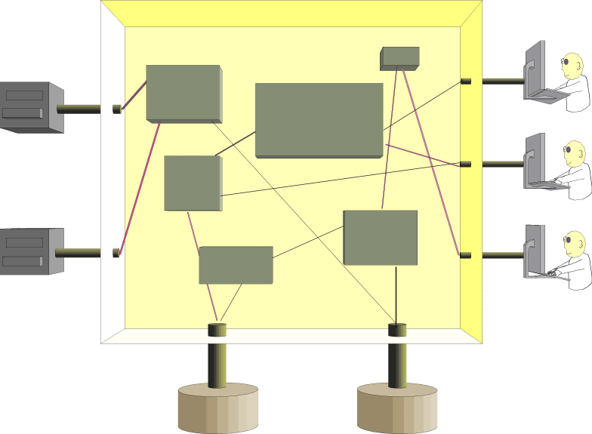
How are they all connected?
This looks too complicated

Slide 9
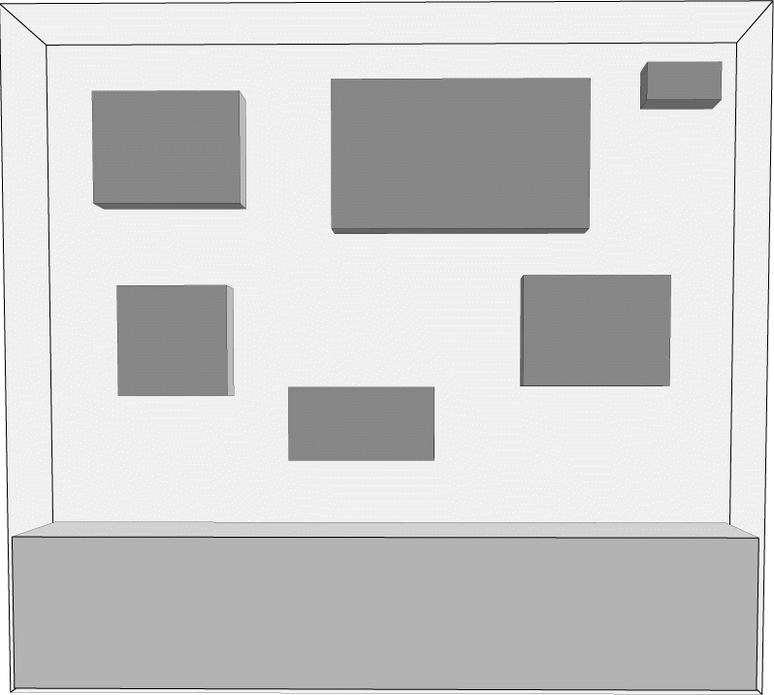
The role of the operating system
To manage all the resources and to connect the various devices to the correct programs.
programs
Operating System

Slide 10
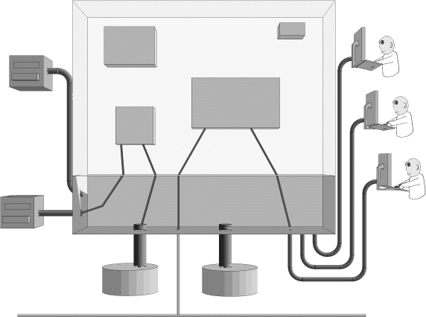
Providing Services to Program
Programs request services from the O/S. The O/S contains code to provide services.
User space
System space
Unix kernel
network

Slide 11
We shall learn about the services provided by the kernel
Input/Output
Process Management
Memory
Devices: tapes, CDs, mice...
Timers
IPC
Network

Slide 12
Our method for understanding
Unix system services:
Seeing how they are used
Learning about the system calls to invoke the services
Writing our own versions of various system programs

Slide 13
Outline of today's class
Course information
Course content
Introduction to Unix
Examples of topics

Slide 14
Unix from the User's Perspective
login, run programs, logout
directories and files
programs
I/O control
pipes
online documentation

Slide 15
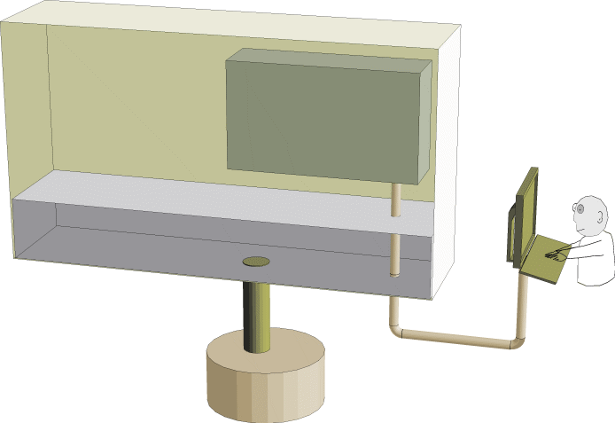
login, run programs, logout
user space
shell
kernel
user
disk

Slide 16
Files and Directories
ls
cd
pwd
mkdir
rmdir

Slide 17
Operations on Files
OPERATION
Unix Command
examine a file
copy a file
delete a file
rename a file
print a file
cat, more, less
cp old new
rm
mv old new
lpr

Slide 18
File permissions
Every file has an "owner" and three groups of file permission attributes
- rwx rwx rwx
owner group world
r = read, w=write, x=execute

Slide 19
How does that work?
The main question for the course
Three (seemingly different) examples:
  Internet bridge
  bc (A Unix calculator)
  Web browsing

Slide 20
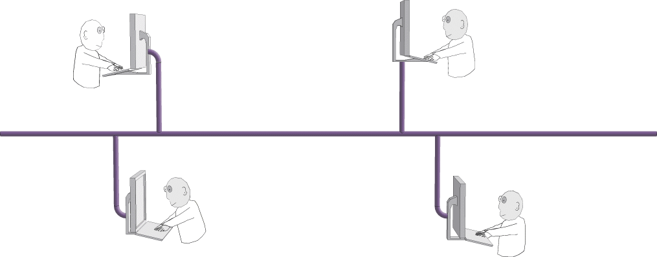
Example 1: Internet Bridge
What does it do? How does it work?

Slide 21
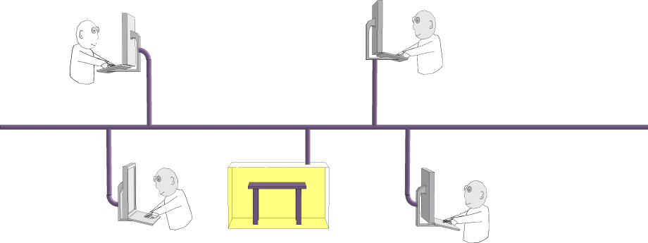
Internet Bridge continued
Four players, virtual cards, and a virtual table. What's going on?

Slide 22


Internet Bridge: Main Ideas
Communication - what do the programs say?
Coordination - sharing resources safely
Network access - how do you program that?

Slide 23
Example 2: bc
The Unix bc program looks like a calculator
$ bc
2+2
4
22*100
2200

Slide 24

bc is not a calculator
dc
bc
bc is a parser. dc (desk calculator program) does
the math. They communicate with 'pipes'.
Communication - what do the programs say?
Coordination - who says what when?
Using pipes - how do you program that?

Slide 25
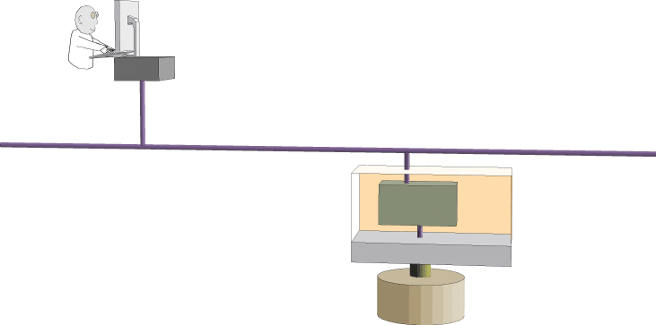
Example 3: Web browsing
request
reply
web server
Like bc/dc: two separate programs communicating over a data channel

Slide 26


Web browsing: Main Ideas
request
reply
web server
Communication - what do the programs say?
Coordination - why says what when?
Network access - how do you program that?

Slide 27
Using the 3-Step Method: more
Step 1: What does it do?
Try it and read the manpage
purpose:
more shows a file page by page
usage:
more filename
or
more < filename
or
command | more

Slide 28
more: the logic
Step 2: How does it work?
Looks pretty simple
Action:
open file
show 24 lines
print [More X%?]
read user input (space or Enter or 'q')
if Enter, advance one line
if space
if 'q', exit

Slide 29
How difficult was that?
Unix programming is not as difficult as you
think it is, but it's not as easy as you
first imagine...
Let's code our version of more and test it

Slide 30
Testing more: simple case
case 1:
more filename
Result: Works ok

Slide 31
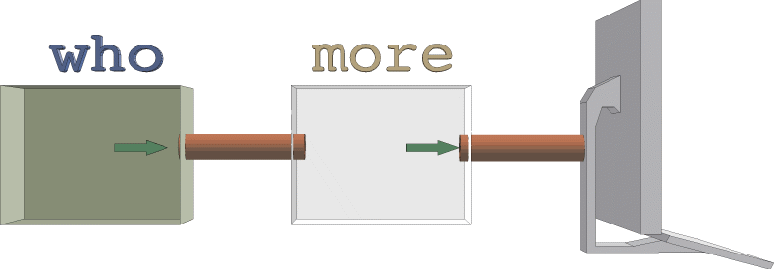
Testing more: pipeline case
case 2:
who | more
Result: trouble...

Slide 32
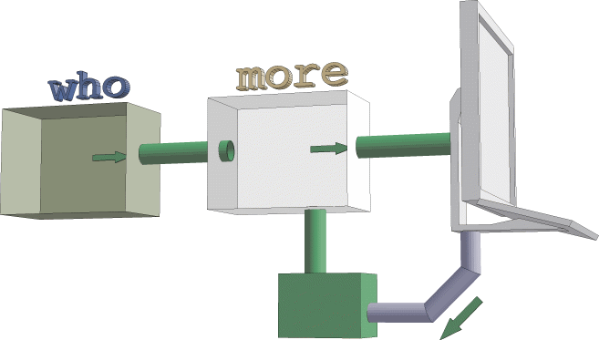
Understanding more
The 'real' version of more has to read from the keyboard even when standard input is attached to a pipe. Here's how it works:
standard input
/dev/tty
Solution: read user input from /dev/tty.

Slide 33
More questions
Reading from /dev/tty solves the pipeline problem,
but...
The real more does not echo the 'q' or the space
The real more does not wait for the Enter key
The real more knows how many lines are on the terminal
How does more control the input device?

Slide 34
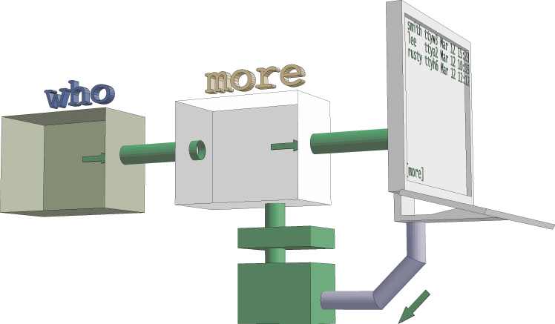
More details
device control unit
Every device has a collection of settings that determine how the device operates. A program can read and modify device settings. For example, more can turn off character echoing.

Slide 35
Yet more questions
  What about the percentage of the file more shows?
  How does it know that?
  What about the reverse video?
  How does it do that?
  How about pressing 'v' to exit the file?
  How does that work?
  less can go backwards?
  Does the program read backwards?

Slide 36
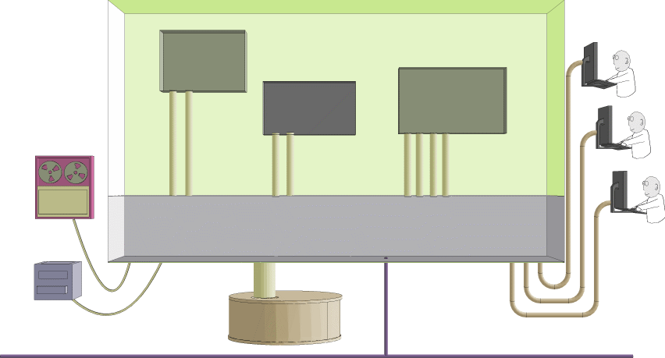
Learning from Unix Programs
Common Unix programs use kernel services. We can learn about those services and how they are used by studying and writing these common programs.
processes
users
data I/O
devices
other kernel services
disks
network programming

