Slide 1
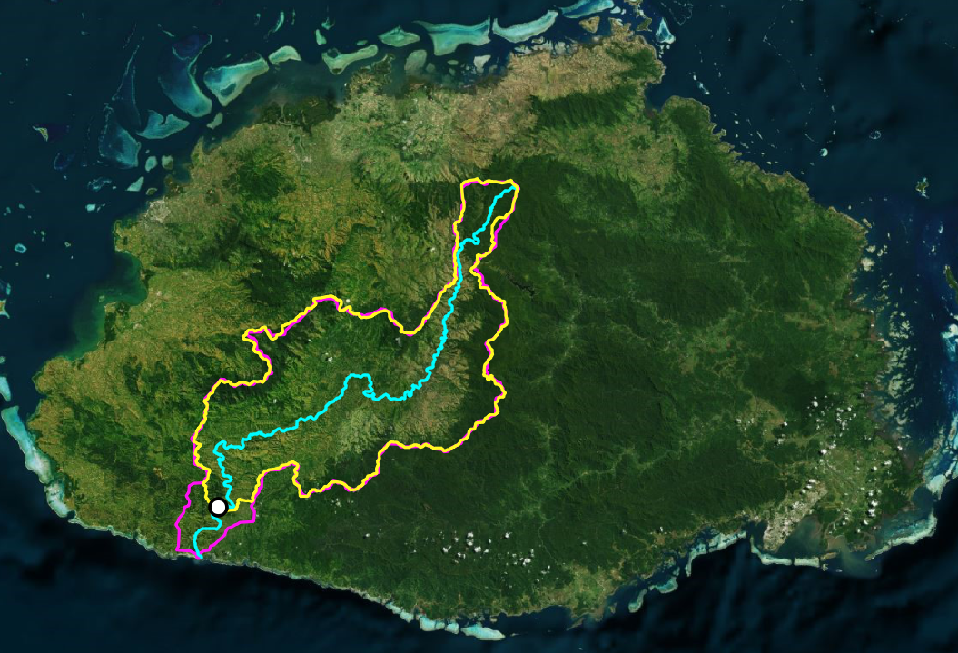

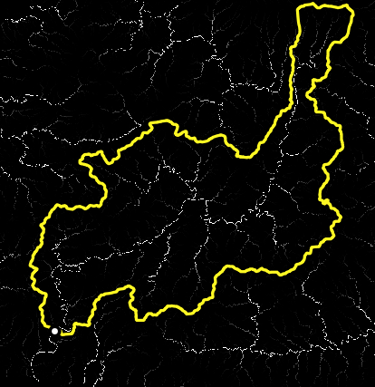
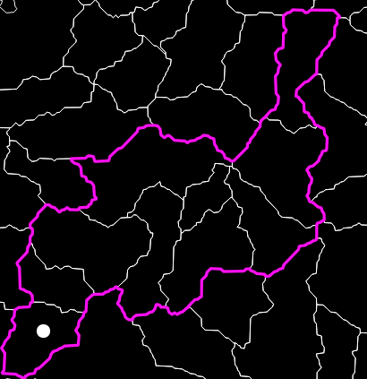
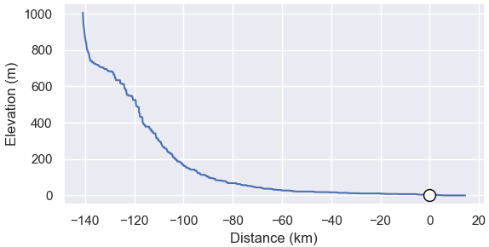
Fiji
Sigatoka River
20 km
stream gage
A
MERIT-Hydro
delineation
HydroBASINS
delineation
B
C
D

