Slide 1
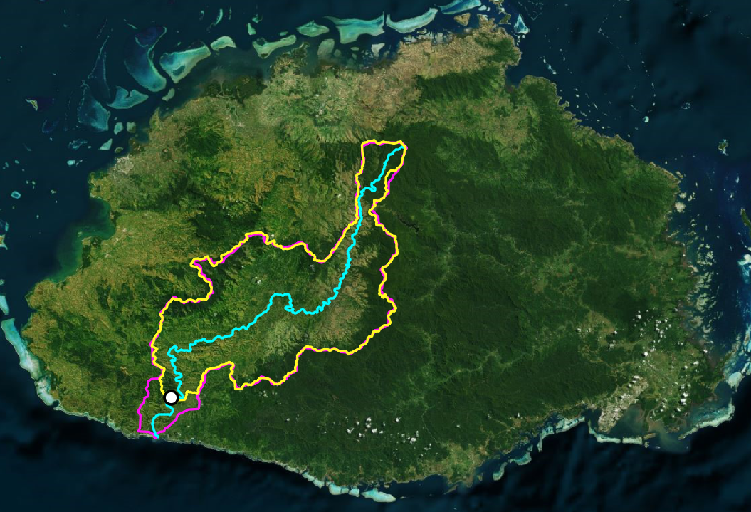

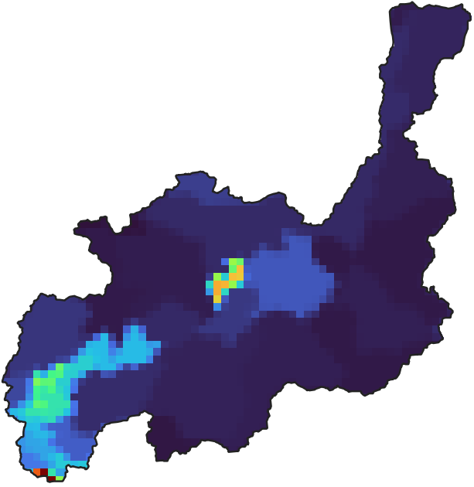
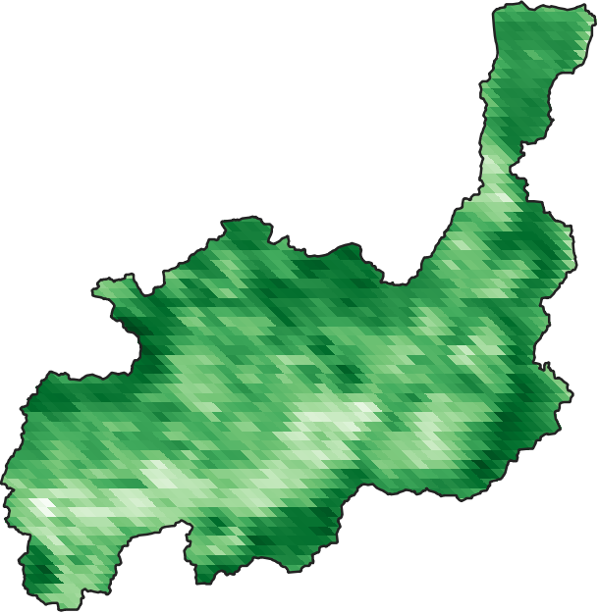
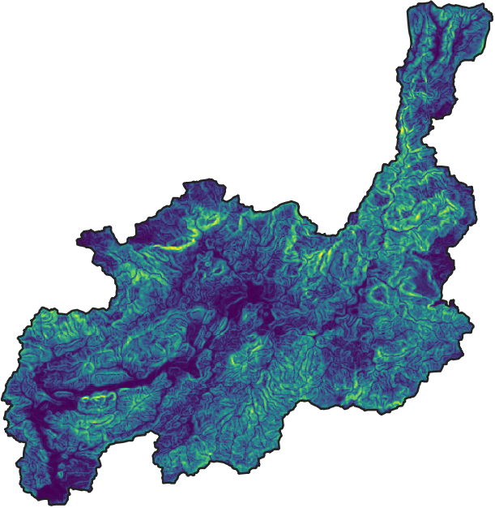
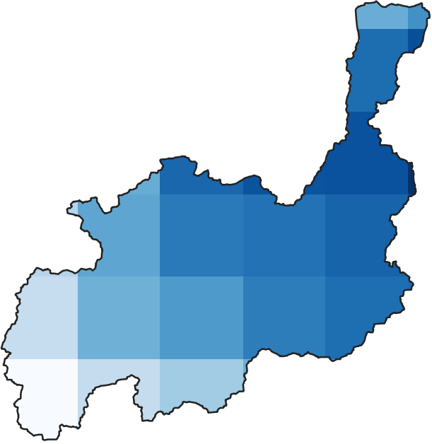
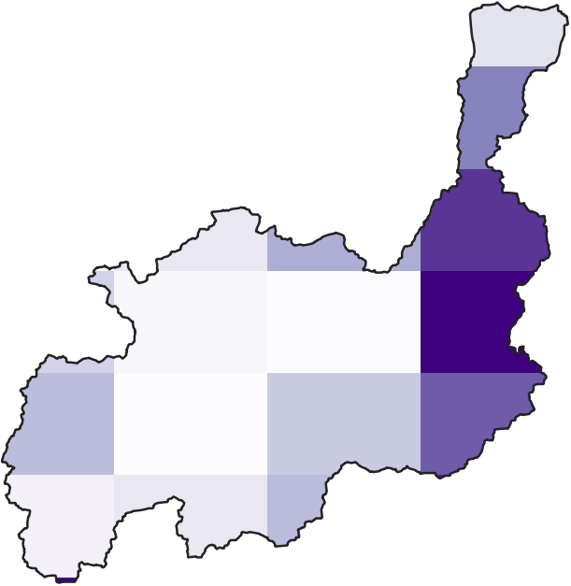
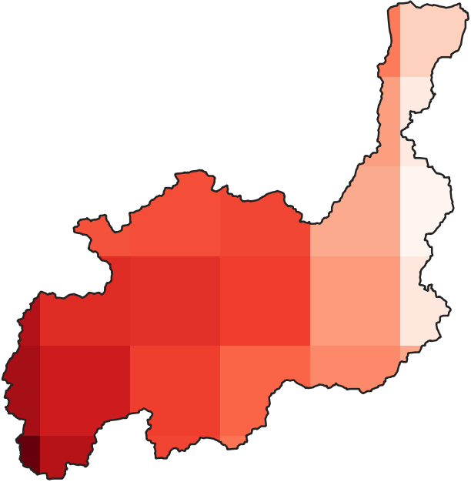
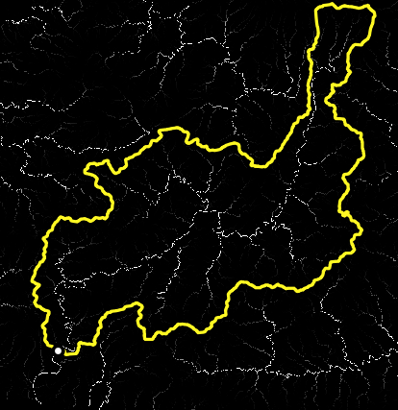
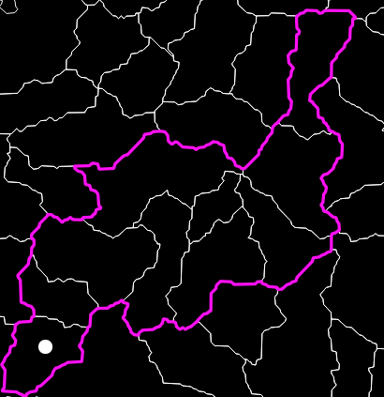
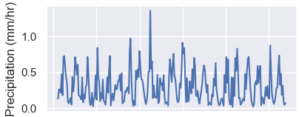
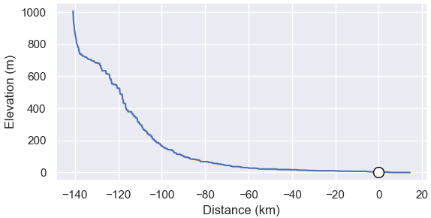
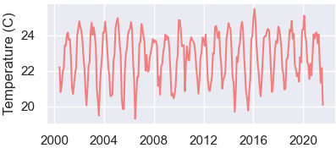
E
Population Density
NDVI
Topo Slope
Fiji
20 km
stream gage
A
MERIT-Hydro
delineation
HydroBASINS
delineation
Precipitation
Soil Moisture
Temperature
F
Sigatoka River
B
C
D
G

Slide 2
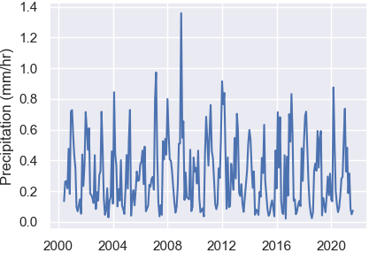
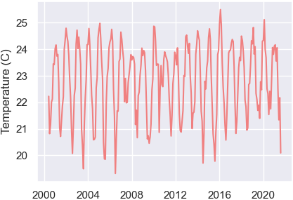
Fiji
SMAP Soil Moisture
ERA5 Temperature
GPM Precipitation
20 km
Sigatoka River
A
Topographic Slope
GPW Human
Population Density
MODIS NDVI
stream gage
MERIT-Hydro
delineation
HydroBASINS
delineation
B
C
D

