Slide 1
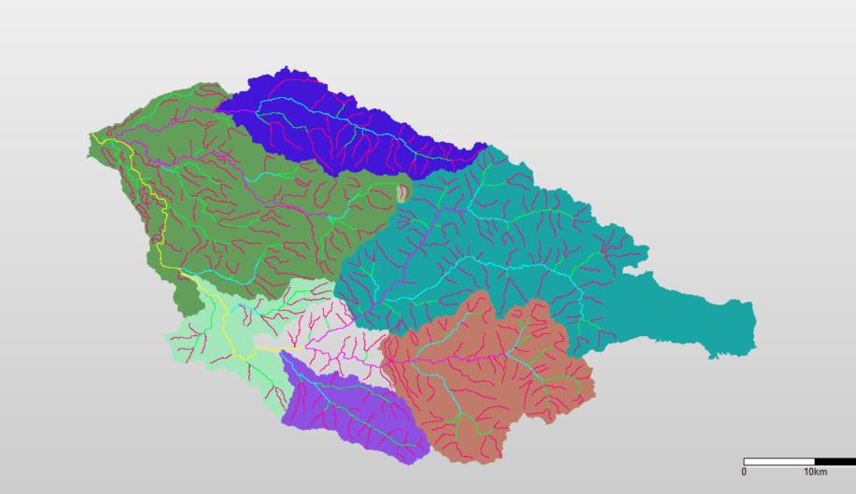
HBVCALIB areas in the South Santiam basin (SUB_AREA = 6)
ThomasCr56
SchaferCr52
Quartzville53
LowerSSantiam43
Waterloo36
Cascadia54
WileyCr55
FOS11

