Slide 1
McKenzie Basin Gages

Slide 2
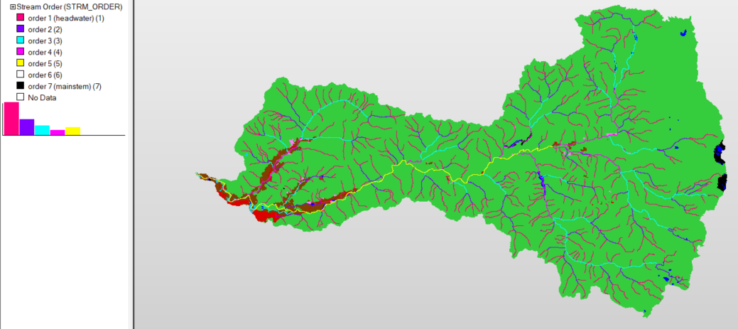
3393 Above Smith R Reservoir
3373 Outlet of Clear Lake
2909 McKenzie R below Leaburg Dam
3411 Lookout Cr.
3513 Mohawk R near Springfield
2909 Q,T McKenzie R near Vida
3359 Below Trail Bridge Dam
3429 T Blue R. below Tidbits Cr.
3405 Q,T Blue River
2751 Q,T Above Hayden Bridge
3009 Q,T S Fork McKenzie R
2801 McKenzie R. near Walterville
4369 Cedar Creek near Springfield
3037 Q,T Above Cougar Lake

Slide 3
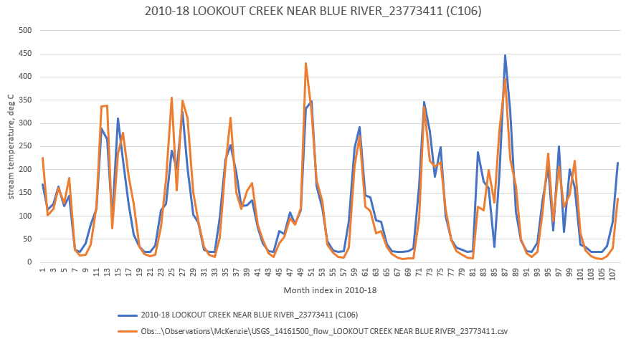
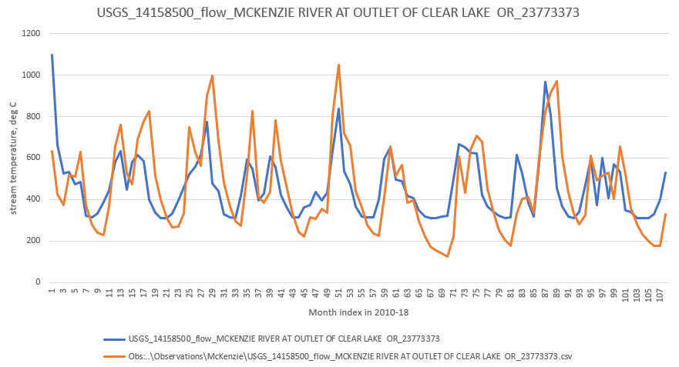
Clear Lake gage with
8.52 cms spring water
NSE 0.43 NS
%BIAS 0.0% VG
RSR 0.76 NS
R2 0.43 NS
Lookout Cr. gage with
0.36 cms spring water
NSE 0.84 VG
%BIAS -1.7% VG
RSR 0.40 VG
R2 0.84 G

Slide 4
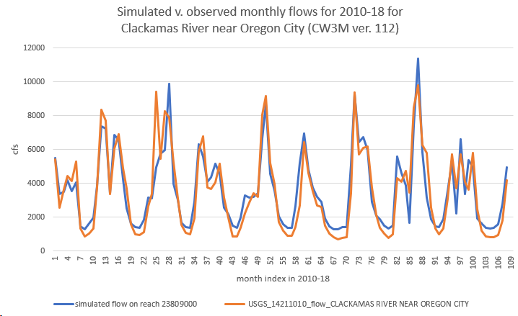
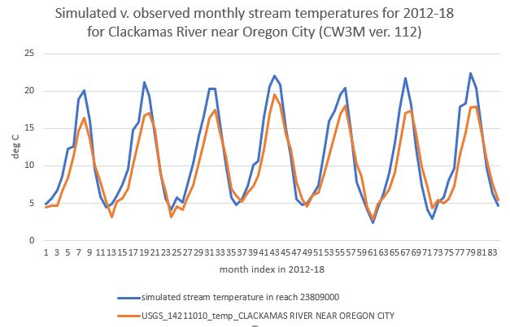

Slide 5
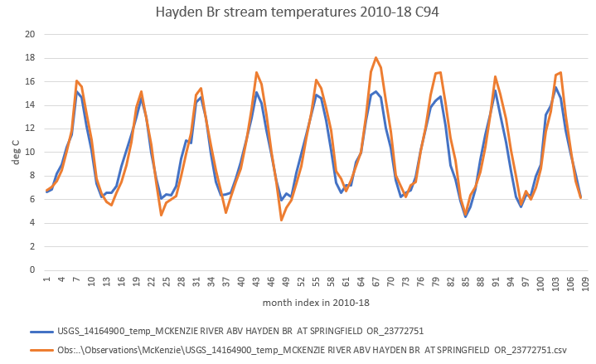
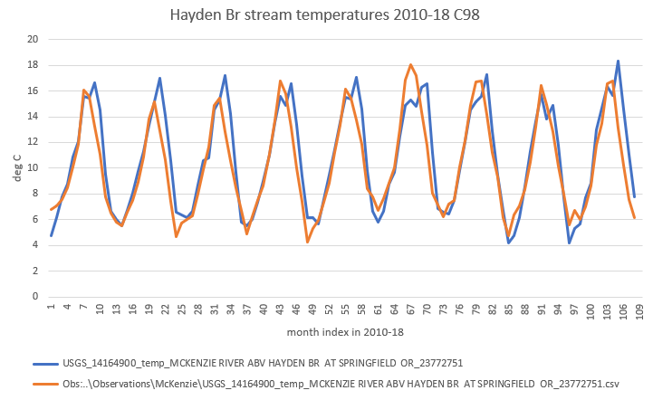
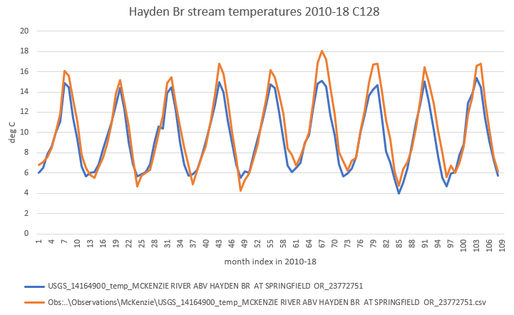

Slide 6
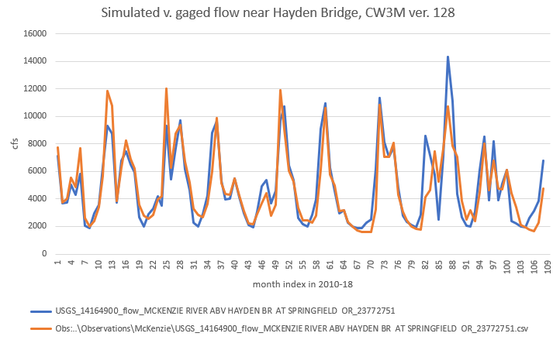

Slide 8
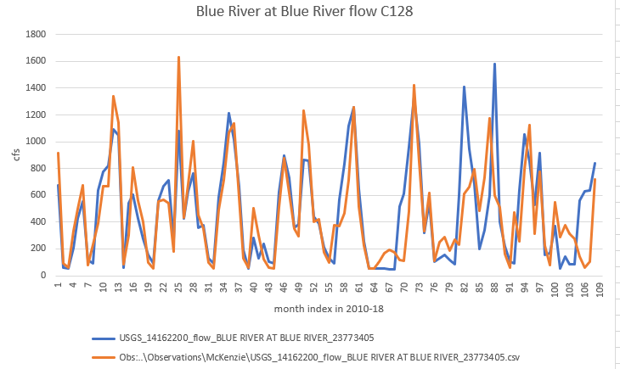

Slide 9
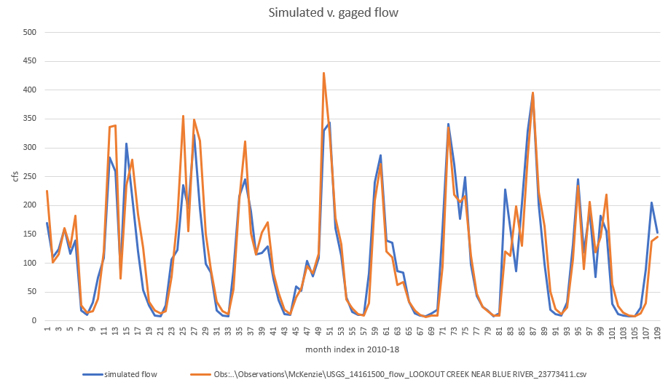
C214 Lookout Creek

