Slide 1
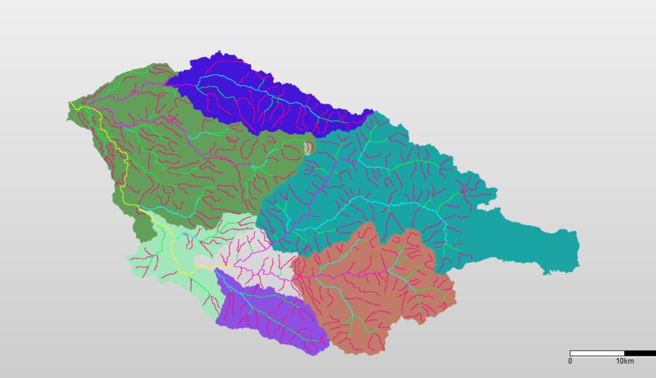
HBVCALIB areas in the South Santiam basin (SUB_AREA = 6)
ThomasCreek56
SchaferCreek52
QuartzvilleCreek53
LowerSSantiam43
Waterloo36
Cascadia54
WileyCreek55
FOS11

