Slide 1


PRINCIPLES OF MACROECONOMICS 2e
Chapter 8 Unemployment
PowerPoint Image Slideshow

Slide 2
8.1 How the Unemployment Rate is
Defined and Computed
The adult population consists of:
Employed - currently working for pay.
Unemployed - out of work and actively looking for a job.
Out of the labor force - those who are not working and not looking for work, whether they want employment or not.
also termed “not in the labor force”
Labor force - the number of employed plus the unemployed.
Unemployment rate - the percentage of adults who are in the labor force and thus seeking jobs, but who do not have jobs.
Unemployment rate = Unemployed people x 100
Total labor force

Slide 3
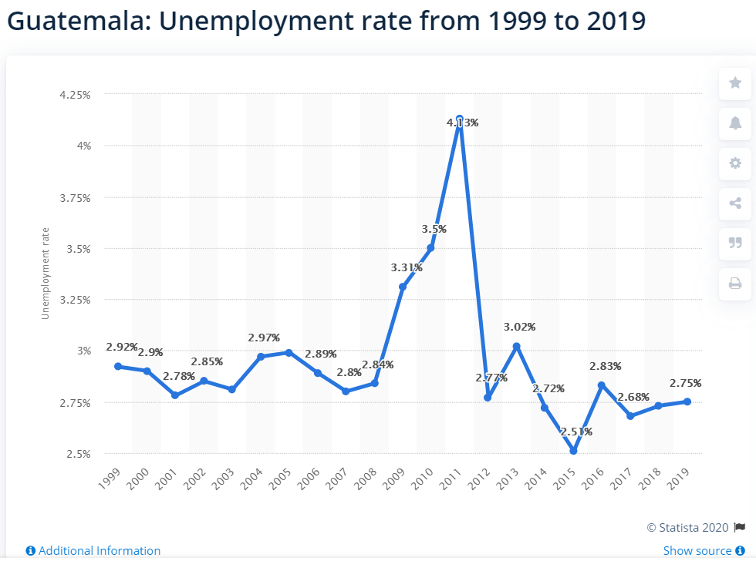

Slide 4
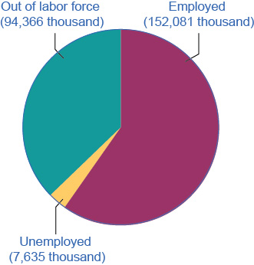
Employed, Unemployed, and Out of the
Labor Force Distribution of Adult Population (age 16 and older), January 2017
The total adult, working-age population in January 2017 was 254.1 million.
Out of this total population, 152.1 million were classified as employed, and 7.6 million were classified as unemployed.
The remaining 94.4 million were classified as out of the labor force.
As you will learn, however, this seemingly simple chart does not tell the whole story.
Discussion Question: What is the unemployment rate?

Slide 5
Hidden Unemployment
“Hidden unemployment” - people who are mislabeled in the categorization of employed, unemployed, or out of the labor force.
Part-time or temporary workers looking for full-time or permanent work.
Underemployed - individuals who are employed in a job that is below their skills.
Discouraged workers - those who have stopped looking for employment due to the lack of suitable positions available.

Slide 6
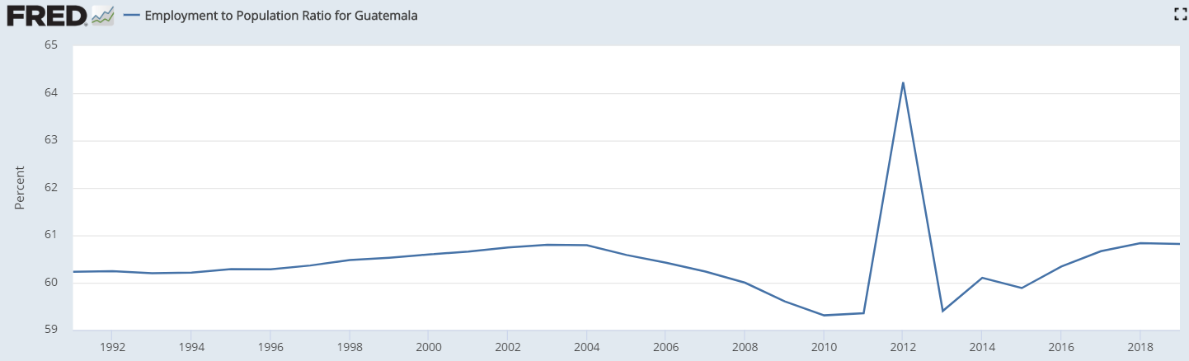
Labor Force Participation Rate
Labor force participation rate - the percentage of adults in an economy who are either employed or who are unemployed and looking for a job.
Labor force participation rate = Total labor force x 100
Total adult population

Slide 7
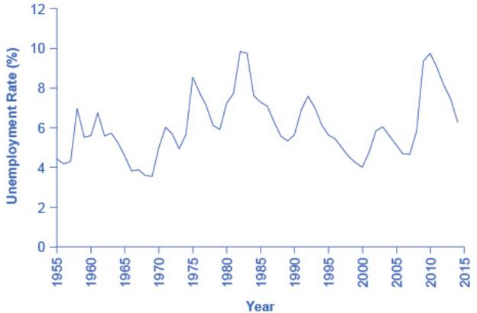
8.2 Patterns of Unemployment
The U.S. unemployment rate moves up and down as the economy moves in and out of recessions.
However, over time, the unemployment rate seems to return to a range of 4% to 6%.
There does not seem to be a long-term trend toward the rate moving generally higher or generally lower. (Source: Federal Reserve Economic Data (FRED) https://research.stlouisfed.org/fred2/series/LRUN64TTUSA156S0)

Slide 8
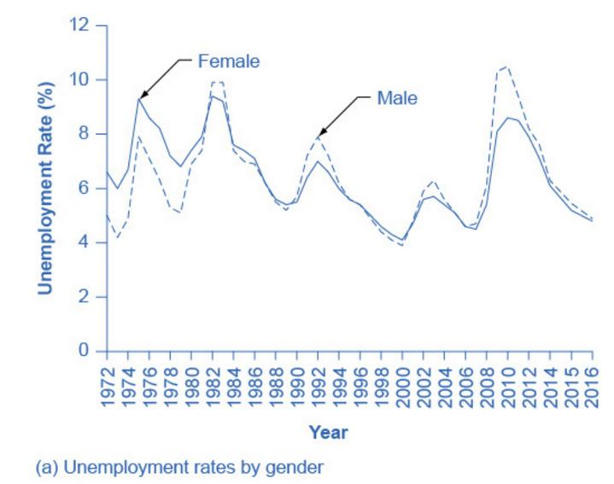
Unemployment Rates by Group - Gender
Unemployment rates for men used to be lower than unemployment rates for women.
In recent decades, the two rates have been very close, often with the unemployment rate for men somewhat higher. (Source: www.bls.gov)

Slide 9
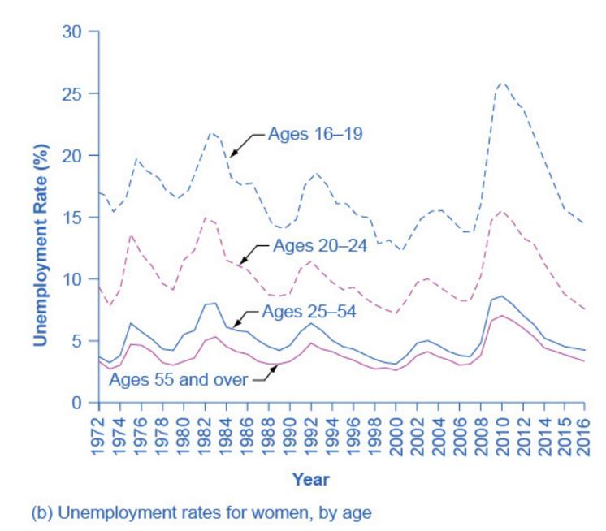
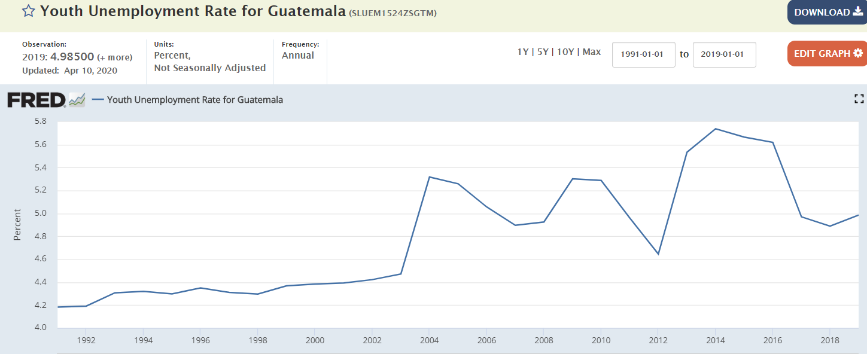
Unemployment Rates by Group - Age
Unemployment rates are highest for the very young and become lower with age. (Source: www.bls.gov)

Slide 10
8.3 What Causes Changes in Unemployment over the Short Run
Cyclical unemployment - unemployment closely tied to the business cycle, like higher unemployment during a recession.
From the standpoint of the supply-and-demand model of competitive and flexible labor markets, unemployment represents something of a puzzle.

Slide 11
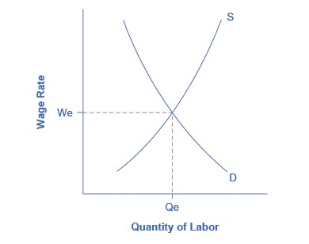
Unemployment and Equilibrium in the
Labor Market
In a labor market with flexible wages, the equilibrium will occur at wage W_{e} and quantity Q_{e},
Here the number of people who want jobs (shown by S) equals the number of jobs available (shown by D).

Slide 12
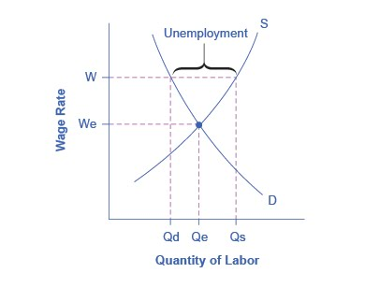
Sticky Wages in the Labor Market
Because the wage rate is stuck at W, above the equilibrium, the number of those who want jobs (Q_{s}) is greater than the number of job openings (Q_{d}).
The result is unemployment, shown by the bracket in the figure.

Slide 13
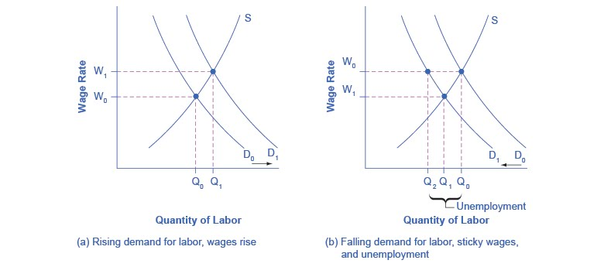
Rising Wage and Low Unemployment:
Where Is the Unemployment in Supply and Demand?
In a labor market where wages are able to rise, an increase in the demand for labor from D₀ to D₁ leads to an increase in equilibrium quantity of labor hired from Q₀ to Q₁ and a rise in the equilibrium wage from W₀ to W₁.

Slide 14
Rising Wage and Low Unemployment:
Where Is the Unemployment in Supply and Demand?
In a labor market where wages do not decline, a fall in the demand for labor from D₀ to D₁ leads to a decline in the quantity of labor demanded at the original wage (W₀) from Q₀ to Q₂. These workers will want to work at the prevailing wage (W₀), but will not be able to find jobs.

Slide 15
8.4 What Causes Changes in
Unemployment over the Long Run
Natural rate of unemployment - the unemployment rate that would exist in a growing and healthy economy from the combination of economic, social, and political factors that exist at a given time.
Frictional unemployment - unemployment that occurs as workers move between jobs.
Structural Unemployment - unemployment that occurs because individuals lack skills valued by employers.
Economists consider the economy to be at full employment when the actual unemployment rate is equal to the natural unemployment rate.

Slide 16
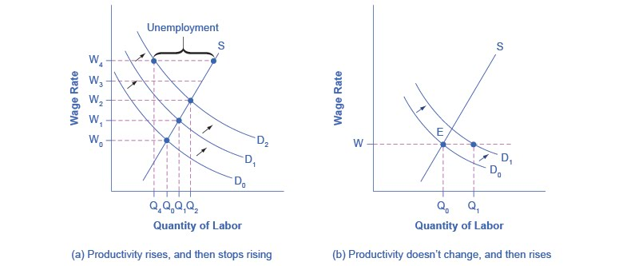
Productivity Shifts and the Natural Rate
of Unemployment
a)
Productivity is rising, increasing the demand for labor. Employers and workers become used to the pattern of wage increases.
Then productivity suddenly stops increasing.
The expectations of employers and workers for wage increases do not shift immediately, so wages keep rising as before.
However, the demand for labor has not increased, so at wage W₄, unemployment exists where the quantity supplied of labor exceeds the quantity demanded.

Slide 17
This OpenStax ancillary resource is © Rice University under a CC-BY 4.0 International license; it may be reproduced or modified but must be attributed to OpenStax, Rice University and any changes must be noted.

