Slide 1
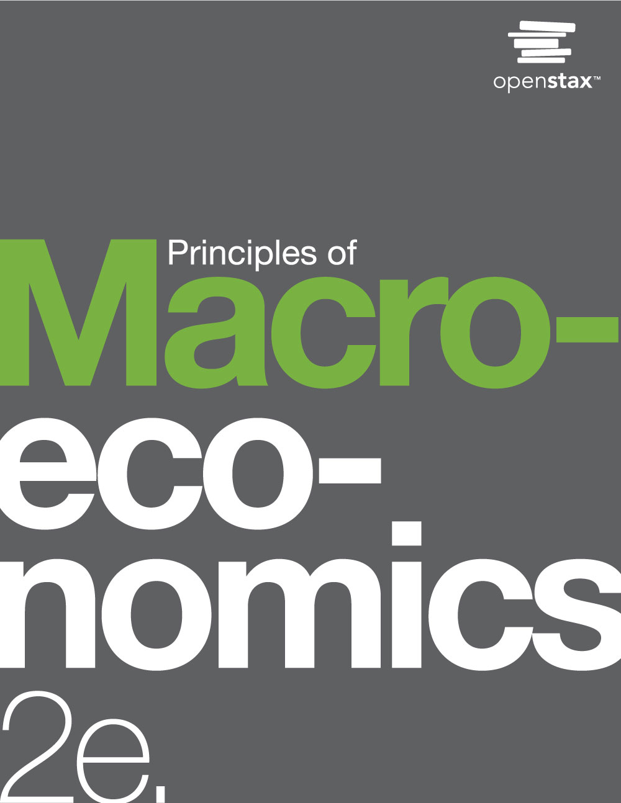

PRINCIPLES OF MACROECONOMICS 2e
Chapter 9 Inflation
PowerPoint Image Slideshow

Slide 2
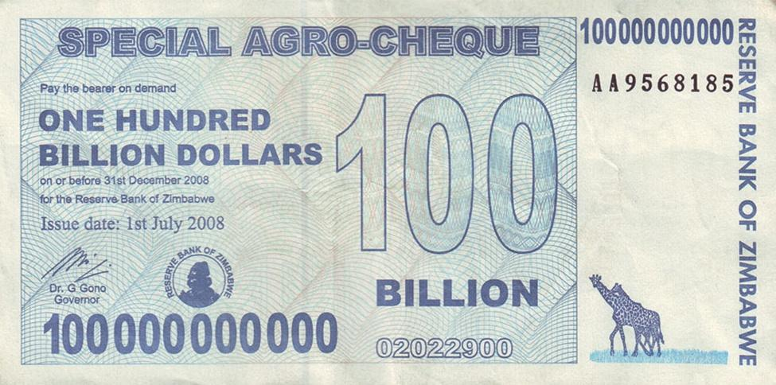
Big Bucks in Zimbabwe
This bill was worth 100 billion Zimbabwean dollars when issued in 2008.
There were even bills issued with a face value of 100 trillion Zimbabwean dollars. The bills had $100,000,000,000,000 written on them.
Unfortunately, they were almost worthless.
At one point, 621,984,228 Zimbabwean dollars were equal to one U.S. dollar.
Eventually, the country abandoned its own currency and allowed people to use foreign currency for purchases. (Credit: modification of work by Samantha Marx/Flickr Creative Commons)

Slide 3
9.1 Tracking Inflation
Inflation - a general and ongoing rise in the level of prices in an entire economy.
Inflation does not refer to a change in relative (individual) prices.
There is pressure for prices to rise in most markets in the economy.
Basket of goods and services - a hypothetical group of different items, with specified quantities of each one meant to represent a “typical” set of consumer purchases.
Used to calculate the price level, by looking at how the prices of those items change over time.
Computed using a weighted average.

Slide 4
Index Numbers
Index number - a unit-free number derived from the price level over a number of years, which makes computing inflation rates easier, since the index number has values around 100.
no dollar signs or other units attached.
Base year - arbitrary year whose value as an index number economists define as 100.
Indexing allows easier eyeballing of the inflation numbers between different years.
Inflation Calculation:
(Level in new year - Level in prior year) x 100 = Percentage change
Level in prior year

Slide 5
9.2 How to Measure Changes in the
Cost of Living
Consumer Price Index (CPI) - a measure of inflation that U.S. government statisticians calculate based on the price level from a fixed basket of goods and services that represents the average consumer's purchases.
Change in fixed basket of goods and services vs. change in cost of living
Substitution bias - an inflation rate calculated using a fixed basket of goods over time tends to overstate the true rise in the cost of living, because it does not take into account that the person can substitute away from goods whose prices rise considerably.
Quality/new goods bias - inflation calculated using a fixed basket of goods over time tends to overstate the true rise in cost of living, because it does not account for improvements in the quality of existing goods or the invention of new goods.

Slide 6
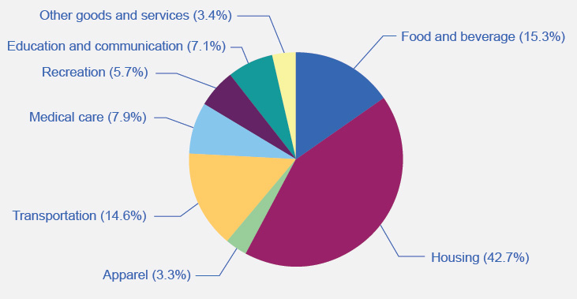
The Weighting of CPI Components
Of the eight categories used to generate the Consumer Price Index, housing is the highest at 42.7%.
The next highest category, food and beverage at 15.3%, is less than half the size of housing.
Other goods and services, and apparel, are the lowest at 3.4% and 3.3%, respectively. (Source: www.bls.gov/cpi)

Slide 7
The CPI and Core Inflation Index
Core inflation index - takes the CPI and excludes volatile economic variables, like energy and food prices.
Economists can have a better sense of the underlying trends in prices that affect the cost of living.
A preferred gauge from which to make important government policy changes.

Slide 8
Additional Price Indices
Producer Price Index (PPI) - a measure of inflation based on prices paid for supplies and inputs by producers of goods and services.
Different industries, commodities, and stages of processing.
International Price Index - a measure of inflation based on the prices of merchandise that are exported or imported.
Employment Cost Index - a measure of inflation based on wages paid in the labor market.
GDP deflator - a measure of inflation based on the prices of all the GDP components (consumption, investment, government, exports minus imports).

Slide 9
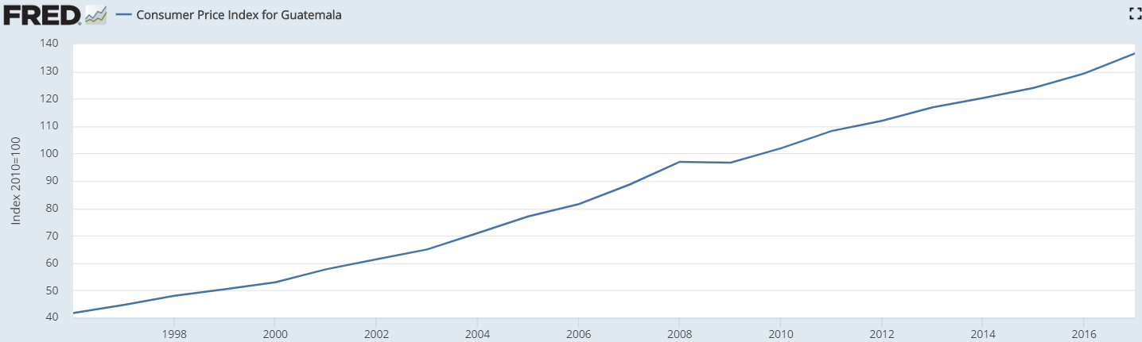
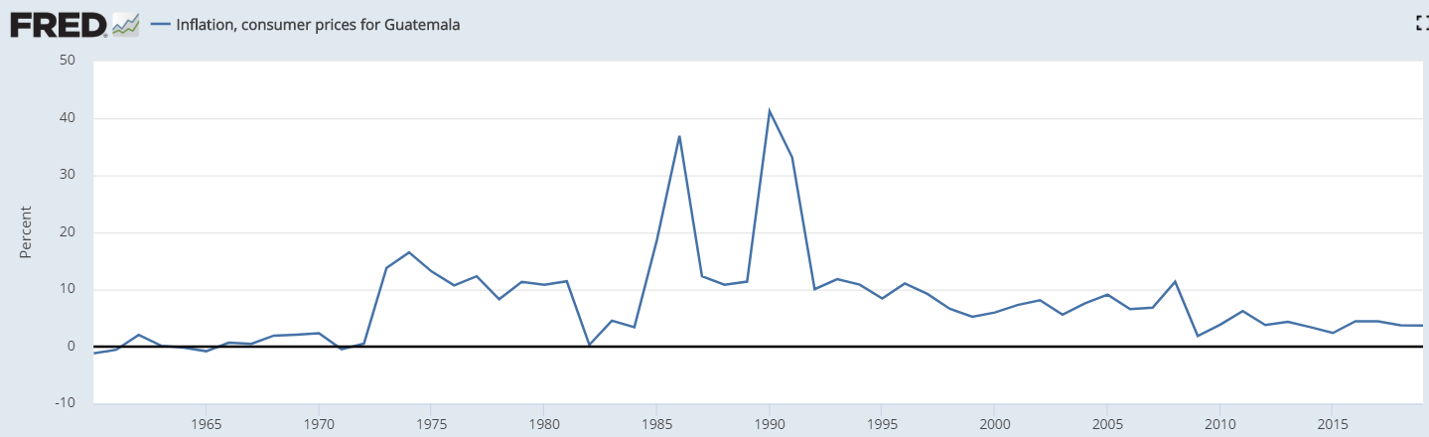
CPI and Inflation for Guatemala

Slide 10
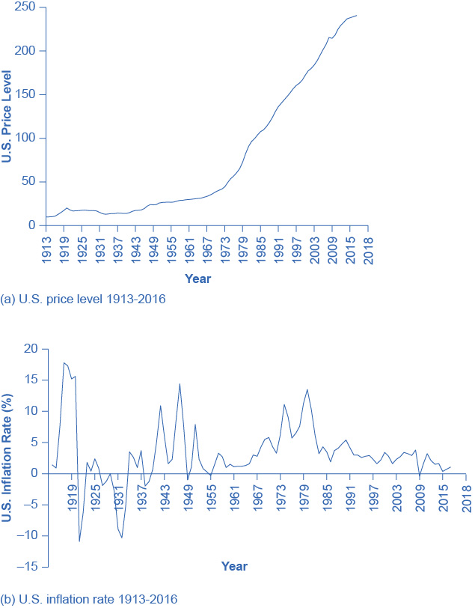
U.S. Price Level and Inflation Rates
The U.S. price level rose relatively little over the first half of the twentieth century. Afterwards, it gradually increases until about 1973, then increases more rapidly through the remainder of the 1970s and beyond, with periodic dips, until 2016, when it reached around 240.
In 1916, the graph starts out with inflation at almost 8%, jumps to about 17% in 1917, drops drastically to close to –11% in 1921, goes up and down periodically, with peaks in the 1940s and the 1970s, until settling to around 1.3% in 2016.

Slide 11
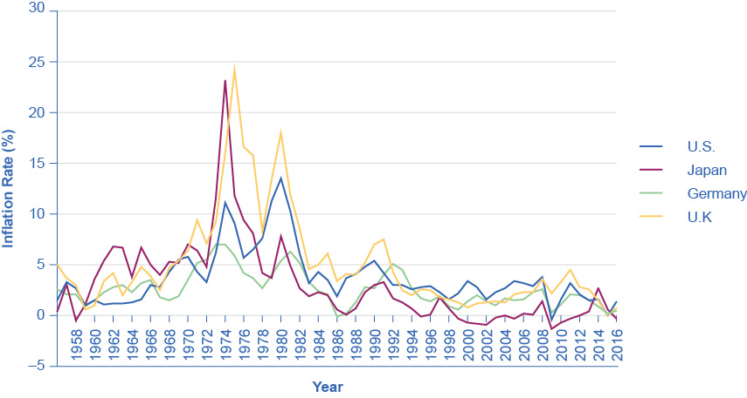
Countries with Relatively Low Inflation
Rates, 1960–2016
This chart shows the annual percentage change in consumer prices compared with the previous year’s consumer prices in the United States, the United Kingdom, Japan, and Germany.

Slide 12
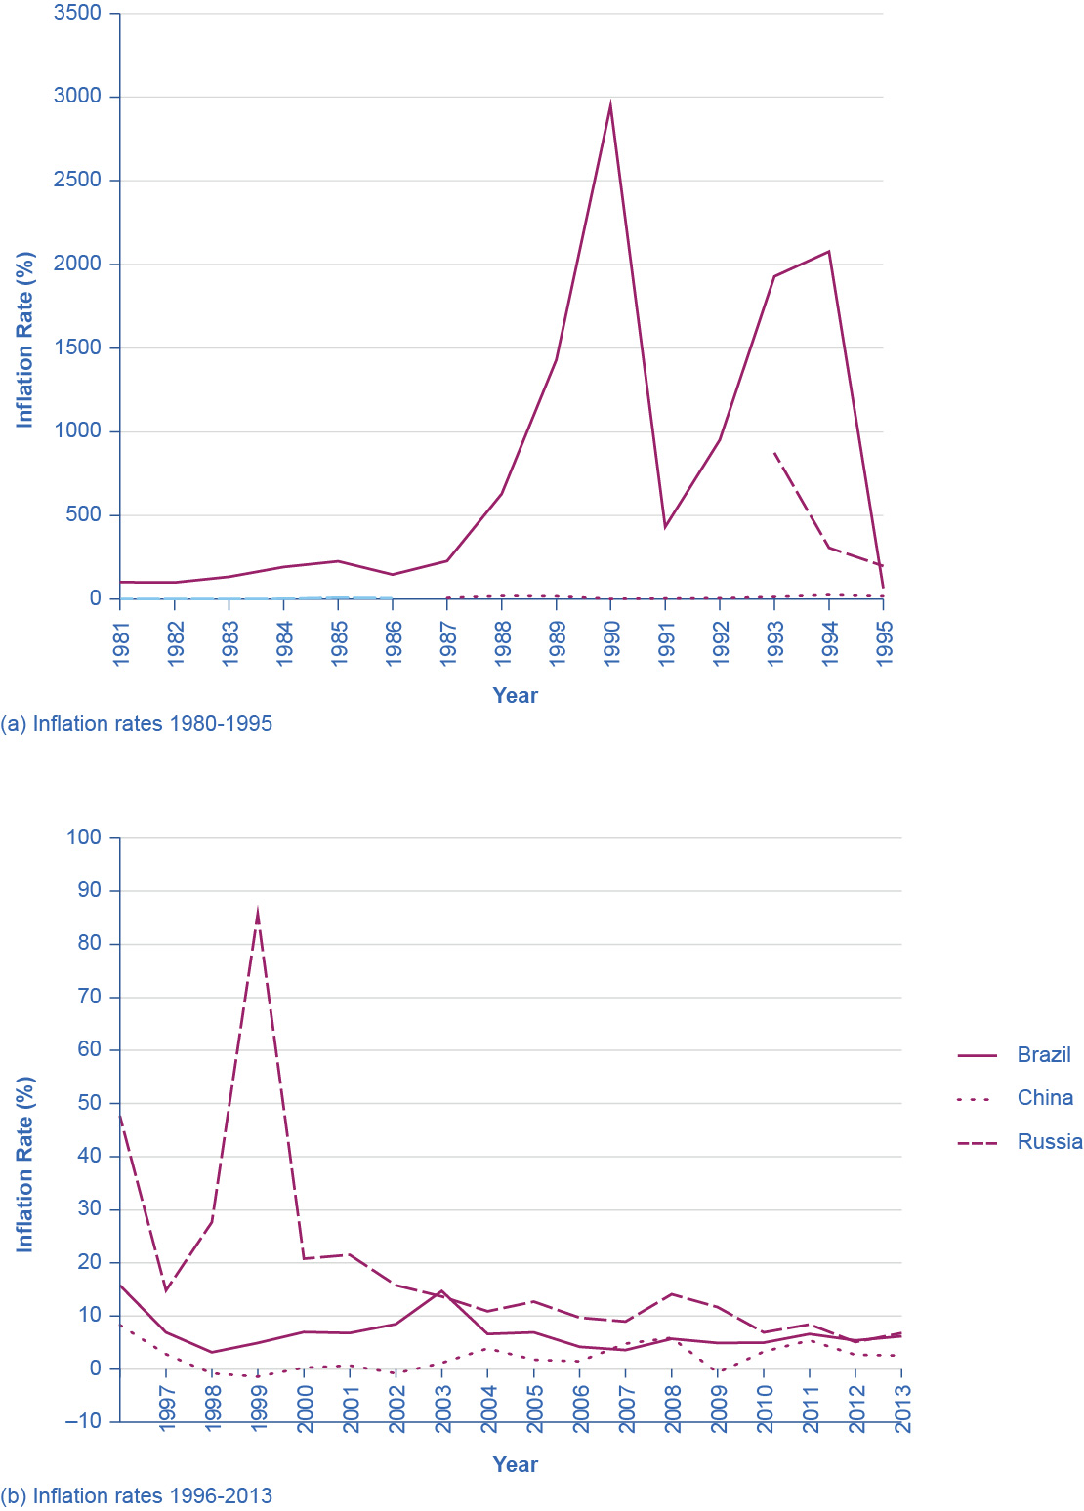
Countries with Relatively High Inflation
Rates, 1980–2016
These charts show inflation rates in Brazil, China, and Russia.
Of these, Brazil and Russia experienced hyperinflation at some point between the mid-1980s and mid-1990s.
Though not as high, China and Nigeria also had high inflation rates in the mid-1990s. Even though their inflation rates have come down over the last two decades, several of these countries continue to see significant inflation rates. (Sources: http://research.stlouisfed.org/fred2/series/FPCPITOTLZGBRA; http://research.stlouisfed.org/fred2/series/CHNCPIALLMINMEI; http://research.stlouisfed.org/fred2/series/FPCPITOTLZGRUS)

Slide 13
9.4 The Confusion Over Inflation
If other economic variables (prices, wages, and interest rates) do not move in sync with inflation, or if they adjust for inflation only after a time lag, then inflation can cause three types of problems:
unintended redistributions of purchasing power
blurred price signals
difficulties in long-term planning

Slide 14
Unintended Redistributions of Purchasing Power
People are hurt by inflation when:
they are holding cash
they have financial asset investments where the nominal return does not keep up with inflation (also can be exacerbated by taxes)
wages lag behind inflation
wage adjustments are often somewhat sticky and occur only once or twice a year.
they are a retiree receiving a private company defined pension
Ordinary people can sometimes benefit from inflation.
A borrower paying a fixed interest rate can end up better off, because they can repay their loans in dollars that are worth less than originally expected.

Slide 15
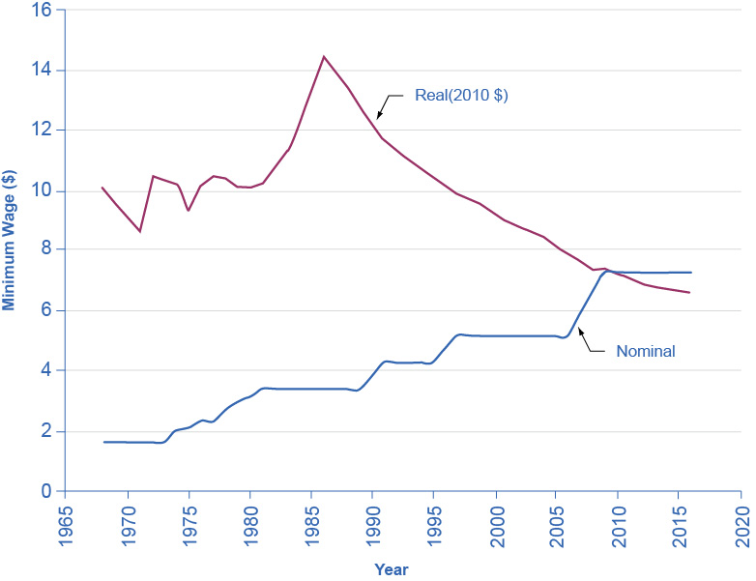
U.S. Minimum Wage and Inflation
After adjusting for inflation, the federal minimum wage dropped more than 30 percent from 1967 to 2010, even though the nominal figure climbed from $1.40 to $7.25 per hour.
Increases in the minimum wage between 2008 and 2010 kept the decline from being worse - as it would have been if the wage had remained the same as it did from 1997 through 2007. (Sources: http://www.dol.gov/whd/minwage/chart.htm; http://data.bls.gov/cgi-bin/surveymost?cu)

Slide 16
Blurred Price Signals
Prices are the messengers in a market economy, conveying information about conditions of demand and supply.
Inflation blurs those price messages.
Inflation means that we perceive price signals more vaguely, like static on the radio .
When the levels and changes of prices become uncertain, businesses and individuals find it harder to react to economic signals.

Slide 17
Problems of Long-Term Planning
Inflation can make long-term planning difficult.
Planning for retirement in unknown future dollar levels.
More time spent by businesses finding ways of profiting from inflation vs. less time spent on productivity, innovation, or quality of service.

Slide 18
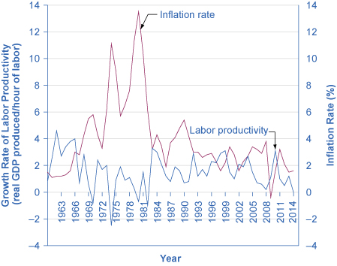
U.S. Inflation Rate and U.S. Labor
Productivity, 1961–2014
Over the last several decades in the United States, there have been times when rising inflation rates have been closely followed by lower productivity rates and lower inflation rates have corresponded to increasing productivity rates.
As the graph shows, however, this correlation does not always exist.

Slide 19
9.5 Indexing and Its Limitations
Indexed - a price, wage, or interest rate is adjusted automatically for inflation.
Examples of indexing arrangements in private markets:
Cost-of-living adjustments (COLAs) - a contractual provision that wage increases will keep up with inflation.
Adjustable-rate mortgage (ARM) - a type of loan a borrower uses to purchase a home in which the interest rate varies with market interest rates.

Slide 20
Indexing in Government Programs
Examples of indexing arrangements in government programs:
The U.S. income tax code is designed so income levels where higher tax rates kick in are indexed to rise automatically with inflation.
The level of Social Security benefits increases each year along with the Consumer Price Index.
An indexed increase in the Social Security tax base accompanies the indexed rise in the benefit level.
U.S. government offers indexed bonds promising to pay a certain real rate of interest above whatever inflation rate occurs.

Slide 21
This OpenStax ancillary resource is © Rice University under a CC-BY 4.0 International license; it may be reproduced or modified but must be attributed to OpenStax, Rice University and any changes must be noted.

