Slide 1
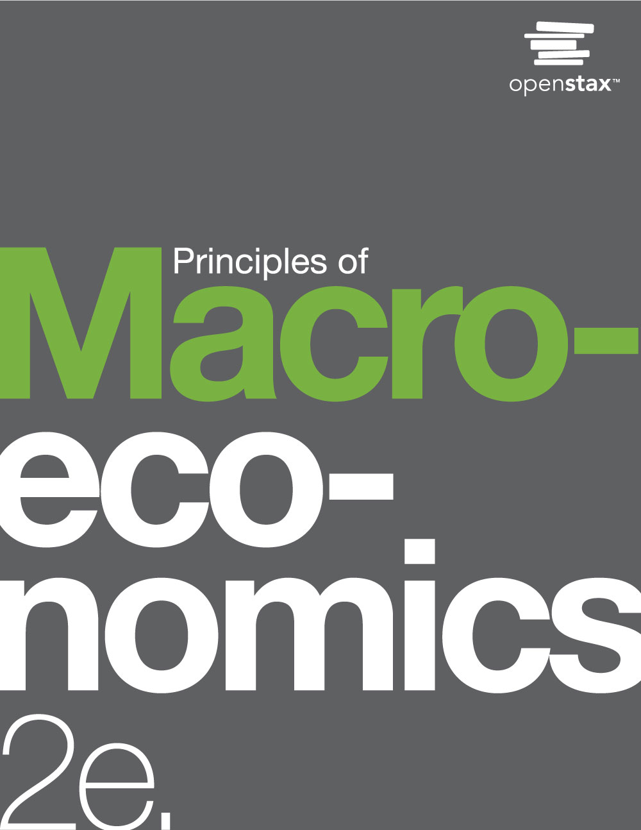

PRINCIPLES OF MACROECONOMICS 2e
Chapter 14 Money and Banking
PowerPoint Image Slideshow

Slide 2
CH.14 OUTLINE
14.1: Defining Money by Its Functions
14.2: Measuring Money: Currency, M1, and M2
14.3: The Role of Banks
14.4: How Banks Create Money

Slide 3
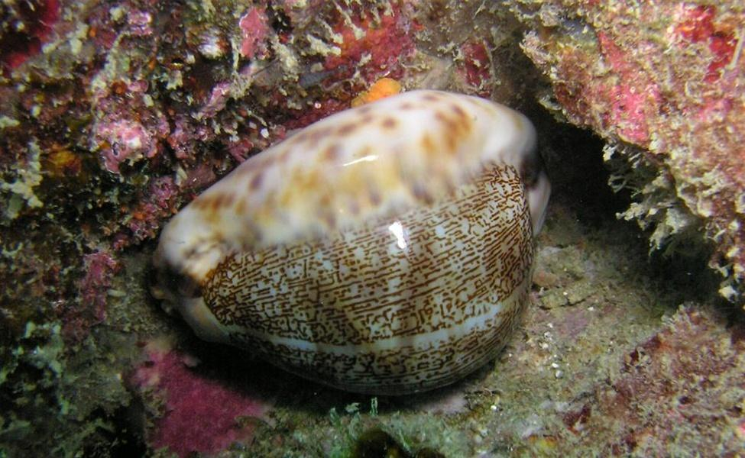
Cowrie Shell or Money?
Is this an image of a cowrie shell or money?
The answer is: Both.
For centuries, people used the extremely durable cowrie shell as a medium of exchange in various parts of the world.
(Credit: modification of work by “prilfish”/Flickr Creative Commons)

Slide 4
14.1 Defining Money by Its Functions
What the world would be like without money?
Barter - trading one good or service for another, without using money.
Double coincidence of wants - a situation in which two people each want some good or service that the other person can provide.

Slide 5
Functions for Money
Money - whatever serves society in four functions:
Medium of exchange - whatever is widely accepted as a method of payment.
Store of value - something that serves as a way of preserving economic value that one can spend or consume in the future.
Unit of account - the common way in which we measure market values in an economy.
Standard of deferred payment - money must also be acceptable to make purchases today that will be paid in the future.

Slide 6
Commodity versus Fiat Money
Commodity money - an item that is used as money, but which also has value from its use as something other than money.
Commodity-backed currencies - dollar bills or other currencies with values backed up by gold or another commodity.
During much of its history, gold and silver backed the money supply in the United States.

Slide 7
Commodity versus Fiat Money, Continued
Now, by government decree, if you owe a debt, then legally speaking, you can pay that debt with the U.S. currency, even though it is not backed by a commodity.
Fiat money - has no intrinsic value, but is declared by a government to be the country's legal tender.
The only backing of our money is universal faith and trust that the currency has value, and nothing more.

Slide 8
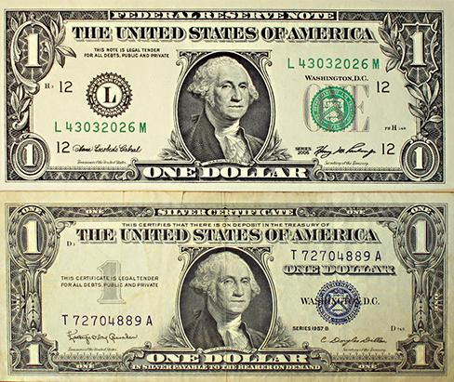
A Silver Certificate and a Modern U.S. Bill
Until 1958, silver certificates were commodity-backed money - backed by silver, as indicated by the words “Silver Certificate” printed on the bill, pictured at bottom.
Today, The Federal Reserve backs U.S. bills, but as fiat money (inconvertible paper money made legal tender by a government decree). (Credit: “The.Comedian”/Flickr Creative Commons)

Slide 9
14.2 Measuring Money: Currency, M1,
and M2
The Federal Reserve Bank:
The central bank of the United States,
Bank regulator and responsible for monetary policy,
Defines money according to its liquidity.
The Federal Reserve Bank has two definitions of money:
M1 money supply - a narrow definition of the money supply that includes currency and checking accounts in banks, and to a lesser degree, traveler’s checks.
M2 money supply - a definition of the money supply that includes everything in M1, but also adds savings deposits, money market funds, and certificates of deposit.

Slide 10
M1 Money
M1 money supply includes:
Coins and currency in circulation - the coins and bills that circulate in an economy that are not held by the U.S Treasury, at the Federal Reserve Bank, or in bank vaults.
Checkable (demand) deposits - checkable deposit in banks that is available by making a cash withdrawal or writing a check.
Traveler’s checks

Slide 11
M2 Money
M2 money supply includes:
All M1 types
Savings deposits - bank account where you cannot withdraw money by writing a check, but can withdraw the money at a bank - or can transfer it easily to a checking account.
Money market fund - the deposits of many investors are pooled together and invested in a safe way like short-term government bonds.
Certificates of Deposit (CD’s) and other time deposits - account that the depositor has committed to leaving in the bank for a certain period of time, in exchange for a higher rate of interest.

Slide 12
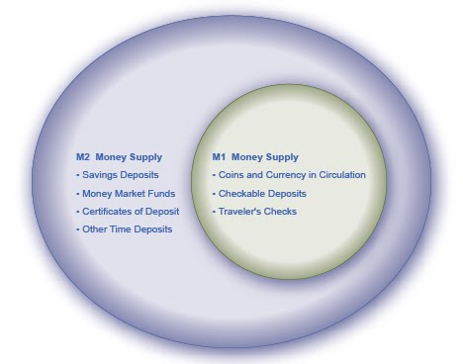
The Relationship between M1 and M2
Money
M1 and M2 money have several definitions, ranging from narrow to broad.
M1 = coins and currency in circulation + checkable (demand) deposits + traveler’s checks.
M2 = M1 + savings deposits + money market funds + certificates of deposit + other time deposits.

Slide 13
Where Does “Plastic Money” Fit In?
Debit card - like a check, is an instruction to the user’s bank to transfer money directly and immediately from your bank account to the seller.
Credit card - immediately transfers money from the credit card company’s checking account to the seller, and at the end of the month the user owes the money to the credit card company.
A credit card is a short-term loan.
Not considered money.
Smart card - stores a certain value of money on a card and then one can use the card to make purchases.
Examples: long-distance phone calls or making purchases at a campus bookstore and cafeteria
Credit cards, debit cards, and smart cards are different ways to move money when you make a purchase.

Slide 14
Banks as Financial Intermediaries
Financial intermediary - an institution that operates between a saver with financial assets to invest and an entity who will borrow those assets and pay a rate of return.
Depository institution - institution that accepts money deposits and then uses these to make loans.
Discussion Question: How do banks make a profit? What does a bank’s balance sheet look like?

Slide 15
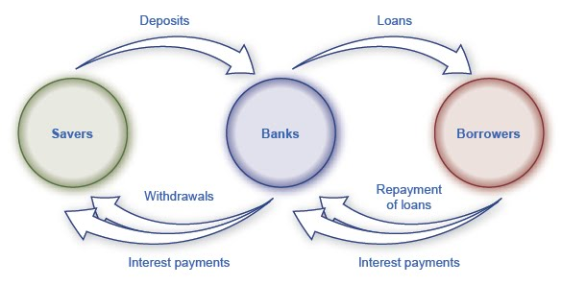
Banks as Financial Intermediaries,
Illustrated
Banks act as financial intermediaries because they stand between savers and borrowers.
Savers place deposits with banks, and then receive interest payments and withdraw money.
Borrowers receive loans from banks and repay the loans with interest.
In turn, banks return money to savers in the form of withdrawals, which also include interest payments from banks to savers.

Slide 16
A Bank’s Balance Sheet
Balance sheet - an accounting tool that lists assets and liabilities.
Asset - item of value that a firm or an individual owns.
Liability - any amount or debt that a firm or an individual owes.
Net worth - the excess of the asset value over and above the amount of the liability; total assets minus total liabilities.
Bank capital - a bank’s net worth.

Slide 17

A Bank’s Balance Sheet
This figure shows a hypothetical and simplified balance sheet for the Safe and Secure Bank.
T-account - a balance sheet with a two-column format, with the T-shape formed by the vertical line down the middle and the horizontal line under the column headings for “Assets” and “Liabilities”.
The “T” in a T-account has:
the assets of a firm, on the left
its liabilities, on the right.

Slide 18
Reserves and Bankruptcy
Reserves - funds that a bank keeps on hand and that it does not loan out or invest in bonds.
The Federal Reserve requires that banks keep a certain percentage of depositors’ money on “reserve”.
We define net worth of a bank as its total assets minus its total liabilities.
For a financially healthy bank, the net worth will be positive.
If a bank has negative net worth and depositors tried to withdraw their money, the bank would not be able to give all depositors their money.

Slide 19
How Banks Go Bankrupt
Potential problems for a bank:
High rate of loan defaults
Asset-liability time mismatch - the ability for customers to withdraw bank’s liabilities in the short term while customers repay its assets in the long term.
Strategies to reduce risk:
Diversify - making loans or investments with a variety of firms, to reduce the risk of being adversely affected by events at one or a few firms.
Sell some of the loans they make in the secondary loan market.
Hold a greater share of assets (government bonds or reserves).

Slide 20
14.4 How Banks Create Money, Part 1
The banking system can create money through the process of making loans.
In the T-account balance sheet above, Singelton Bank is simply storing money for depositors, and not making loans.
It cannot earn any interest income and cannot pay its depositors an interest rate.
Now, by loaning out $9 million and charging interest, it will be able to make interest payments to depositors.
This alters Singelton Bank’s balance sheet:
It now has $1 million in (required 10%) reserves and a loan to Hank’s Auto Supply of $9 million.
Singelton Bank Balance Sheet
Singelton Bank Balance Sheet

Slide 21
How Banks Create Money, Part 2
First National Balance Sheet
Singelton Bank issues Hank’s Auto Supply a cashier’s check for the $9 million.
Hank deposits the loan in his regular checking account with First National Bank.
The deposits at First National Bank rise by $9 million and its reserves also rise by $9 million.
Bank lending has expanded the money supply by $9 million.
Now, First National Bank must hold some required reserves ($900,000) but can lend out the other amount ($8.1 million) in a loan to Jack’s Chevy Dealership.
First National Balance Sheet

Slide 22
How Banks Create Money, Part 3
Second National Balance Sheet
If Jack’s Chevy Dealership deposits the loan in its checking account at Second National, the money supply just increased by an additional $8.1 million.
Making loans that are then deposited into a demand deposit account increases the M1 money supply.
This money creation is possible because there are multiple banks in the financial system.
They are required to hold only a fraction of their deposits,
loans end up deposited in other banks,
which increases deposits and the money supply.

Slide 23
The Money Multiplier and a
Multi-Bank System
If all banks loan out their excess reserves, the money supply will expand.
In a multi-bank system, institutions determine the amount of money that the system can create by using the money multiplier.
The money multiplier formula = 1 / Reserve Requirement
By multiplying the money multiplier by the excess reserves, we can determine the total amount of M1 money supply created in the banking system.
Discussion Question: If the reserve requirement is 10%, and a bank’s excess reserves are $9 million, what is the change in the M1 money supply?

Slide 24
Cautions about the Money Multiplier
The quantity of money in an economy is closely linked to the quantity of lending or credit in the economy.
All the money in the economy, except for the original reserves, is a result of bank loans that institutions repeatedly re-deposit and loan.
A bank can also choose to hold extra reserves, above the required amount.
Banks may decide to vary how much they hold in reserves for two reasons:
macroeconomic conditions
government rules

Slide 25
Cautions about the Money Multiplier, Continued
In a recession, banks are likely to hold a higher proportion of reserves due to fear that customers are less likely to repay loans.
The Federal Reserve may also raise or lower the required reserves held by banks as a policy move to affect the quantity of money in an economy.
Additionally, if people do not deposit cash, banks cannot recirculate the money in the form of loans.

Slide 26
This OpenStax ancillary resource is © Rice University under a CC-BY 4.0 International license; it may be reproduced or modified but must be attributed to OpenStax, Rice University and any changes must be noted.

