Slide 1
Fantasy Football
Database
By Thomas Wilberding, David Djeljaj, Yariq Hasan

Slide 2
Problem Statement & System Requirements
Create a college football database containing teams, their stats, and their players
Administrators will enter data on the teams each week
Database applications are to use the stats of the teams to determine odds for the upcoming games each week.
System will allow teams to be enrolled in the database

Slide 3
Functional Requirements
Administrators can create and edit team entries to the database
Administrators can create and edit team stat entries
Administrators can create and edit player information
Administrators can delete all entries in the database

Slide 4
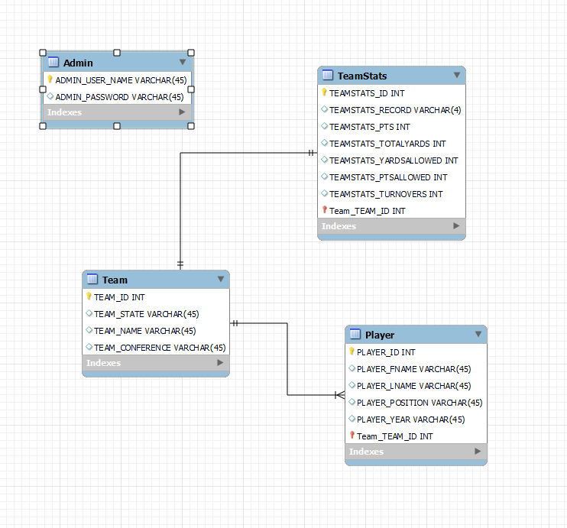
Conceptual Database

Slide 5
Tools Used in Development
MySQL workbench - create of ERD and forward engineering of the database
Nodejs - create sql queries and other functionality in webpage
Visual Studio Code - used in development of website
Discord - communication
Github - storing and sharing of code

Slide 6
Demo

