Slide 1
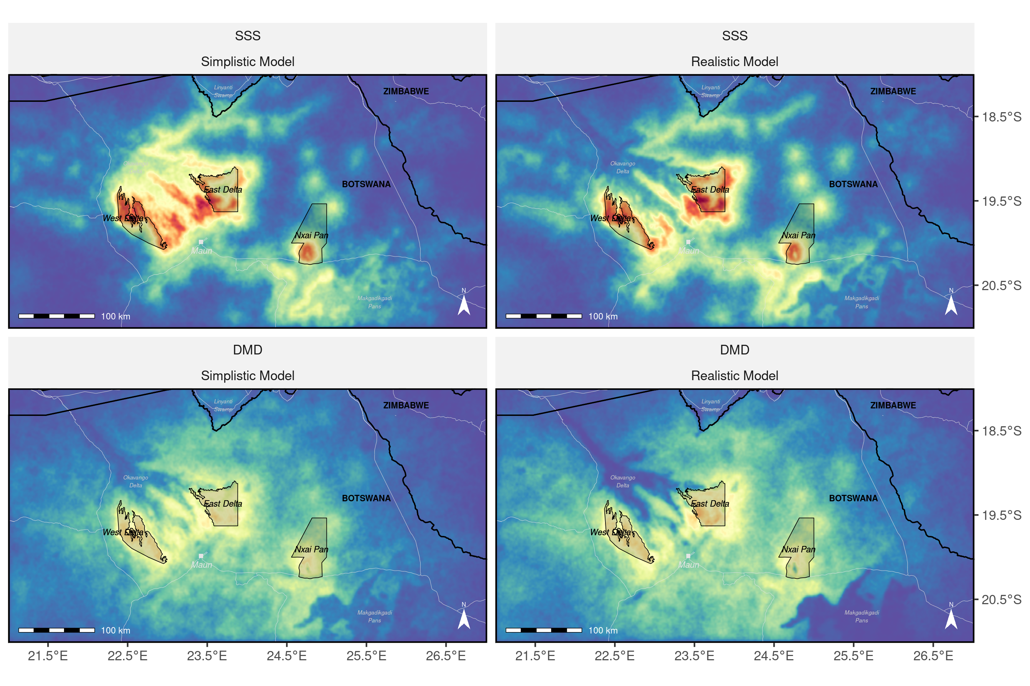
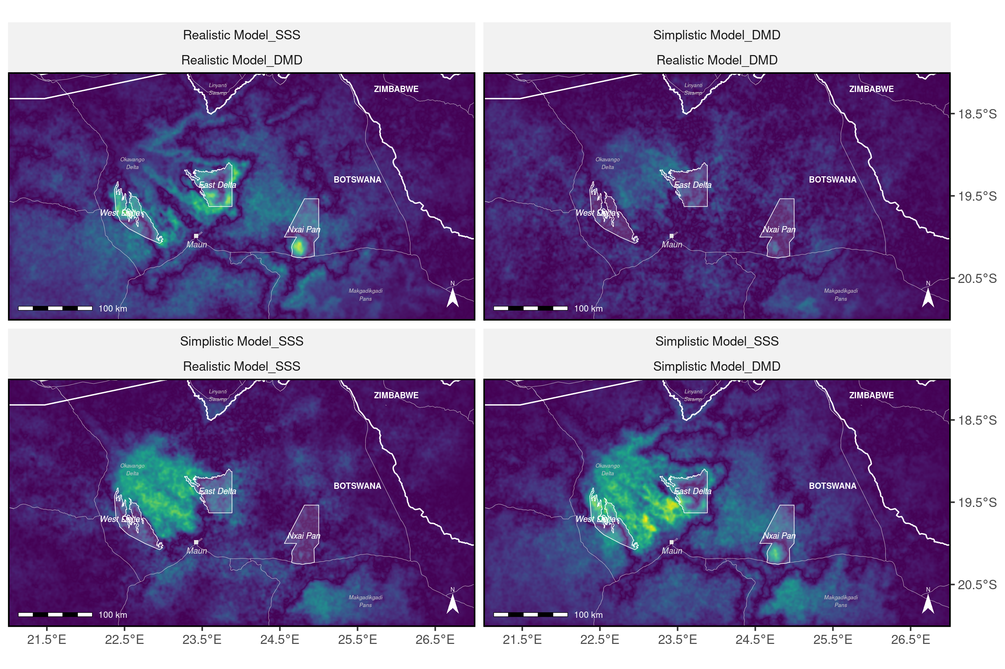
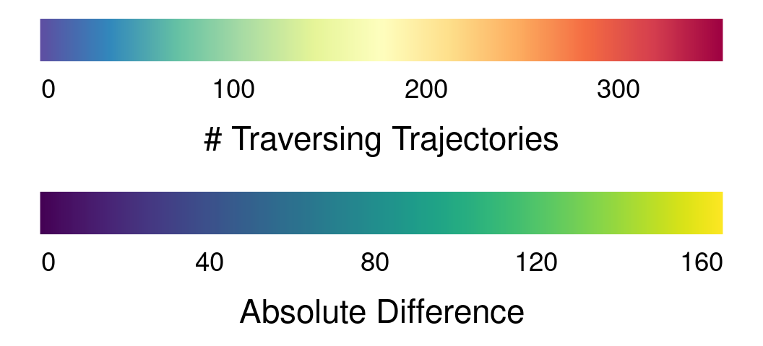
Simplistic Model
Realistic Model
|Realistic – Simplistic|
a
b
|b-a|
SSS
c
d
|d-c|
DMD
|c-a|
|d-b|
|DMD-SSS|
Notes:
1

