Slide 1
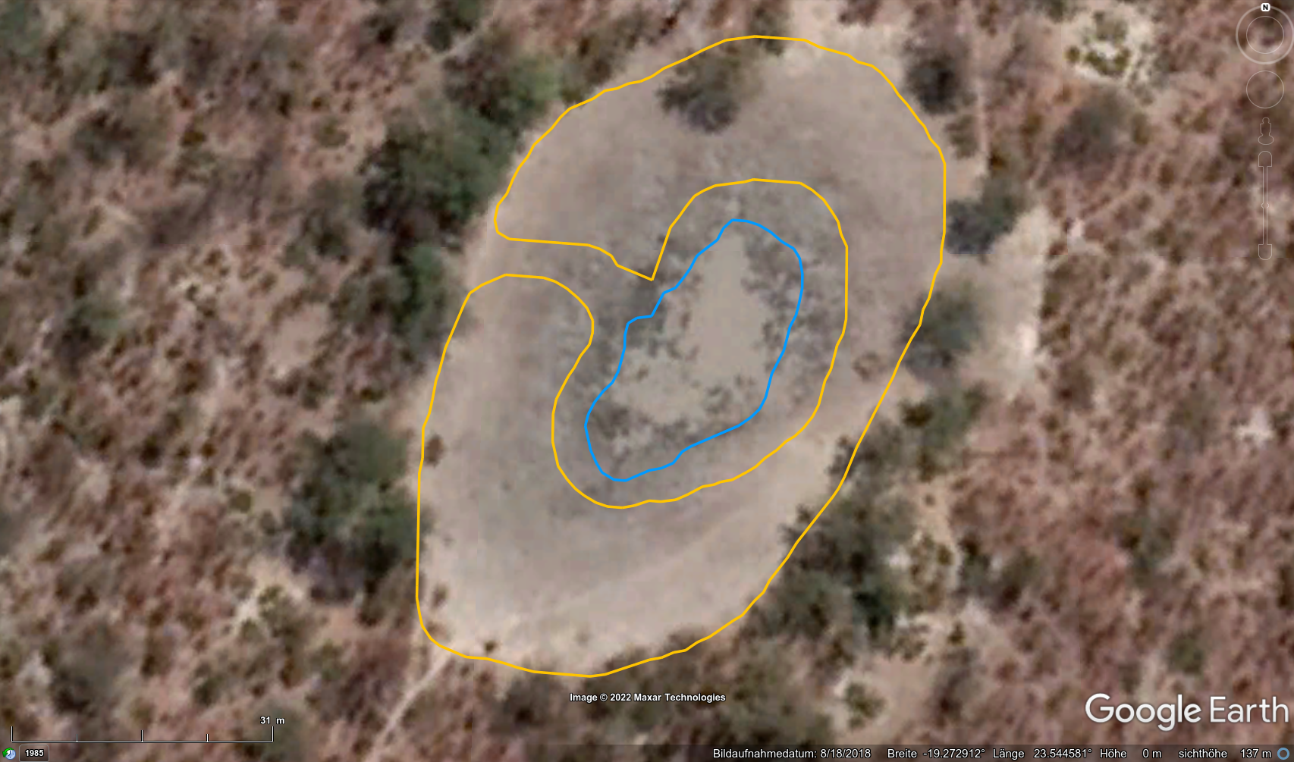
Wet-Pan
Dryland
(but seasonally inundated)
Image aquisition date

