Slide 1

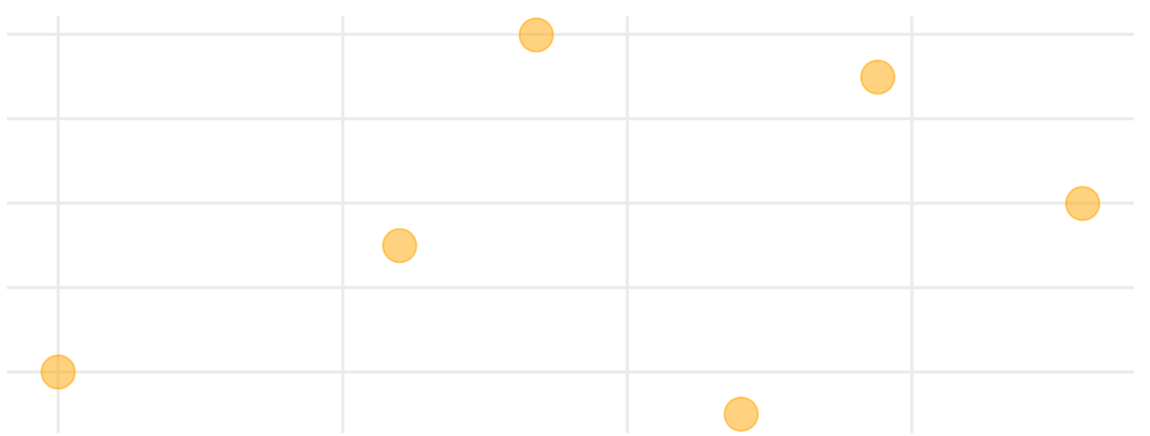
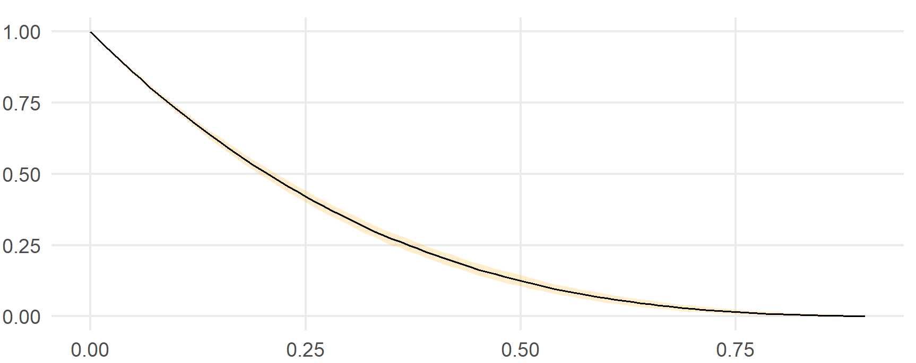
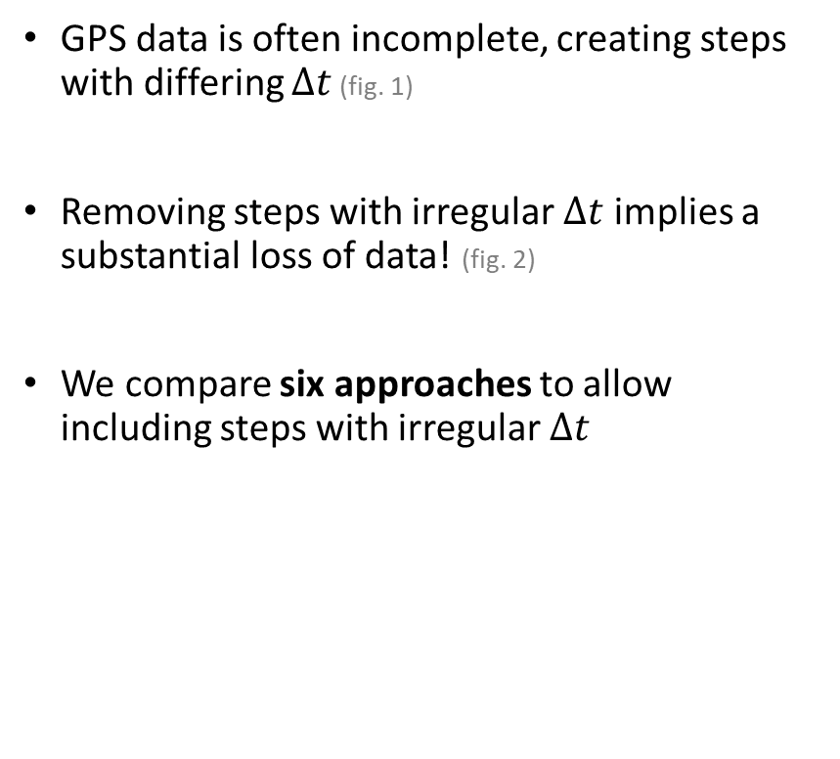
Step-Selection with Irregular Fixes
David Hofmann, PhD
University of Zurich
GPS data is often incomplete, creating steps with differing $∆t$ (fig. 1)
Removing steps with irregular $∆t$ implies a substantial loss of data! (fig. 2)
We compare six approaches to allow including steps with irregular $∆t$
11:00
10:00
$$∆t=1$$
Latitude
07:00
$$∆t=2$$
09:00
$$∆t=1$$
$$∆t=1$$
06:00
08:00
Longitude
Uncorrected | Modeled
Naive | Multistep
Dynamic | Imputed
Fraction of usable steps
Fraction of missing data

