Slide 1

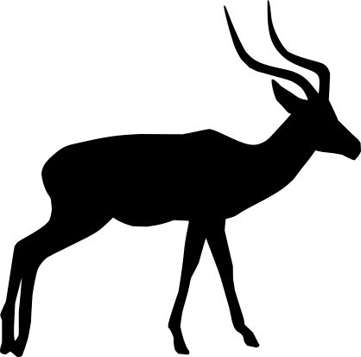




Pre-Processing
Animal-Detection
Species-Classification
Exif
Metadata
=
=
=
=
MegaDetector
TrapTagger

