Slide 1
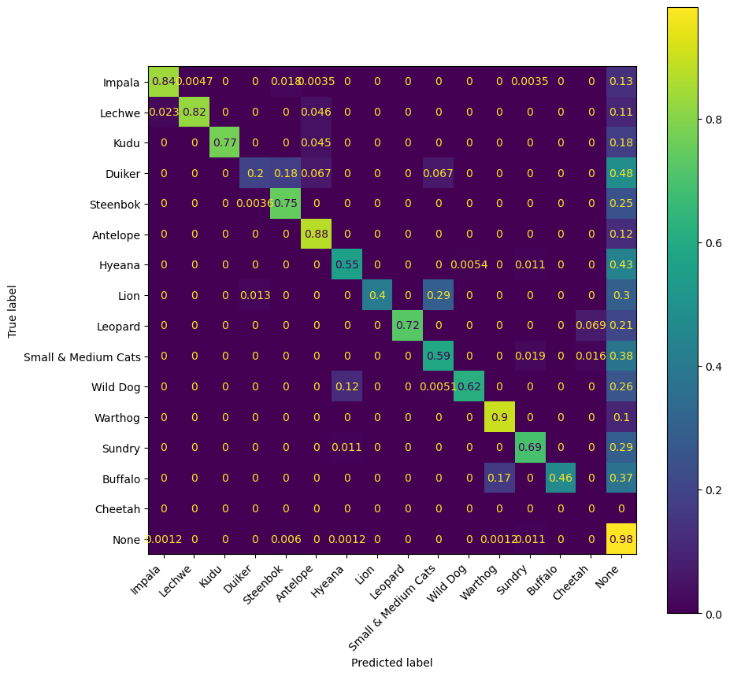
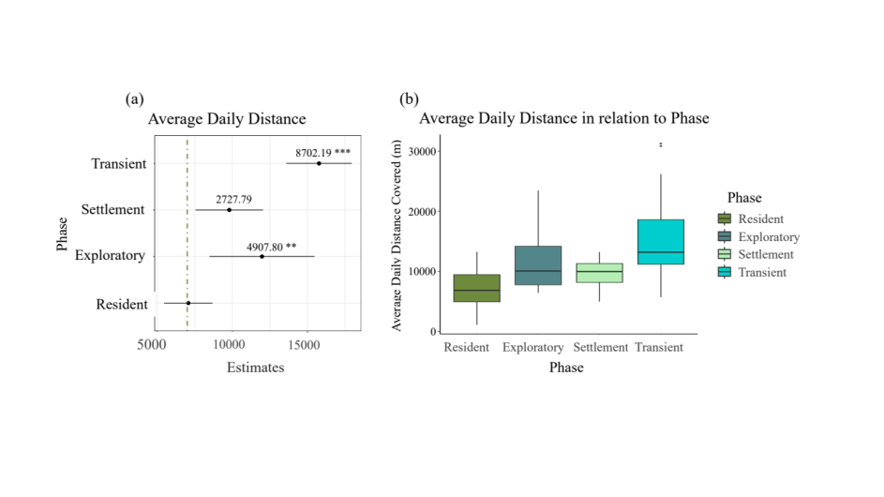
a
b
30,000
20,000
Average Daily Distance Covered (m)
True Label
Proportion of Labels
10,000
0
Resident
Exploratory
Settlement
Transience
Predicted Label

