Slide 1





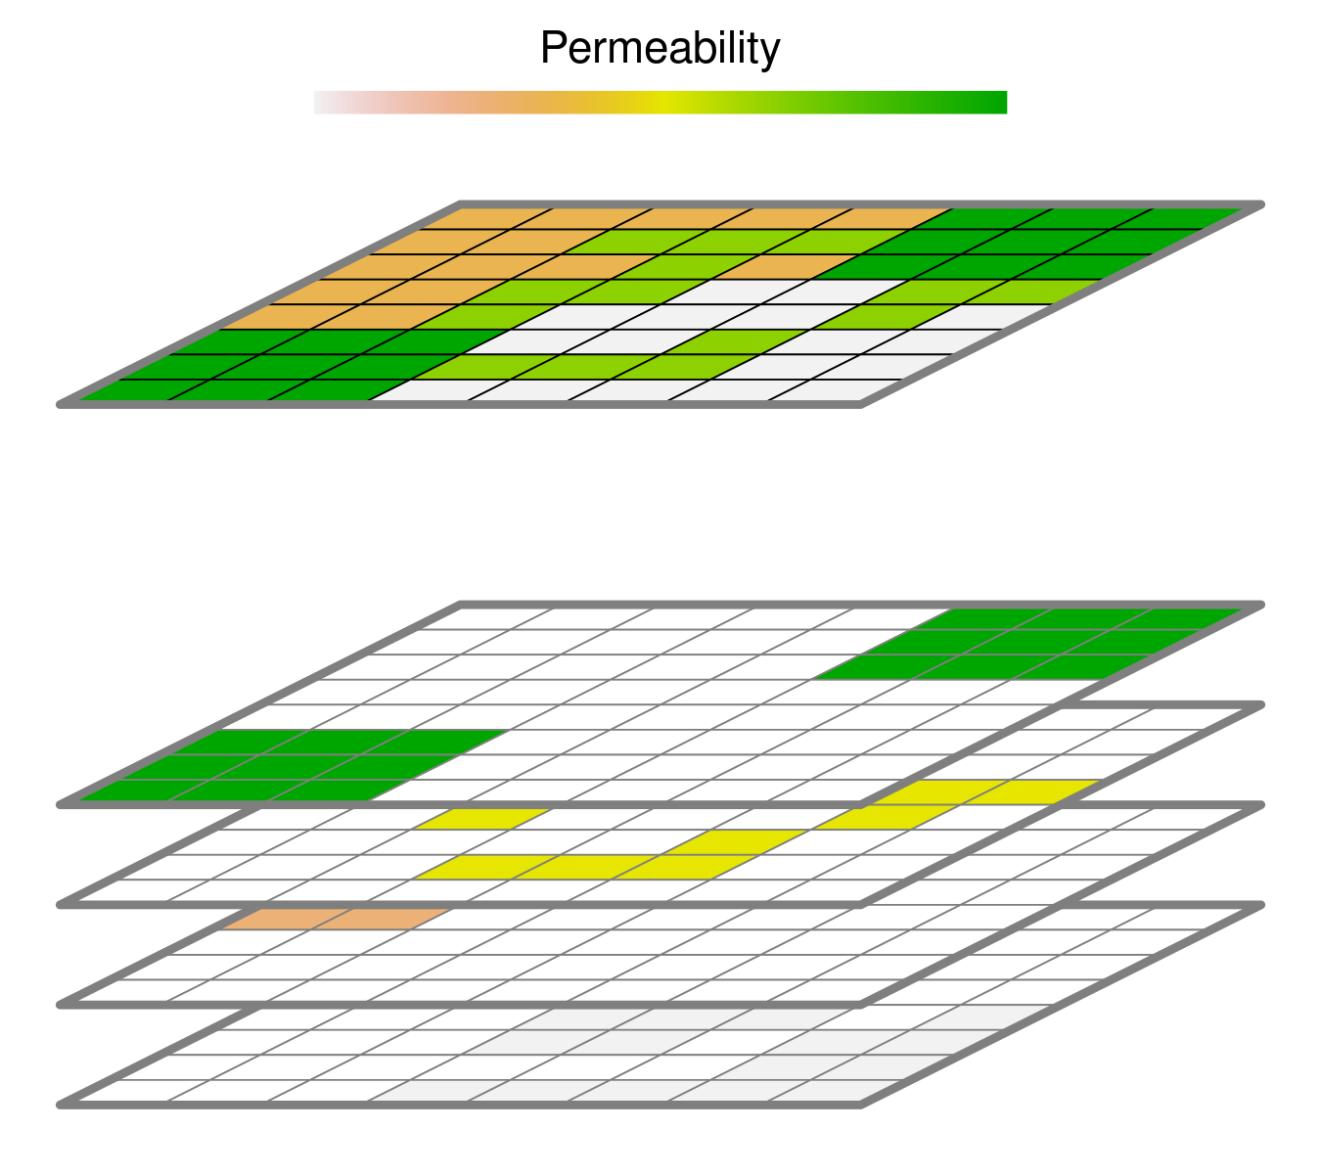





Connectivity Modeling Pipeline
Inference
Prediction / Simulation
Data
Selection Model
Permeability Surface
Connectivity Model
Point Selection
Least-Cost
Species Data
observed
available
Randomized Least-Cost
Path Selection
Circuit Theory
observed
available
Environmental Data
Step Selection
Individual-Based
observed
available

