Slide 1
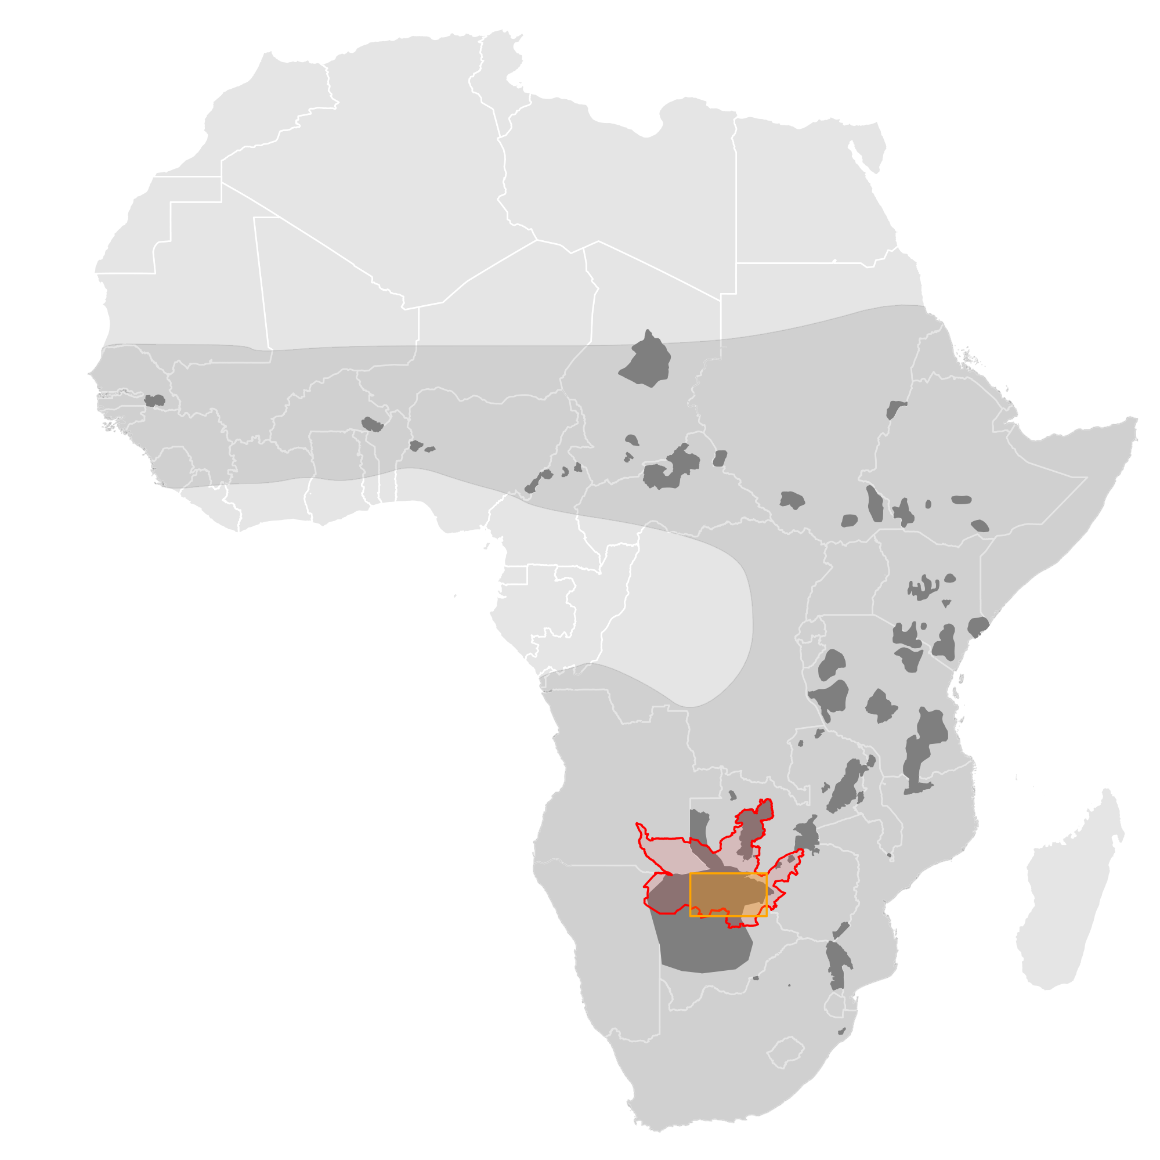
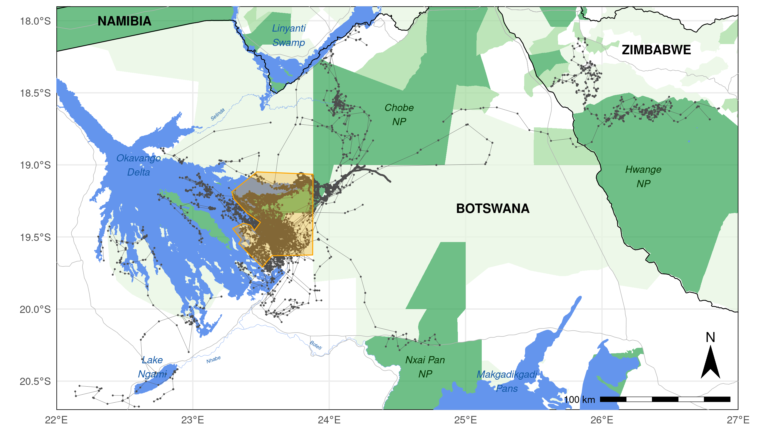

a
b
Historic Range of L. pictus
Current Range of L. pictus
Country Borders
National Parks
BPC Study Area
Roads
Forest Reserves
Main Study Area
Open Water & Rivers
KAZA-TFCA
GPS During Dispersal
Other Protected Areas

