Slide 1
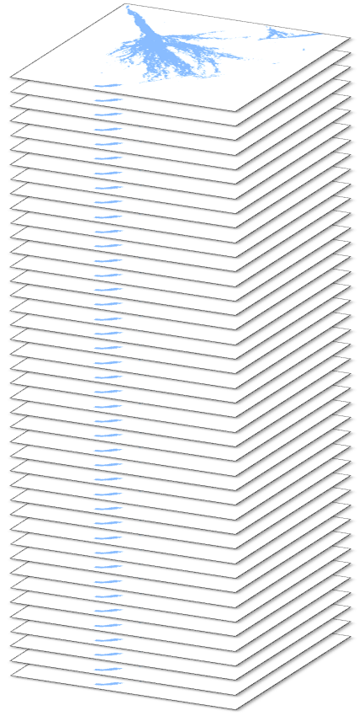
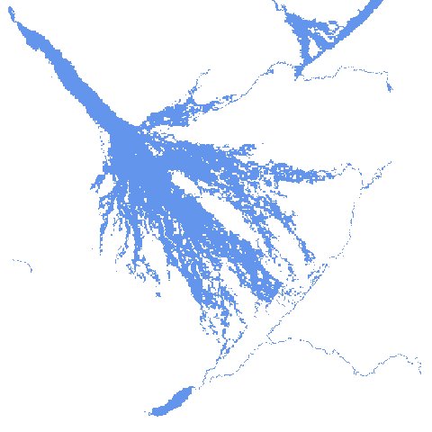
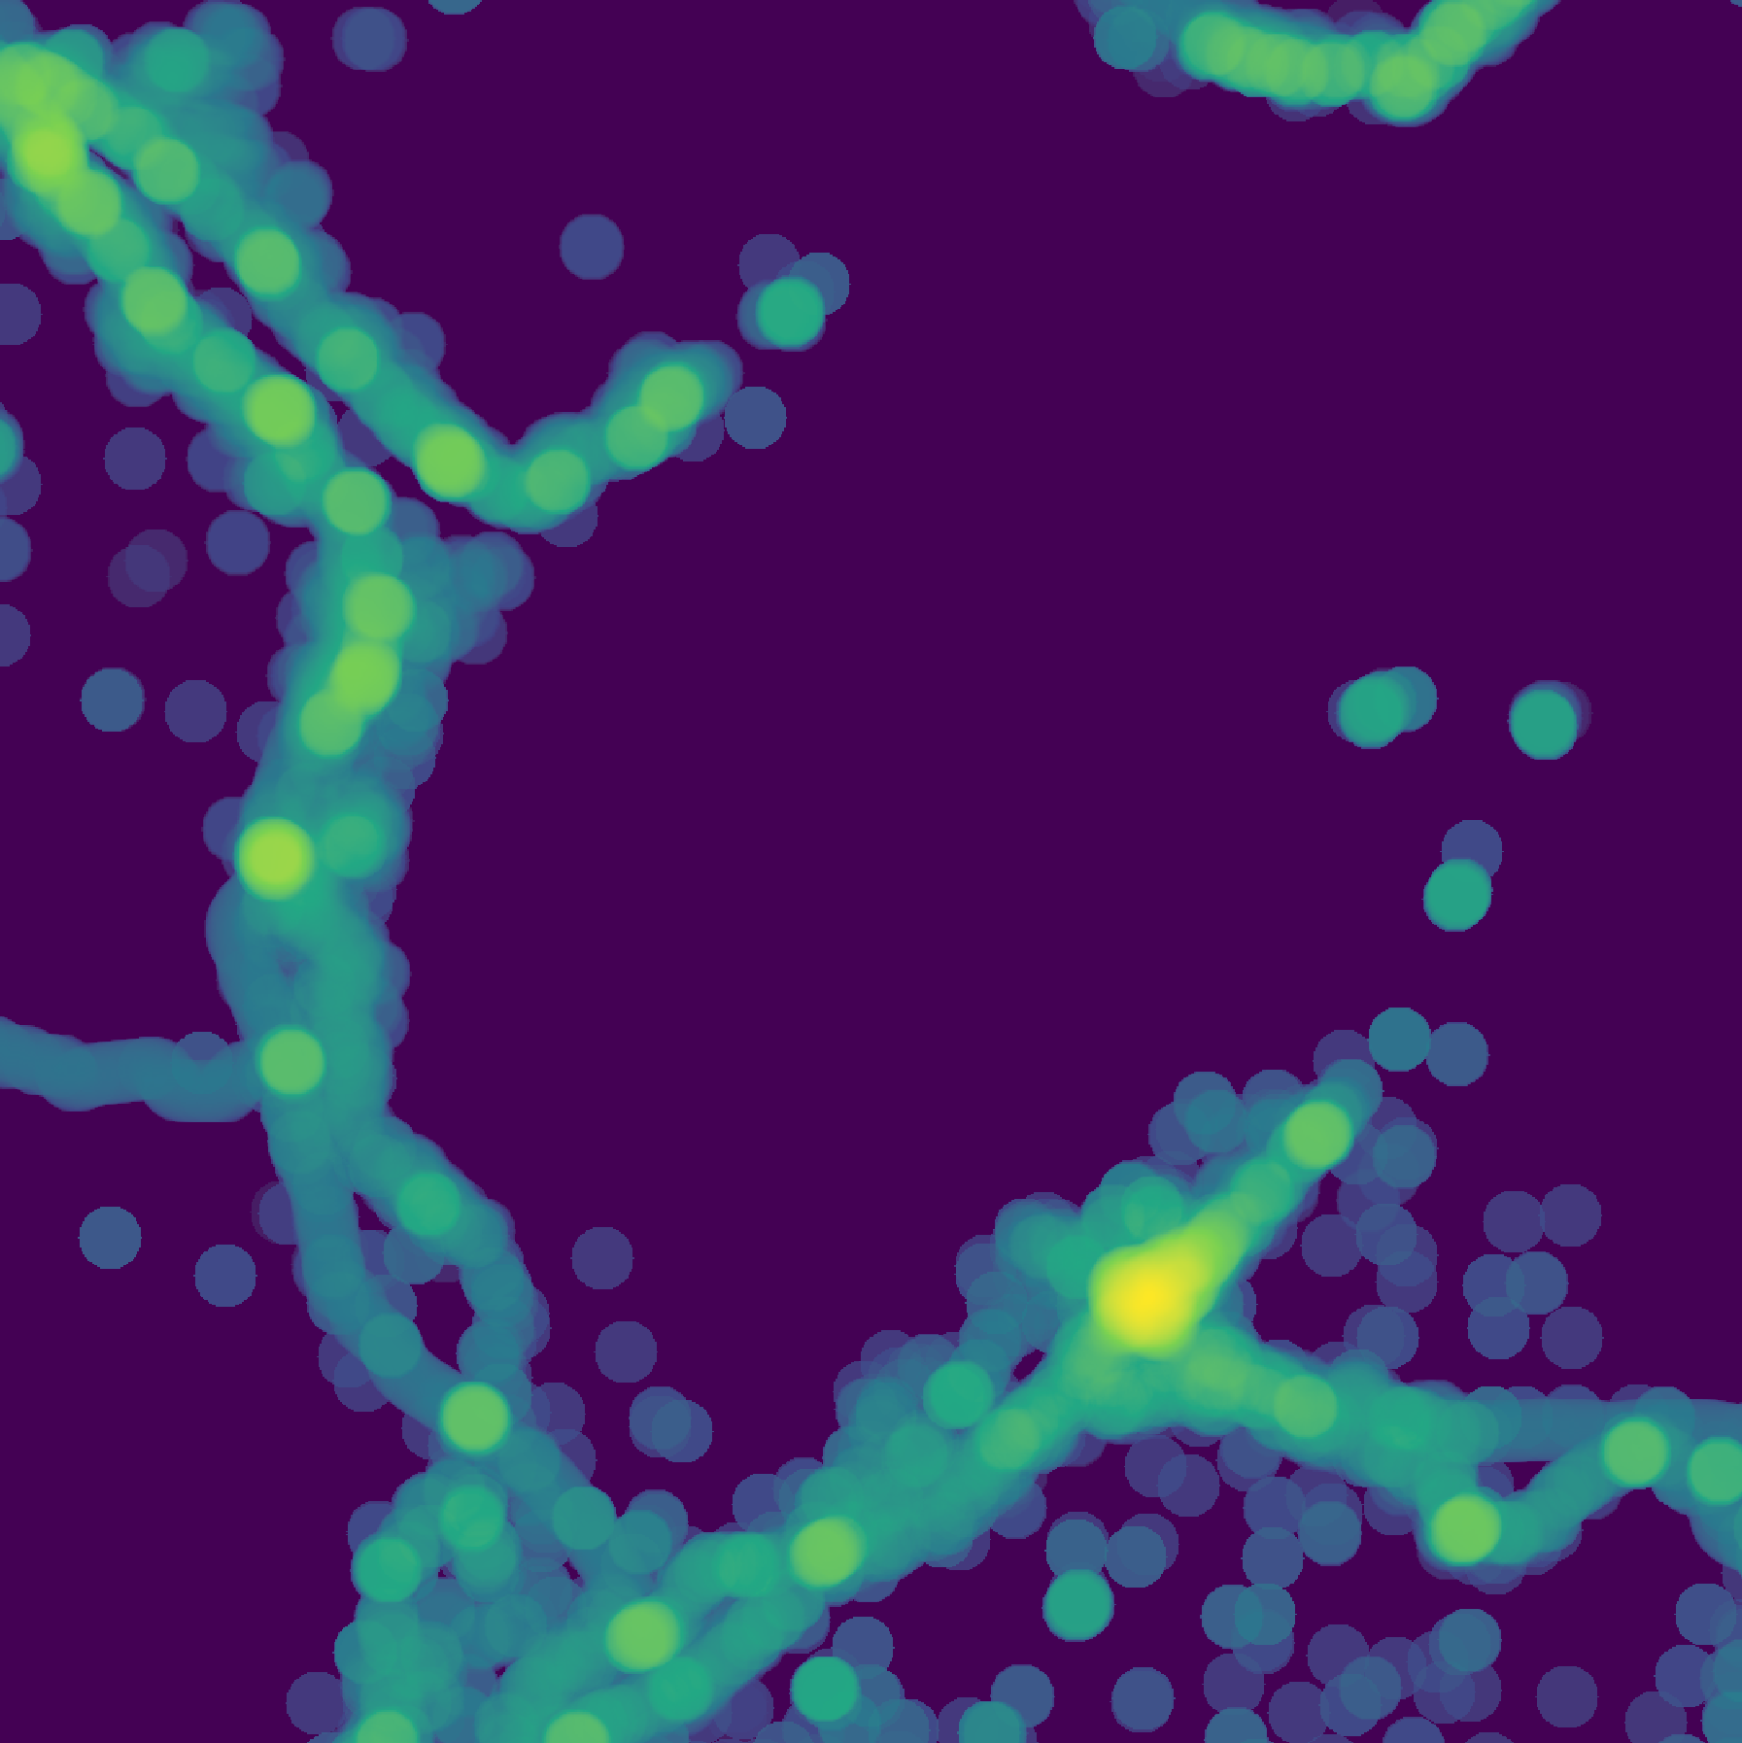

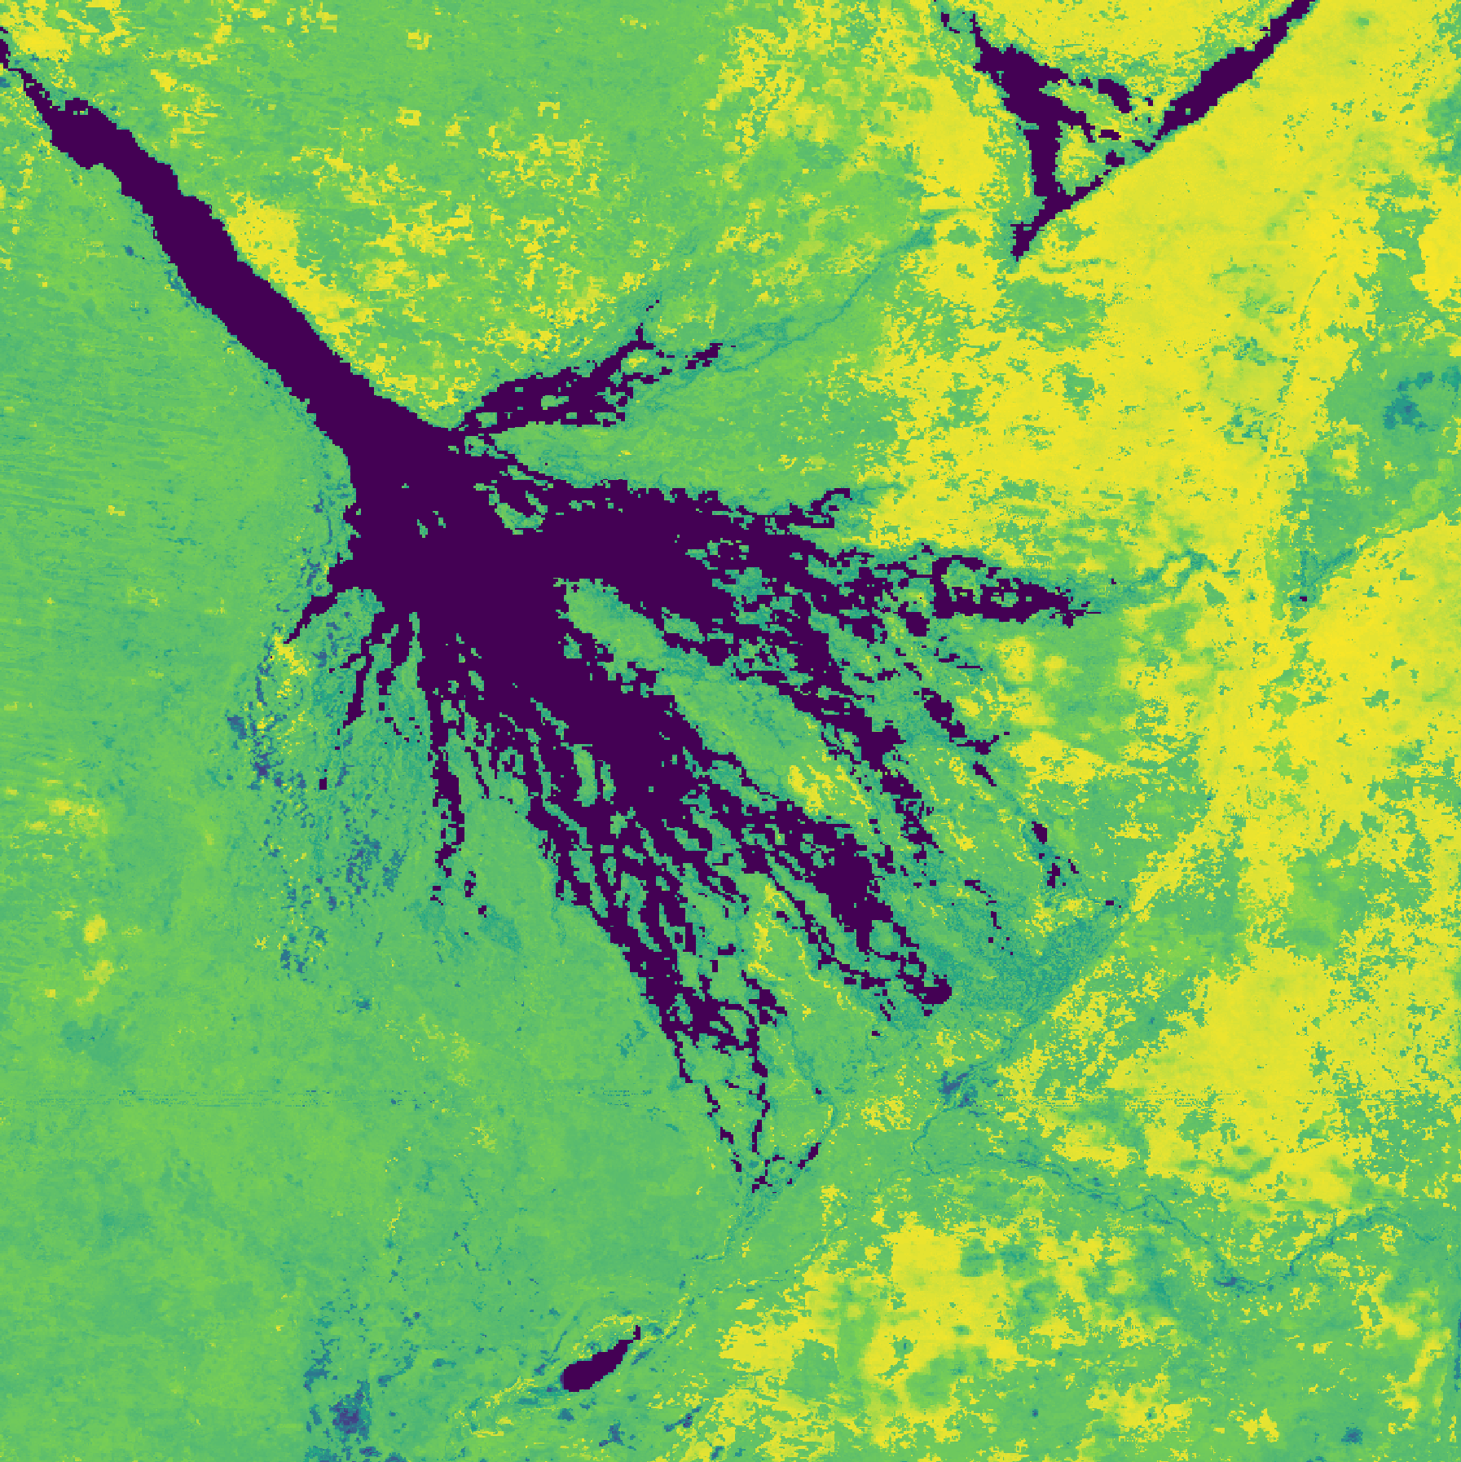
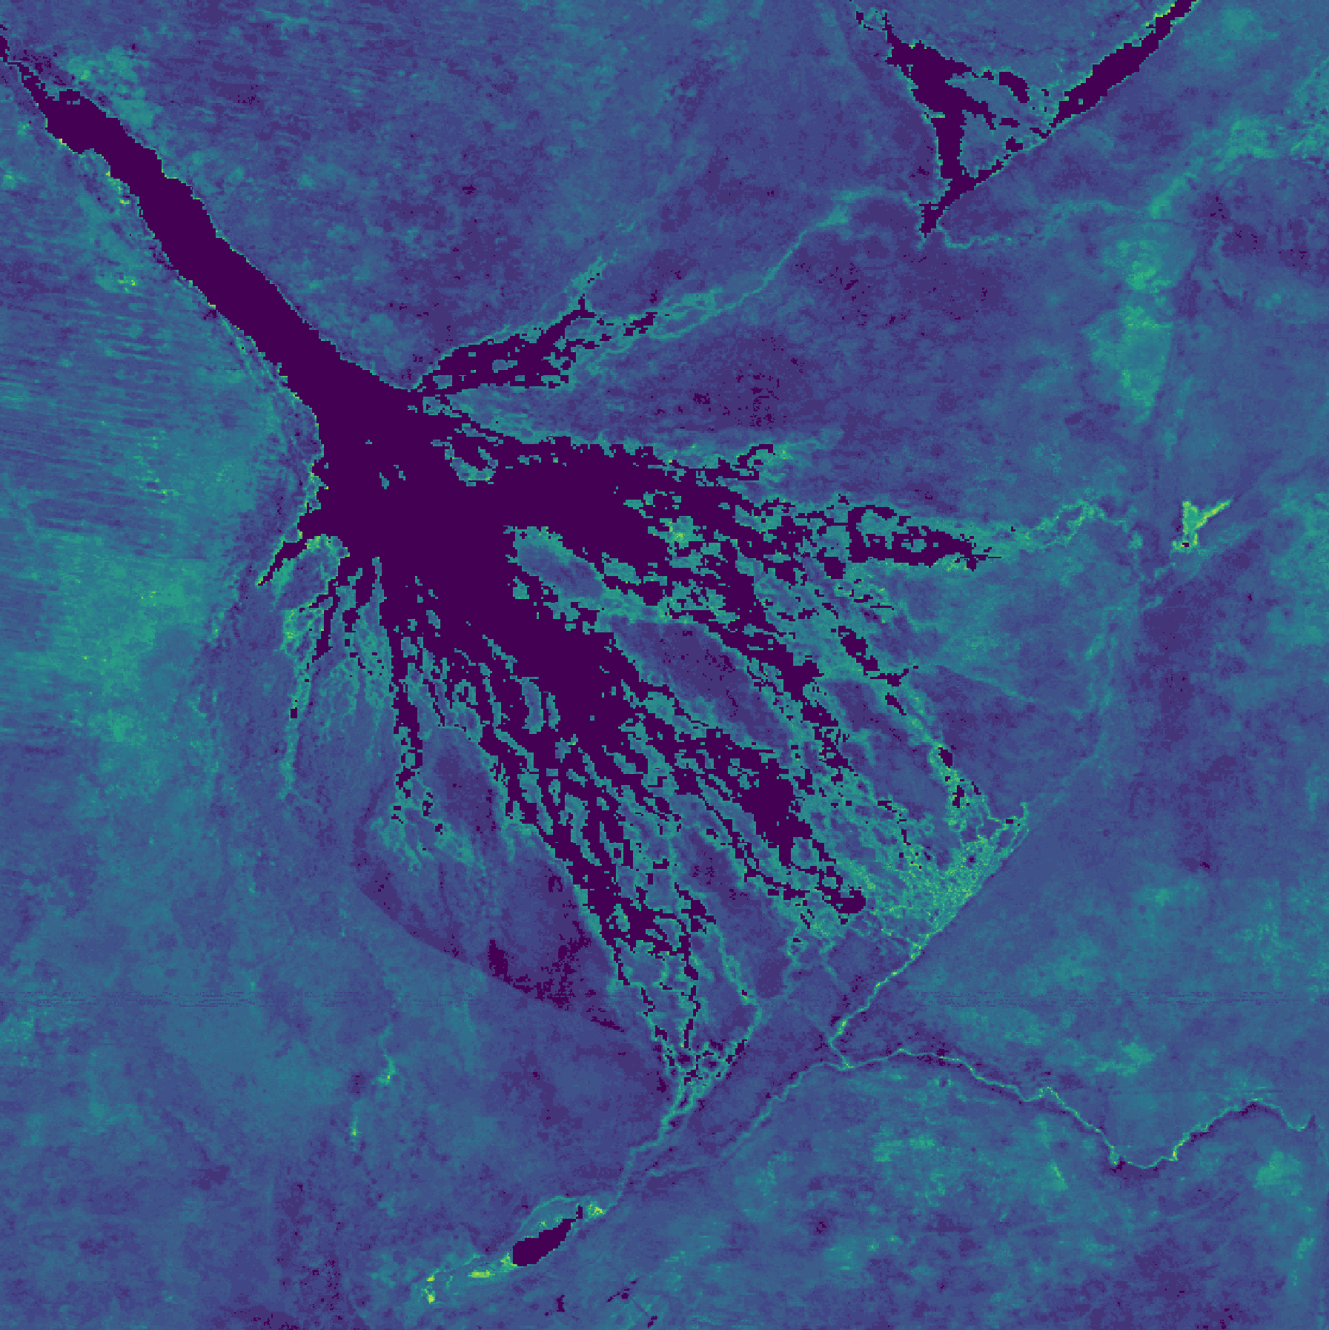
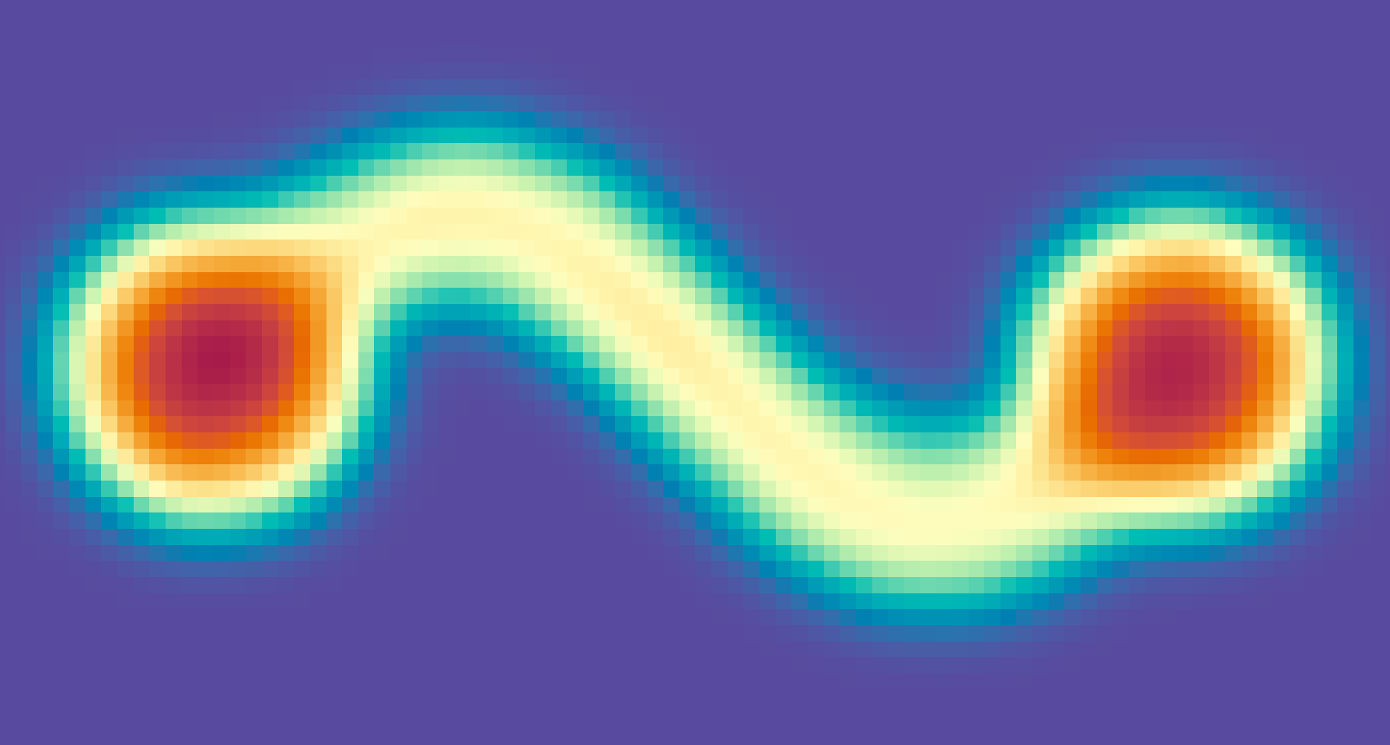
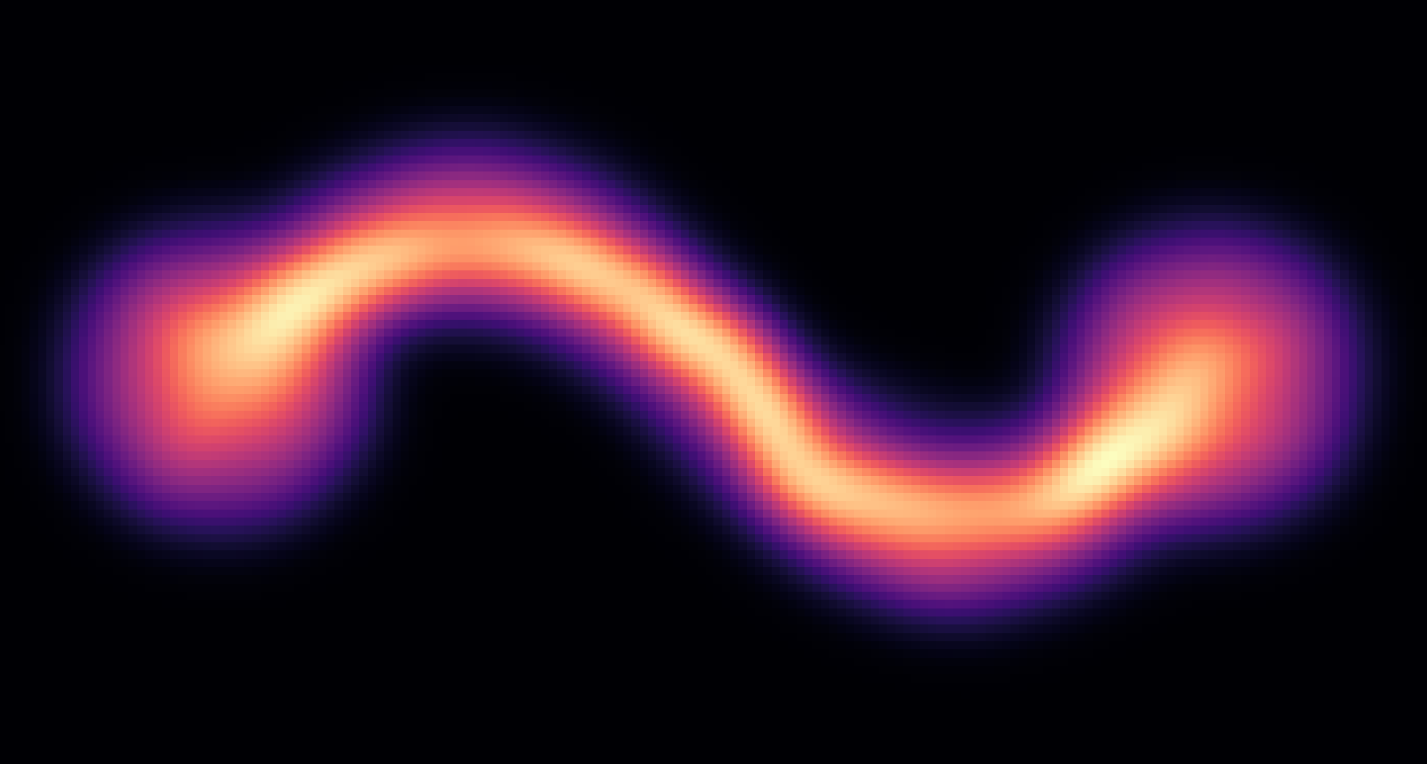
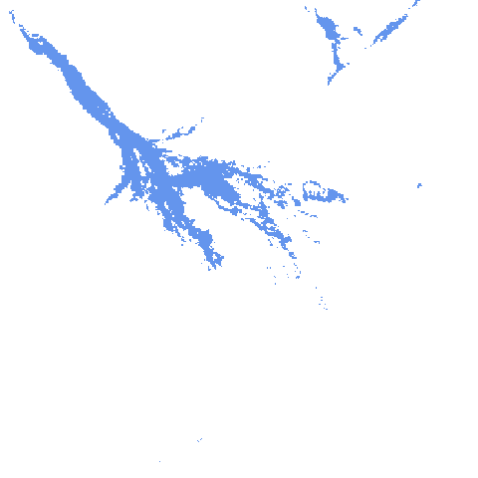
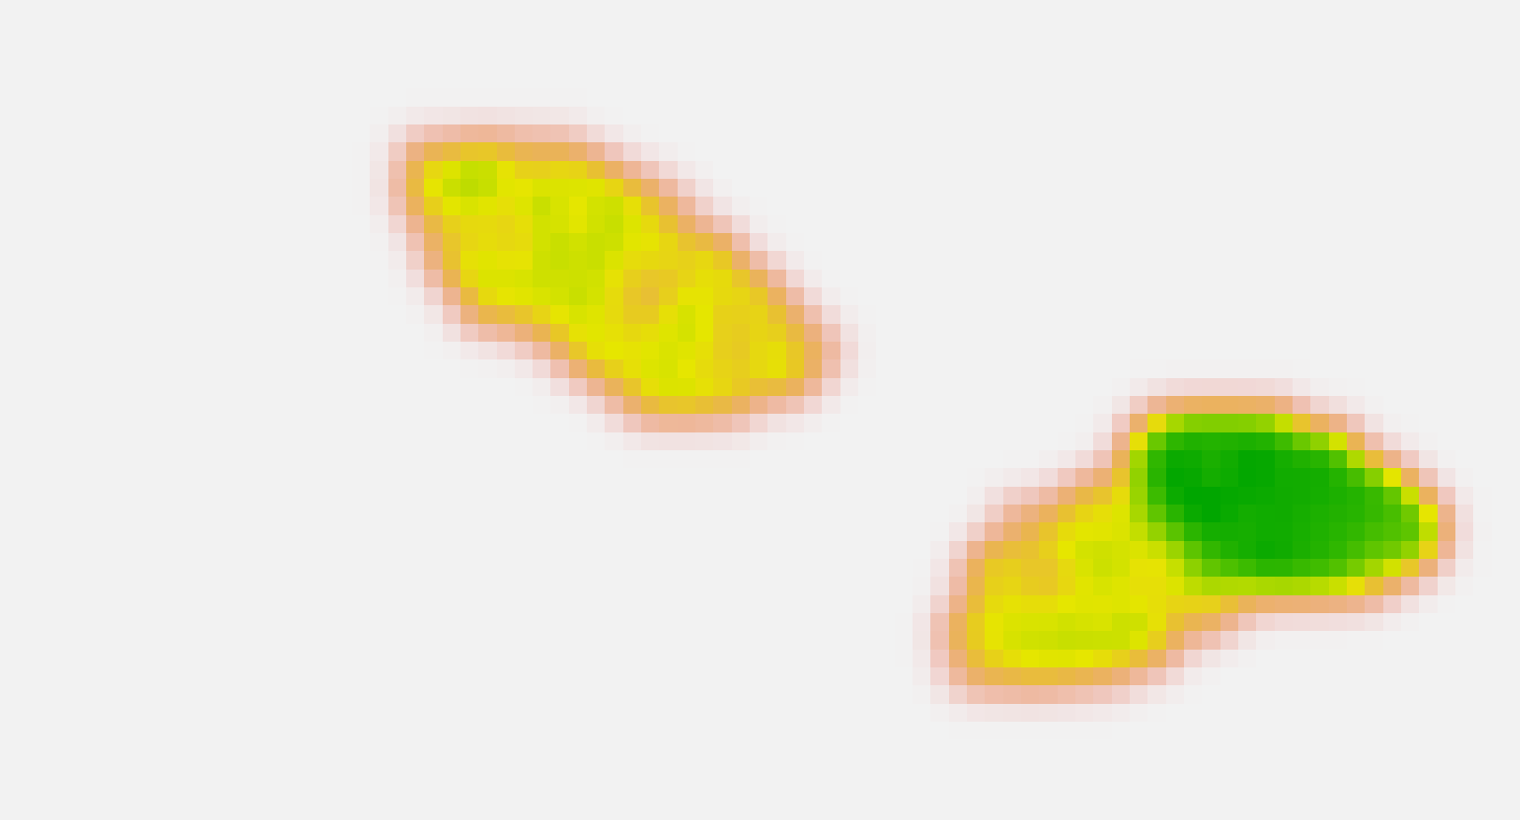

a
b
c
Extreme Environmental Scenarios
Dispersal-Simulation
Connectivity Mapping
Inter-Patch Connectivity
maximum flood
max
(n = 100)
Intensity of Use
Flood Extent
static covariates
Betweenness
minimum flood
min
(n = 100)
Human-Wildlife Conflict Potential
2000-2019
(n = 700)
static covariates
Simulation governed by an empirically parameterized iSSF dispersal model (Hofmann et al., 2023)
Adapted from Hofmann et al., 2023

