Slide 1
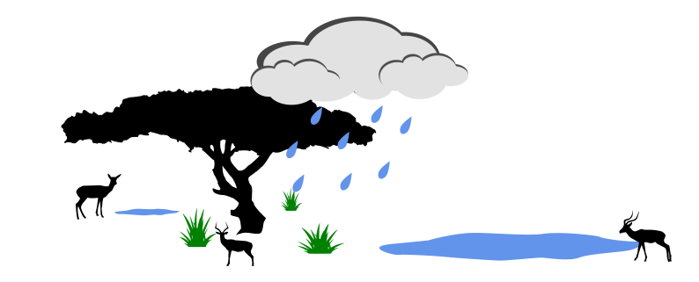



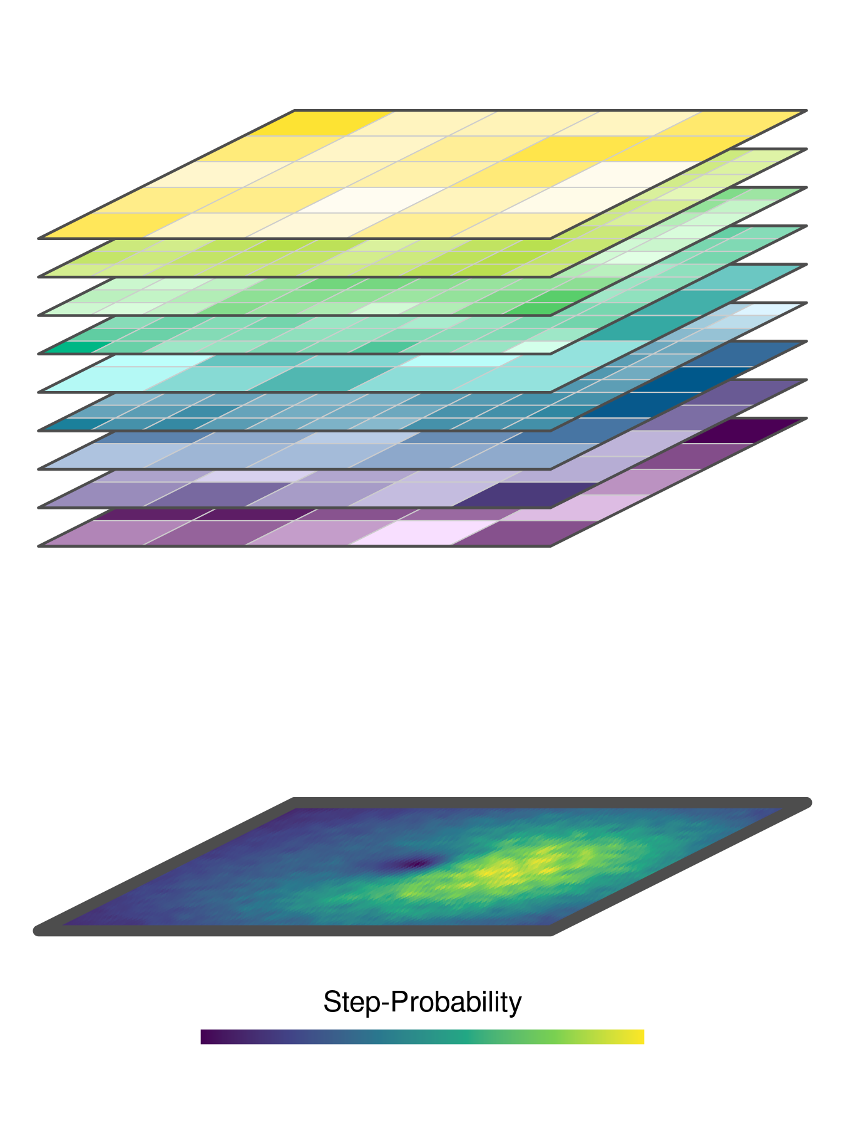

Time
(day of the year)
Covariate-Stackt
iSSF
Redistribution Kernel

