Slide 1
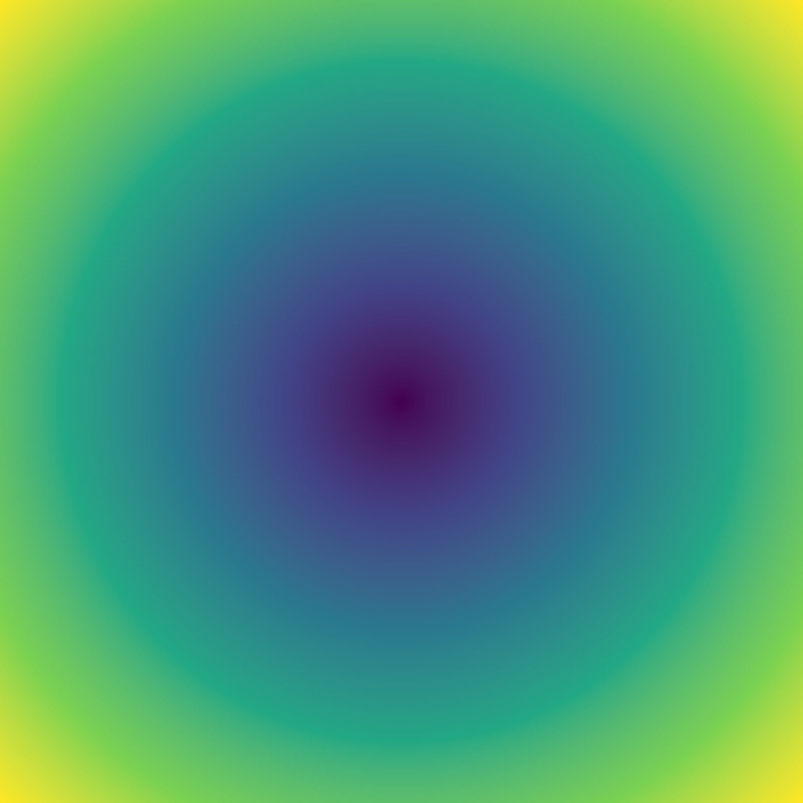
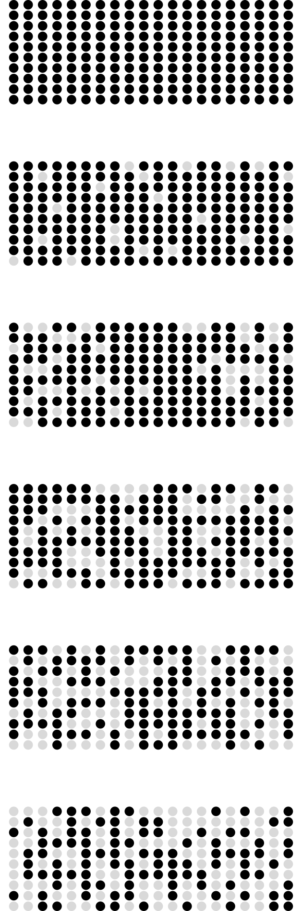
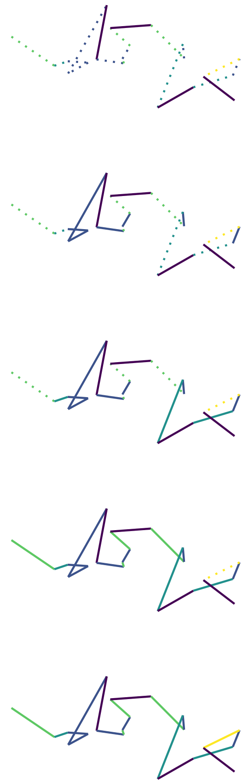
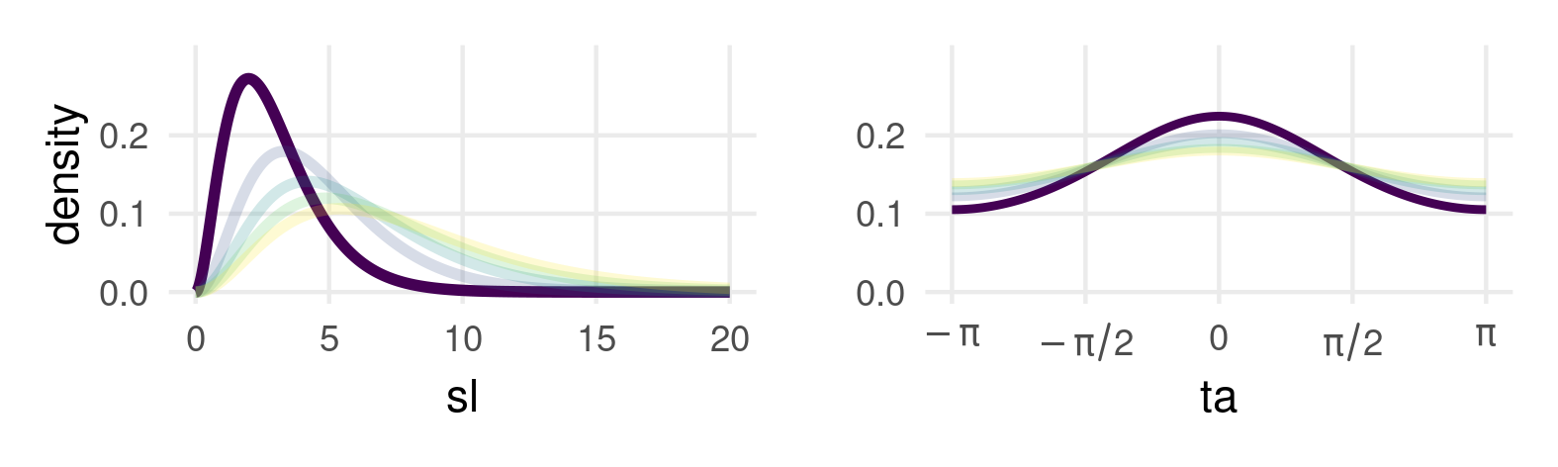
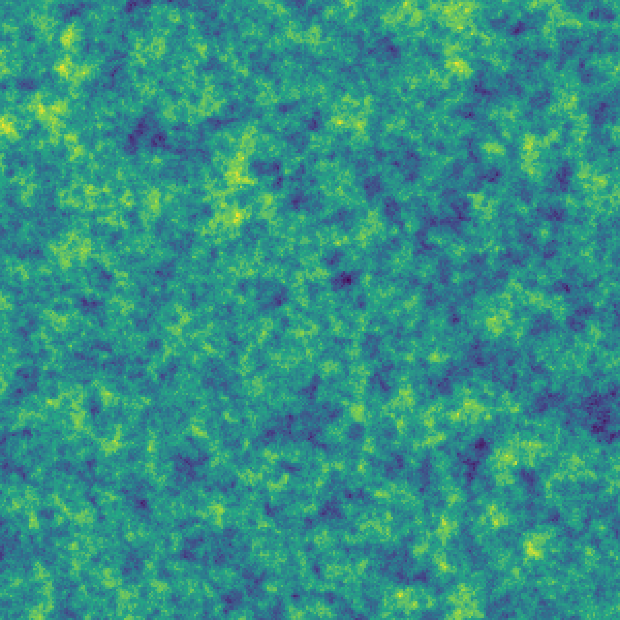
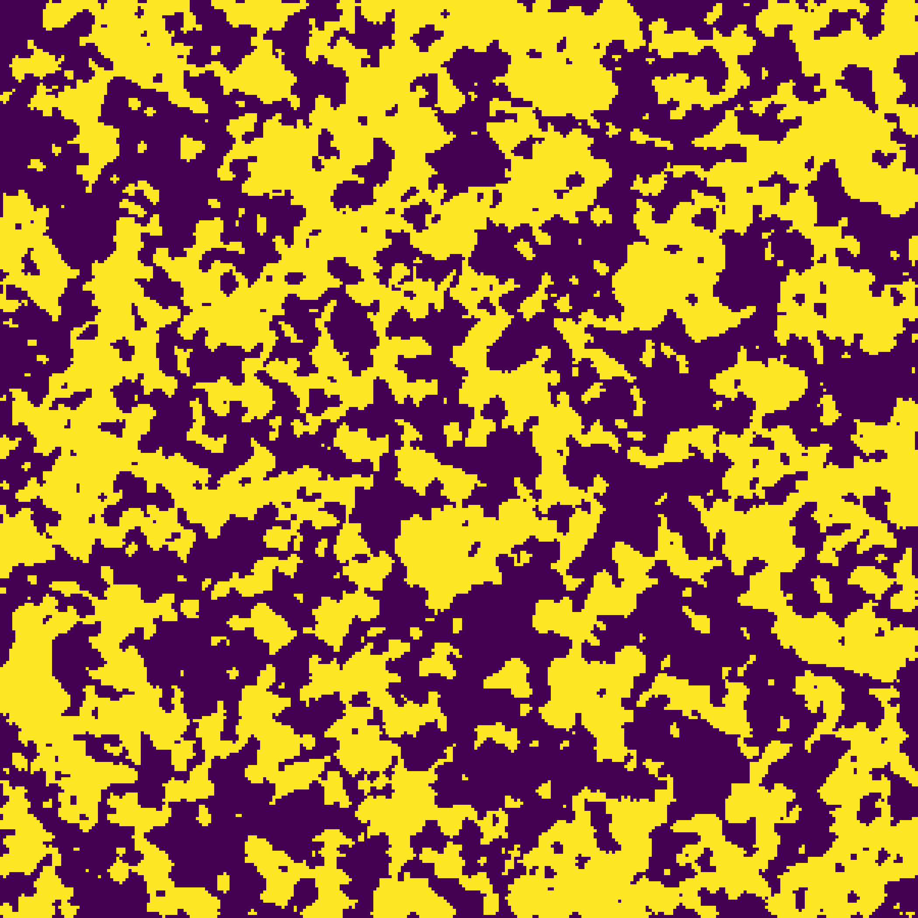

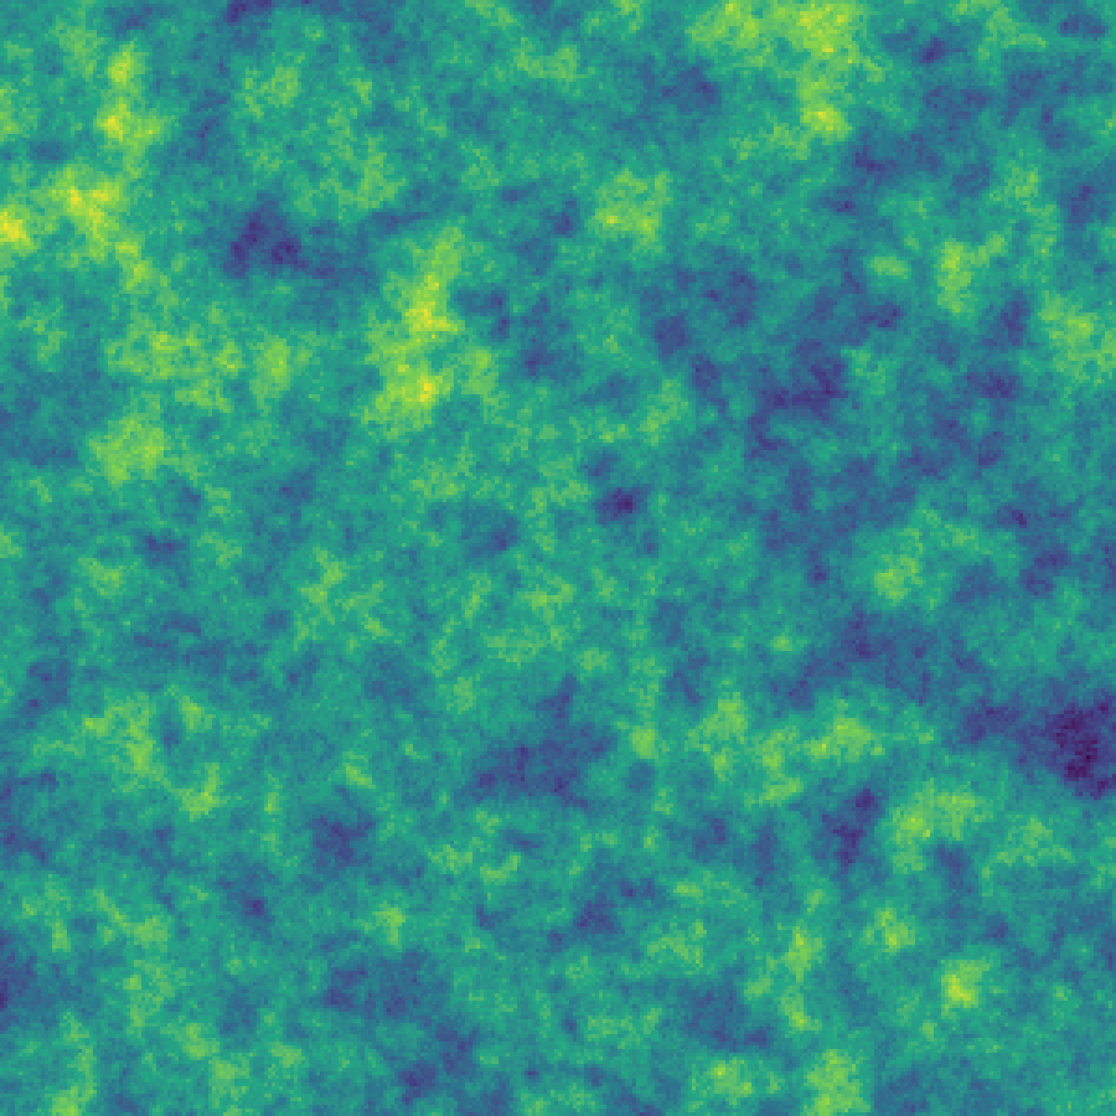
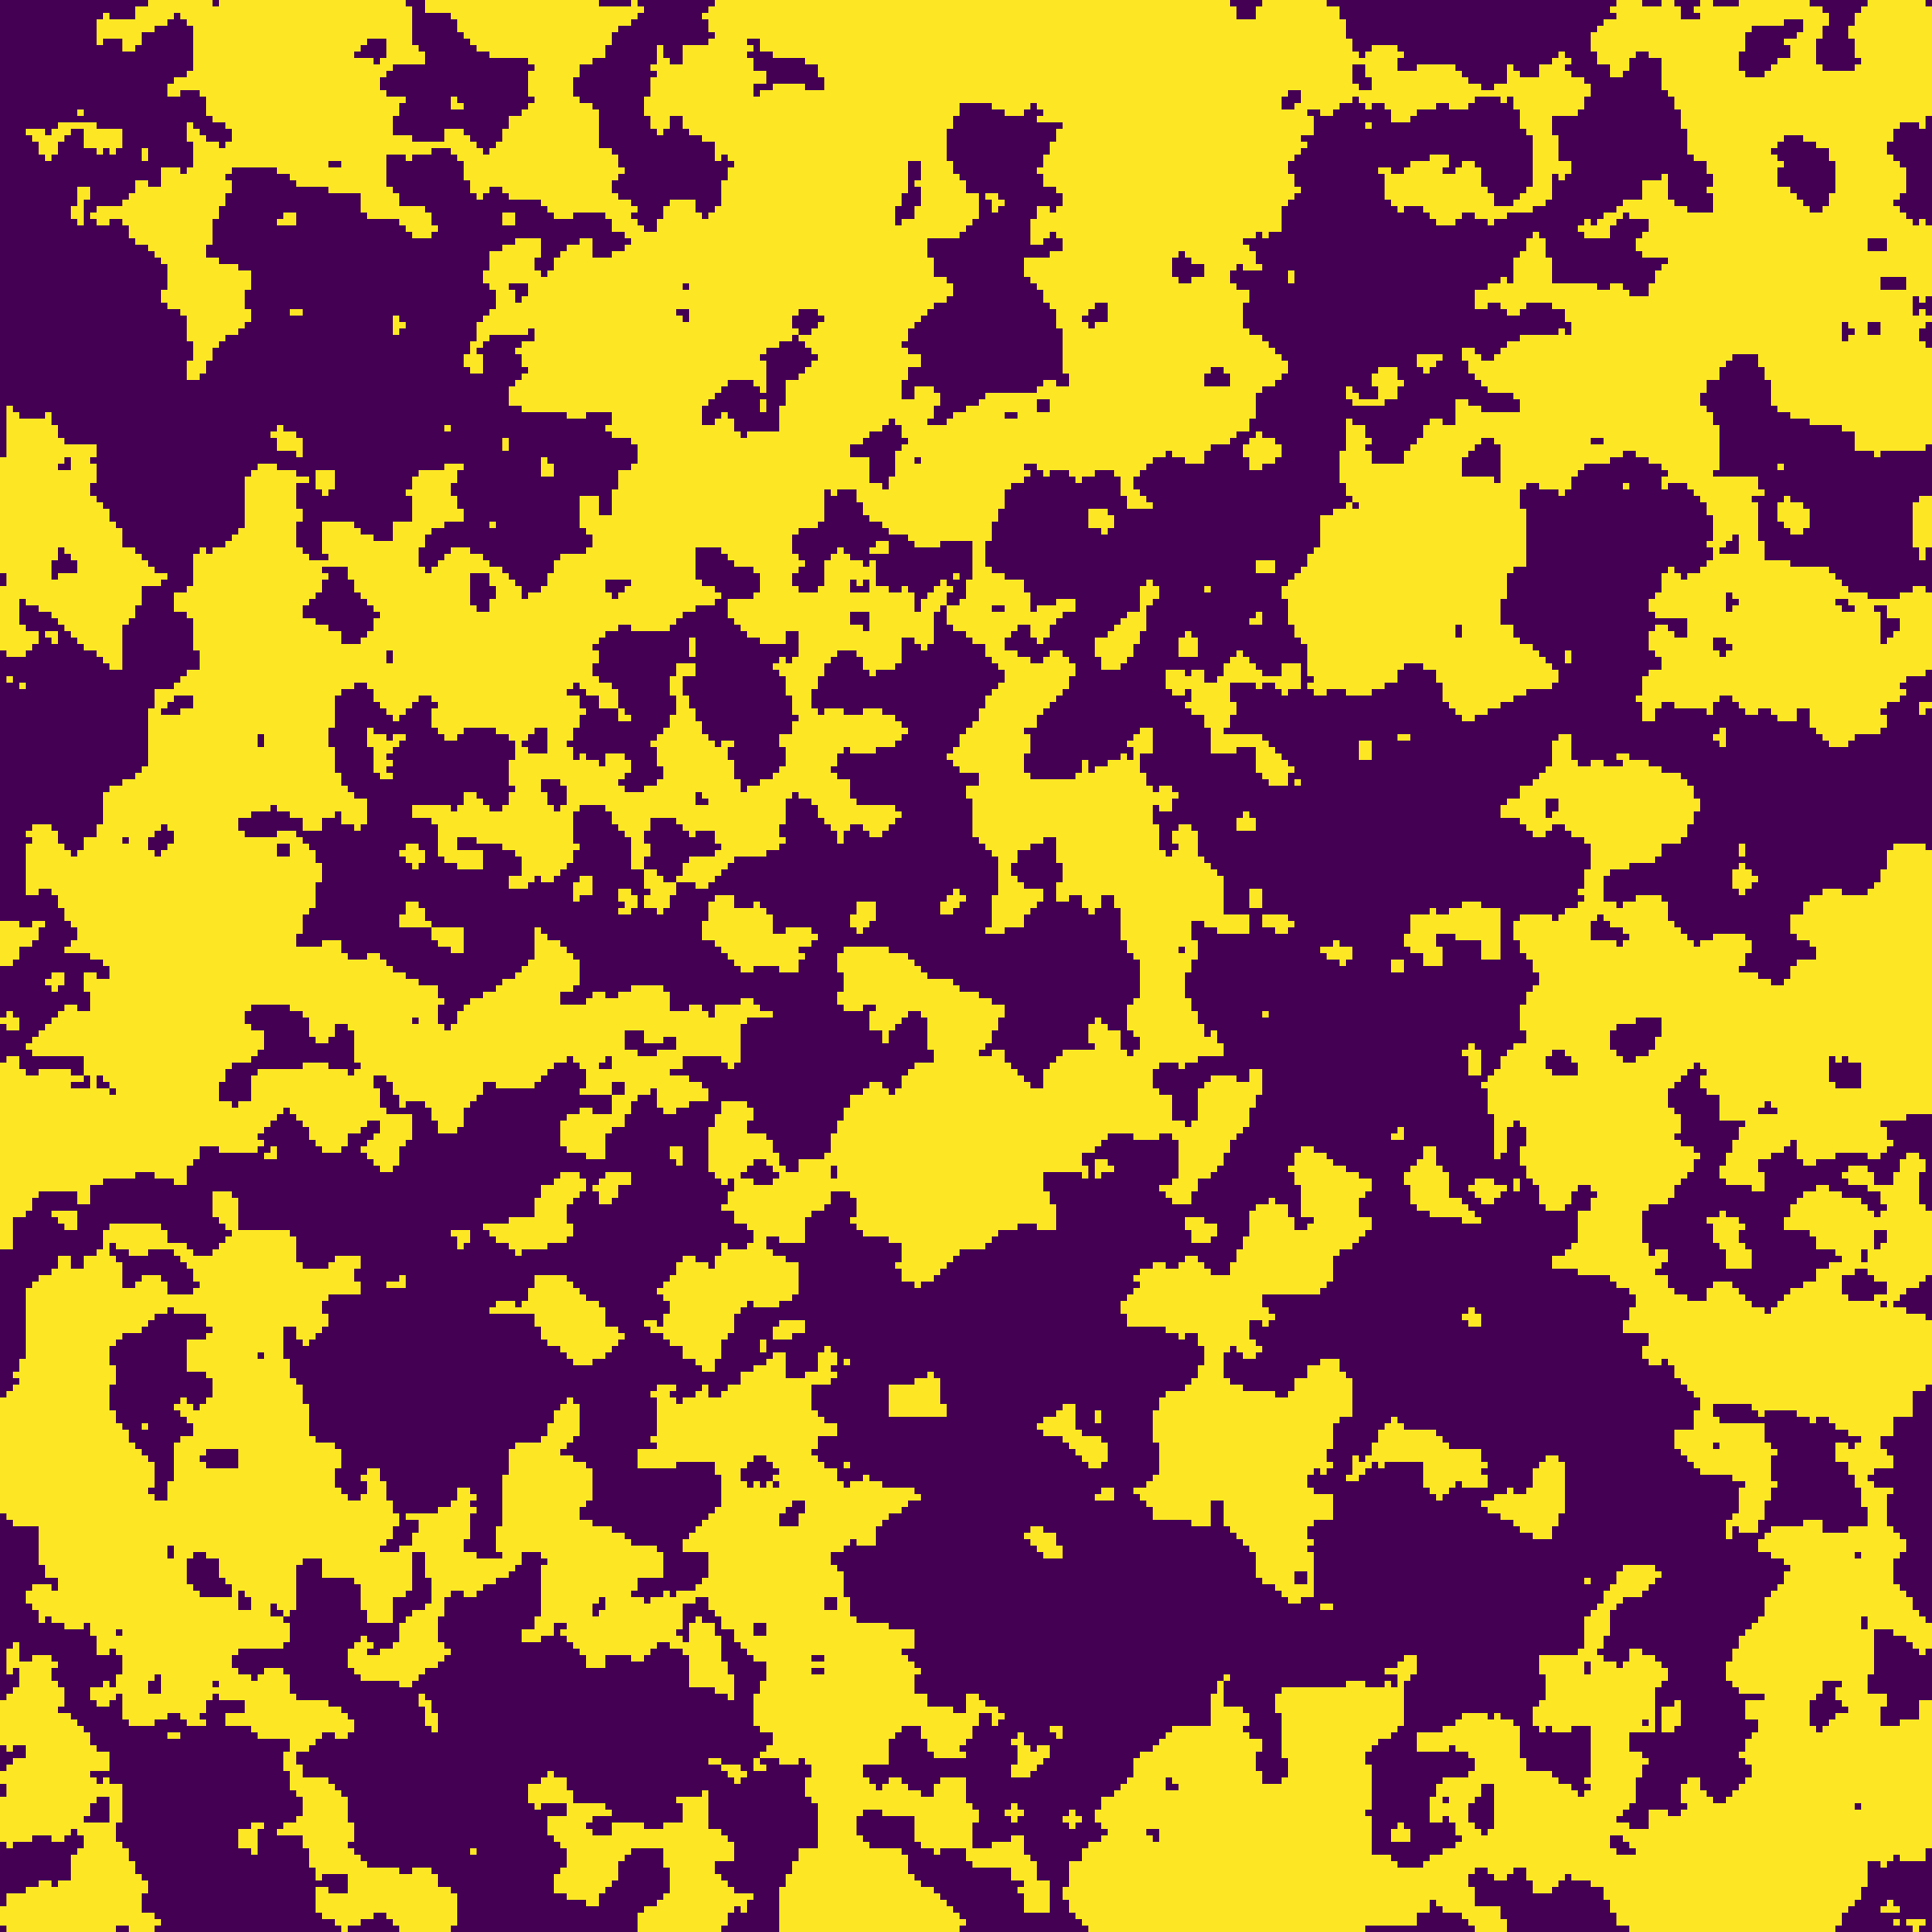
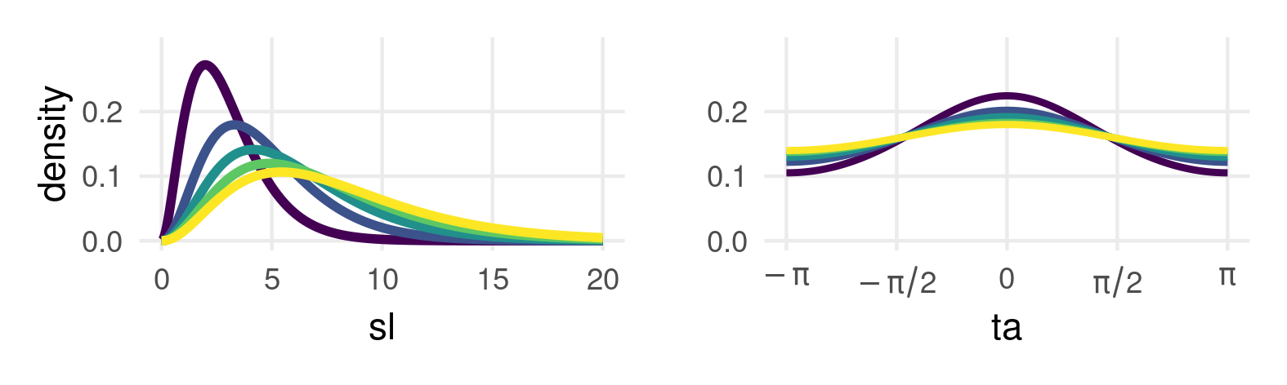
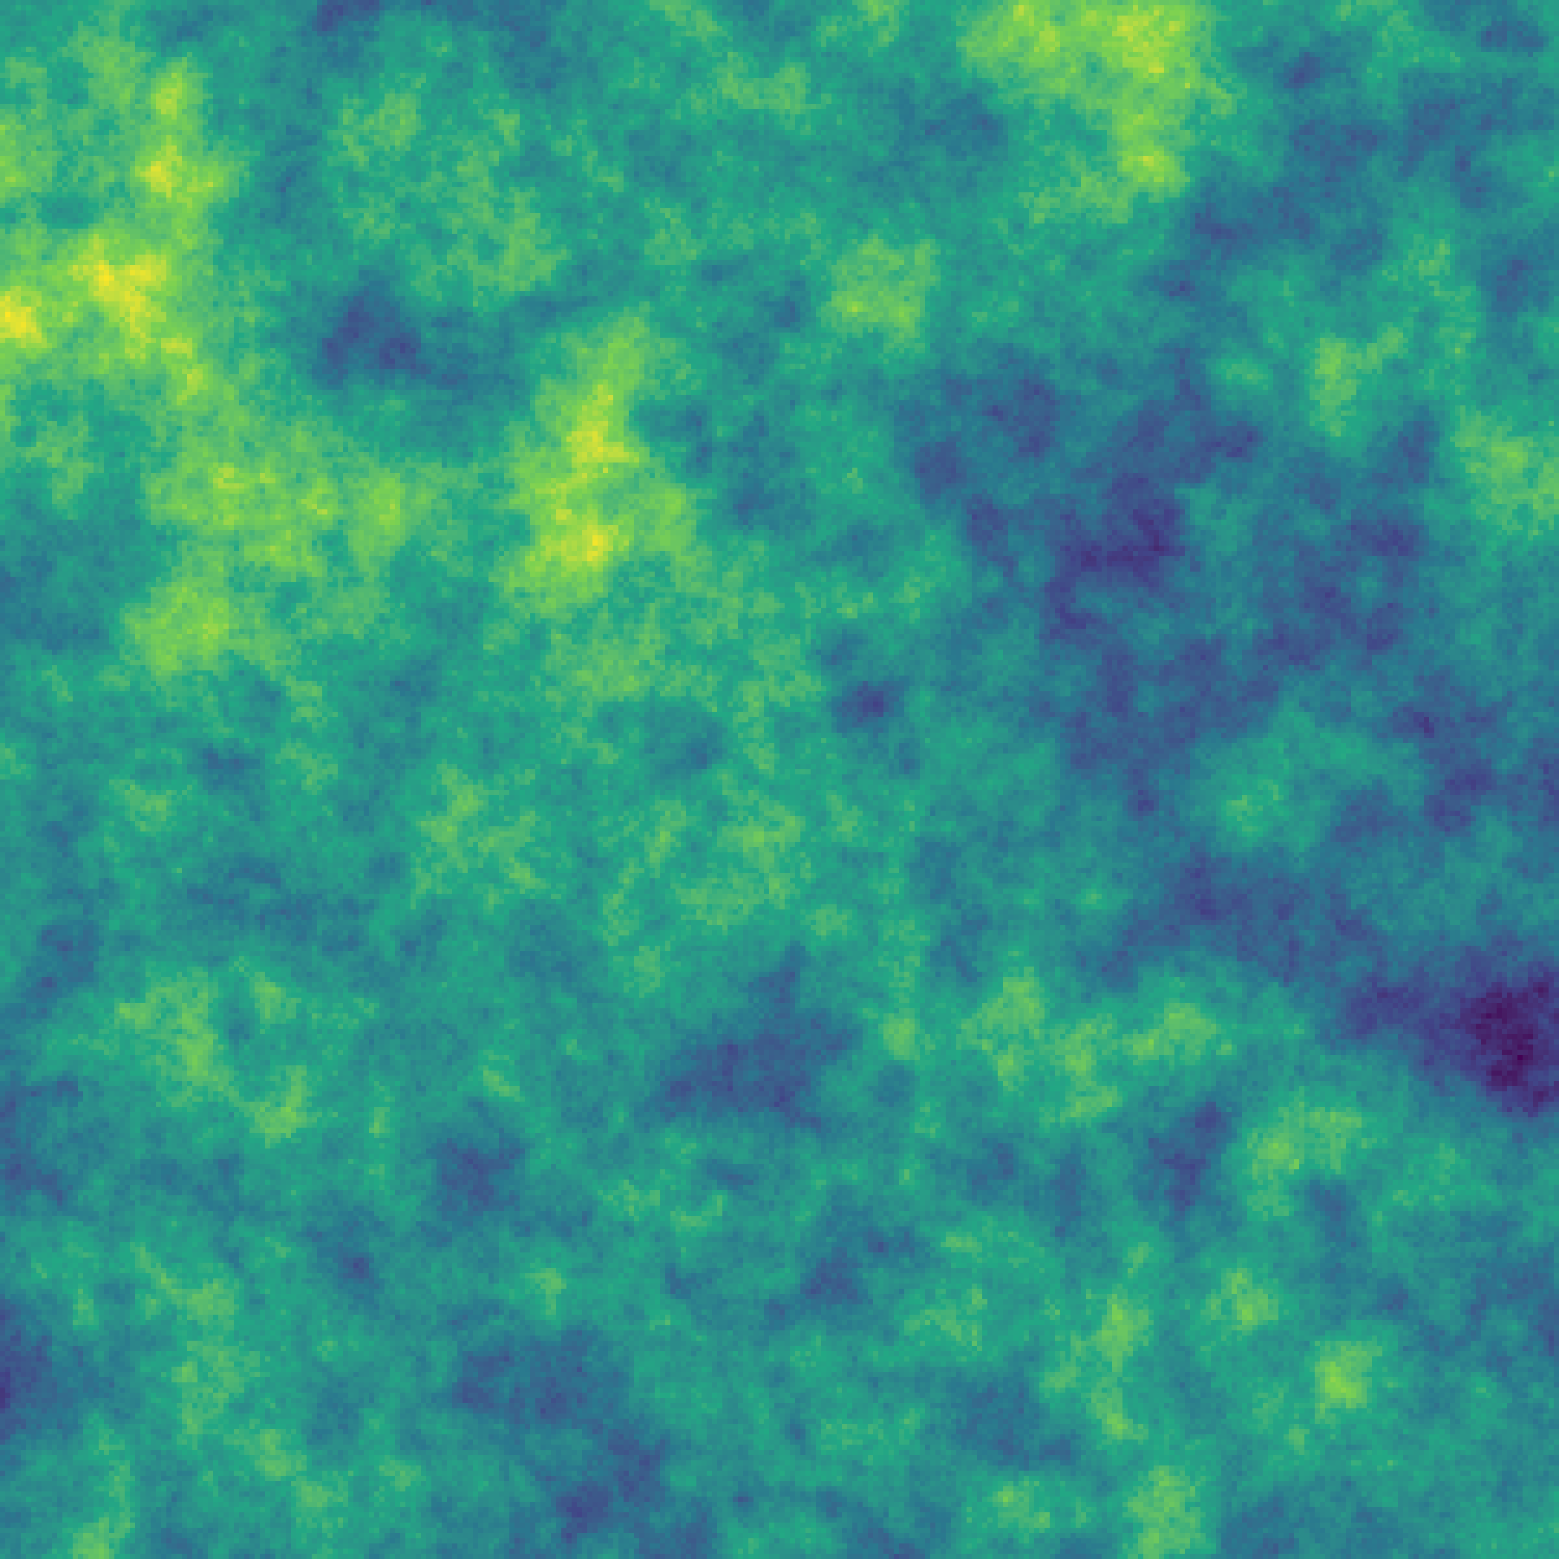
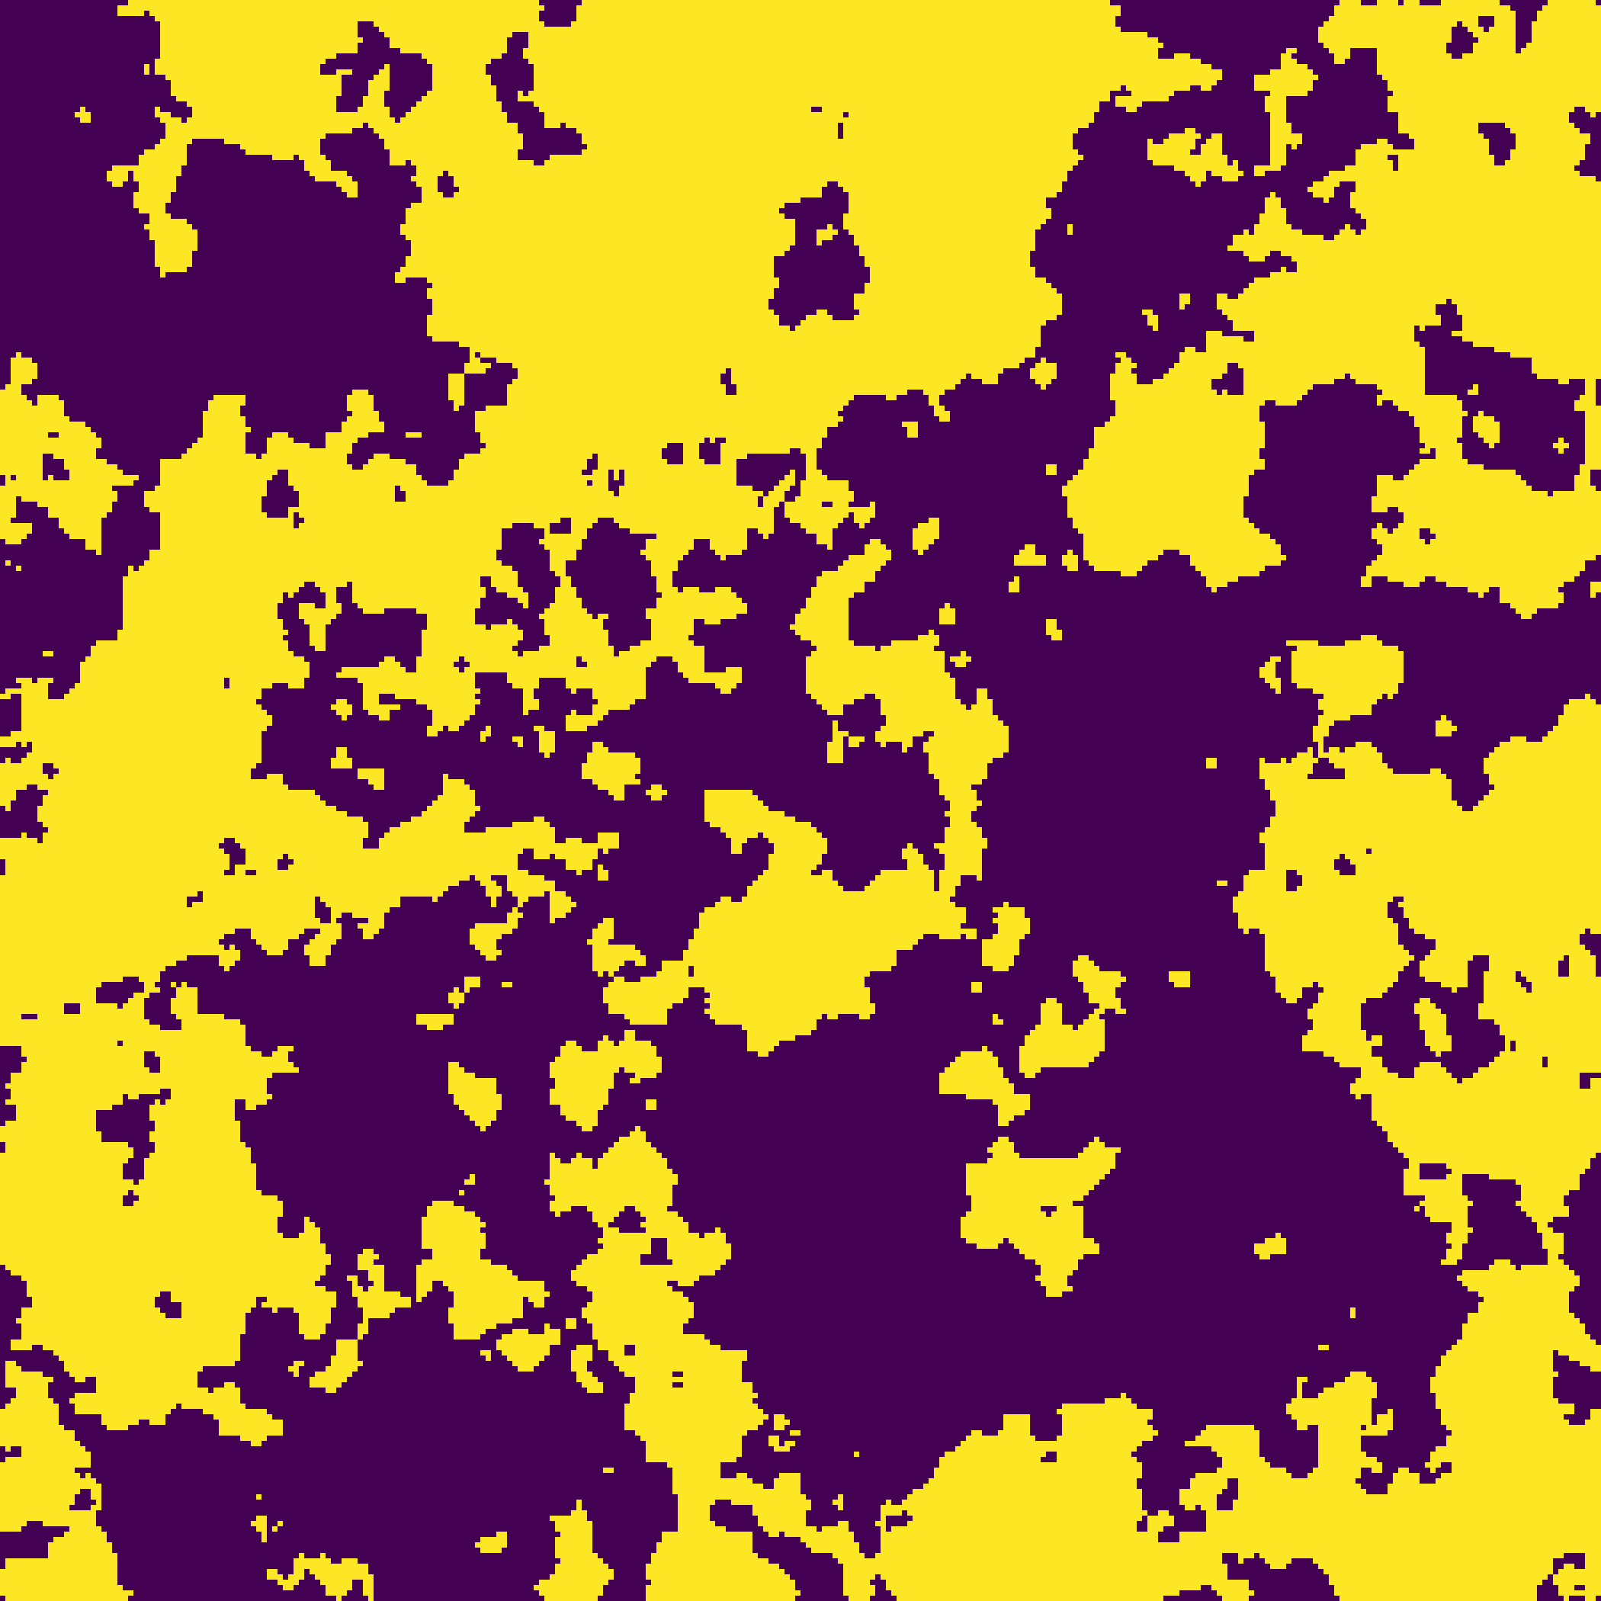
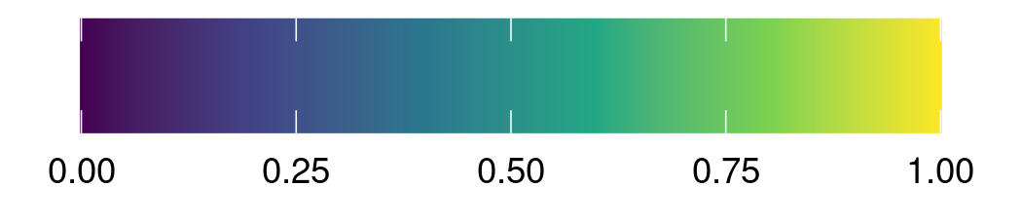
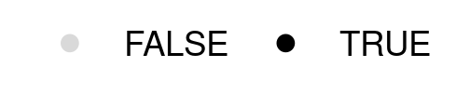
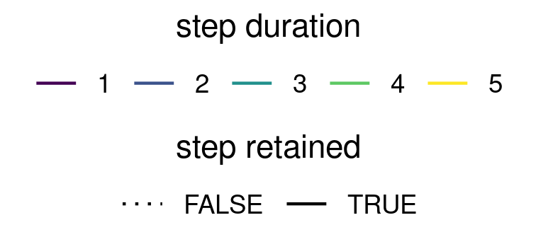
Simulation
Analysis
Autocorrelation Range
Missingness
Forgiveness
Model Approach
dist
elev
0%
forest
1
Uncorrected
5
10%
2
Imputed
Δt = 1
Δt = 1
missing
Δt = 1
Δt = 1
imputed
dist
elev
20%
forest
* Δt
10
3
Naïve
30%
dist
4
Dynamic + Model
elev
40%
forest
20
5
Multistep
Δt = 1
Δt = 1
missing
50%
Δt = 2
Covariate Value
Location Obtained
Step-Duration
Step-Duration
Step Retained
Step Type
OBSERVED
INTERMEDIATE RANDOM
RANDOM

Slide 2
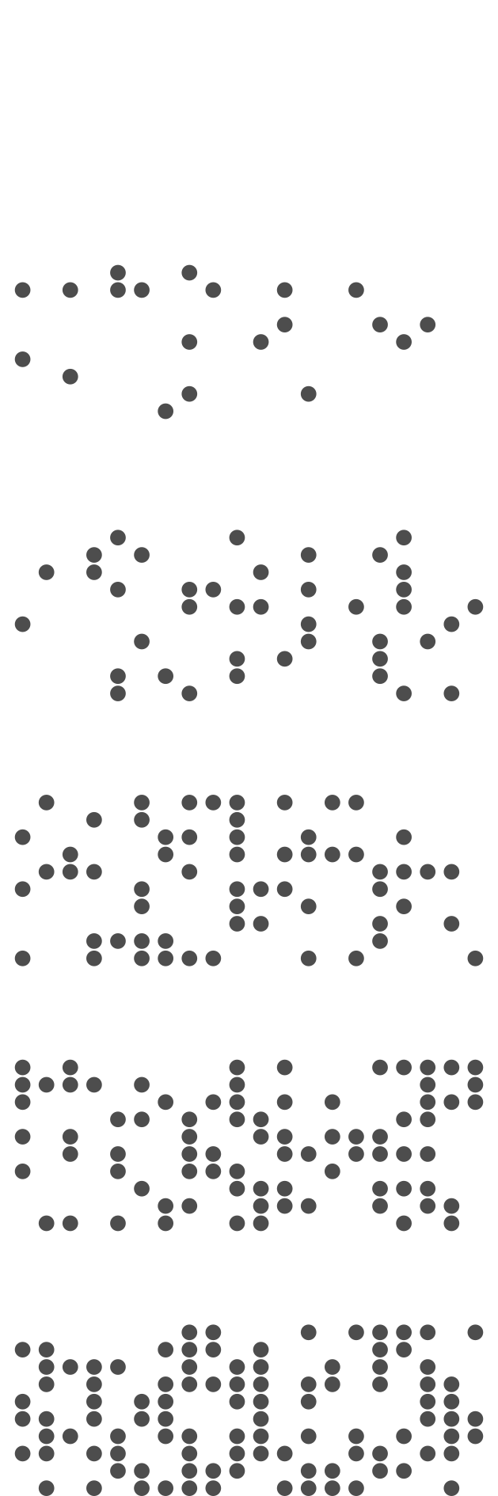
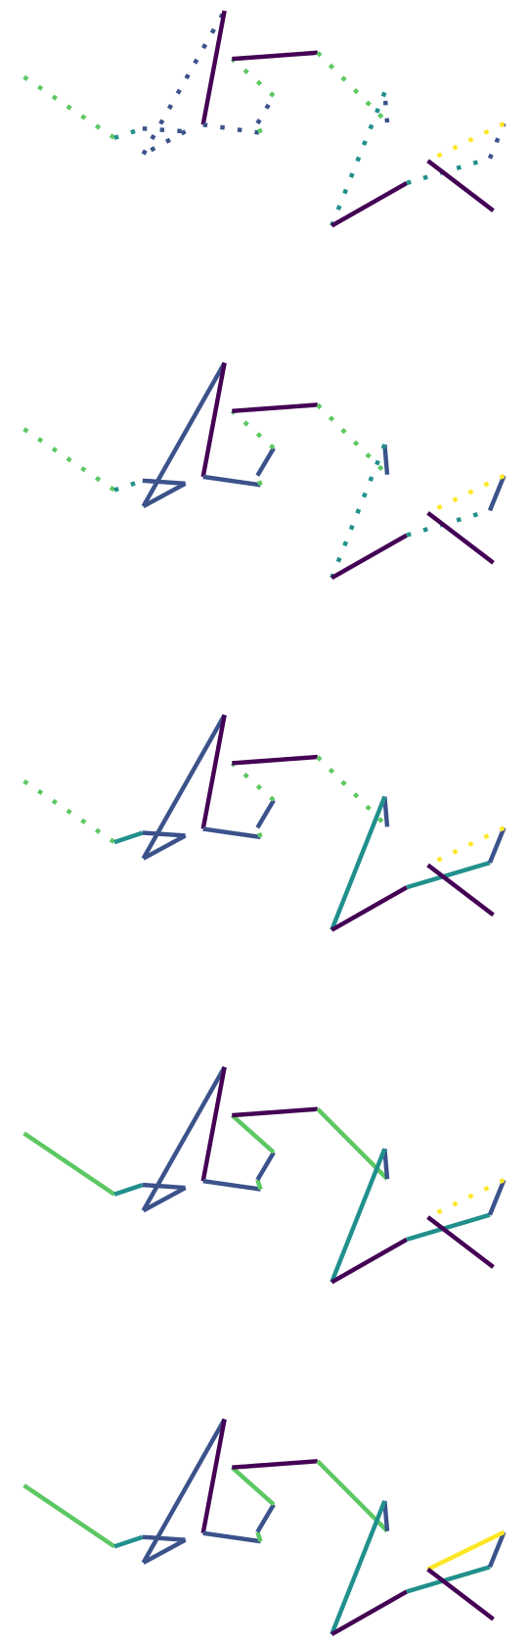
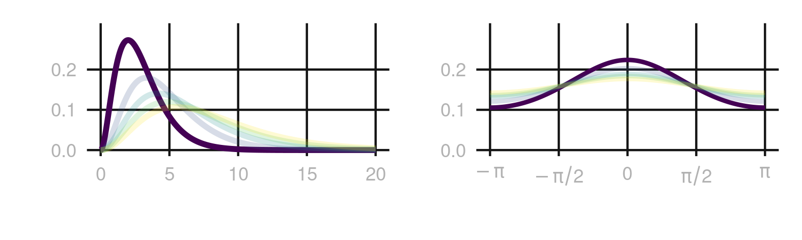

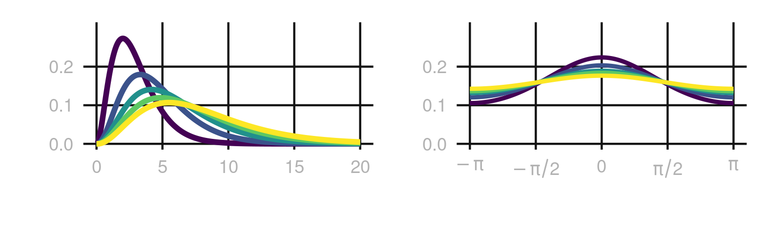

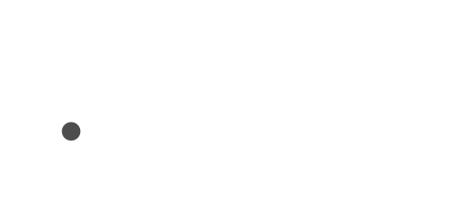
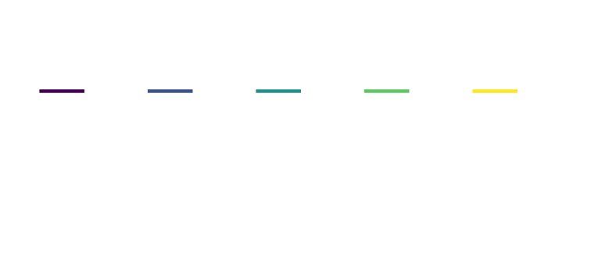
Simulation
Analysis
Autocorrelation Range
Missingness
Forgiveness
Model Approach
dist
elev
0%
forest
1
Uncorrected
5
10%
2
Imputed
Δt = 1
Δt = 1
missing
Δt = 1
Δt = 1
dist
imputed
elev
20%
forest
* Δt
10
3
Naïve
30%
dist
4
Dynamic + Model
elev
40%
forest
20
Δt = 1
Δt = 1
missing
50%
5
Multistep
Δt = 2
Covariate Value
Location Obtained
Step-Duration
Step-Duration
Step Retained
Step Type
OBSERVED
INTERMEDIATE RANDOM
RANDOM

Slide 3
To export the plot:
- go to export
- save as png
- set width to 90 cm
4B0055
00588B
009B95
53CC67
FDE333

