Slide 1
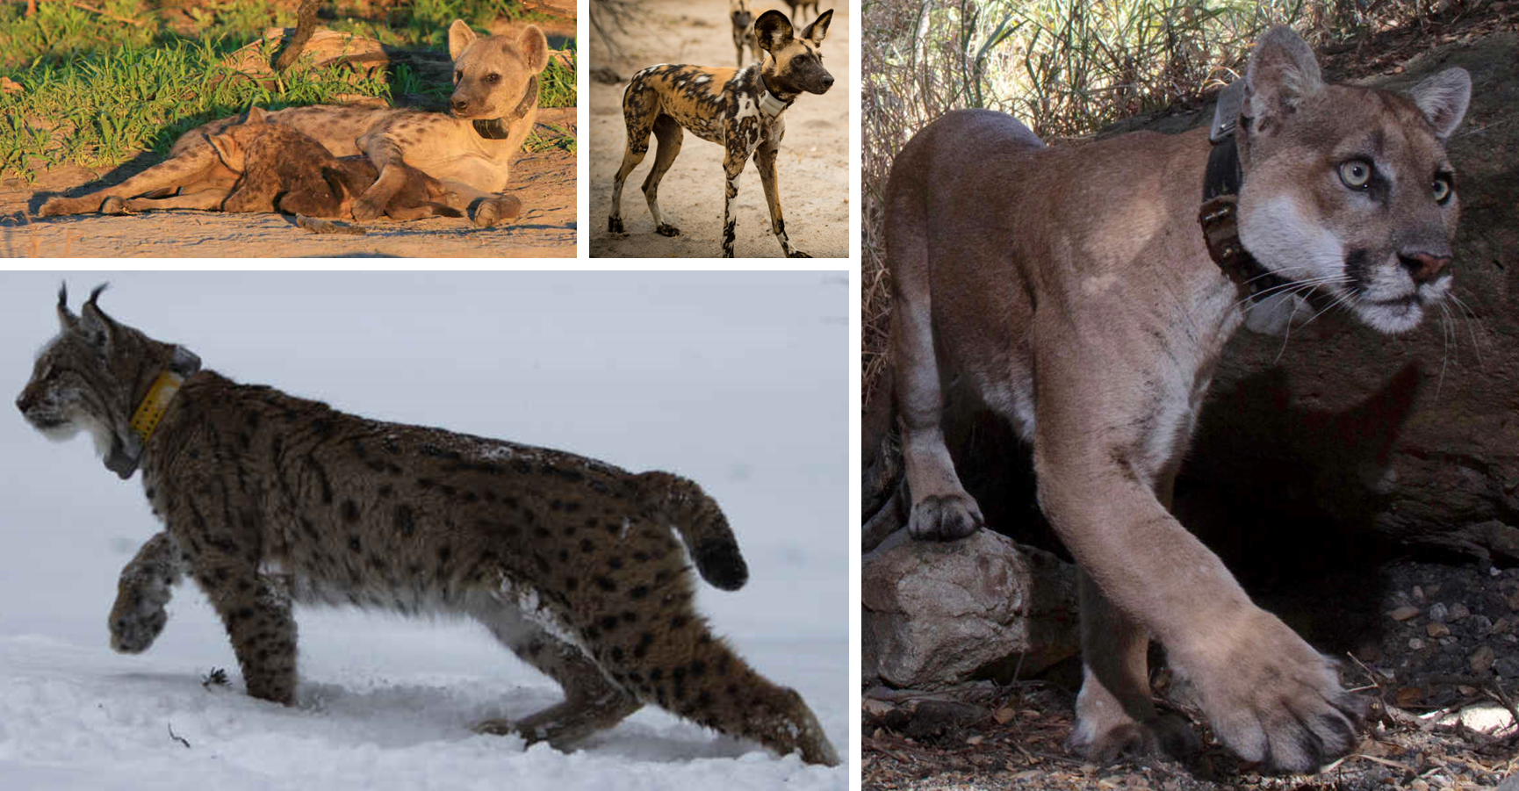
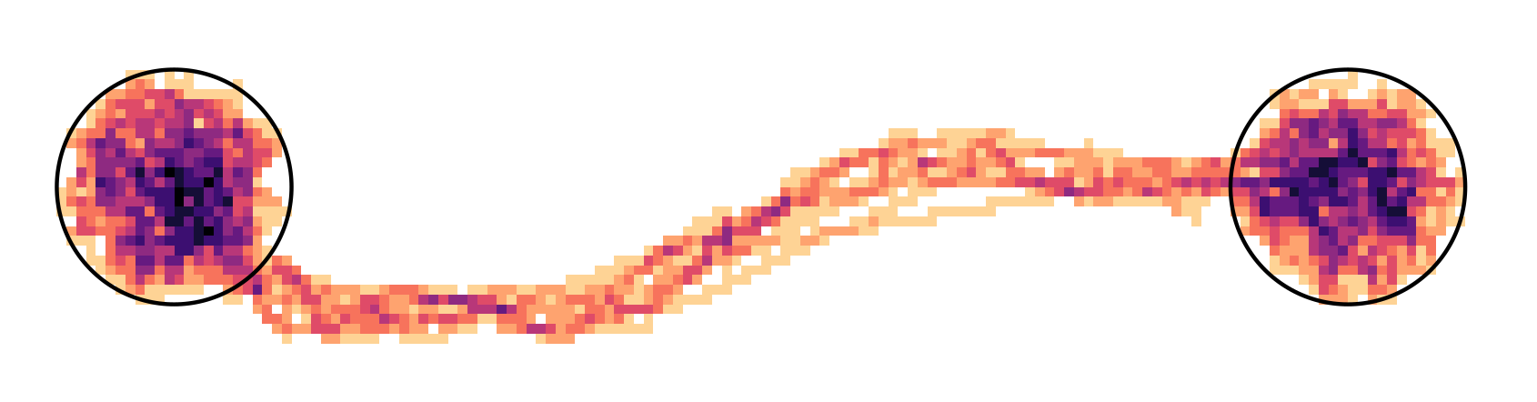

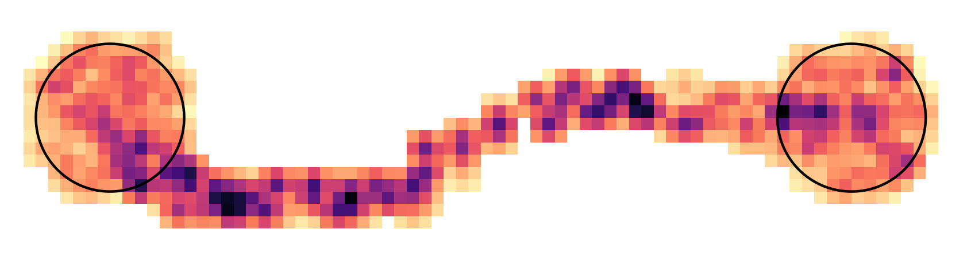
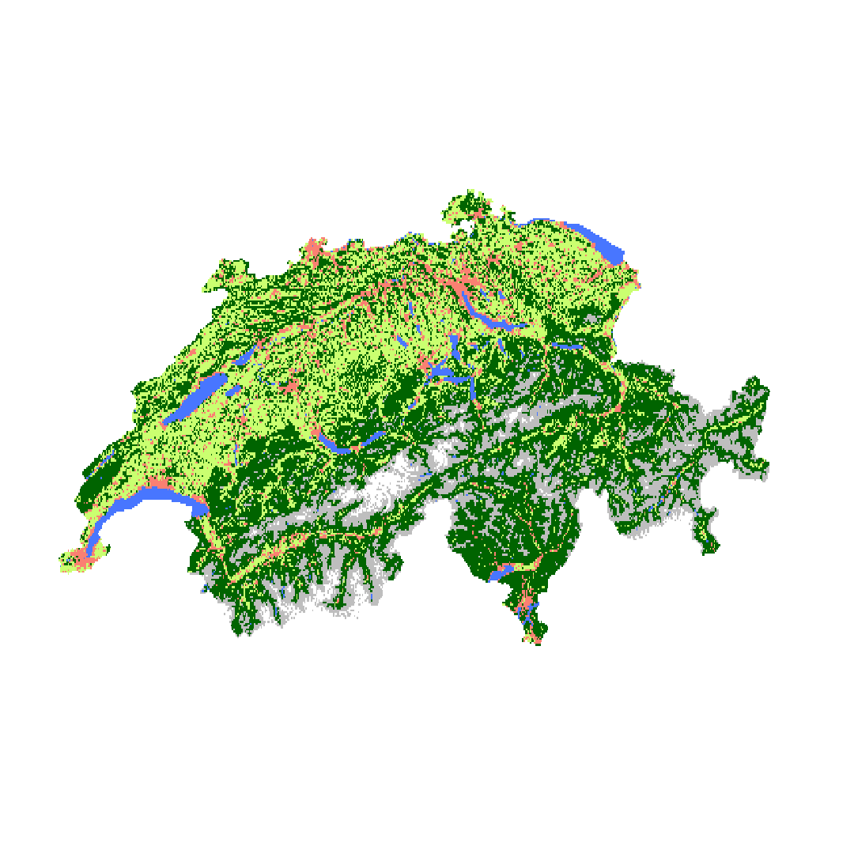
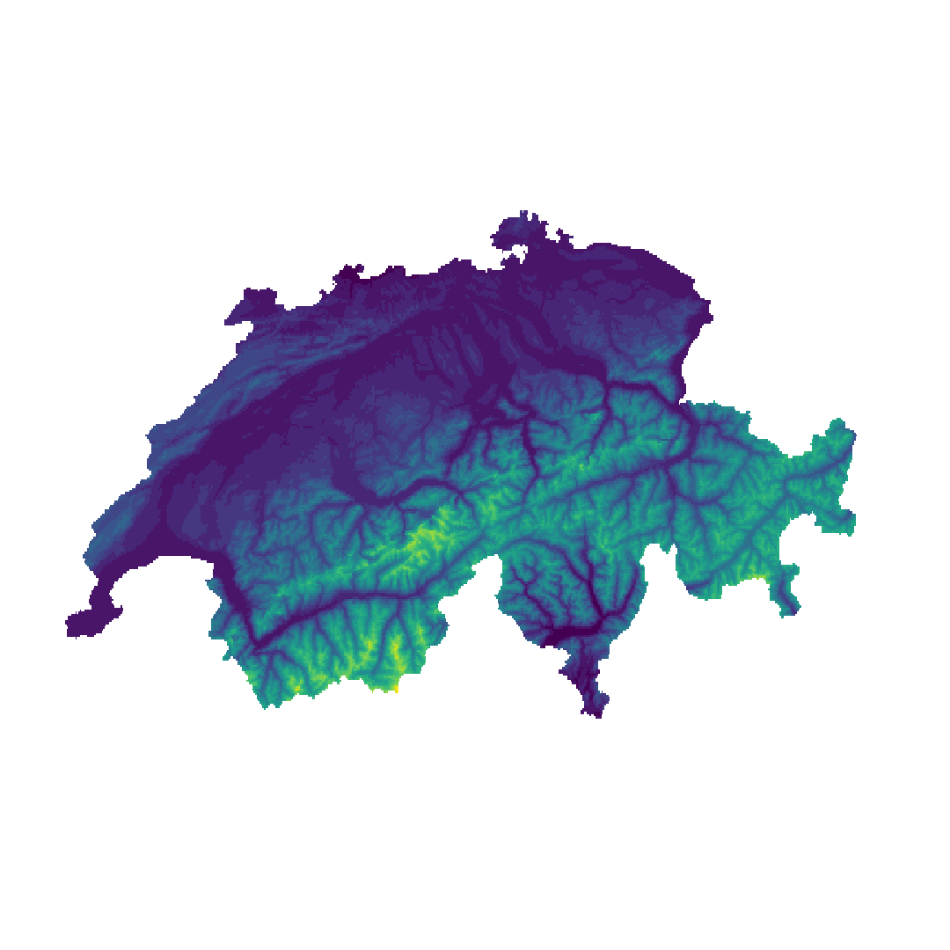
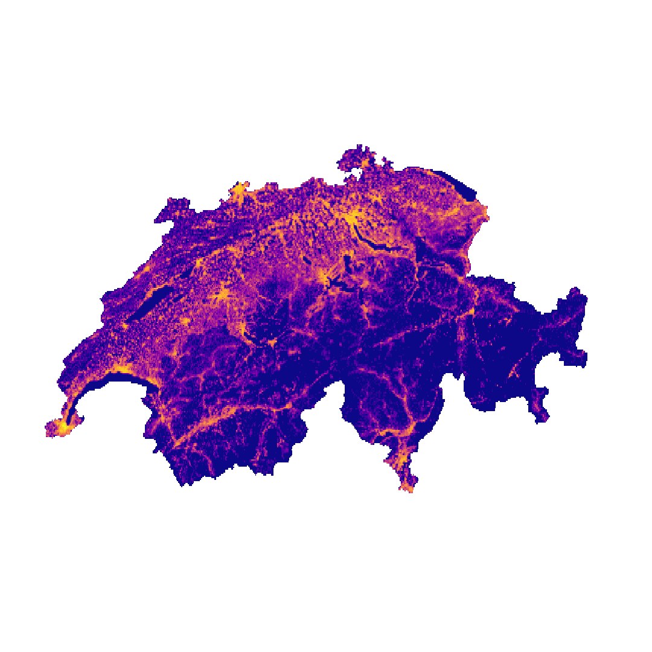
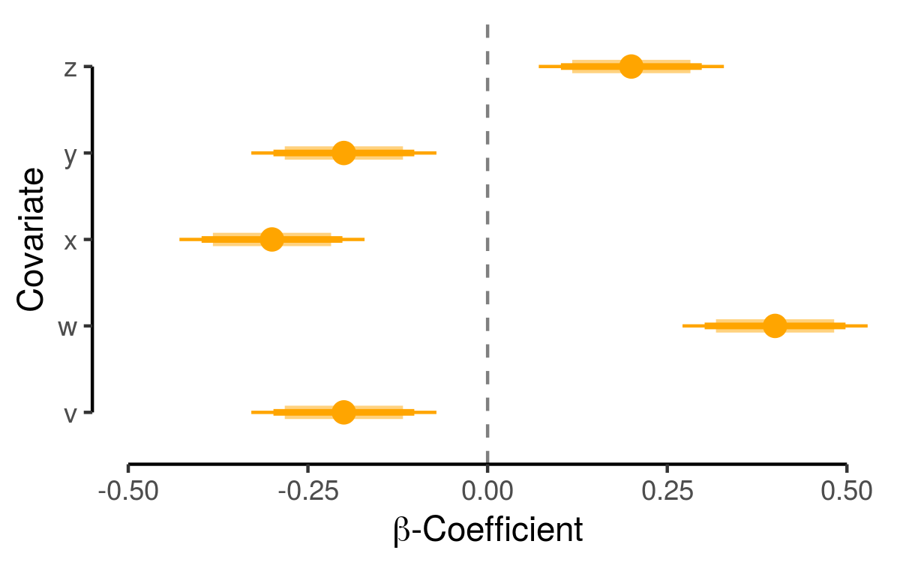
Heatmap
(traversal frequency / intensity of use)
Integrated Step Selection Functions
Betweenness
(bottlenecks & dispersal corridors)
GPS Data &
Habitat Covariates
Movement
Model
Dispersal Simulation
Interpatch Connectivity
(presence, intensity, and duration of functional links between patches)
A
0.6
B
0.3

Slide 2

Heatmap
(Traversal Frequency)
Betweenness
(Bottlenecks & Dispersal Corridors)
GPS Data &
Habitat Covariates
Integrated Step Selection Model
Dispersal Simulation
cos(ta)
sl
Interpatch Connectivity
(Frequency & Duration of Connections between Patches)
log(sl)
elevation
humans
A
0.6
B
e.g. Land Cover, Elevation, Human Density
0.3
-1.0
-0.5
0
0.5
1.0
$β$-Estimates

