Slide 1
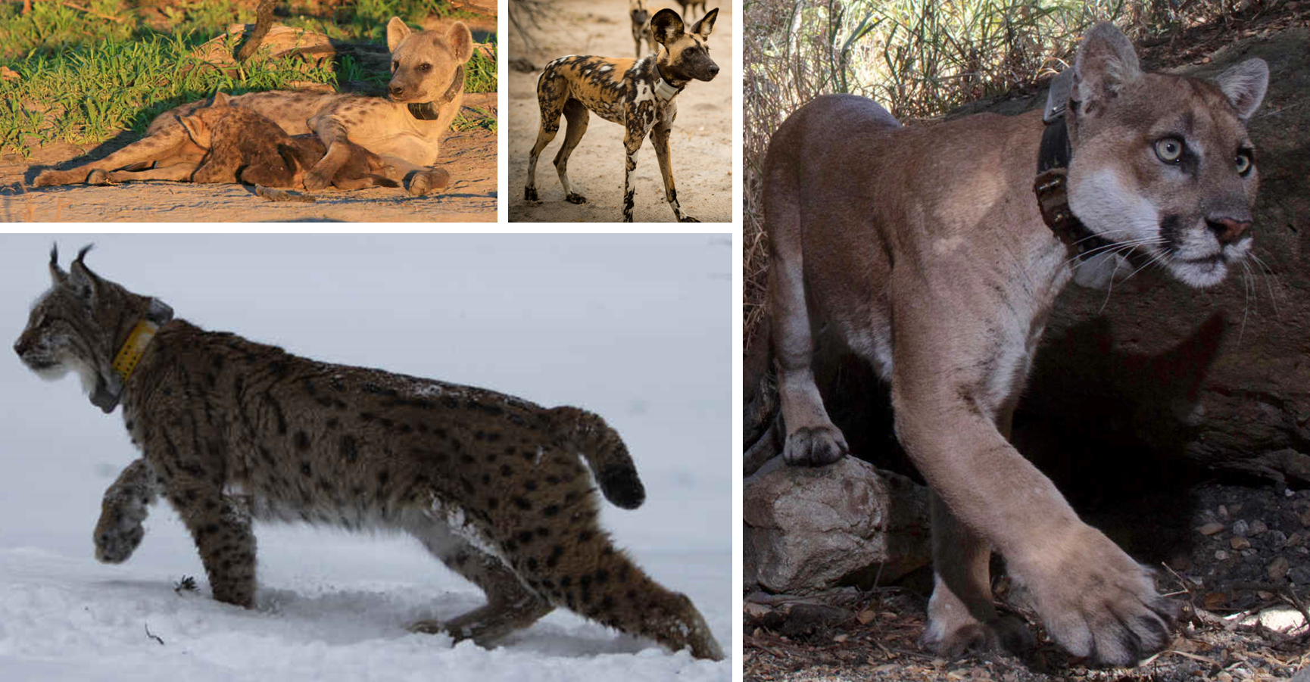
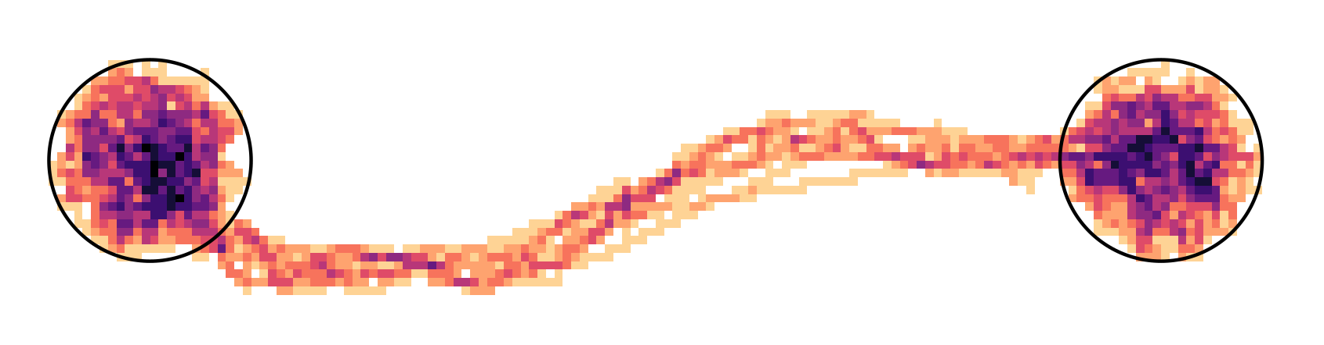

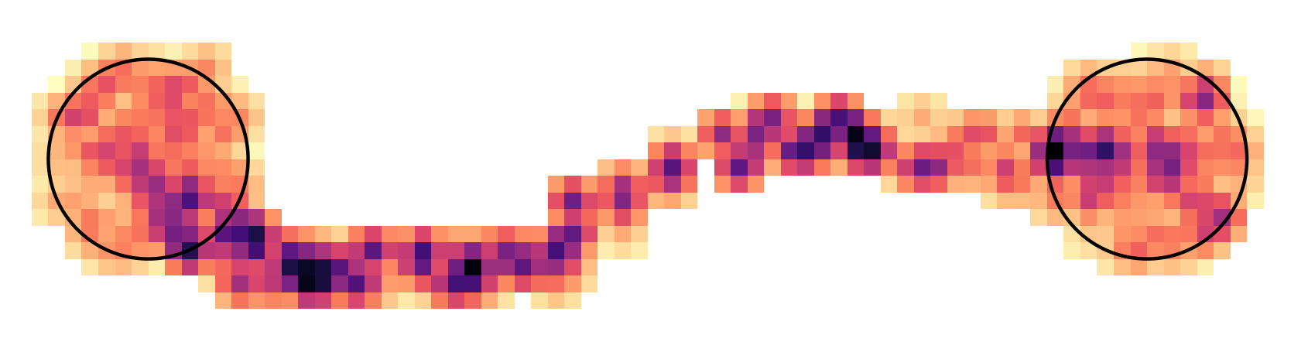
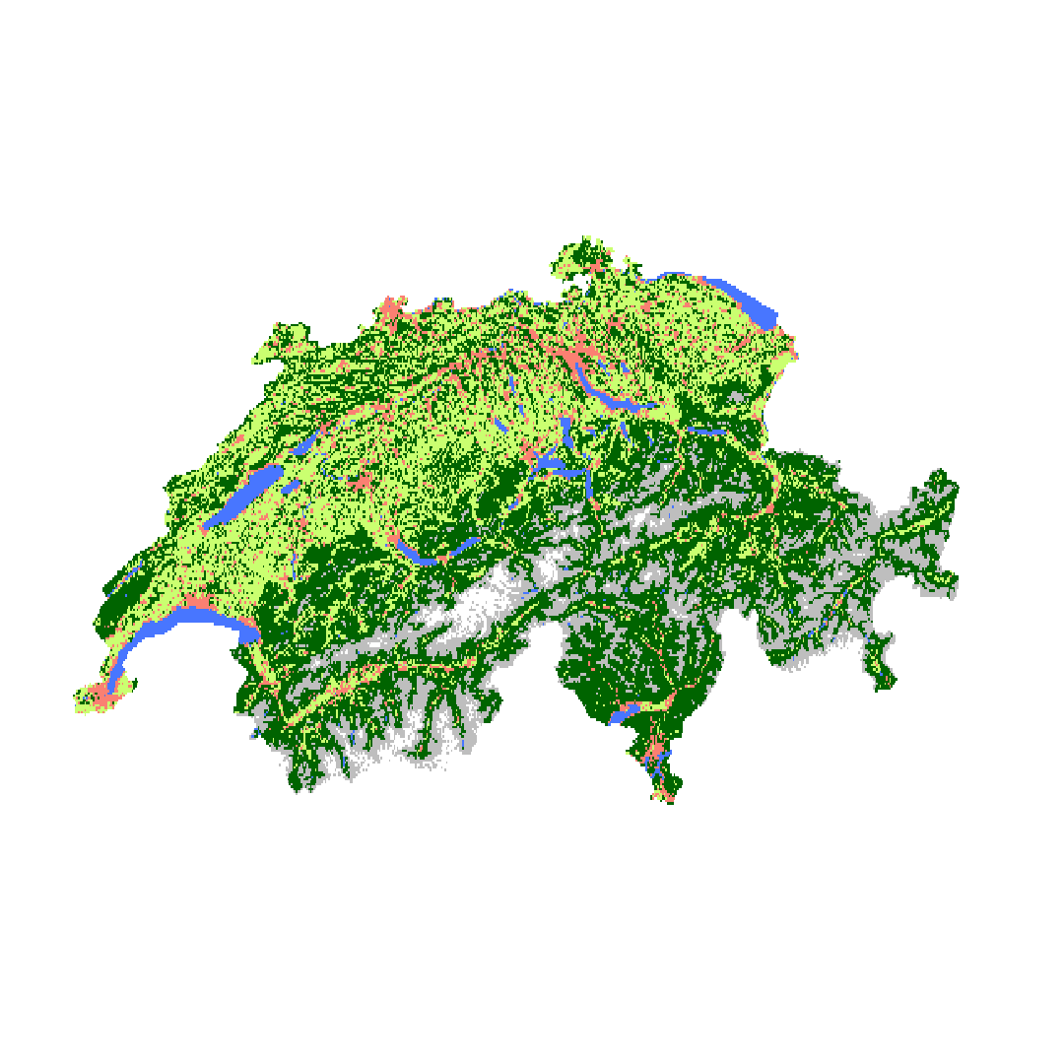
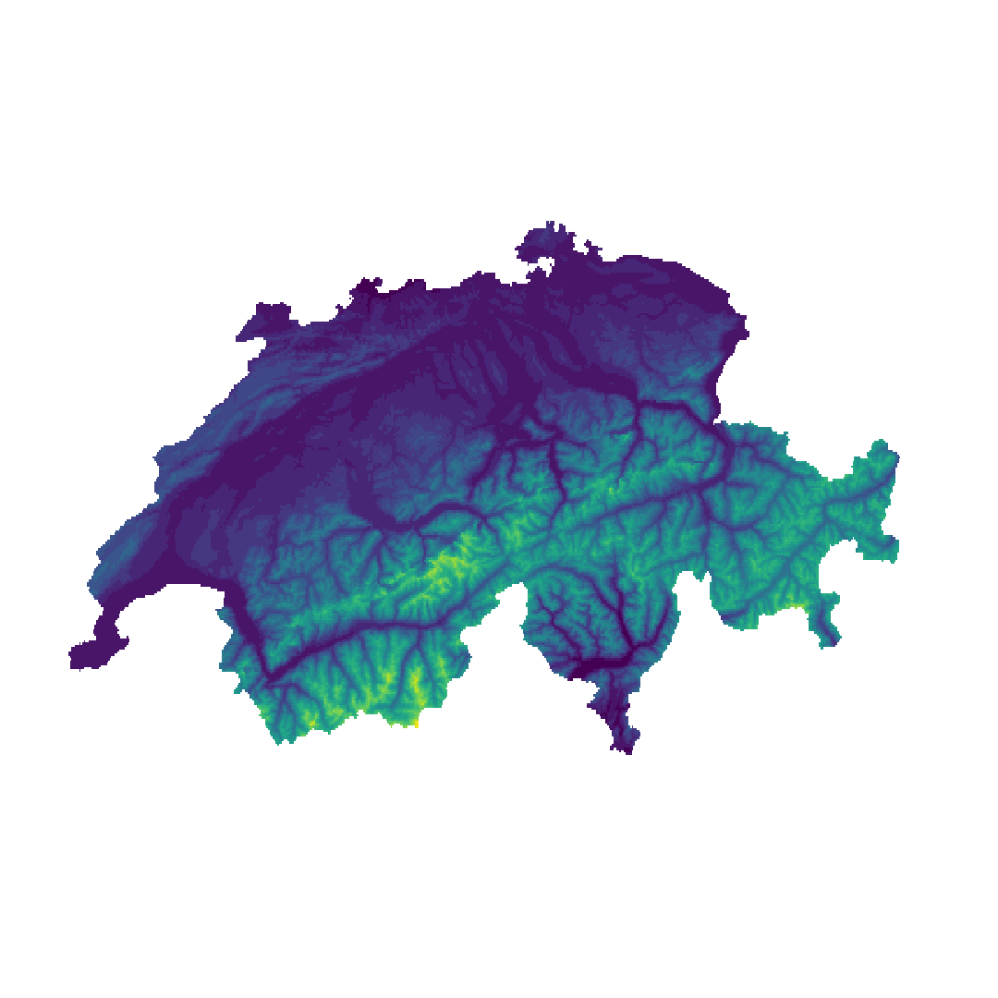
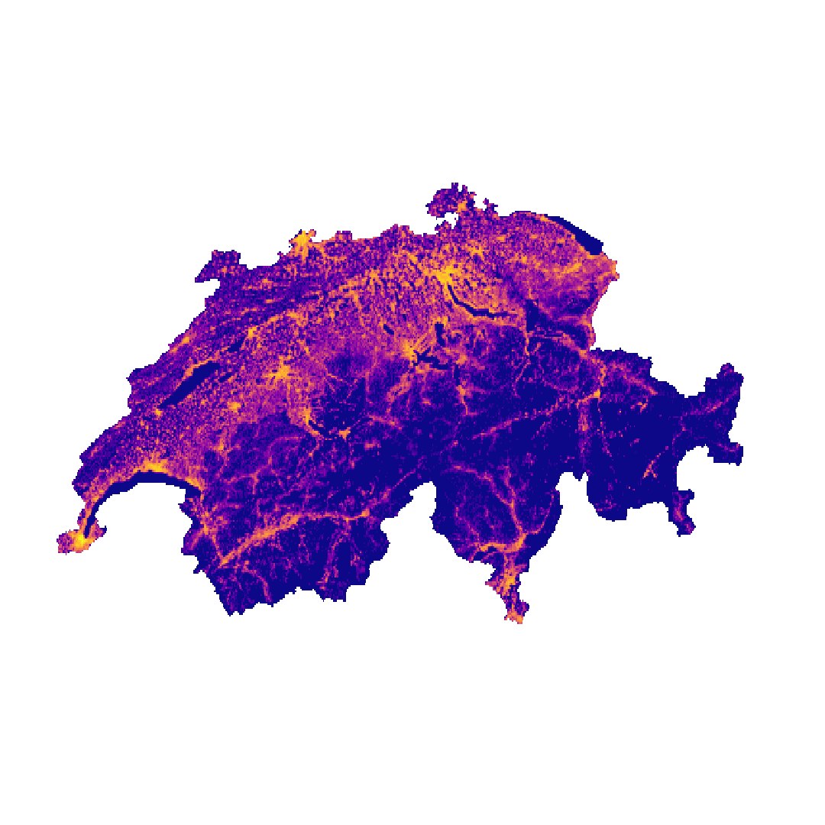
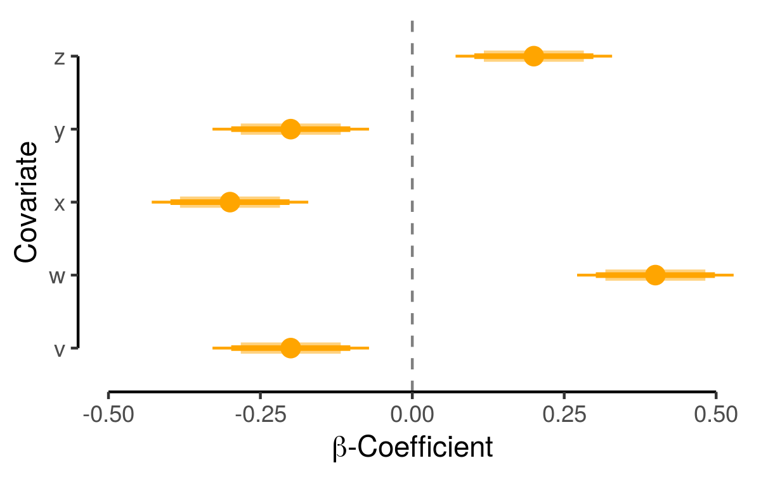
Heatmap
(Traversal Frequency)
Betweenness
(Bottlenecks & Dispersal Corridors)
GPS Data &
Habitat Covariates
Integrated Step Selection Model
Dispersal Simulation
Interpatch Connectivity
(Frequency & Duration of Connections between Patches)
A
0.6
B
0.3

Slide 2

Heatmap
(Traversal Frequency)
Betweenness
(Bottlenecks & Dispersal Corridors)
GPS Data &
Habitat Covariates
Integrated Step Selection Model
Dispersal Simulation
cos(ta)
sl
Interpatch Connectivity
(Frequency & Duration of Connections between Patches)
log(sl)
elevation
humans
A
0.6
B
e.g. Land Cover, Elevation, Human Density
0.3
-1.0
-0.5
0
0.5
1.0
$β$-Estimates

