Slide 1
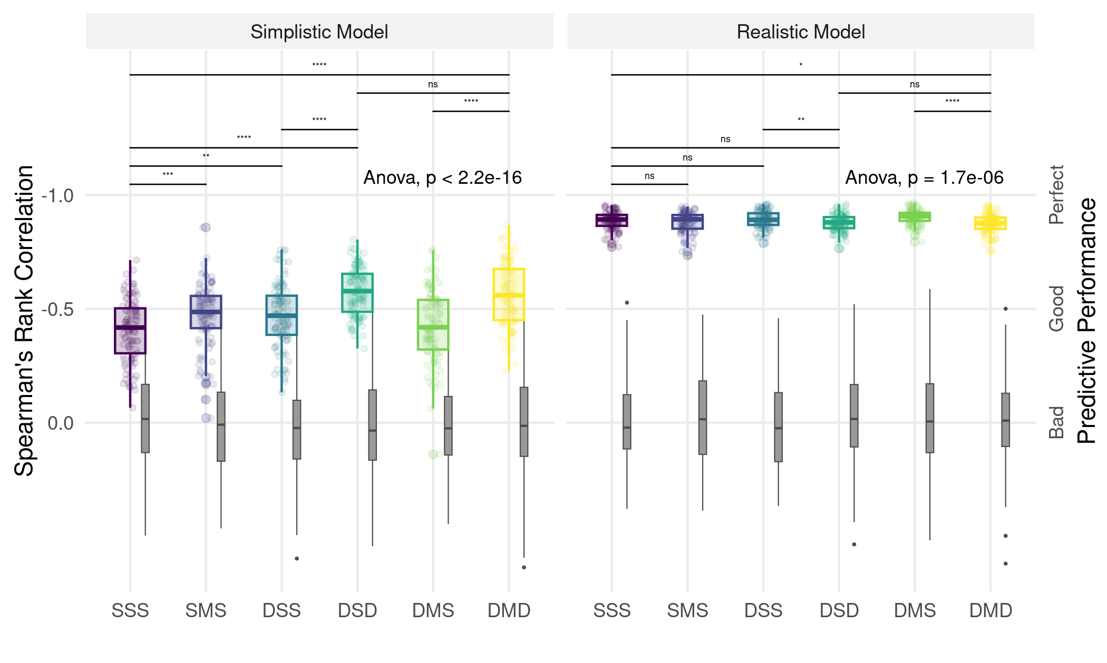
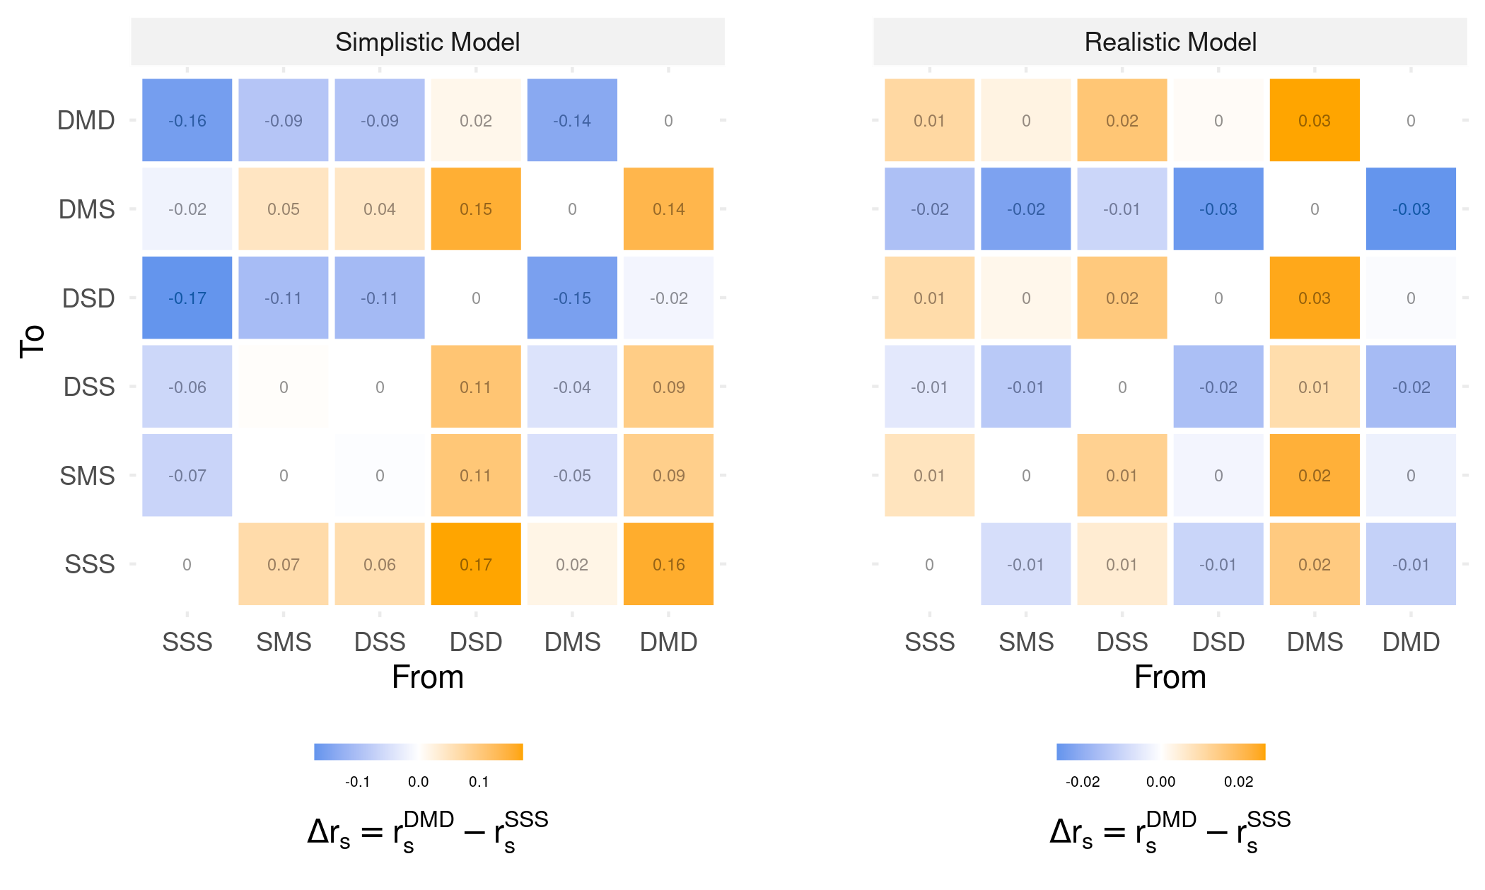
a
Low
Degree of Dynamism
High
Low
Degree of Dynamism
High
b

