Slide 1
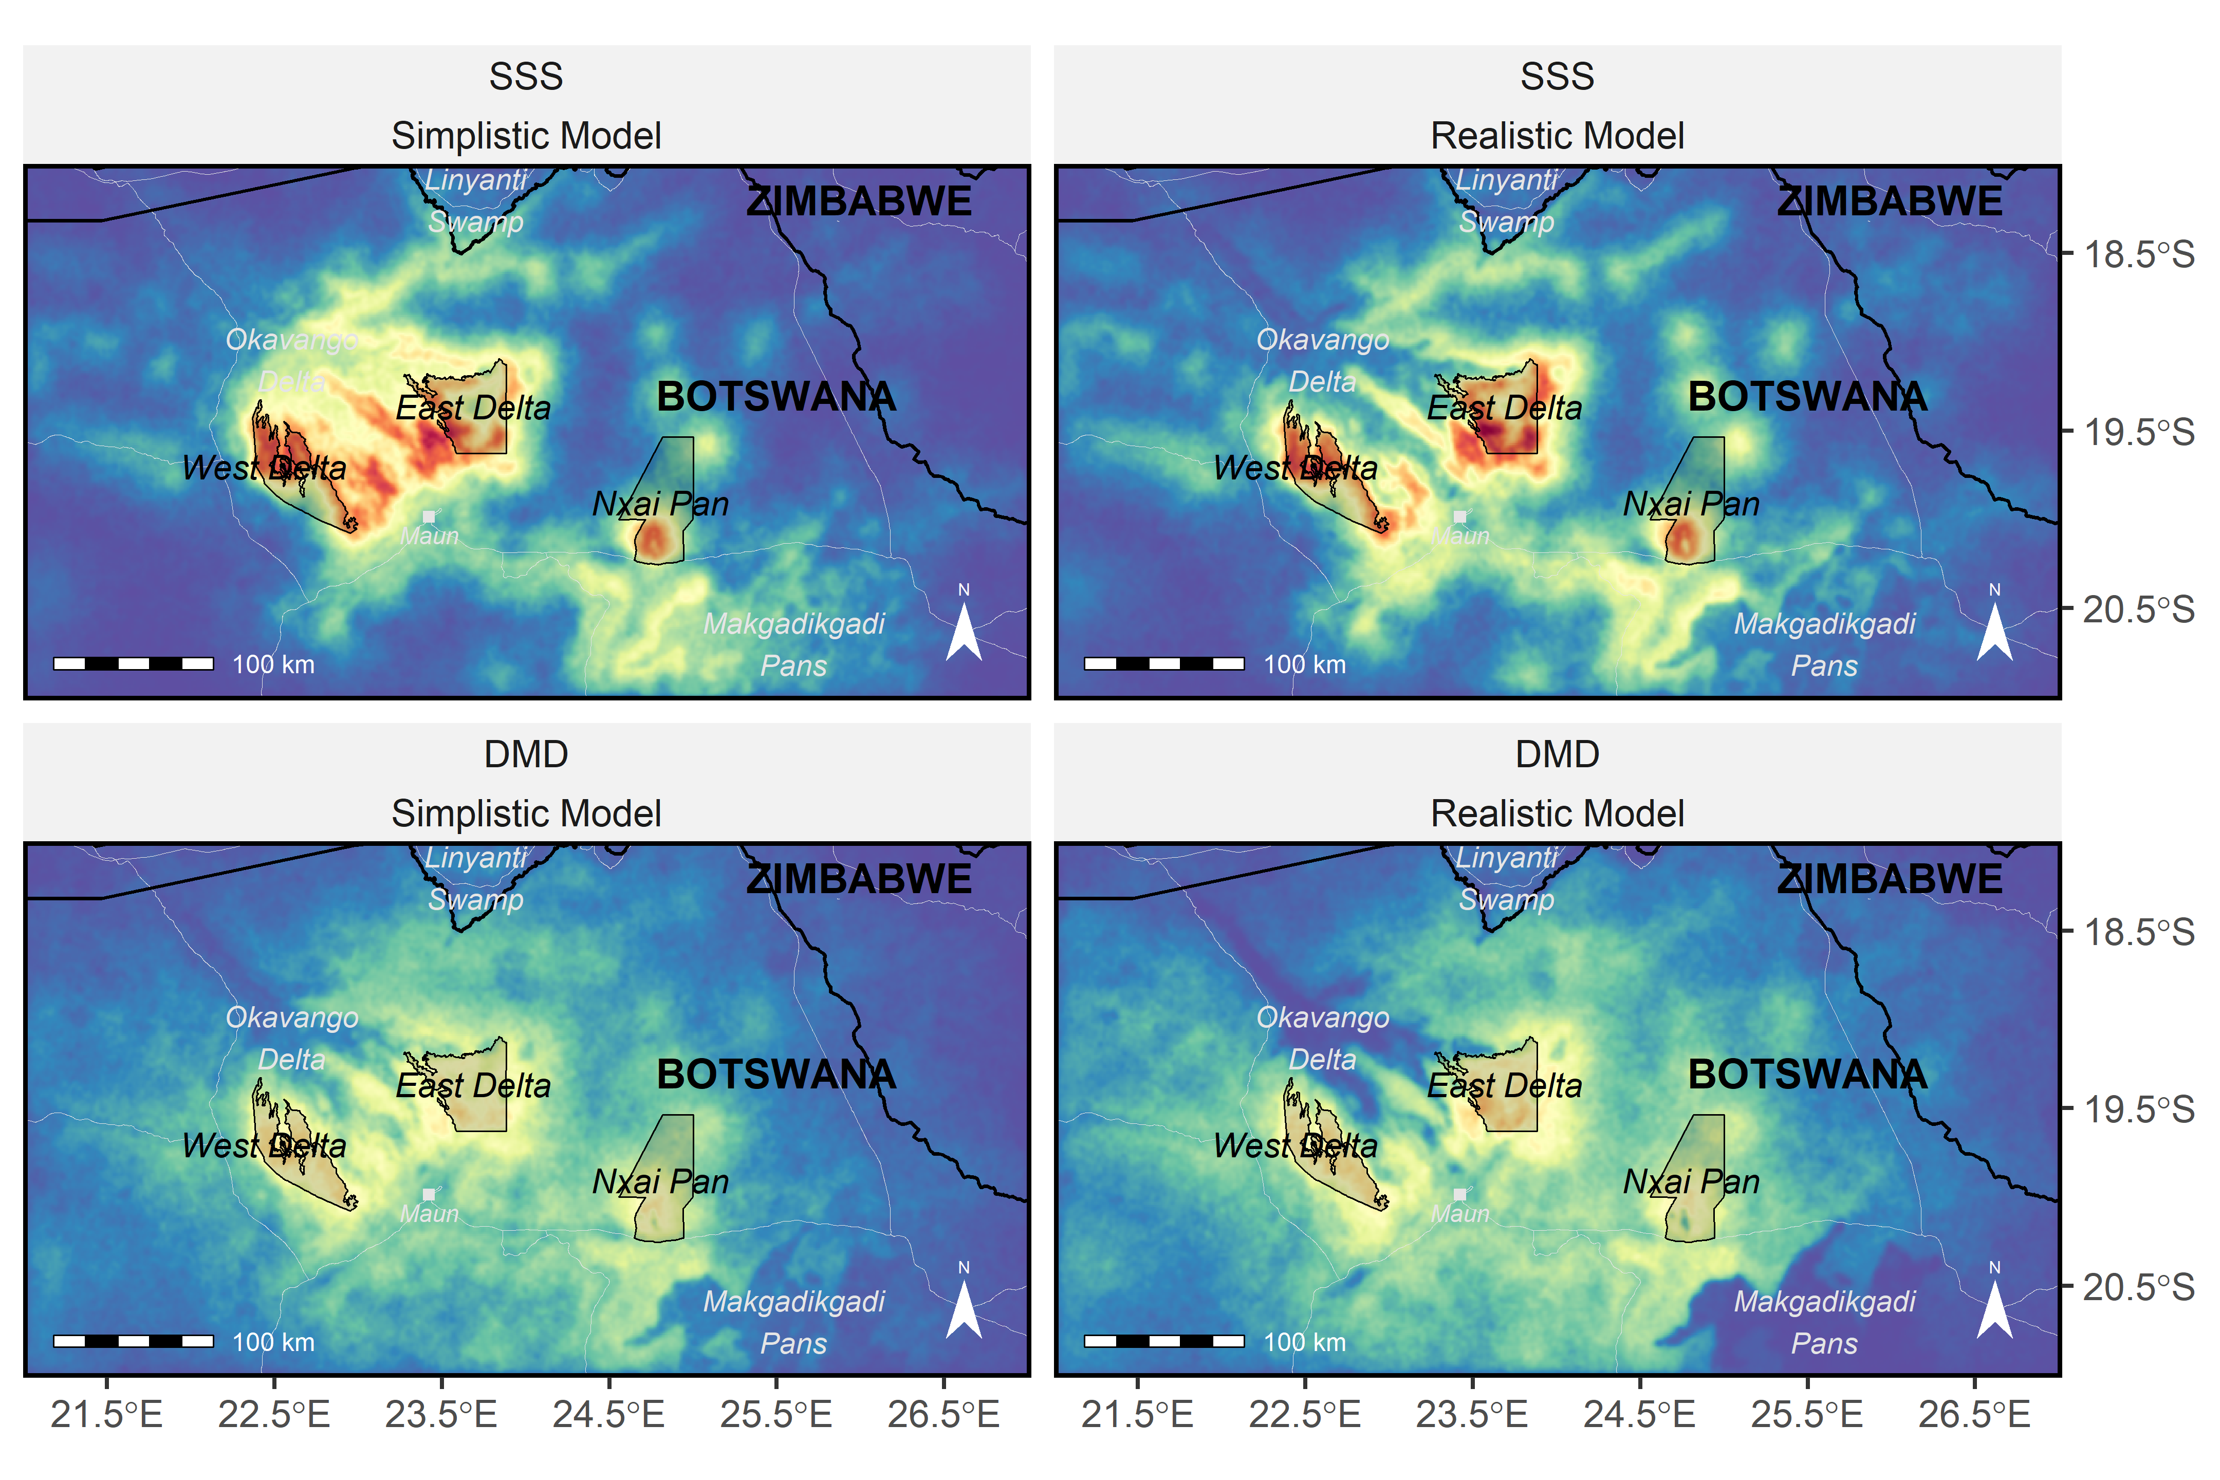
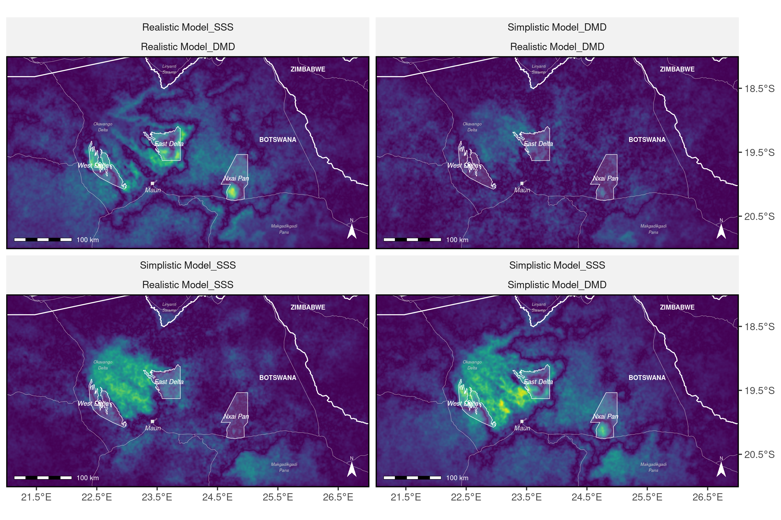
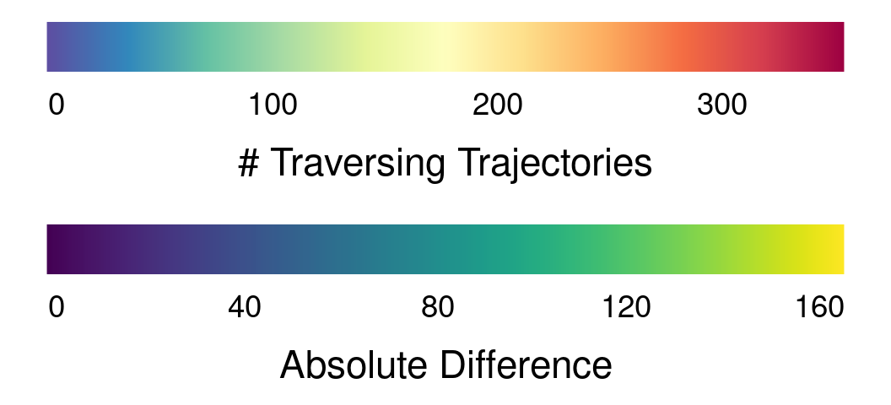
Simplistic Model
Realistic Model
SSS
a
b
Simplistic Model
Realistic Model
DMD
c
d
Notes:
1

Slide 2
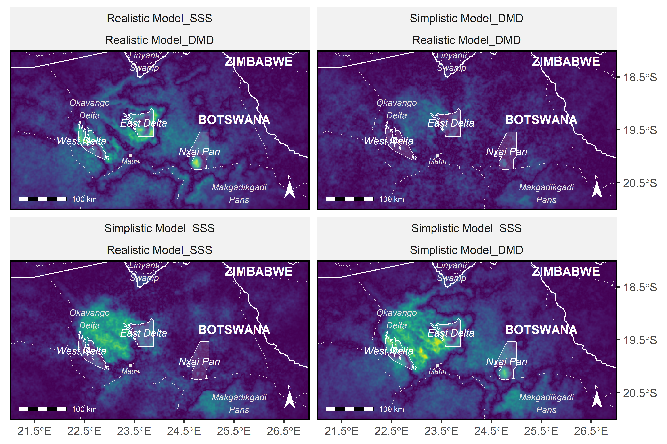
SSS
DMD
|Realistic – Simplistic|
a
b
Simplistic Model
Realistic Model
|DMD-SSS|
c
d

