Slide 1
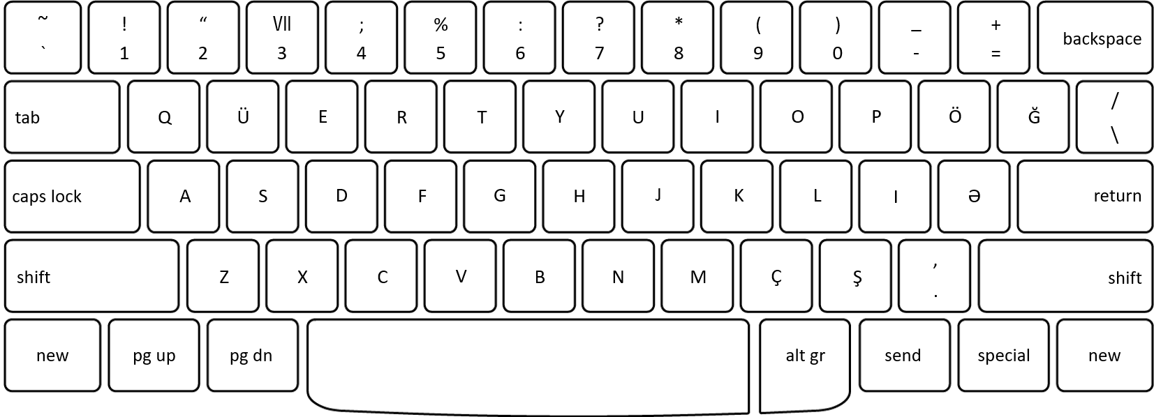
Video Controls
/
Jump 5 seconds backward /forward
D
K
Q
Quit
/
Decrease / increase video speed
F
J
S
Skip
/
Jump 5 seconds backward / jump 5 seconds forward
G
H
Pause

Slide 2
LEVEL 1
LEVEL 2
Carnivorous
Herbivorous
Not Animals
People
Lion
Leopard
Wild Dog
Cheetah
Spotted Hyaena
Brown Hyaena
Fox
1
Genet
Honeybadger
Caracal
Jackal
Mongoose
Civet
Small Cat
8
2
9
4
3
2
1
3
c
4
j
5
m
6
v
7
x

