Slide 1
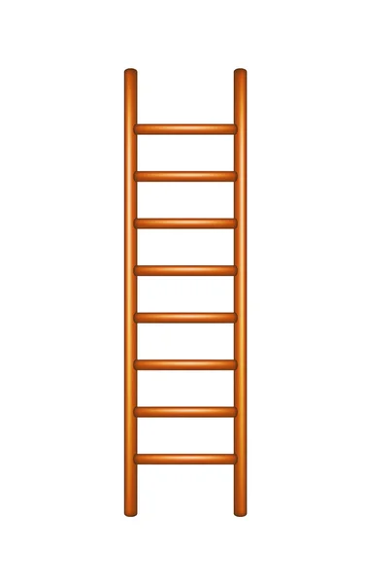
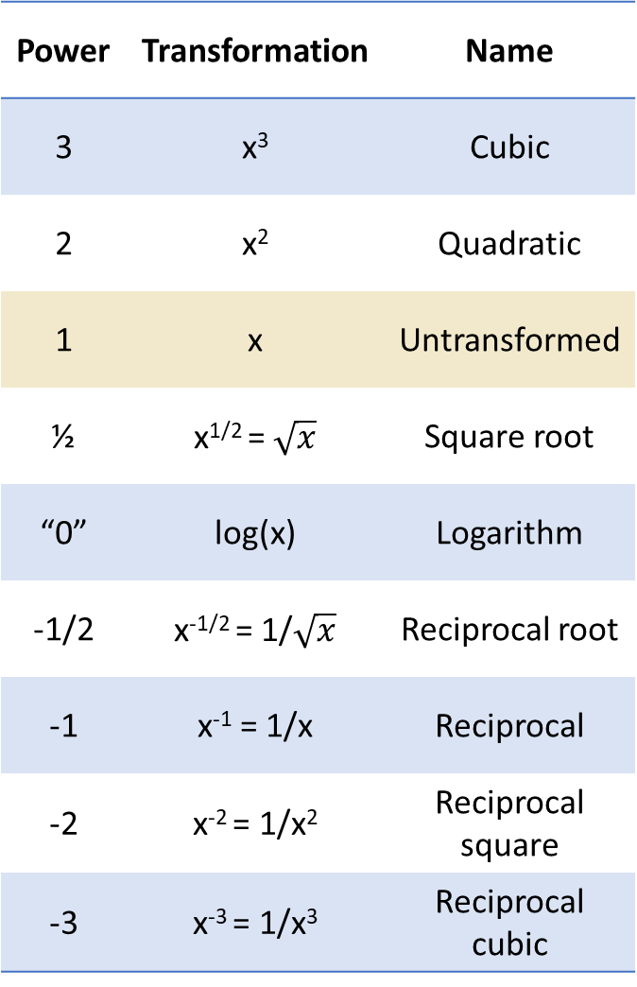
Power | Transformation | Name
3 | x³ | Cubic
2 | x² | Quadratic
1 | x | Untransformed
½ | x^{1/2} = $\sqrt{x}$ | Square root
“0” | log(x) | Logarithm
-1/2 | x^{-1/2} = 1/$\sqrt{x}$ | Reciprocal root
-1 | x⁻¹ = 1/x | Reciprocal
-2 | x⁻² = 1/x² | Reciprocal square
-3 | x⁻³ = 1/x³ | Reciprocal cubic

