Slide 1
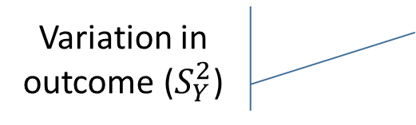
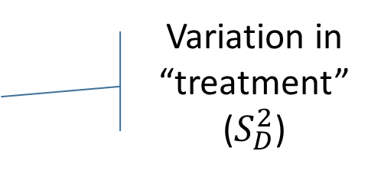
Variation in Y predicted by D
Variation in outcome ($S_{Y}^{2}$)
Variation in “treatment” ($S_{D}^{2}$)

