Slide 1
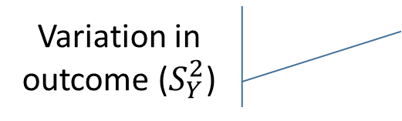
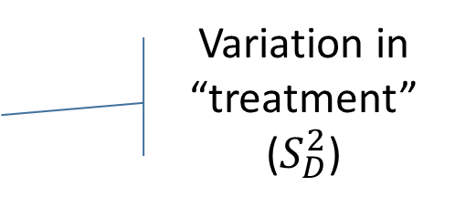
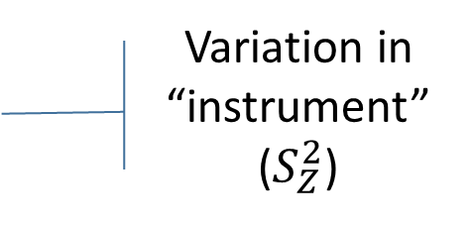
Variation in “instrument” ($S_{Z}^{2}$)
Variation in Y predicted by D
Variation in outcome ($S_{Y}^{2}$)
Variation in “treatment” ($S_{D}^{2}$)
Variation in Y predicted by D, circumscribed by Z

