Slide 1



AES
Add-on processor for RISC-V
Students: David Dan
Dolev Vaknin
Supervisor: Eric Herbelin
Semester: Winter 2019

Slide 2
abstract
In our days, where we use sensors and processors anywhere and anytime, it’s getting
very hard to keep our data safe.
There are a lot of chances to steal the information between collecting the raw data by a sensor, and encryption of that data by our processor.
The goal of this project is to design and implement an AES encryption (or any other safe encryption method) inside RISC-V processor.
In this project we are using RI5CY core embedded in Pulpenix microcontroller.

Slide 3
background
RISC-V is an open ISA
Founded by University of Berkeley, California.
Adopted by many in both academy and industry.
PULP
Parallel Ultra Low Power open-source computing platform
A collaboration of ETH Zurich and University of Bologna.
PULPino processor
Based on PULP platform.
Uses RI5CY core.
PULPeniX
Developed in Bar Ilan, Enics lab.
A HW and SW development and simulation environment.
AES
Advanced Encryption Standard - specification for the encryption of electronic data, based on a design principle known as a substitution–permutation network.

Slide 4
Goals
Knowing RISC-V PULPINO infrastructure
Based on Michael and Avi project.
Integrating AES in RISC-V environment
AES accelerator and designated new commands (While maintaining backward compatibility).
Demonstrate advantages in terms of performance
We expect to increase in power and decrease in performance.
Implement and debug AES on FPGA (optional)

Slide 5
Possible solutions – pros and cons
 | Encryption from buffer | Encryption on-the-fly | Encryption command
Pros | Relatively secure Relatively Easy to implement | Easy to implement Encryption in early stages | Can store one encrypted register
Cons | Need to encrypt 4 registers (128-bit) Slow down the processor | Not very secure (not AES) | Not the most secure method Hard to implement Slow down the processor

Slide 6
AES algorithm
AES encryption is done in several rounds (10 rounds for 128 bit key), and each one of the rounds is consist of several processing steps.
Plain-Text
Key
Round Key (0)
SubBytes
ShiftRows
…
MixColumn
…
Key Expansion Unit
Round Key (9)
SubBytes
ShiftRows
Round Key (10)
Cipher text

Slide 7
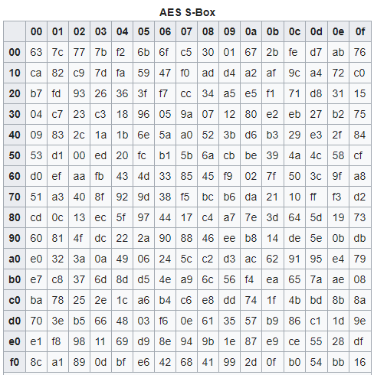
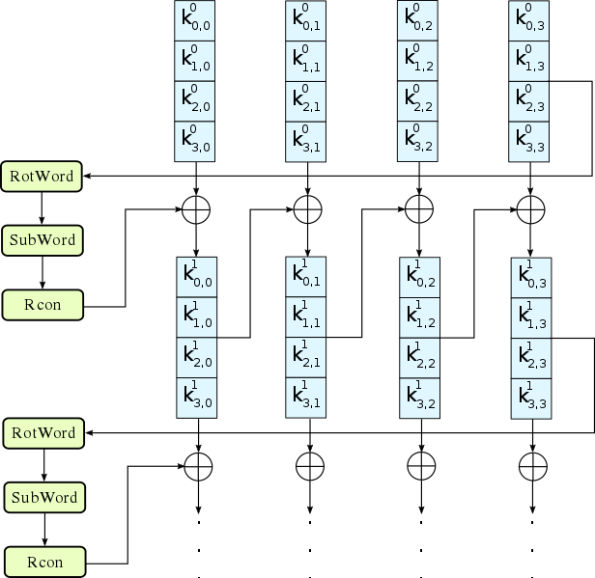
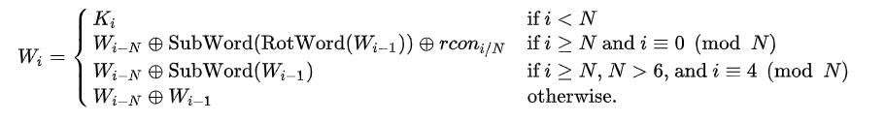
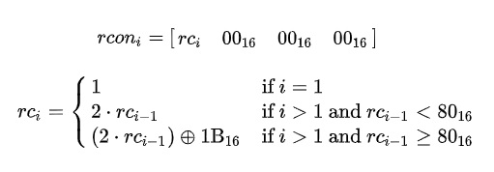
KeyExpansion
Expanding the given key with 128 bits to 1408 bits using Rijndael's key schedule.
RotWord
SubWord
Rcon

Slide 8
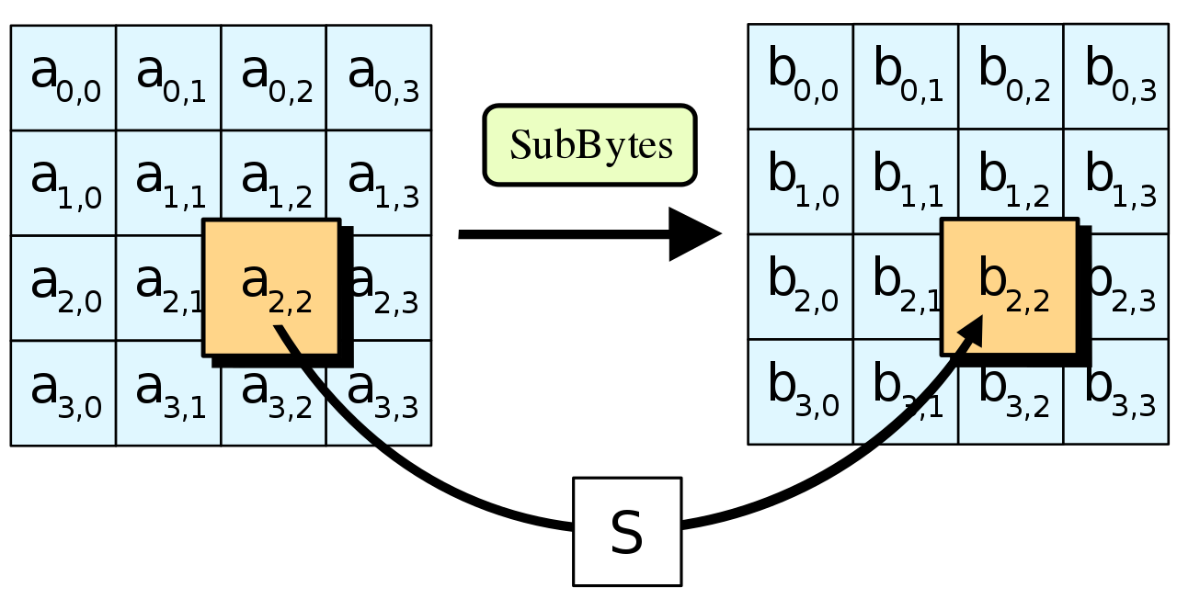
SubBytes
A non-linear substitution step where each byte is replaced with another according to a lookup table.
SubBytes

Slide 9
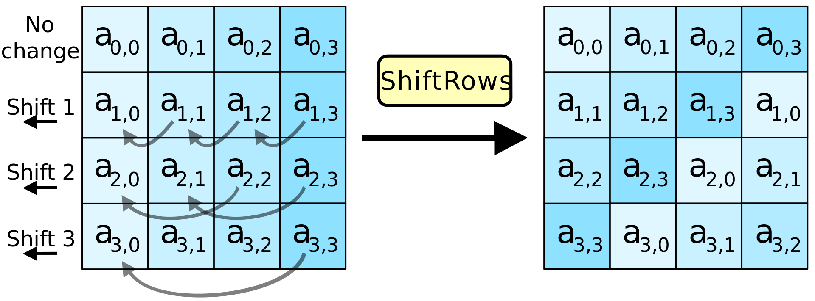
ShiftRows
A transposition step where the last three rows of the state are shifted cyclically a certain number of steps.

Slide 10
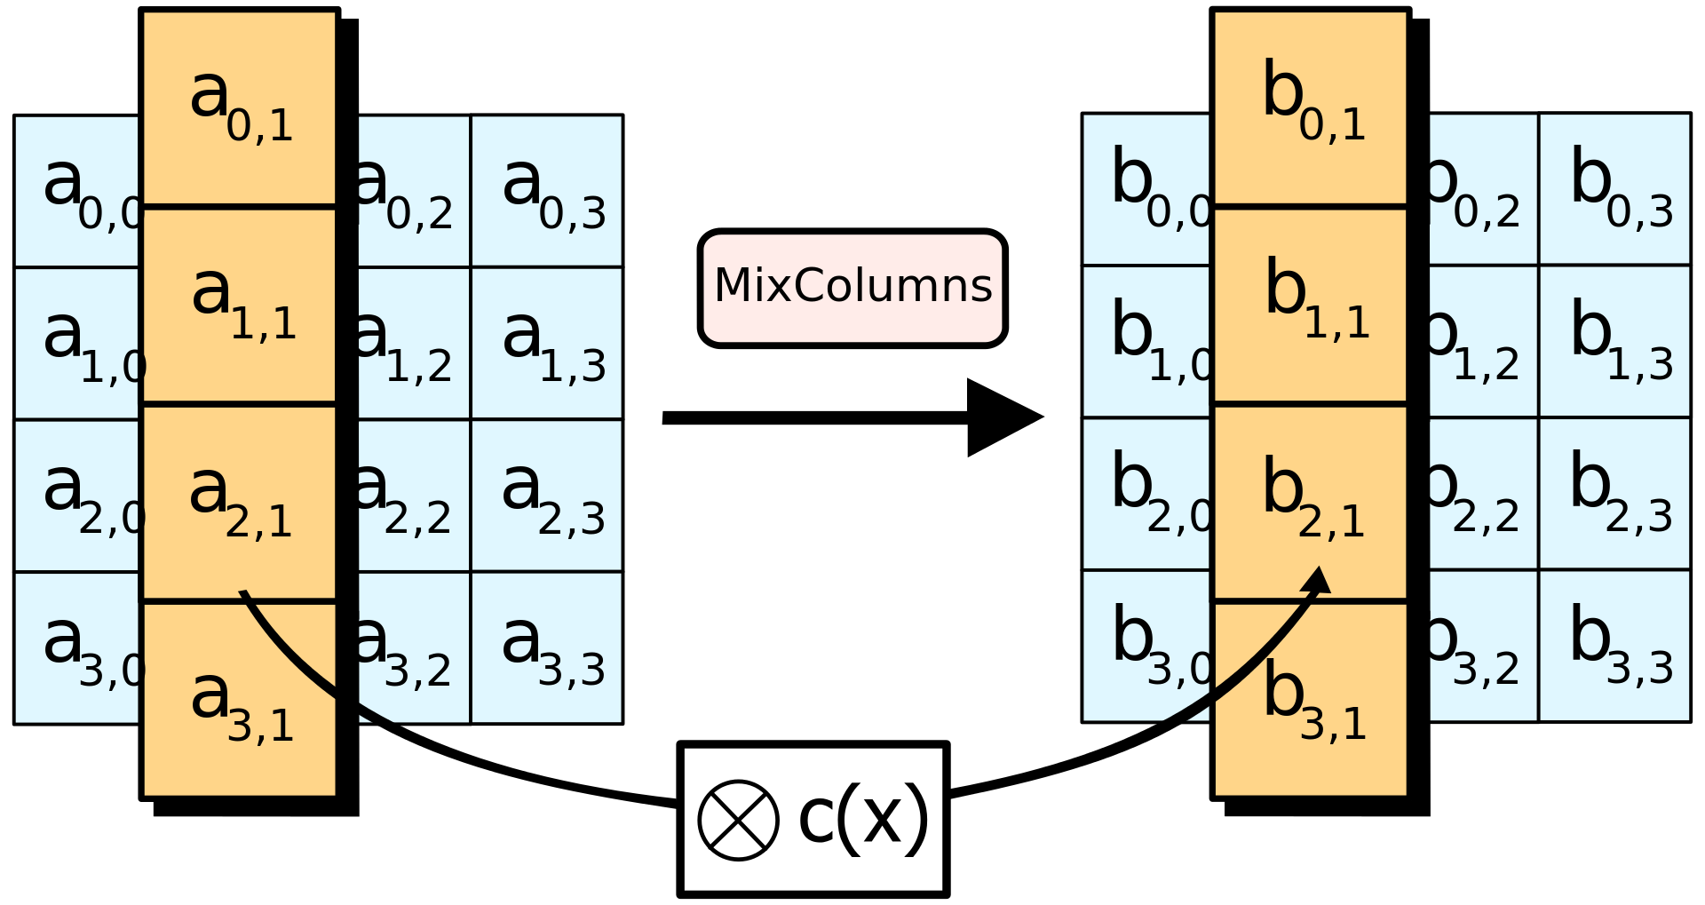
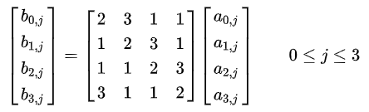
MixColumns (except for the last round)
A linear mixing operation which operates on the columns of the state, combining the four bytes in each column.
MixColumns

Slide 11
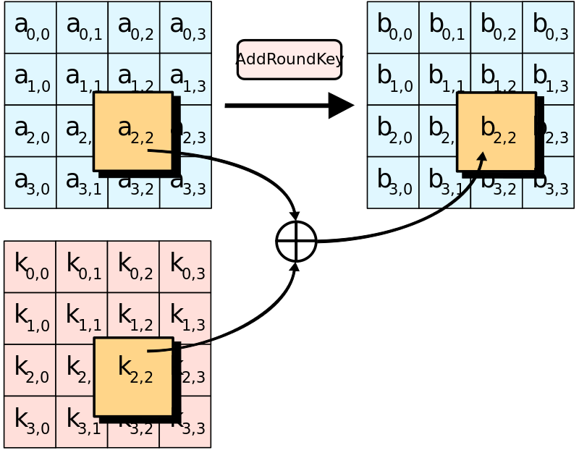
AddRoundKey
Each byte of the state is combined with a byte of the round key using bitwise xor. (twice in the first round - in the beginning and in the end of the round)

Slide 12
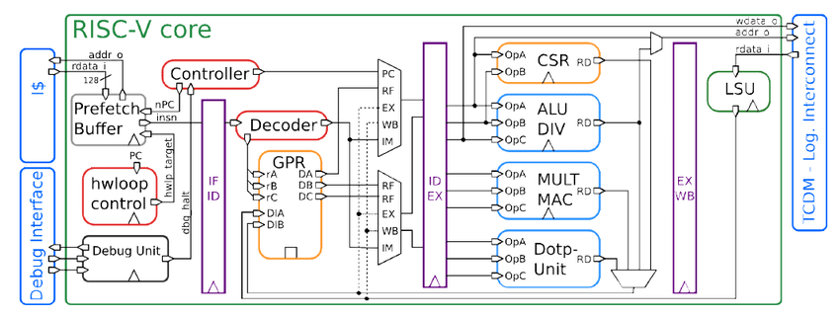
Base architecture of the selected solution
128-bit data
AES register file
128-bit data
AES engine
AES WB
32-bit
128-bit key
128-bit ciphered
32-bit

Slide 13
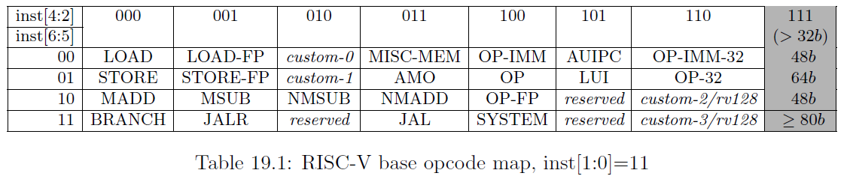
Commands structure
0x0
0x0
0x[0-31]
0x[0-3]
0x[0-3]
0x3b

Slide 14
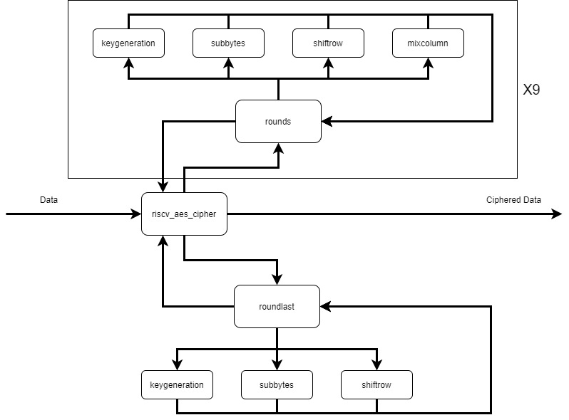
AES Engine Architecture

Slide 15
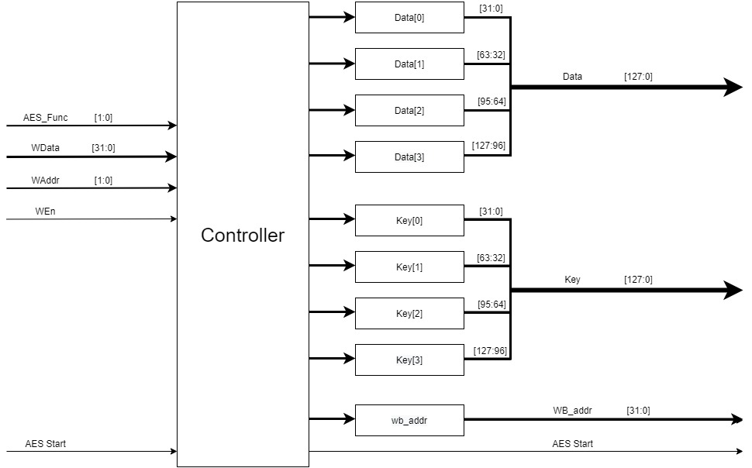
AES Register File Architecture

Slide 16
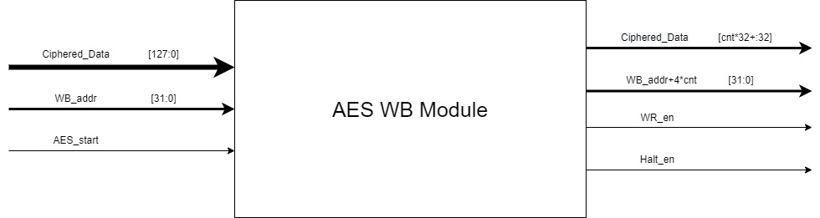
AES Write Back Architecture

Slide 17
