Slide 1



AES
Add-on processor for RISC-V
Students: David Dan
Dolev Vaknin
Supervisor: Eric Herbelin
Semester: Winter 2019

Slide 2
abstract
In our days, where we use sensors and processors anywhere and anytime, it’s getting
very hard to keep our data safe.
There are a lot of chances to steal the information between collecting the raw data by a sensor, and encryption of that data by our processor.
The goal of this project is to design and implement an AES encryption (or any other safe encryption method) inside RISC-V processor.
In this project we are using RI5CY core embedded in Pulpenix microcontroller.

Slide 3
background
RISC-V is an open ISA
Founded by University of Berkeley, California.
Adopted by many in both academy and industry.
PULP
Parallel Ultra Low Power open-source computing platform
A collaboration of ETH Zurich and University of Bologna.
PULPino processor
Based on PULP platform.
Uses RI5CY core.
PULPeniX
Developed in Bar Ilan, Enics lab.
A HW and SW development and simulation environment.
AES
Advanced Encryption Standard - specification for the encryption of electronic data, based on a design principle known as a substitution–permutation network.

Slide 4
Goals
Knowing RISC-V PULPINO infrastructure
Based on Michael and Avi project.
Integrating AES in RISC-V environment
AES accelerator and designated new commands (While maintaining backward compatibility).
Demonstrate advantages in terms of performance
We expect to increase in power and decrease in performance.

Slide 5
Possible solutions – pros and cons
 | Encryption from buffer | Encryption on-the-fly | Encryption command
Pros | Relatively secure Relatively Easy to implement | Easy to implement Encryption in early stages | Can store one encrypted register
Cons | Need to encrypt 4 registers (128-bit) Slow down the processor | Not very secure (not AES) | Not the most secure method Hard to implement Slow down the processor

Slide 6
AES algorithm
AES encryption is done in several rounds (10 rounds for 128 bit key), and each one of the rounds is consist of several processing steps.
Plain-Text
Key
Round Key (0)
SubBytes
ShiftRows
…
MixColumn
…
Key Expansion Unit
Round Key (9)
SubBytes
ShiftRows
Round Key (10)
Cipher text

Slide 7
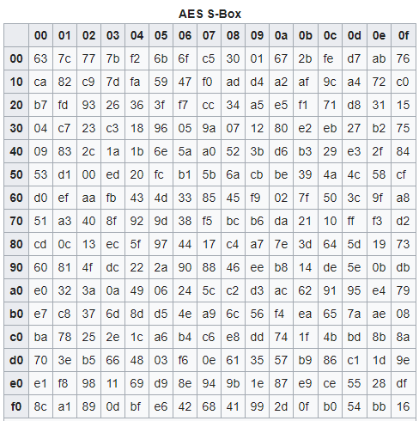
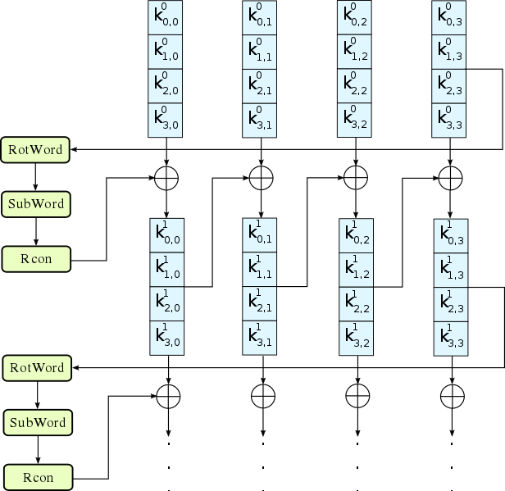
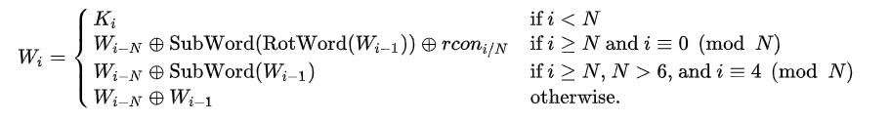
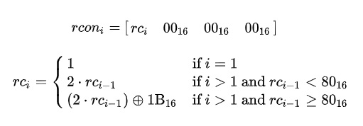
KeyExpansion
Expanding the given key with 128 bits to 1408 bits using Rijndael's key schedule.
RotWord
SubWord
Rcon

Slide 8
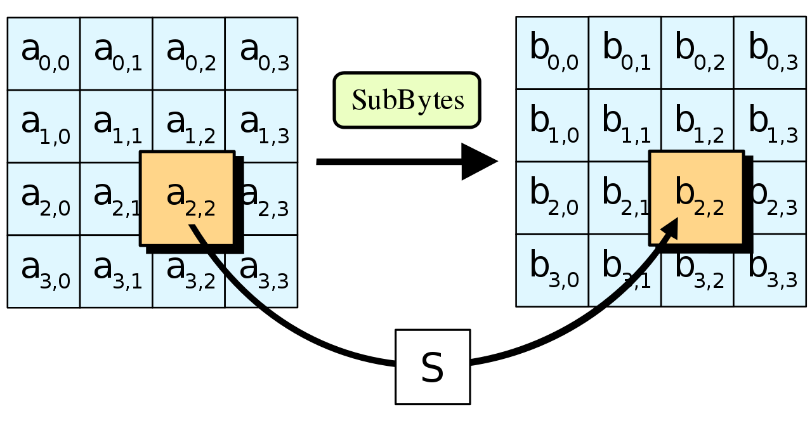
SubBytes
A non-linear substitution step where each byte is replaced with another according to a lookup table.
SubBytes

Slide 9
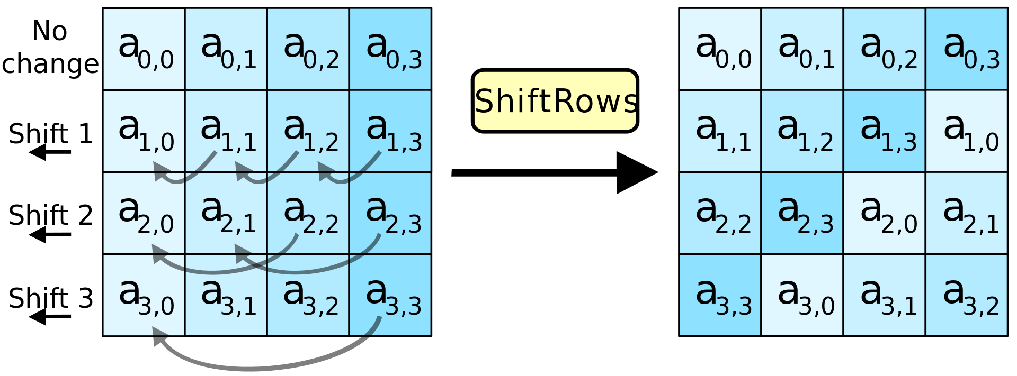
ShiftRows
A transposition step where the last three rows of the state are shifted cyclically a certain number of steps.

Slide 10
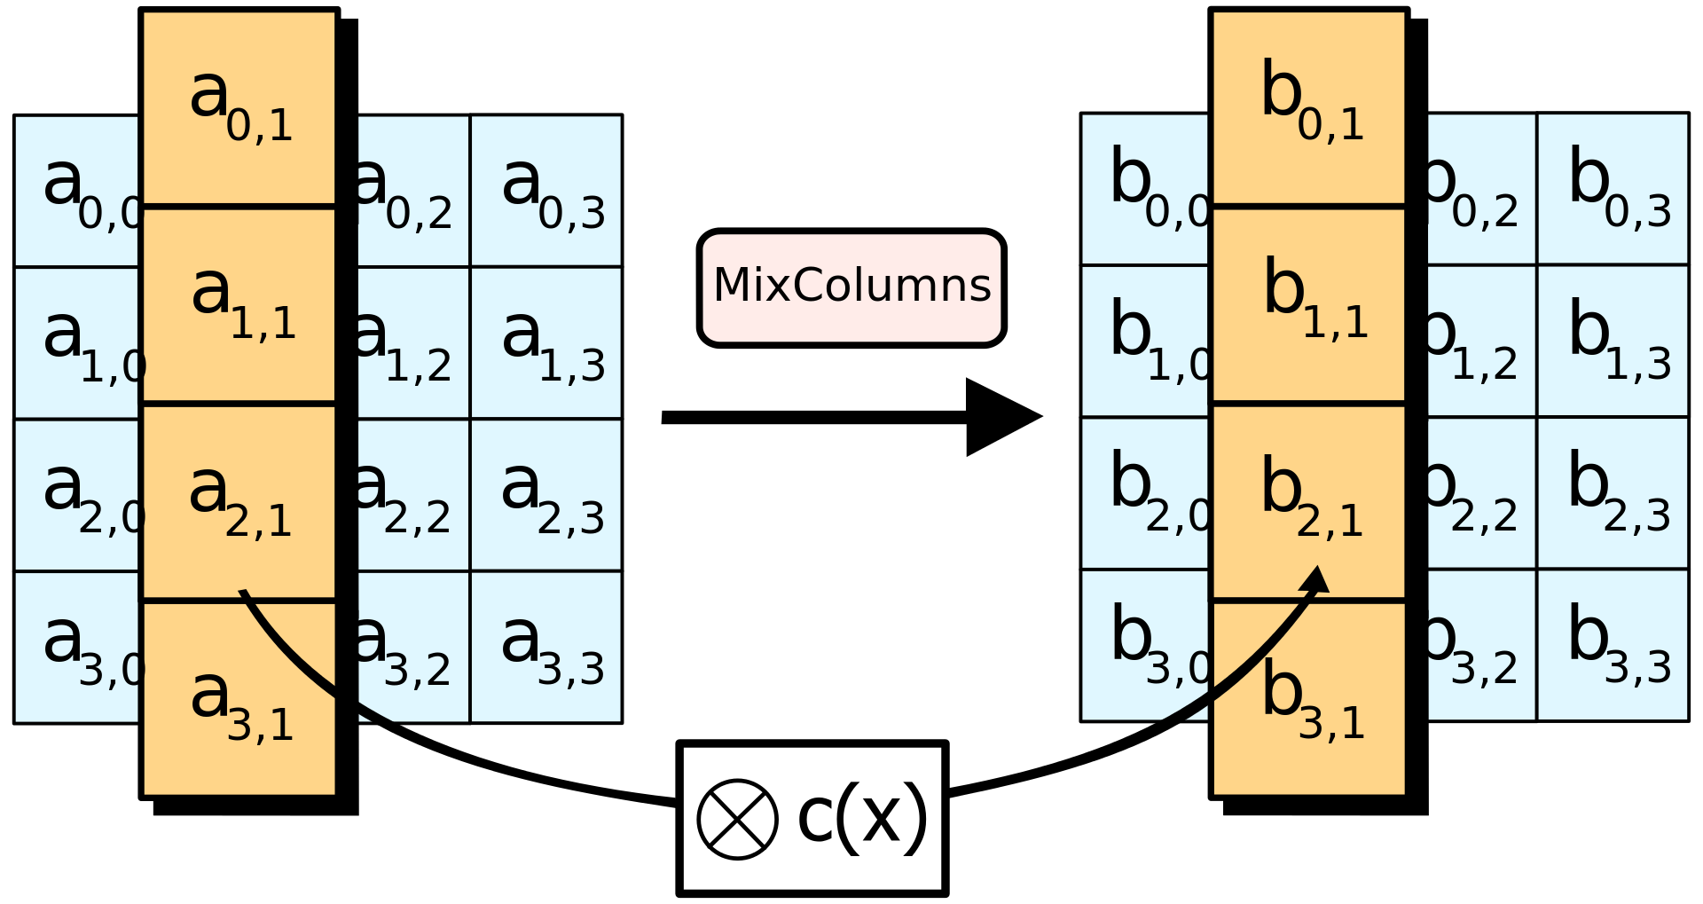
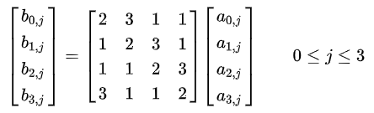
MixColumns (except for the last round)
A linear mixing operation which operates on the columns of the state, combining the four bytes in each column.
MixColumns

Slide 11
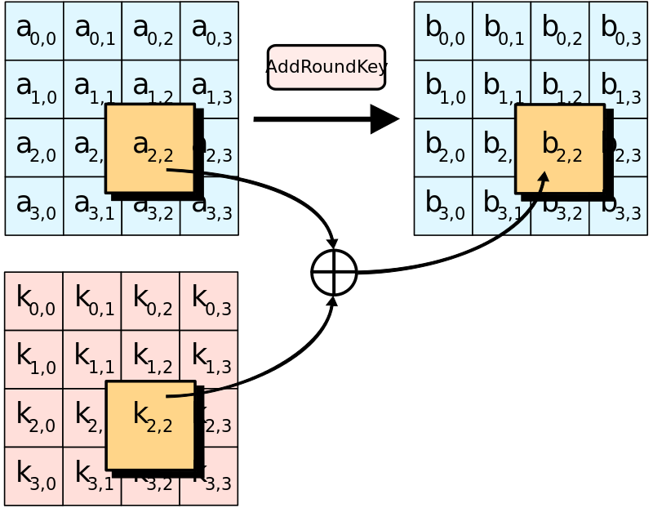
AddRoundKey
Each byte of the state is combined with a byte of the round key using bitwise xor. (twice in the first round - in the beginning and in the end of the round)

Slide 12
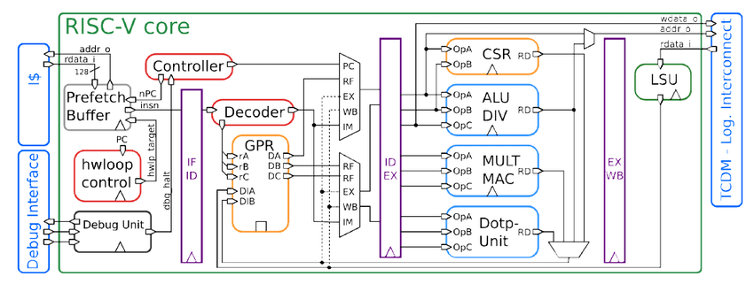
Base architecture of the selected solution
128-bit data
AES register file
128-bit data
AES engine
AES WB
32-bit
128-bit key
128-bit ciphered
32-bit

Slide 13
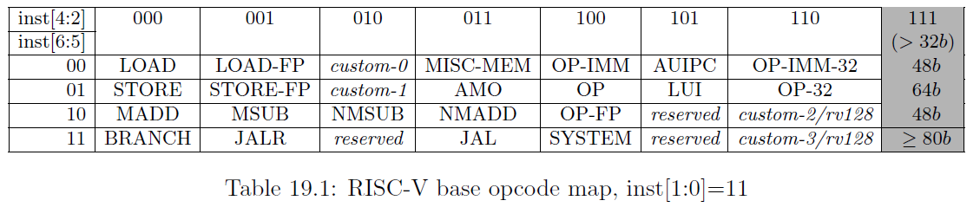
Commands structure
0x0
0x0
0x[0-31]
0x[0-3]
0x[0-3]
0x3b

Slide 14
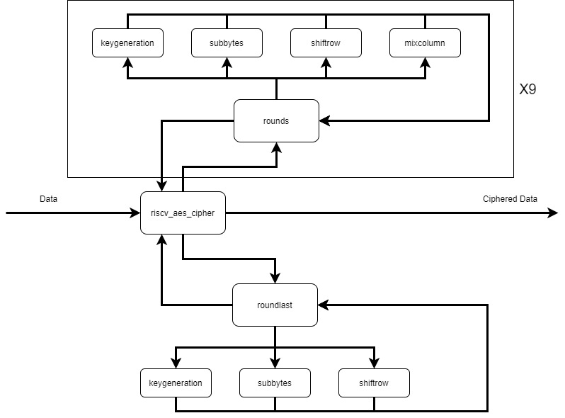
AES Engine Architecture

Slide 15
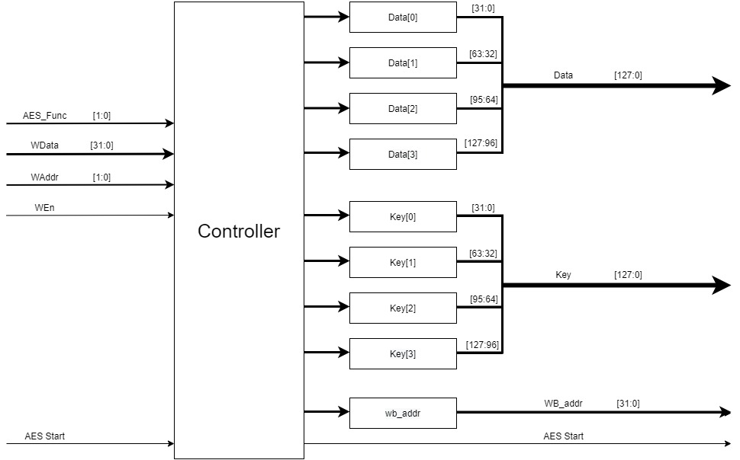
AES Register File Architecture

Slide 16
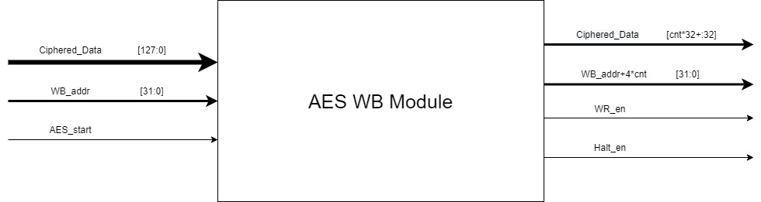
AES Write Back Architecture

Slide 17
