Slide 1

UFO
DATA
MINING

Slide 2
TEXT FONT
TOP SECRET MISSON
OBJECTIVE: GAIN NEW INFORMATION ABOUT UFOs IN THE UNITED STATES
USE DATA FOUND ON KAGGLE TO DIVE DEEPER INTO UFO SIGHTINGS
FIND PATTERNS OF UFOs PREVIOUSLY UNKNOWN

Slide 3
WHAT DOES THE DATASET CONTAIN
80,000 ROWS OF:
Date/Time
City, State, Country
Duration (seconds)&(hours/mins)
Comments
Date Posted
Latitude & Longitude

Slide 4
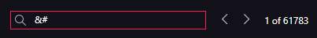
POSSIBLE INTERFERNCE FROM ALIENS (AKA NOISY DATA)
DATA SEEMS TO CONTAIN LOTS OF ODD SYMBOLS AND GIBBERISH
EXAMPLES:
&#39 | &#44 | &#33
(COULD BE PART OF AN ALIEN LANUAGE BUT WE HAVEN’T PROVEN IT YET)

Slide 5
DATA CLEANING
REMOVED: “GIBBERISH” USING THE FIND AND REPLACE FEATURE IN EXCEL
SPLIT:DATE/TIME FROM
10/10/1949 20:30
To Two Columns:
10/10/1949 , 20:30

Slide 6
DATA CLEANING
REMOVED: DURATION (HOURS/MINS) SINCE THERE WAS ALREADY DURATION (SECONDS)
REMOVED: ALL EXCESSIVE COUNTRIES

Slide 7
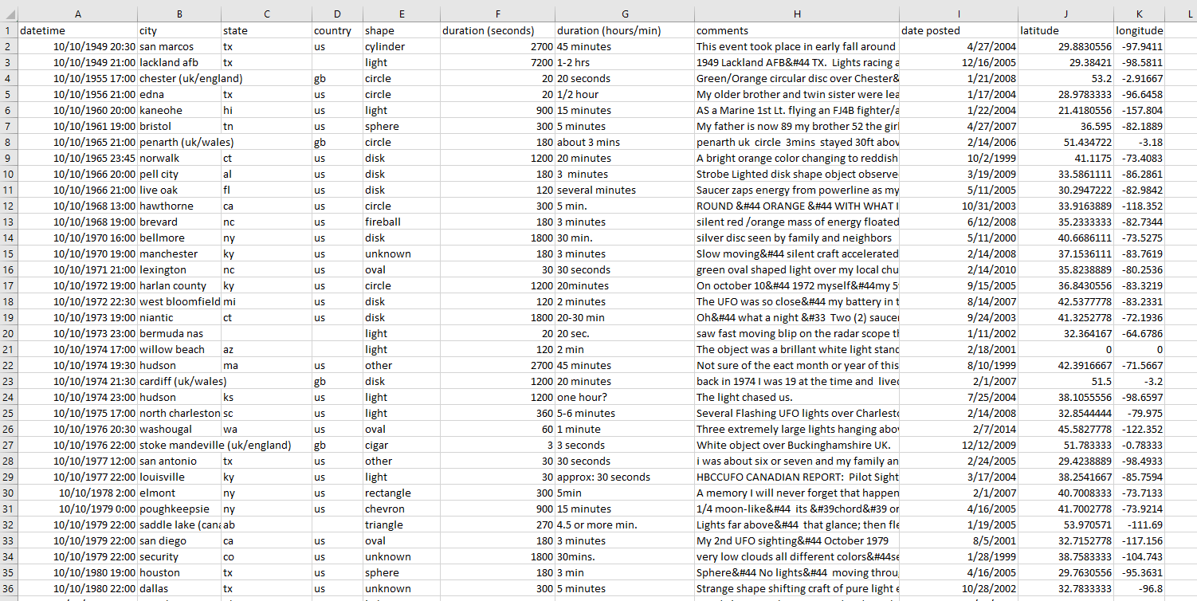
BEFORE

Slide 8
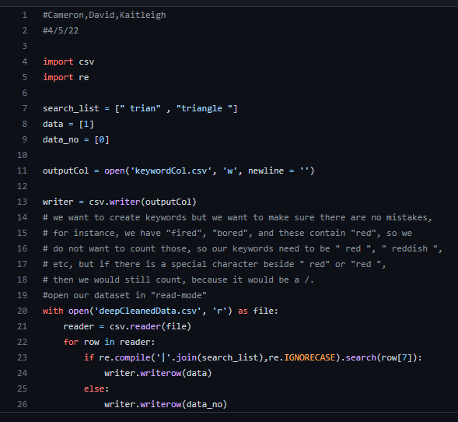
DATA PREPROCESSING
A SCRIPT WAS CREATED TO FIND TO SEARCH THE DOCUMENT FOR THE OCCURANCE OF KEY WORDS

Slide 9
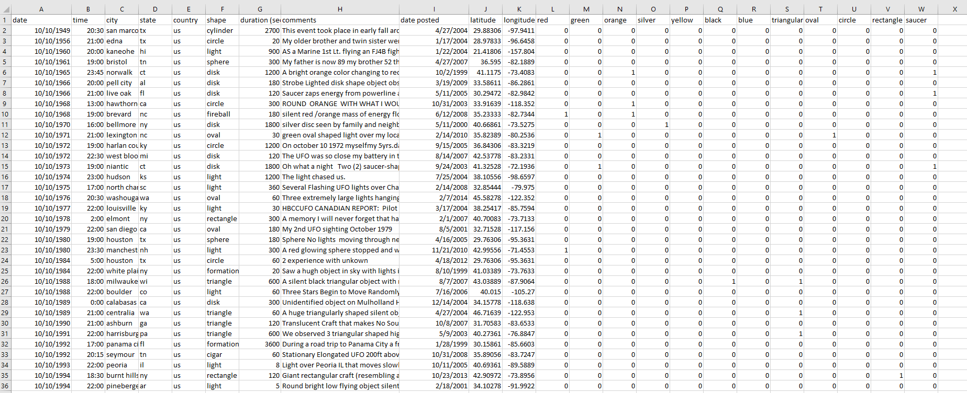
DATA PREPROCESSING

Slide 10
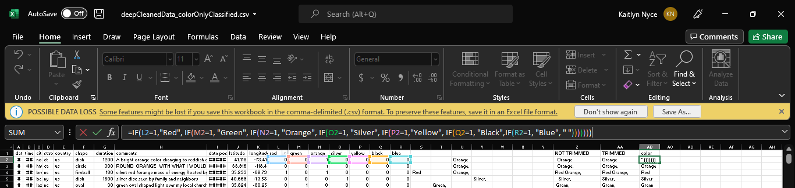
DATA PREPROCESSING

Slide 11
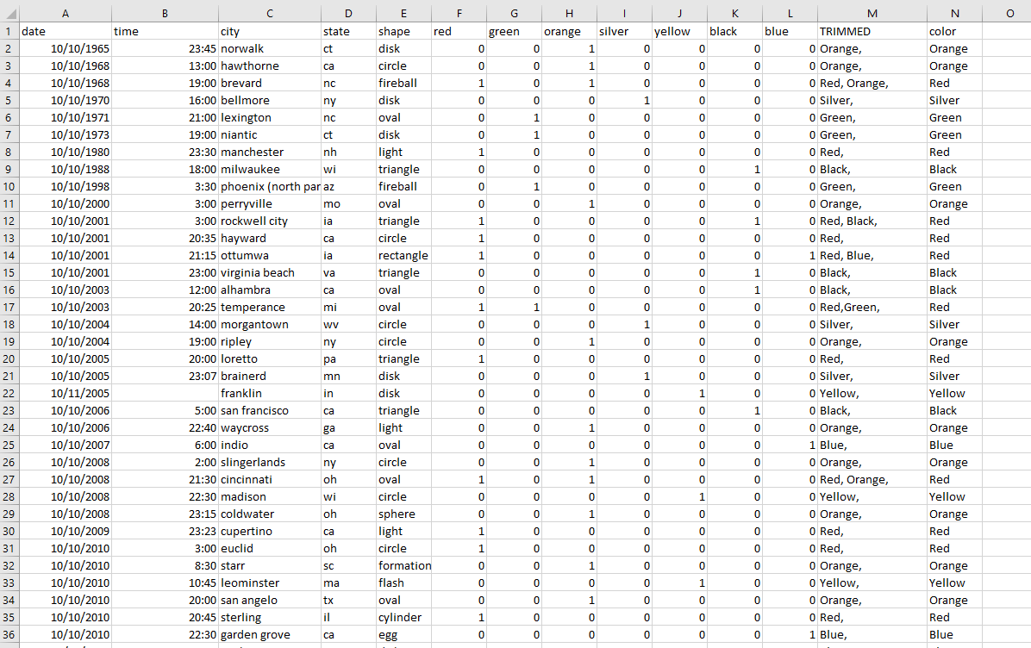
DATA PREPROCESSING

Slide 12
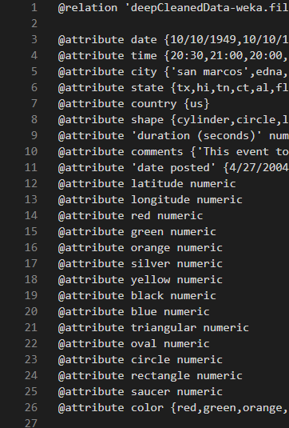
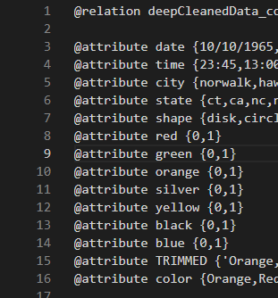
DATA PREPROCESSING

Slide 13
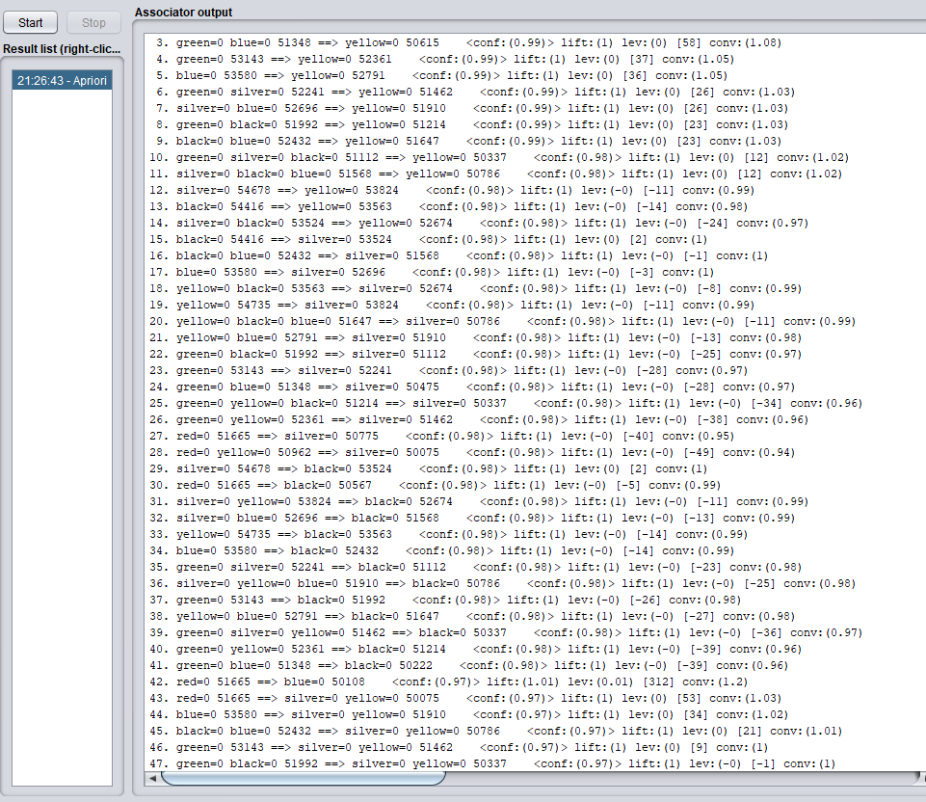
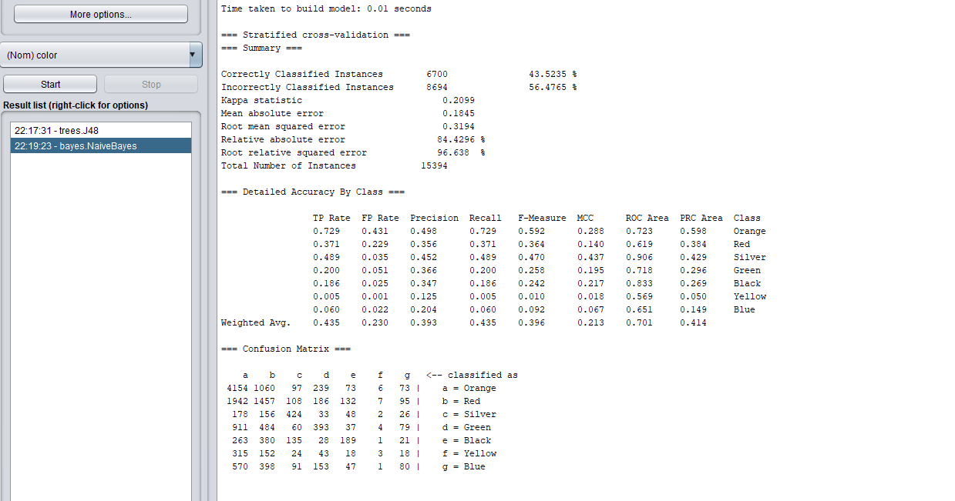
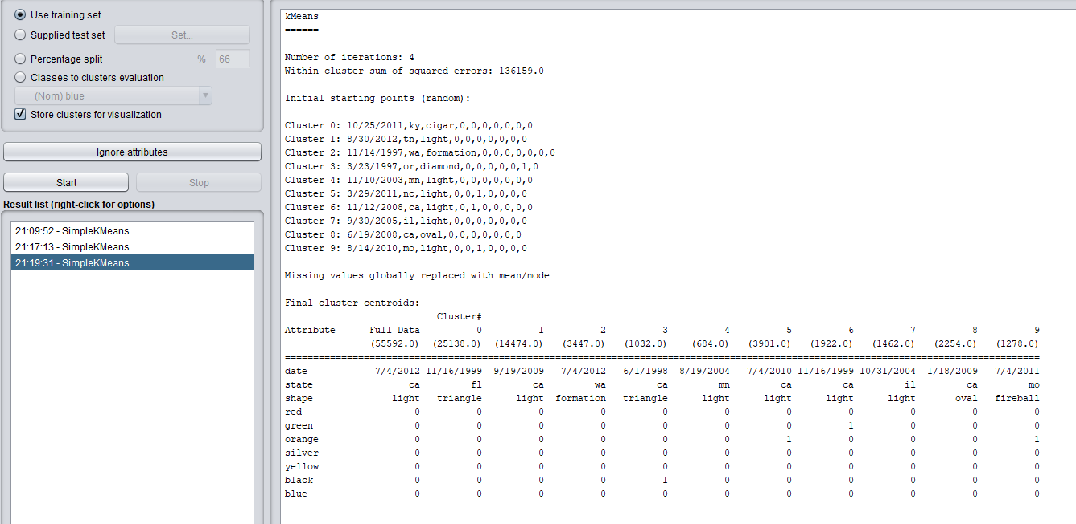
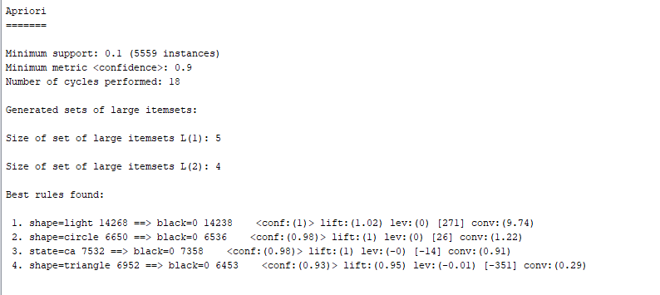
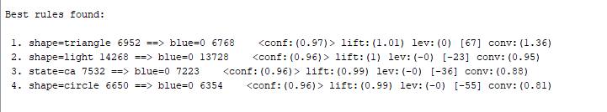
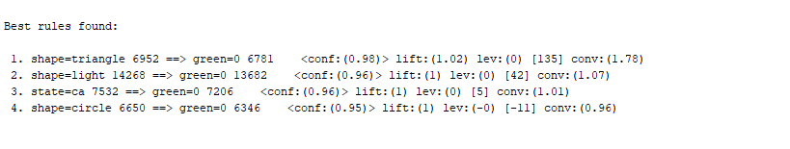
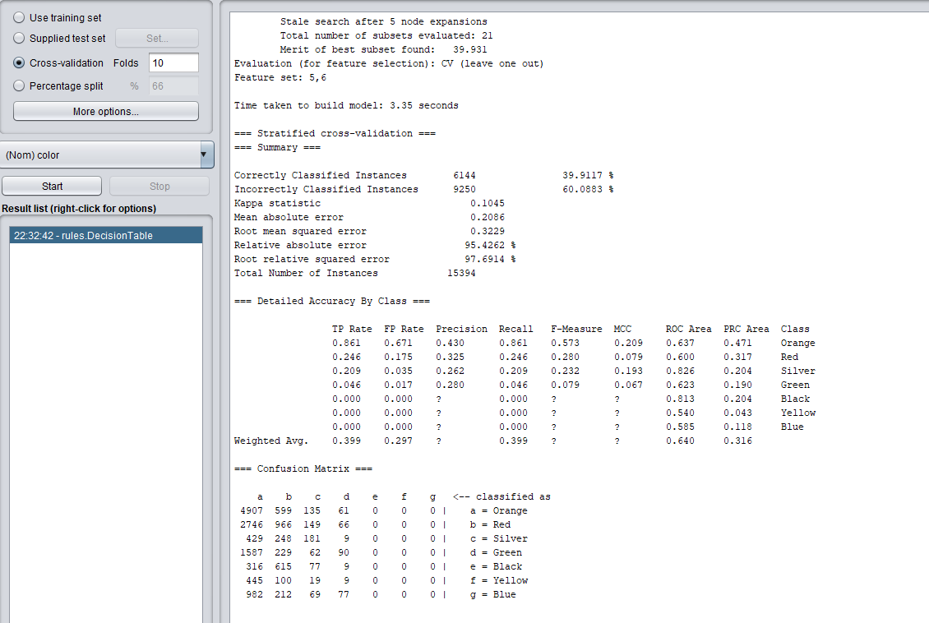
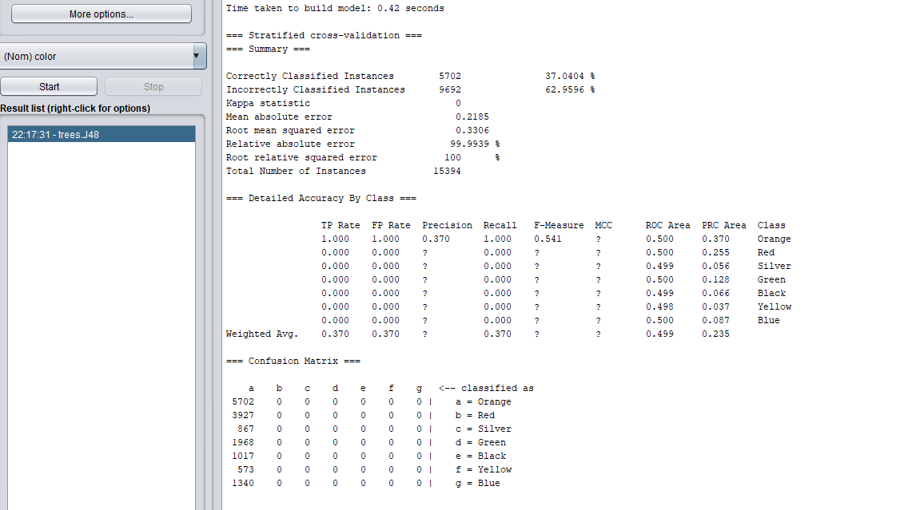
DATA MINING THE NEW DATA

Slide 14
DATA MINING THE NEW DATA

Slide 15
DATA MINING THE NEW DATA

Slide 16
DATA MINING THE NEW DATA

Slide 17
DATA MINING THE NEW DATA

Slide 18
DATA MINING THE NEW DATA

Slide 19
DATA MINING THE NEW DATA

Slide 20
MISSON RESULTS
WE WERE ABLE TO PARSE THE COLOR FROM THE COMMENTS, AND ASSIGN IT AS THE CLASS LABEL
THERE WEREN’T ANY STRONG PATTERNS THAT WERE FORMED FROM USING THIS DATA SET, BUT…

Slide 21
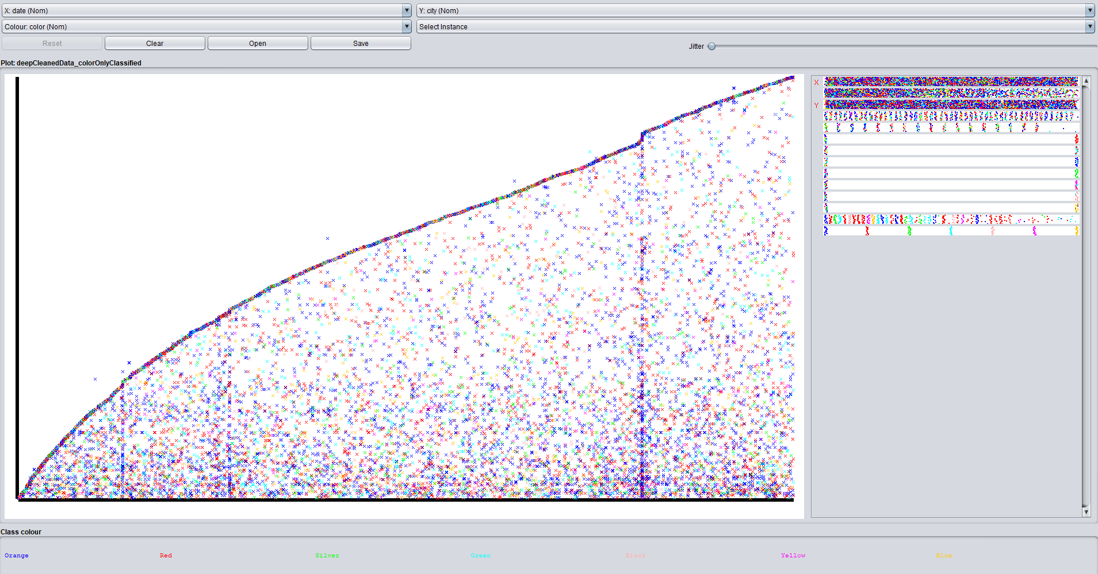
TEXT FONT
DOES THIS PROVE THAT ALIENS EXIST?
WE DON’T KNOW WHAT IT MEANS…

