Slide 1

UFO
DATA
MINING

Slide 2
TEXT FONT
TOP SECRET MISSON
OBJECTIVE: GAIN NEW INFORMATION ABOUT UFOs IN THE UNITED STATES
USE DATA FOUND ON KAGGLE TO DIVE DEEPER INTO UFO SIGHTINGS
FIND PATTERNS OF UFOs PREVIOUSLY UNKNOWN

Slide 3
WHAT DOES THE DATASET CONTAIN
80,000 ROWS OF:
Date/Time
City, State, Country
Duration (seconds)&(hours/mins)
Comments
Date Posted
Latitude & Longitude

Slide 4
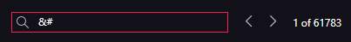
POSSIBLE INTERFERNCE FROM ALIENS (AKA NOISY DATA)
DATA SEEMS TO CONTAIN LOTS OF ODD SYMBOLS AND GIBBERISH
EXAMPLES:
&#39 | &#44 | &#33
(COULD BE PART OF AN ALIEN LANUAGE BUT WE HAVEN’T PROVEN IT YET)

Slide 5
DATA CLEANING
REMOVED: “GIBBERISH” USING THE FIND AND REPLACE FEATURE
SPLIT:DATE/TIME FROM
10/10/1949 20:30
To
10/10/1949 , 20:30

Slide 6
DATA CLEANING
REMOVED: DURATION (HOURS/MINS) SINCE THERE WAS ALREADY DURATION (SECONDS)
REMOVED: ALL EXCESSIVE COUNTRIES
REMOVED: LATITUDE AND LONGITUDE

Slide 7
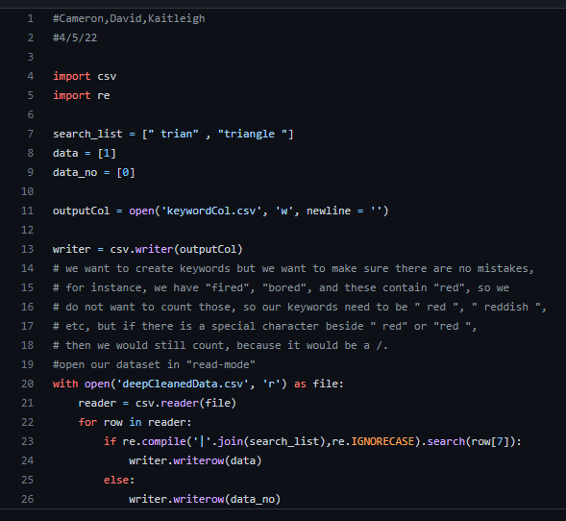
DATA PREPROCESSING
A SCRIPT WAS CREATED TO FIND TO SEARCH THE DOCUMENT FOR THE OCCURANCE OF KEY WORDS

Slide 8
DATA MINING THE NEW DATA
########################################################################################

Slide 9
MISSON RESULTS
########################################################################################

