Slide 1
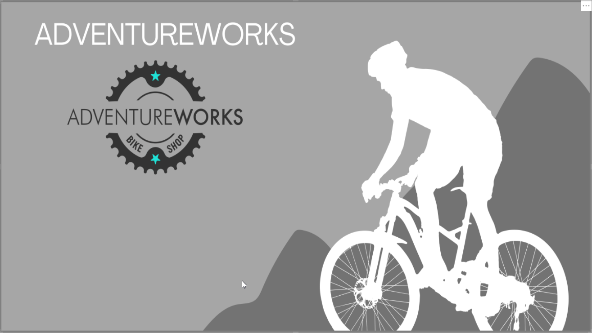

Slide 2

Adventure Works is a fictional company dedicated to manufacturing and selling bicycles, as well as cycling apparel, equipment, and accessories.
Main Business Lines
Bicycle Sales - Represents 87% of total sales.
Bicycle Components Sales - Contributes 10% to total sales.
Clothes and Accessories Sales - Marginal contribution to total sales.
Markets and Regional Contribution
The company operates in three primary markets:
North America (USA and Canada): Contributes 72% of sales.
Europe (UK, Germany, and France): Contributes 18% of sales.
Pacific (Australia): Accounts for the remaining 10%.
Sales Model and Channels
Adventure Works primarily follows an in-store sales model, representing 70% of
sales, distributed across three sales channels:
AW (Adventure Works) - Brand-owned stores.
BS (Bike Shops) - Cycling specialty stores or chains.
OS (Other Specialty) - General sports retail chains.

Slide 3
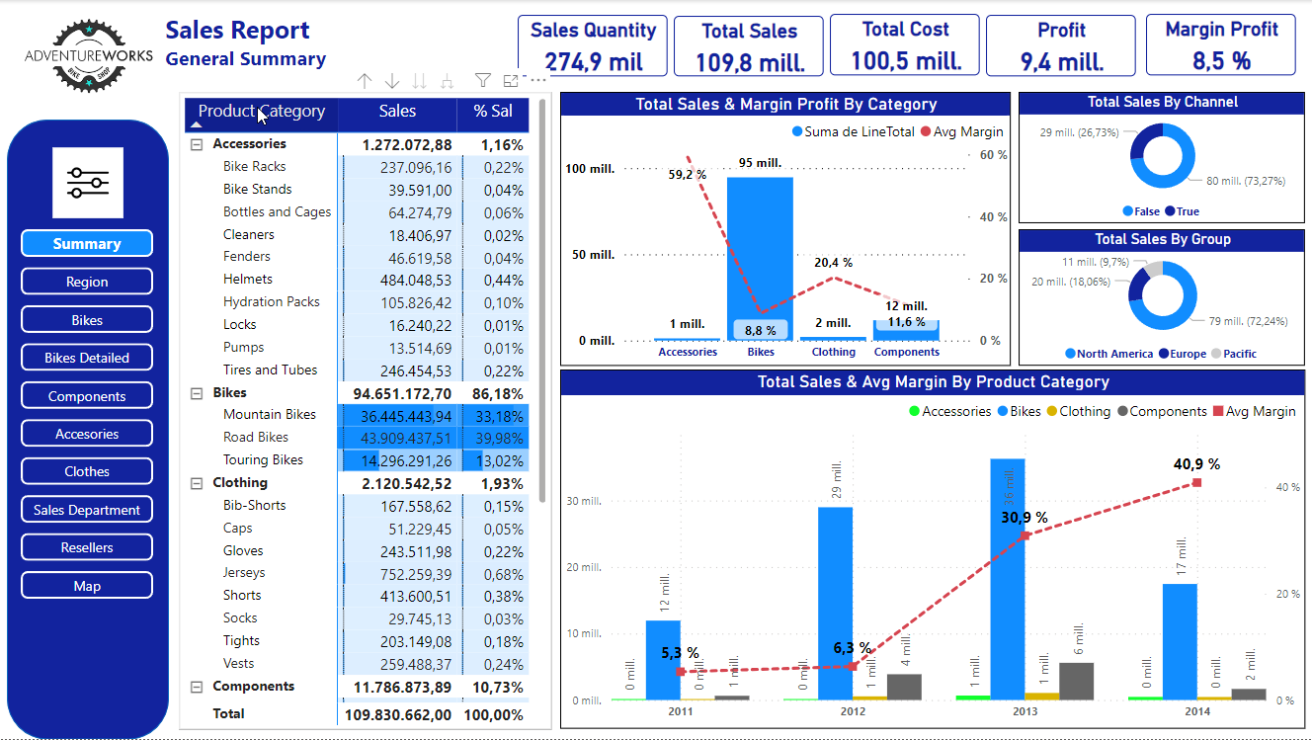

Slide 4
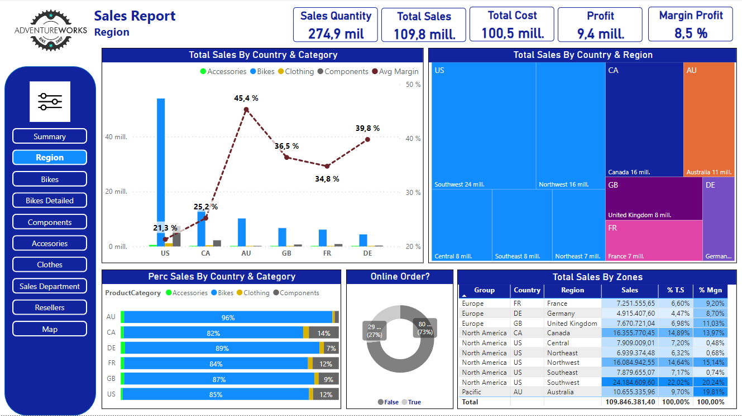

Slide 5
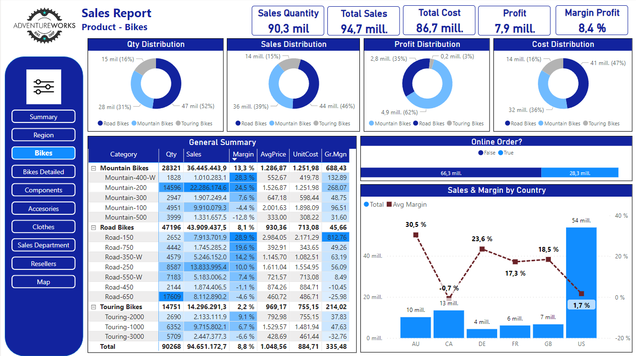

Slide 6
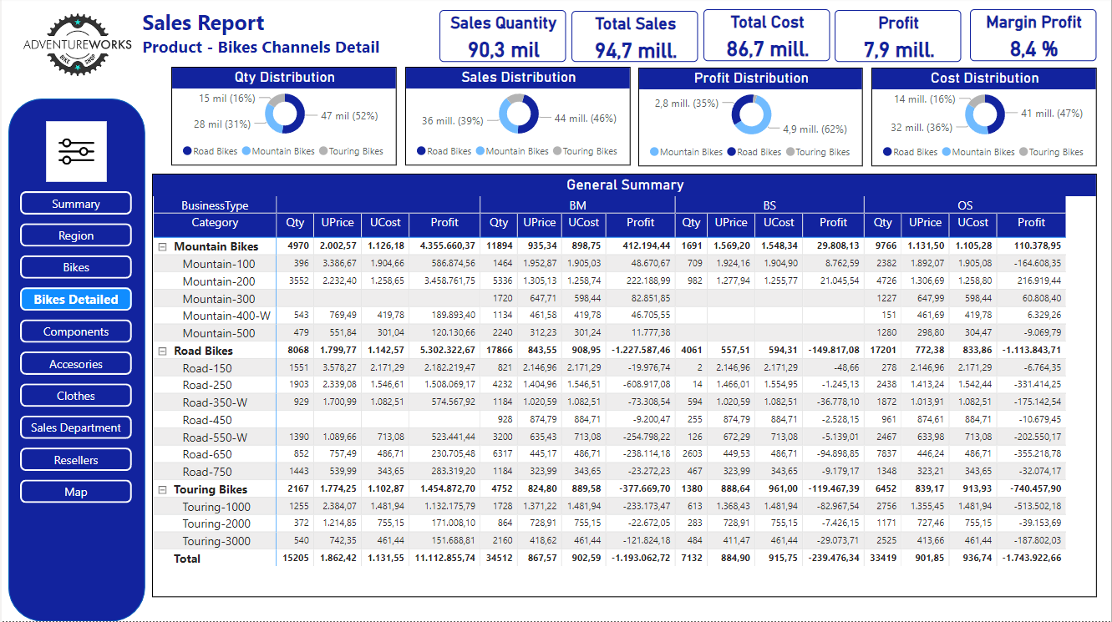

Slide 7
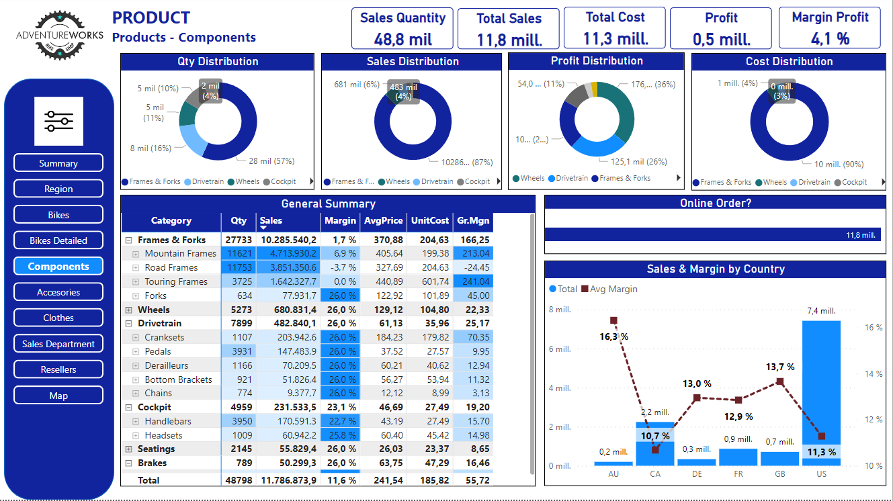

Slide 8
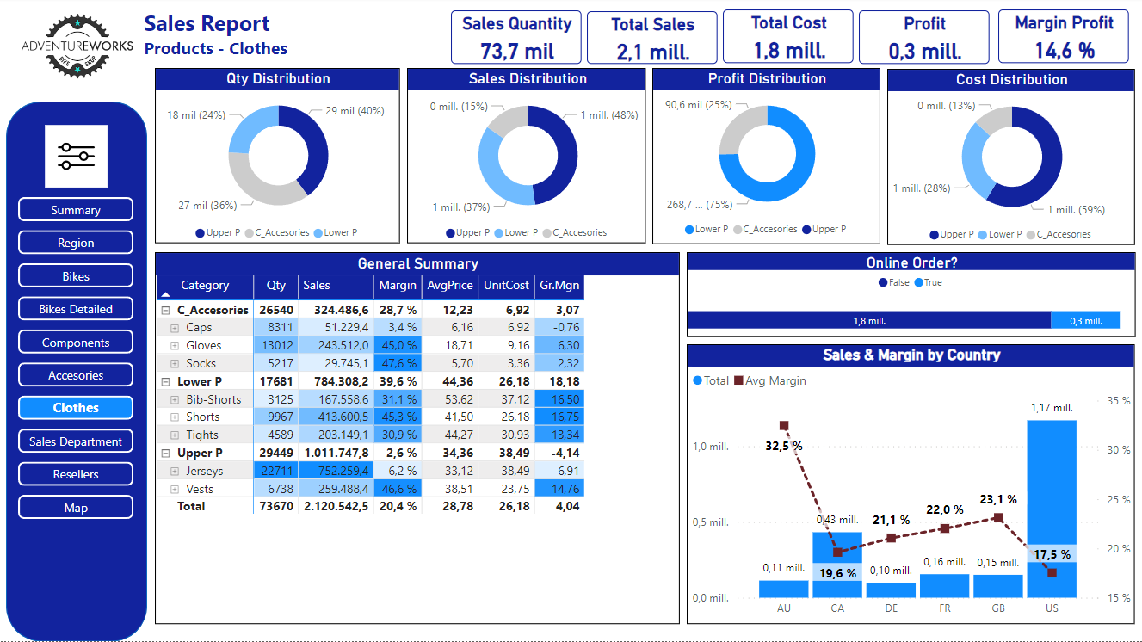
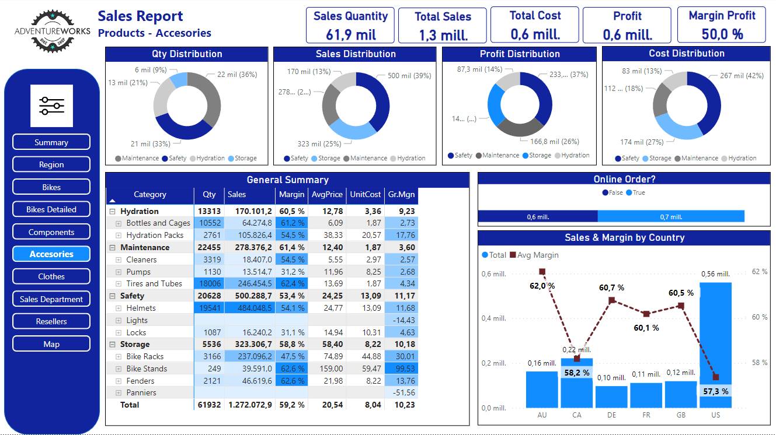

Slide 9
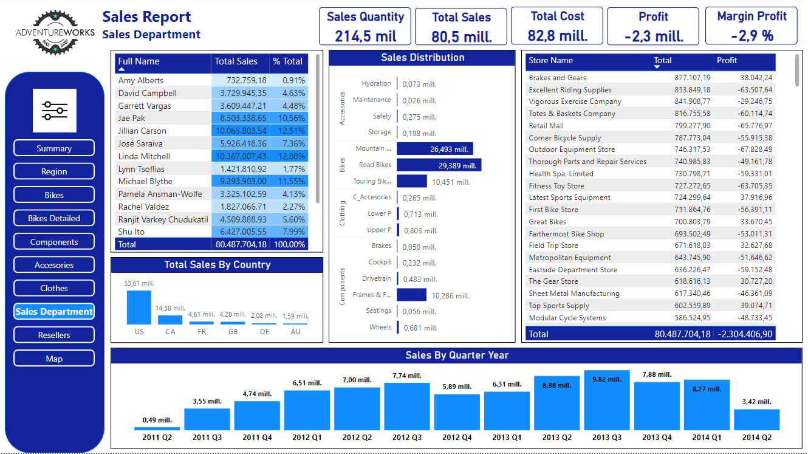

Slide 10
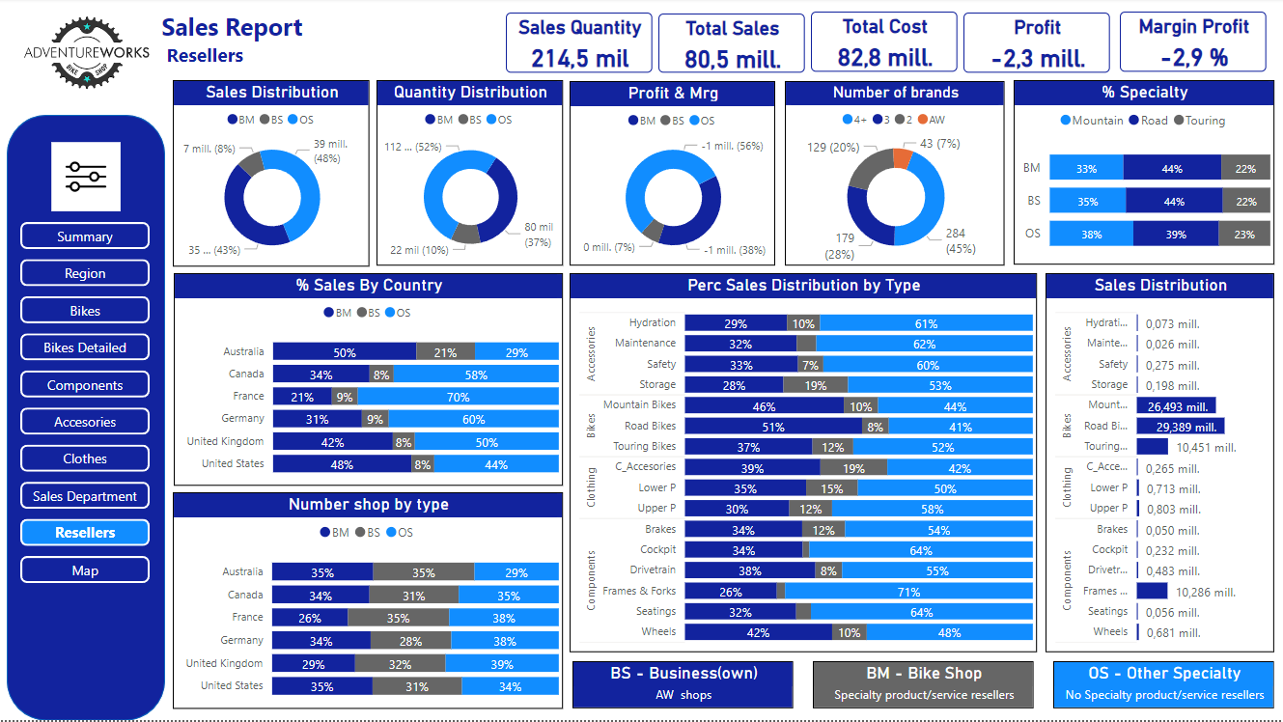

Slide 11
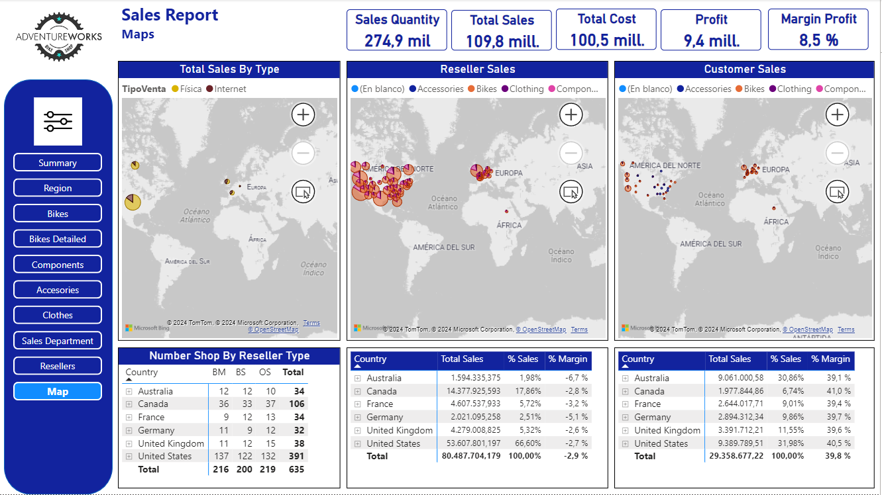

Slide 12
Sales Distribution by Product Line
Bicycles: 87% of sales, representing the main revenue source with consistent growth.
Components: 10% of sales, showing stable margins and moderate growth.
Accessories and Apparel: 3% of sales, with varying margins but steady performance overall.
Profitability by Region
North America: 72% of sales but the lowest profit margin at 22%.
Europe: 18% of sales, with a moderate profit margin.
Pacific Region: 10% of sales but highest profit margin at 45%, indicating high profitability relative to sales volume.
Opportunity for Margin Optimization
The inverse relationship between sales volume and profit margin highlights potential to refine regional profitability strategies.
Sales Model and Channels
70% of sales occur through physical stores, divided into three key types:
Brand-Owned Stores (BS): Adventure Works' exclusive outlets, focused mainly on premium models.
Bike Shops (BM): Specialized bicycle stores with a dedicated cycling audience.
General Sports Retailers (OS): Broad sports retail channels.
30% of sales are generated online, where margins exceed 30% across all categories.

Slide 13
Bicycle Line Analysis
Mountain Bikes: Represent 39% of total sales and 62% of profit. The high-margin Mountain-200 model drives profitability in this category.
Road Bikes: Account for 46% of sales but only 35% of profit. The best-selling Road-650 model operates at a loss, indicating the need for a profitability review.
Touring Bikes: Contribute 15% of sales yet only 3% of profit. The Touring-3000 model notably underperforms, calling for strategic adjustments.
Channel-Specific Challenges: While Mountain Bikes perform well in physical stores, Road and Touring categories collectively face losses of $3.73 million in these channels. In contrast, the online channel remains consistently profitable with strong margins.
Performance by Retail Channel
Bike Shops (BM): Show a total loss of $1.4 million, largely due to underperforming Road and Touring models.
Brand-Owned Stores (BS): The lowest sales volume channel, offering only high-end Mountain models, which restricts sales potential. Road models, such as the Road-650 and Road-350W, account for 87% of losses here.
General Sports Retailers (OS): The most challenging channel with $2.5 million in losses from Road models and $700K from Touring models, primarily driven by underperforming models like the Road-250 and Touring-1000.

Slide 14
Components Line
Contributes 10.73% of total sales with margins in the 10-15% range.
Frames and Forks are underperforming, with Road frames incurring a $200K loss. Excluding this subcategory could improve the overall margin to about 25%.
Clothes and Accessories
Accessories: Represent 1.3% of sales and achieve a high margin of 50%, with half of the profit driven by Hydration and Maintenance products.
Apparel: High sales volume with a lower average margin of 14.6%. Physical store sales (85% of volume) yield only a 9.7% margin, compared to a 40.1% margin in online sales. Notable losses include popular items like the Long-Sleeve Jersey (-$113K) and Short-Sleeve Jersey (-$75K).
Key Insights
Negative Profitability in Physical Retail: All in-store channels incur losses, with the OS channel performing the worst. Strategic adjustments are needed to improve profitability in physical retail locations.
Model-Specific Profitability Challenges: Losses are concentrated in specific models, such as the Road-250, Road-550W, and Road-650 in the Road Bike line, and Touring-1000 and Touring-3000 in the Touring Bike line. Addressing these models could substantially boost margins.
Online Sales Potential: Online sales are profitable across all categories and regions, indicating a strong case for prioritizing online channel expansion.

Slide 15
Final Recommendations
Expand Online Sales
Leverage the consistently high margins of online sales by expanding the online product range and marketing efforts.
Invest in user experience improvements for the online platform to enhance customer satisfaction and repeat purchases.
Consider introducing exclusive online promotions to capture a broader audience and drive higher-margin sales.
Optimize Brand-Owned Stores
Adjust inventory in Brand-Owned Stores (BS) to increase sales by aligning offerings with local market demand.
Broaden the product selection to include more Road and Touring models, while focusing on promoting the high-performing Mountain models to attract brand-loyal customers.
Assess the potential for adding lower-cost models to increase foot traffic and capture a wider customer demographic.
3. Revise Pricing Strategies for Physical Stores
Review pricing on underperforming Road and Touring models in physical stores to better align prices with production costs and customer expectations.
Consider tiered or promotional pricing to boost demand for lower-margin models and test new pricing structures in select locations before full-scale implementation.
Regularly monitor pricing effectiveness and adapt to changes in customer demand and competitor pricing.

Slide 16
Streamline Product Offerings
Conduct a detailed review of low-performing models across all lines and consider phasing out or replacing them with higher-margin alternatives.
Evaluate the potential for consolidating or rebranding certain products to reduce complexity and improve overall profitability.
Focus on maintaining a portfolio of products that aligns with customer preferences and maximizes Adventure Works’ competitive advantages in high-margin categories.
Final Summary
By recalibrating its product and channel strategies, Adventure Works can enhance profitability and achieve sustainable, balanced growth across all sales channels and product lines. This approach focuses on emphasizing profitable models, optimizing in-store offerings, and expanding online sales for long-term success.

