Slide 1
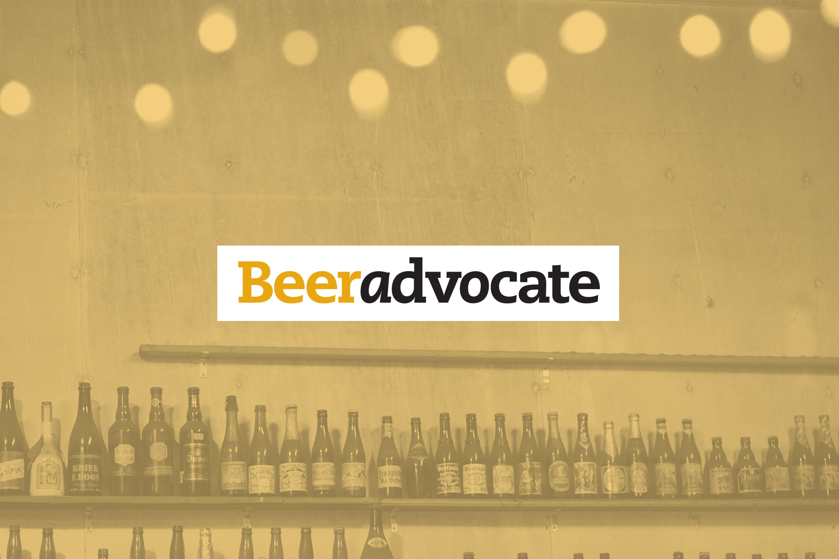
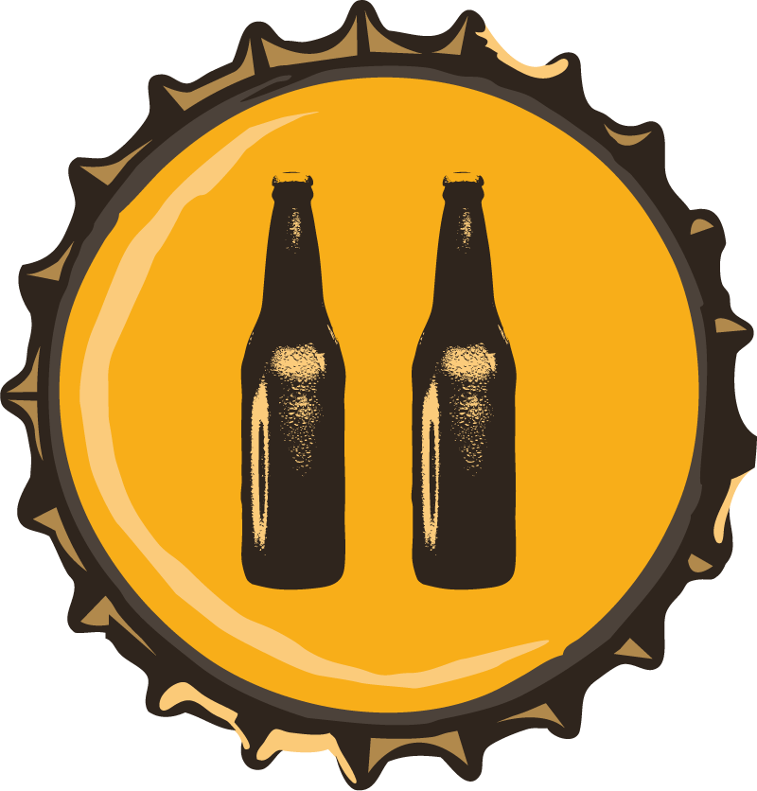
David De Vega Martin

Slide 2


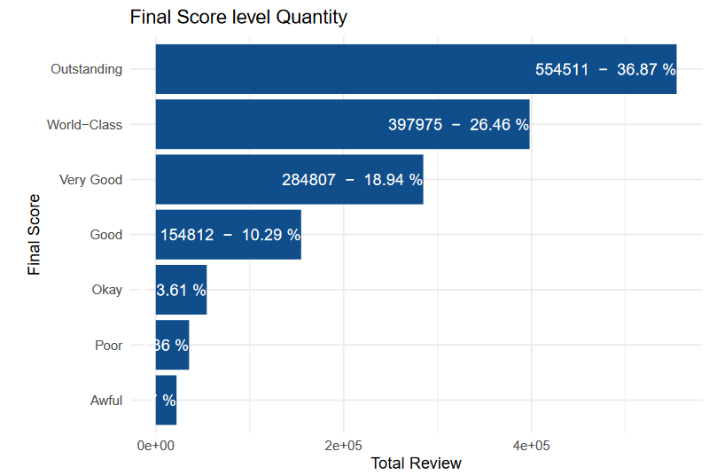
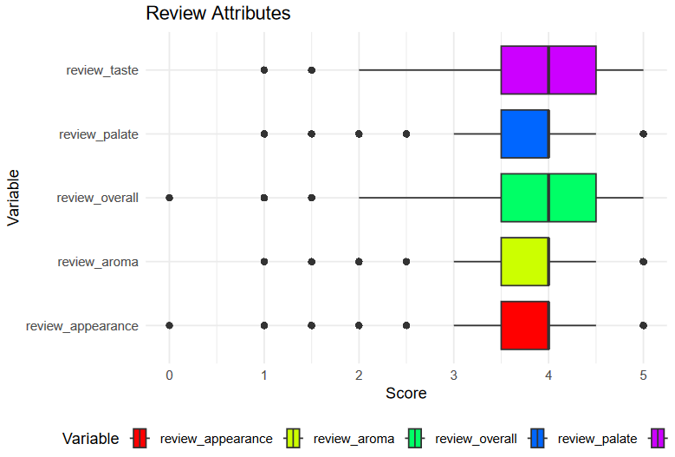
The Beer-Review dataset comprises approximately 1.5 million beer reviews with 13 distinct attributes. The data is sourced from the Beer Advocate forum, where users evaluate beers based on five key criteria:
aroma, appearance, palate, flavor, and an overall global rating. Scale from 0 to 5.
Classification : World-Class [4.50 - 5.00], Outstanding [4.00 - 4.49], Very Good [3.75 - 3.99], Good [3.50 - 3.74],
Okay [3.00 - 3.49], Poor [2.00 - 2.99], Awful [0 - 1.99]
Additionally, the dataset includes supplementary information such as the beer’s name, overall rating, type, alcohol content (ABV), and the username and company behind each review.
Location: https://www.kaggle.com/datasets/thedevastator/1-5-million-beer-reviews-from-beer-advocate/code
Dataset Overview
Total Reviews: 1,5 million
Total Beers: 49,000
Beer Types: 14
Beer Subtypes: 104
Total Users: 32,908
Total Breweries: 5,155

Slide 3
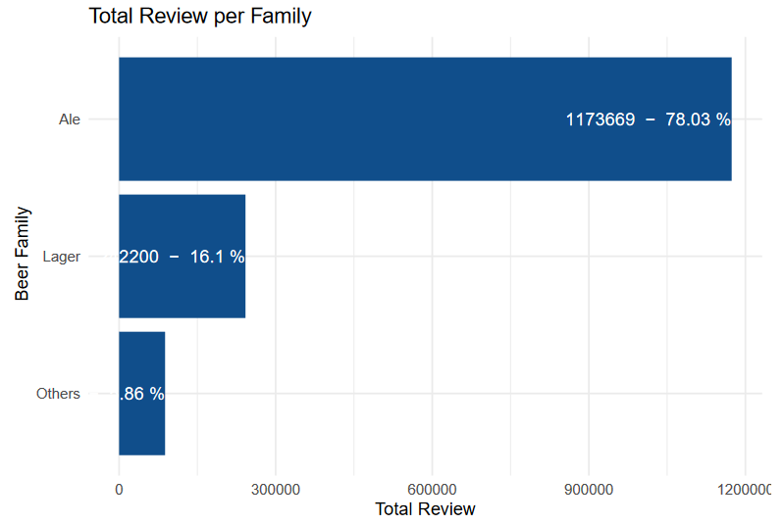
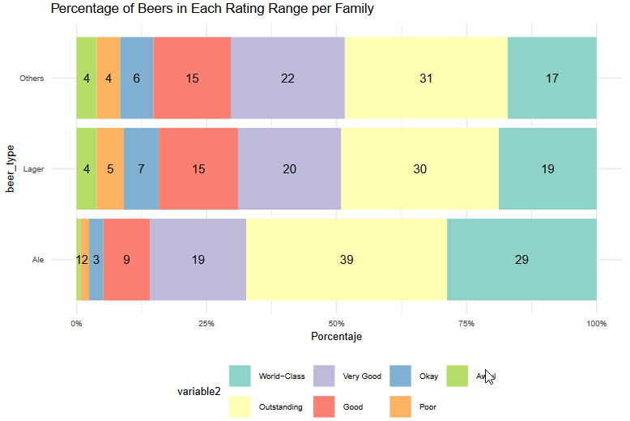
Number reviews and percentages by Beer Type

Slide 4
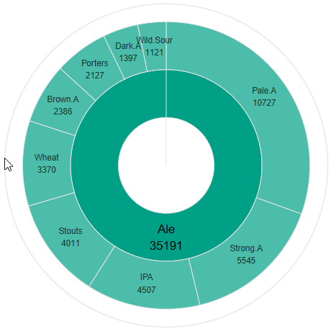
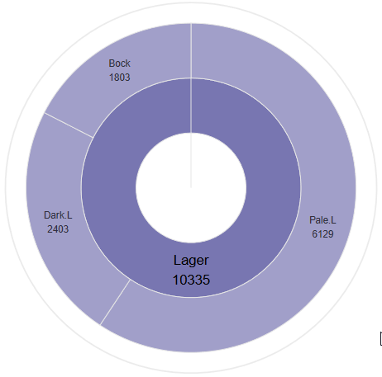
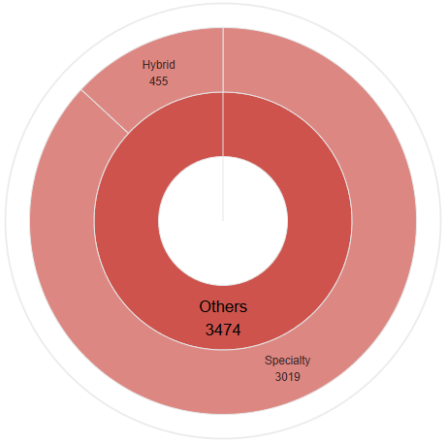
Beer Types: Ale, Lager & Others. 3.
Beer Subtypes 14. (All Beer subtypes are described in Main Explanatory Report).
| Total Beers: 35,191 | Beer Types: 9 |
| Beer Subtypes: 64 | Total Users: 29,381 | | Total Companies: 4,141 |
| Total Beers: 10335 | Beer Types: 3 |
| Beer Subtypes: 24 | Total Users: 16,712 | | Total Companies: 2,895 |
| Total Beers: 3,474 | Beer Types: 2 |
| Beer Subtypes: 16 | Total Users: 11,558 | | Total Companies: 1,480 |

Slide 5
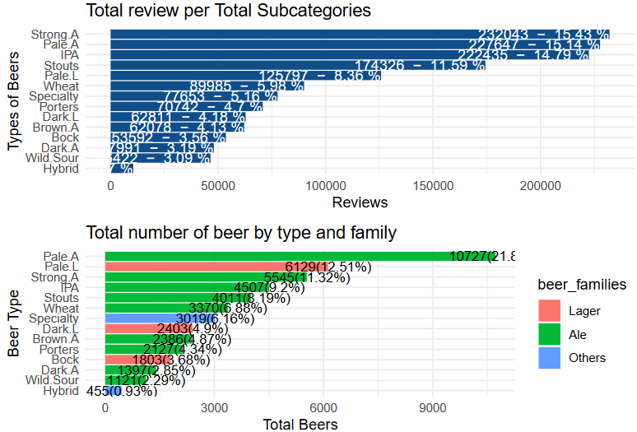

Slide 6
Overview of Beer Reviews and Popular Types
High Ratings in Beer Reviews
A remarkable 92% of beer reviews give a rating of "good" or higher, indicating a strong positive reception across the board.
Beer Types by Popularity
Ale: Dominates the market, making up approximately 78% of all reviews, positioning it as the most popular category.
Lager: Accounts for 16% of reviews, with a steady but smaller consumer base.
Other Types: Represent 6% of reviews, indicating a niche audience interested in occasional, exploratory consumption.
Top Reviewed Ale Types (50% of All Reviews)
Strong Ale: Most reviewed type, comprising 20% of all reviews.
Pale Ale: Represents about 10% of reviews.
IPA: Also accounts for around 10% of reviews.
Stout: Similar popularity to Pale Ale and IPA, with roughly 10% of reviews.
Most Consumed Ale Variants
Pale Lager: The most consumed ale, matching top ale types with 10% of total consumption.
Dark Lager: Though popular, represents less than 5% of total ale consumption.
Other Beers and Specialty Types
Specialty beers in the Others category make up around 5% of total reviews, attracting a small but dedicated consumer group.

Slide 7
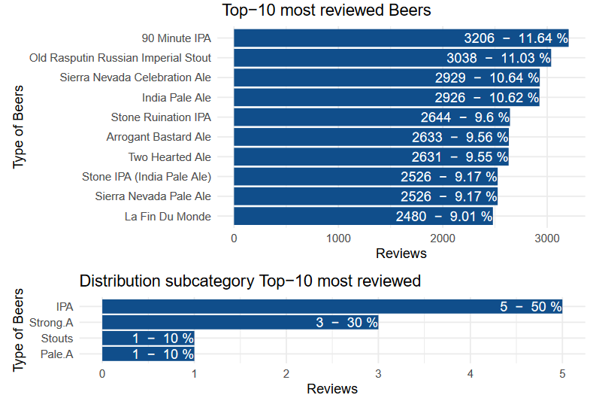
Top 10 Most Reviewed Beers I

Slide 8
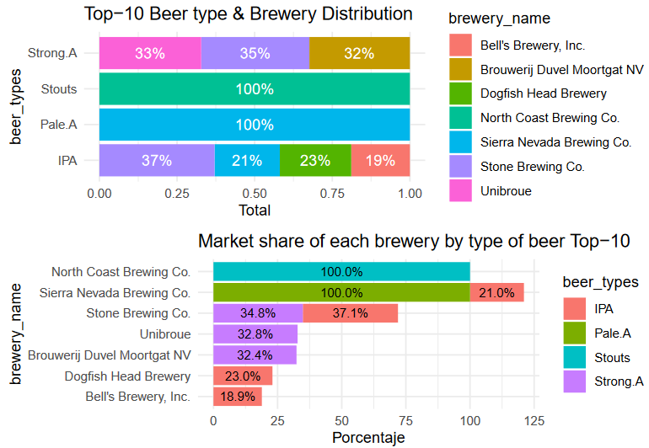
Top 10 Most Reviewed Beers II

Slide 9
Analysis of the Top 10 Most Reviewed Beers
Review Range and Percentage
The top 10 beers each have between 2,500 and 3,000 reviews.
These represent approximately 9% to 11% of all reviews, underscoring their popularity.
Beer Types in the Top 10
IPA: Holds a strong presence with 5 of the top 10 beers.
Strong Ale: Represented by 3 beers, highlighting its popularity within ale types.
Stout: One stout beer stands out, reinforcing its niche appeal.
Pale Ale: One pale ale also makes it to the top 10 list.
Overall, the top 10 list is entirely dominated by Ale types, showcasing the consumer preference
for this category.
Leading Companies in the Top 10 Beers
North Coast Brewing: Leads the market in the stout category, standing out as a unique stout provider.
Sierra Nevada: Commands the pale ale market entirely and holds a moderate share in the IPA category.
Stone Brewing: Significant presence with major shares in both the strong ale and IPA segments.
Other Participants: Maintain standard shares across the categories, contributing to the ale-dominated
landscape.

Slide 10
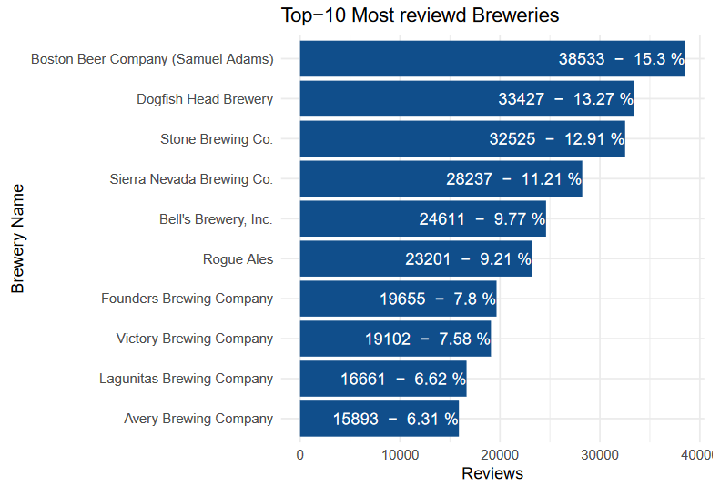
Top 10 Most Reviewed Breweries (Analyzes Only the Top 3)

Slide 11
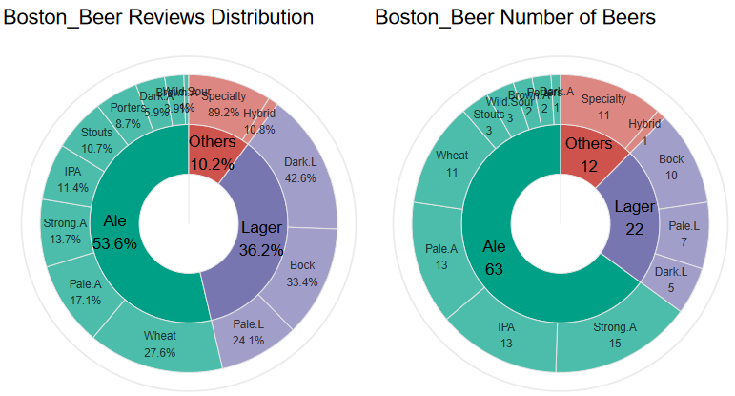
Boston Beer:
| Description | Total Beers: 97 | Beer Types: 14 | Beer Subtypes: 50 | Total Users: 7250

Slide 12
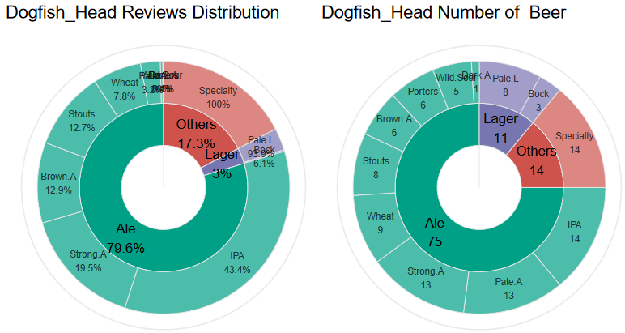
Dogfish Head Brewery:
| Description | Total Beers: 100 | Beer Types: 12 | Beer Subtypes: 50 | Total Users: 8096

Slide 13
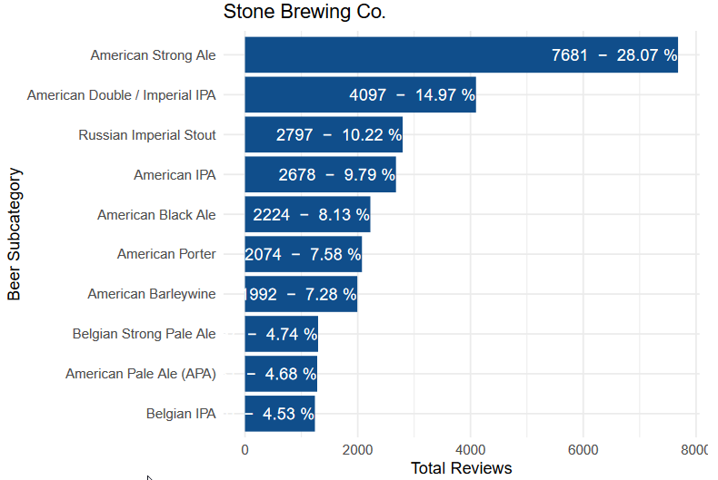
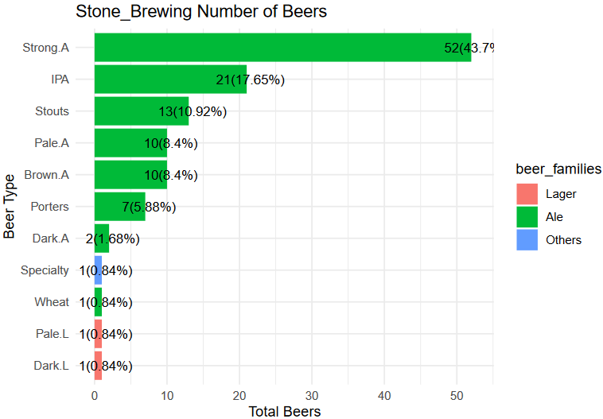
Stone Brewing Co:
| Description | Total Beers: 100 | Beer Types: 12 | Beer Subtypes: 50 | Total Users: 8096

Slide 14
Summary: Top 10 Craft Beer Breweries by Market Review Volume
Volume of Reviews and Relevance:
The top 10 breweries each hold between 38,000 and 15,000 reviews.
Together, they represent 15% to 6% of the top 10 market’s total reviews, indicating significant influence.
Analysis of Leading Breweries:
Boston Beer - Diversified Portfolio Strategy
Portfolio: 97 beers across the main categories (Ales, Lagers, and Specialty Beers).
Success: Achieves broad popularity without relying on individual flagship products.
Goal: Appeals to a wide range of customers, ensuring market stability with a variety of styles.
Dogfish Head Brewery - Innovation and Focus on Ales
Portfolio: 100 beers, primarily focused on Ales, especially IPAs and Strong Ales.
Strategy: Emphasis on strong, experimental beers that attract craft beer enthusiasts.
Focus: Concentrates reviews on a select group of intense, unique beers that act as flagship products.
Stone Brewing Co. - Flagship Product Concentration Strategy
Portfolio: 30 beers, mainly Ales with a strong emphasis on IPA and American Strong Ale.
Strategy: High review concentration on a few flagship products, attracting a loyal niche audience.
Goal: Establish a strong market presence with a limited but highly in-demand offering,
solidifying their position in the intense beer segment.

Slide 15
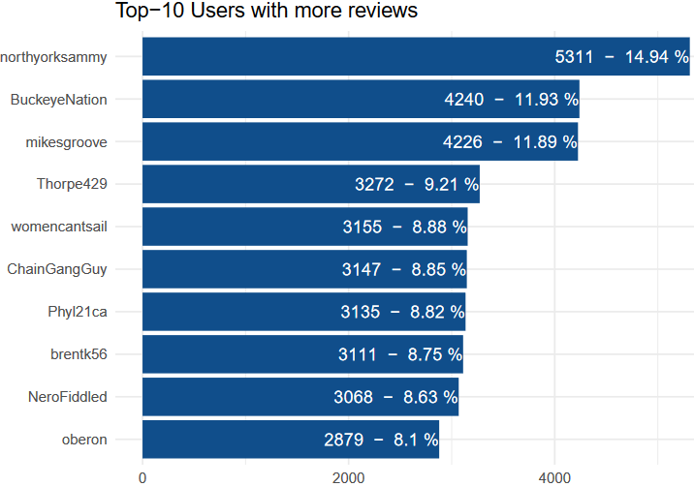
Top 10 Reviewers (Analyzes Only the Top 3)

Slide 16
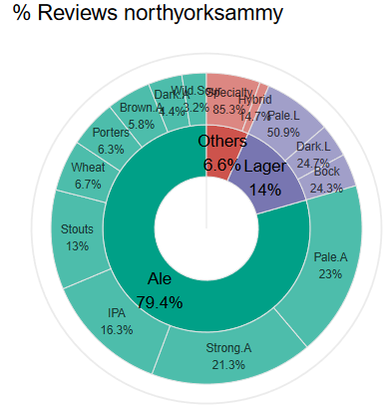
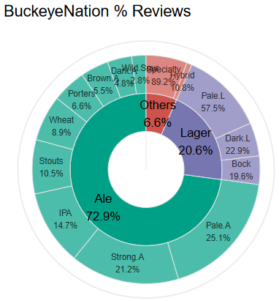
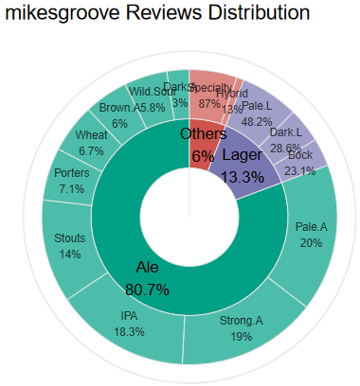
Top 3 Reviewers
| Description | Total Beers: 5311 | Beer Types: 14 | Beer Subtypes: 103 |
| Description | Total Beers: 4240 | Beer Types: 14 | Beer Subtypes: 104 |
| Description | Total Beers: 4226 | Beer Types: 14 | Beer Subtypes: 104 |

Slide 17
Top Beer Reviewers’ Profiles: Key Insights
1. NorthYorkSammy
Ales: With 79.4% of reviews focusing on Ale, NorthYorkSammy shows a strong inclination toward rich and complex flavors. Within Ales, there’s a preference for:
Pale Ales (23%): Balanced and lightly bitter, suiting varied occasions.
Strong Ales (21%): Full-bodied and higher in alcohol, suggesting enjoyment of bolder flavors.
IPAs (16%): Known for intense hops and aroma, highlighting a taste for bitter profiles.
Stouts and Porters (13% and 6%): Preferences here suggest enjoyment of deep, malt-driven flavors with notes of coffee or chocolate.
Lagers: Representing 14%, mostly Pale Lagers (51%), which offer lighter, refreshing tastes. Occasional Dark Lager and Bock preferences show an appreciation for more malted Lager options.
Others: Specialty beers make up 6.5%, indicating occasional interest in unique or experimental flavors.
2. BuckeyeNation
Ales: Comprising 72.9% of reviews, BuckeyeNation’s preferences are diverse within Ales:
Pale Ales (25%) and Strong Ales (21%): Reflecting a taste for balanced yet robust profiles.
IPAs (15%) and Stouts (10%): Points to a liking for both hop-driven bitterness and rich, dark notes.
Wheat Ales (8.9%) and Porters (6.6%): Lighter but flavorful options that add variety to their profile.
Lagers: Second choice at 20.6%, primarily Pale Lagers (57%), but also Dark Lager and Bock for richer maltiness.
Others: Specialty styles make up 6.5%, revealing interest in exclusive, experimental offerings.
3. MikesGroove
Ales: Dominating with 80.7%, preferences span from lighter Pale Ales (20%) to strong, hoppy IPAs (18%).
Significant interest in Strong Ales and Stouts (14%) shows a penchant for richer, heavier styles.
Lagers: Making up 13.3% of reviews, primarily Pale Lagers (48%), but also richer Dark Lagers and Bocks.
Others: Specialty beers are 6%, showing a curiosity toward unique, limited-edition offerings.

